Slide 1
Emre Cakmak
ToDO LIST APPLICATION

Slide 2
Introduction
The Objective:
Build a Todo List Application
To Demonstrate:
Agile & Project Management
Databases & Cloud Fundamentals
Programming & Testing Fundamentals
Front-End Web Technologies
Consultant Journey
API Development
Automated Testing

Slide 3
Consultant Journey
Technologies learned
HTML, CSS, JavaScript
SQL
Java & Unit/Integration Testing
Maven
JUnit
Spring
User-Acceptance Testing:
Selenium
Static Analysis:
SonarQube

Slide 4
Risk Assessment

Slide 5
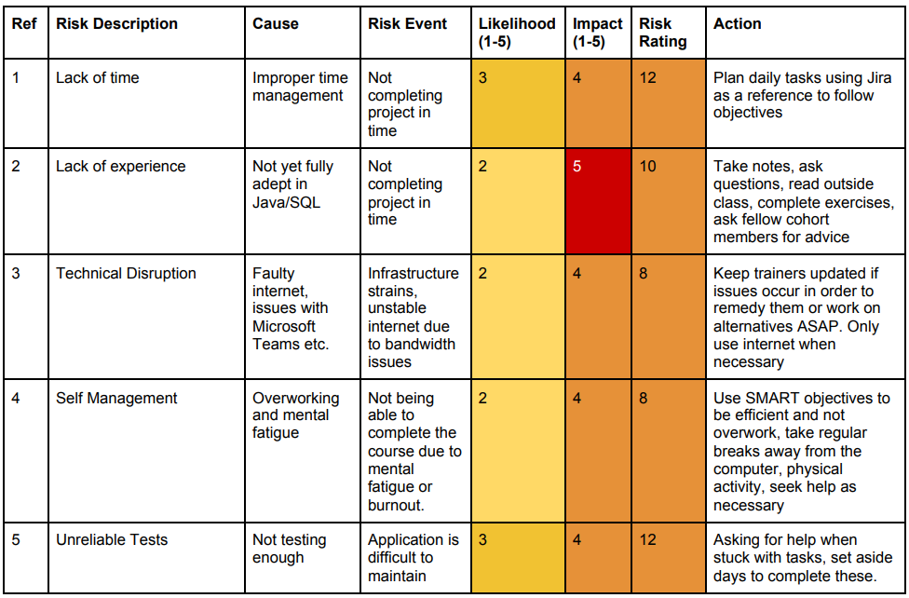
Risk Assessment – Initial Scores and Actions

Slide 6
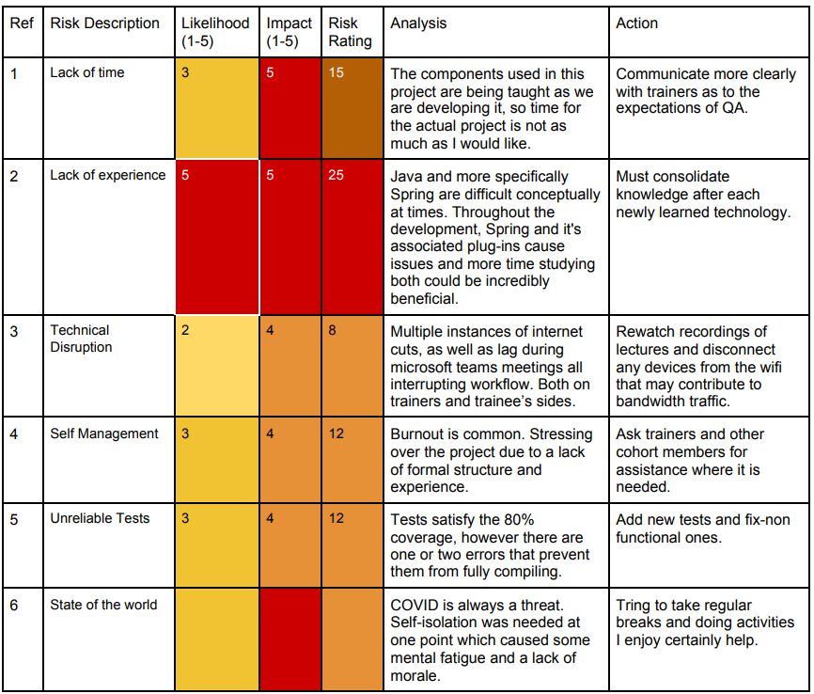
Risk Assessment – Intermediary Scores/Actions

Slide 7
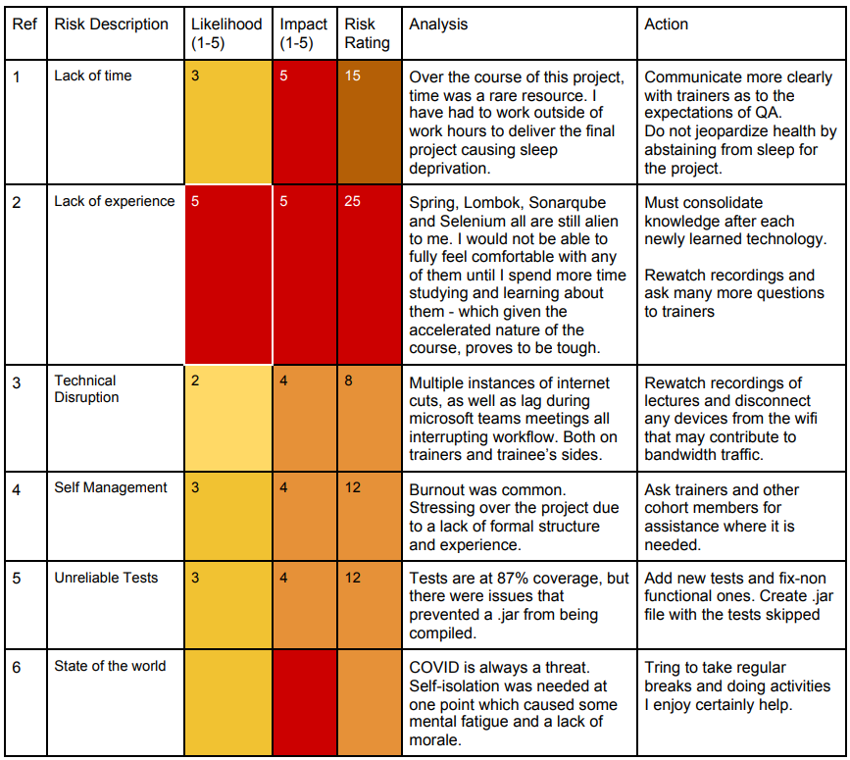
Risk Assessment – Final Scores/Actions

Slide 8
Project Management
Jira
UMLs
User Stories
MoSCoWs

Slide 9
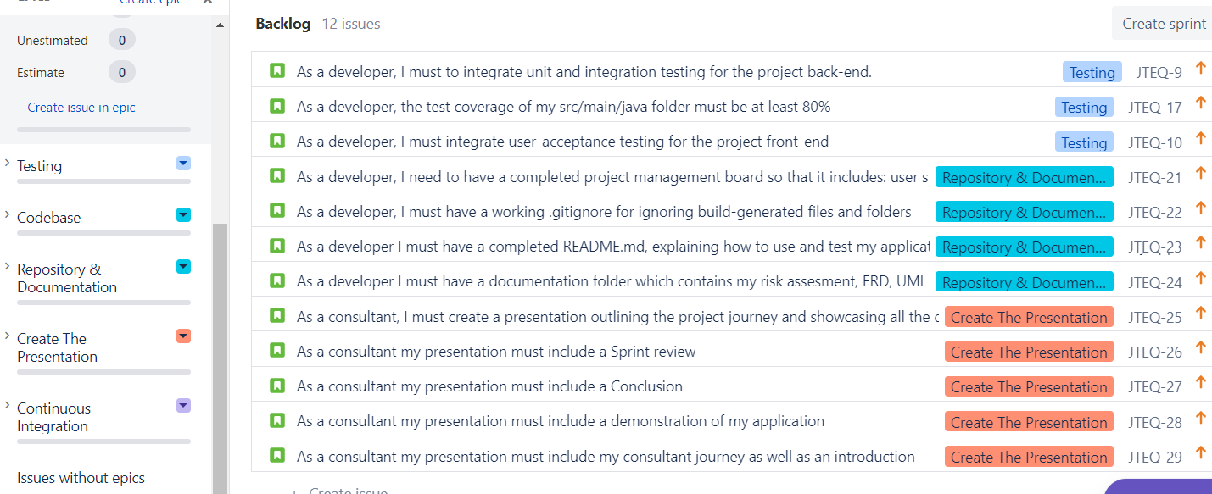
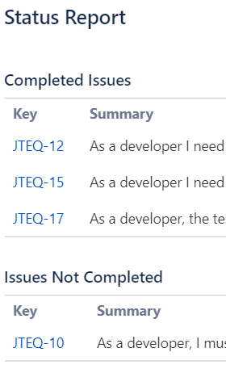
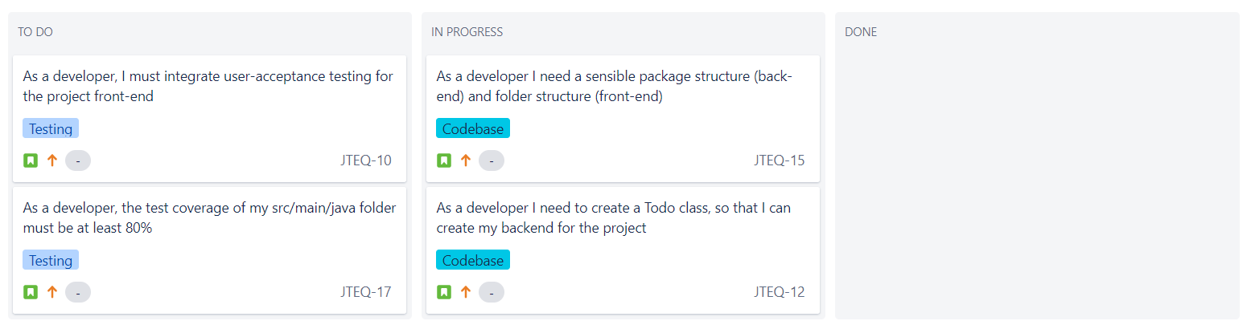
Jira Board

Slide 10
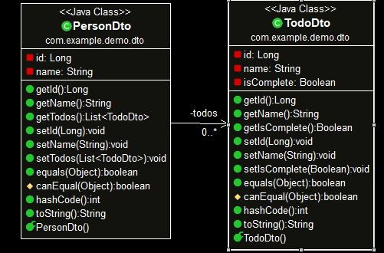
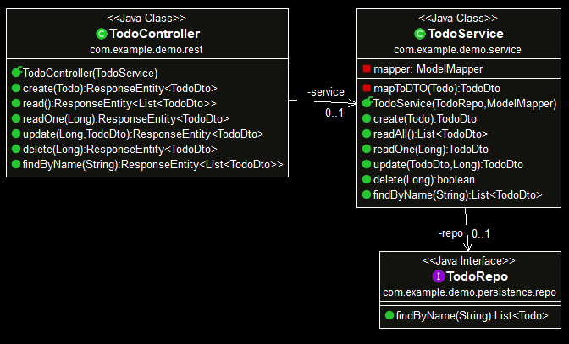
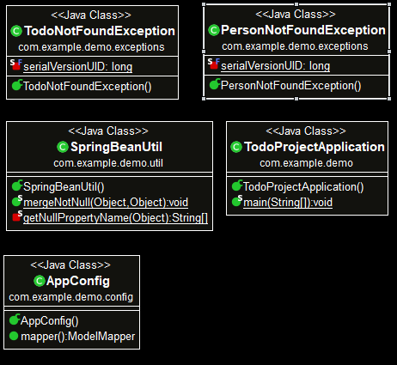
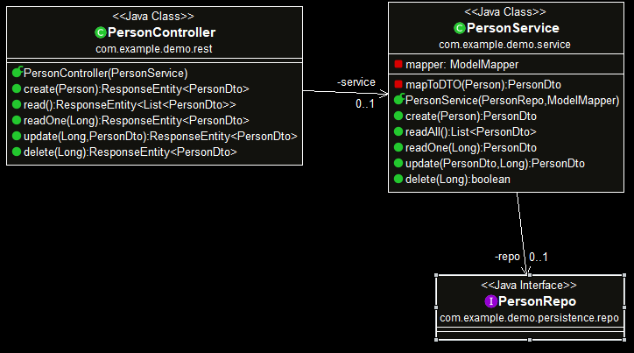
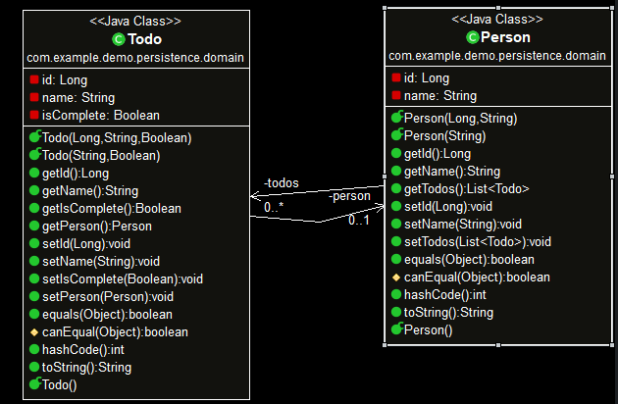
UMLs

Slide 11
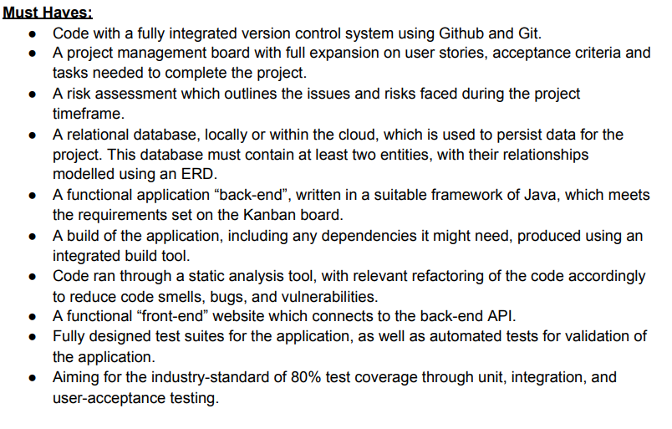
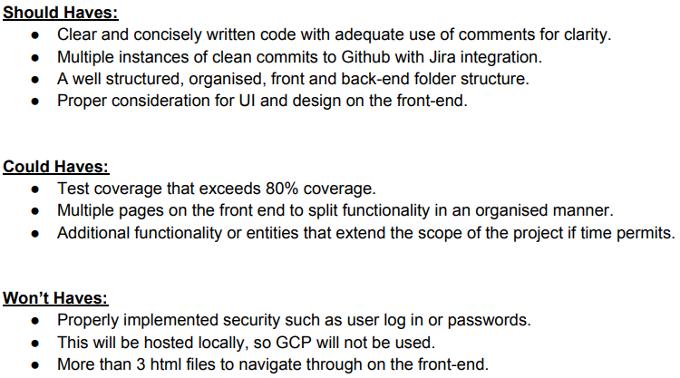

Slide 12
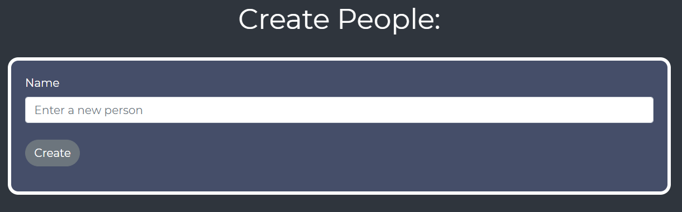
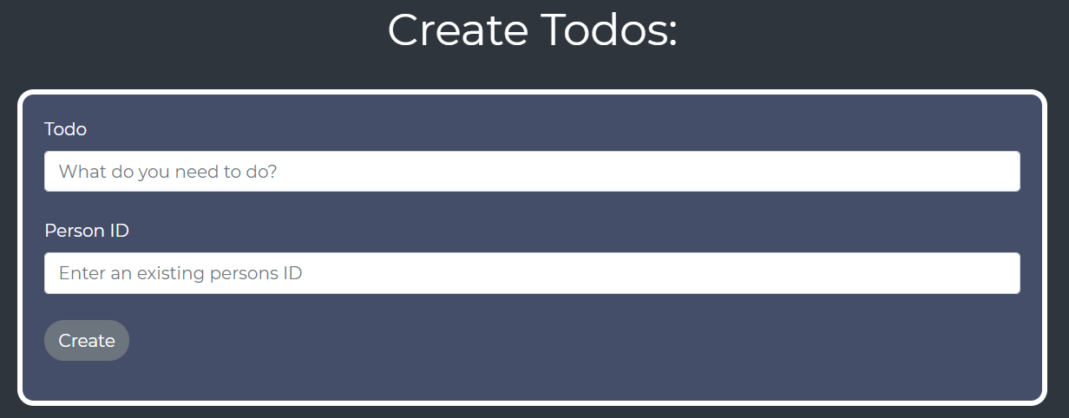
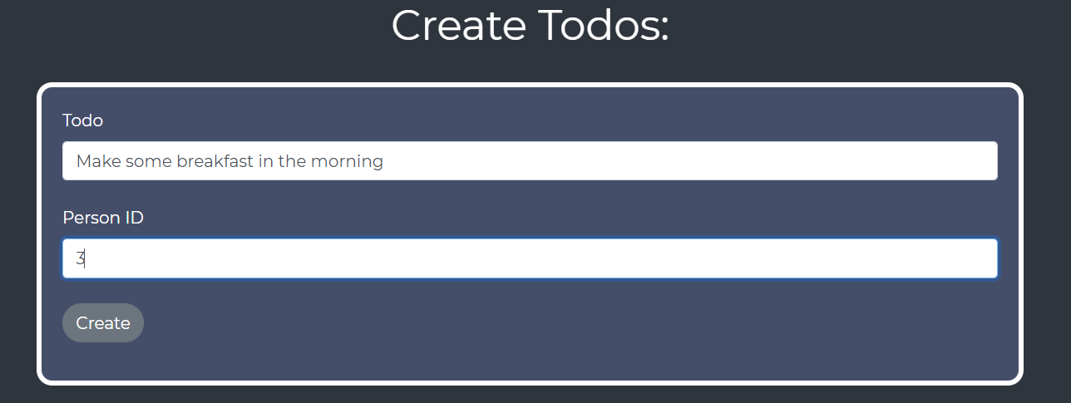
Customer user stories

Slide 13
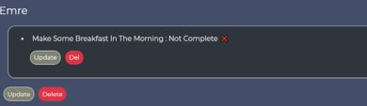
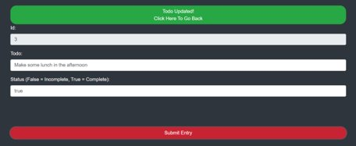
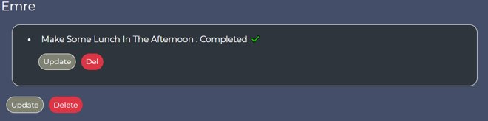

Slide 14
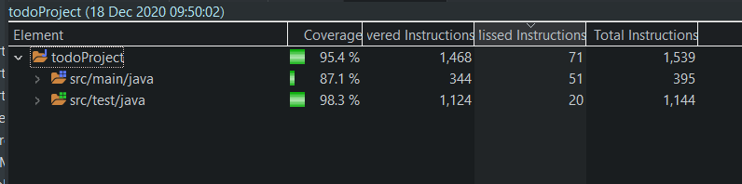
Testing

Slide 15
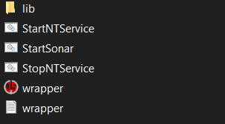
Selenium and SonarQube Issues
SonarQube installation issues:
StartSonar file would not implement the proper processes due to it thinking localhost:9000 being "used"
Lack of Selenium/ Front-End Testing
Due to time constraints
Lack of experience
Will revisit in the future

Slide 16
Retrospective - Sprint Review
What went wrong?
Time constraints
Lack of experience
Incomplete Front-End Testing
What went right?
The application is fully functional and looks aesthetically pleasing
I learned a lot, even if there is room for improvement
Given an extra week, the Front-End testing could easily be completed
SonarQube installation issues.

Slide 17
Final Conclusion
The project is fully functional with good design
Implementation of Integration and Unit testing; Test coverage was at 80%+
For the future, proper implementation of Front-End testing
Successful .jar build
Reinforced Front-End knowledge

