Slide 1

Kaminsky Attack
DNS Cache Poisoning
Theoretical Overview & Step-by-Step Practical Setup
Emre Topcu - 20220808011
Muhammed Kaan Uman - 202208080603

Slide 2


The Caching Effect & The Problem
•
The Goal: DNS Cache Poisoning aims to forge a response to misdirect users to a malicious server.
•
The Hurdle: To succeed remotely, the attacker must perfectly guess the 16-bit Transaction ID (TXID).
•
The Caching Effect: If guessed incorrectly, the legitimate response arrives first and is cached by the resolver.
•
The Lockout: Once the authentic record is cached, the attacker is completely locked out until the record's Time-To-Live (TTL) expires.

Slide 3


The Kaminsky Breakthrough
Random Subdomains
Continuous Exploitation
Dan Kaminsky bypassed the TTL caching effect entirely by querying non-existent, randomly generated subdomains (e.g., aaaaa.example.com).
This simple adjustment opens an infinite vulnerability window. It grants the attacker unlimited attempts to flood the server with spoofed responses.
Because the queried subdomain is guaranteed not to be in the cache, the local server is forced to forward the query to the authoritative server every single time.
By continually guessing the 16-bit TXID rapidly, the attacker can poison the cache and hijack the entire domain's authority.

Slide 4
SEED Labs Environment Setup
Entity Container | IP Address | Network Role & Architecture
Attacker | 10.9.0.1 | Operates in host mode. Grants full access to network interfaces for packet manipulation and high-speed flooding.
User (Victim) | 10.9.0.5 | The victim machine utilized strictly to trigger the catalyst recursive DNS queries.
Local DNS Server | 10.9.0.53 | The target resolver running BIND 9. (Note: DNSSEC is disabled for the scope of this demonstration).
Attacker NS | 10.9.0.153 | The malicious authoritative server hosting the attacker32.com zone.

Slide 5
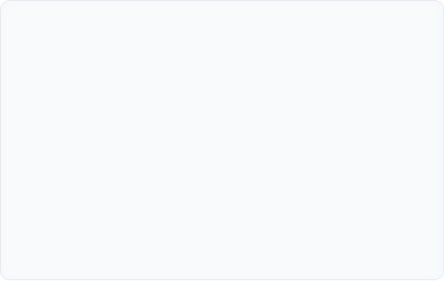

Target Reconnaissance
•
In a remote attack, the spoofed UDP packet must perfectly mimic the legitimate authoritative nameserver.
•
The target DNS server will instantly drop any response where the Source IP does not exactly match the IP it originally queried.
•
We execute dig @10.9.0.53 example.com NS to map the network.
•
Discovery: Requests are forwarded to Cloudflare's nameservers. This IP address is captured for hardcoding into our malicious payload's IP Layer.

Slide 6






The Hybrid Payload Strategy
Scapy Templates
High-Speed C
Fixed UDP Port
Python's Scapy library is convenient but inherently too slow for a microsecond race condition. We use it instead to serialize a perfect, forged payload into raw binary files.
A custom C program loads these binaries into memory. It operates a rapid loop, dynamically overwriting the random 5-char string and incrementing the TXID to flood the network.
Source Port Randomization (SPR) is disabled in our lab setup. The query port is fixed at 33333, reducing our required entropy strictly to the 16-bit TXID.

Slide 7
Crafting the Spoofed Packet Architecture
Question Section: Configured to query a random 5-character subdomain (e.g., abcde.example.com) to bypass existing cached records.
Answer Section: Provides a fake IP resolution mapping the queried random subdomain to a malicious IP like 1.2.3.4.
Authority Section (The Kill Switch): This is the critical step. It injects a poisoned NS record, explicitly replacing example.com's actual nameserver with ns.attacker32.com.
IP Layer Spoofing: The Source IP is explicitly forged as the legitimate Cloudflare IP identified during our reconnaissance phase.

Slide 8


The Race Condition
Winning the Microsecond Sprint
The core of the execution relies on pure probability and network speed. Our C program rapidly iterates through 3,000 packets per trigger.
At specific memory offsets, the payload dynamically modifies the subdomain string (offsets 41, 64) and the TXID (offset 28).
To win the transaction ID race, our forged packet must hit the Local DNS resolver and match the query state precisely before Cloudflare's legitimate response arrives.

Slide 9
Orchestrating the Attack (Multi-Terminal)
Terminal 2: Flood
Reset & Repeat
Execute ./attack. The script injects thousands of spoofed UDP packets blindly per second.
Race conditions are probabilistic. If Cloudflare wins, we repeat the exact sequence until successful.
Terminal 1: Purge
Terminal 3: Trigger
Execute rndc flush on the Local DNS to ensure the server initiates a fresh recursive query.
Execute dig @10.9.0.53 from User. Prompts the local DNS, opening the vulnerability window.

Slide 10
Verifying the Poisoned Cache
1. User Terminal Result
2. Database Cache Dump
Upon winning the race, the dig command on the User machine immediately returns the spoofed IP (1.2.3.5) instead of the authentic Cloudflare IP.
Executing rndc dumpdb-cache on the target reveals the ultimate payload objective.
The cache explicitly shows example.com is assigned to ns.attacker32.com with a TTL of 3 Days. All subsequent traffic for the entire domain is effectively hijacked.
A Wireshark trace will confirm our flood of UDP responses and visualize the moment the Local DNS server accepted our packet and dropped the late legitimate response.

Slide 11
Live Demonstration
Transitioning to Code Execution Phase

