Slide 1
Report: Big Mountain Resort
Emre Yuce • 06/17/2024

Slide 2
Problem Identification
Problem Statement
Operational Cost Increase: +$1,540,000 after new chair.
Revenue Goal: Increase revenue by 10%.
Possible Solutions
Increase Ticket Price: Best value option.
Cut Costs: Without undermining ticket prices or to support a higher ticket price.
Timeline:
Deadline: Before the upcoming season tickets are released.
Constraints with solution space:
Operational Impact: Slowing or ending any operations could cause speculation in the media about Big Mountain Resort.
Employment Risks: Reducing operations might result in terminating some employment positions, potentially exposing the company to legal issues.
Data Availability: Assess if current data is sufficient; gather additional data if necessary.

Slide 3
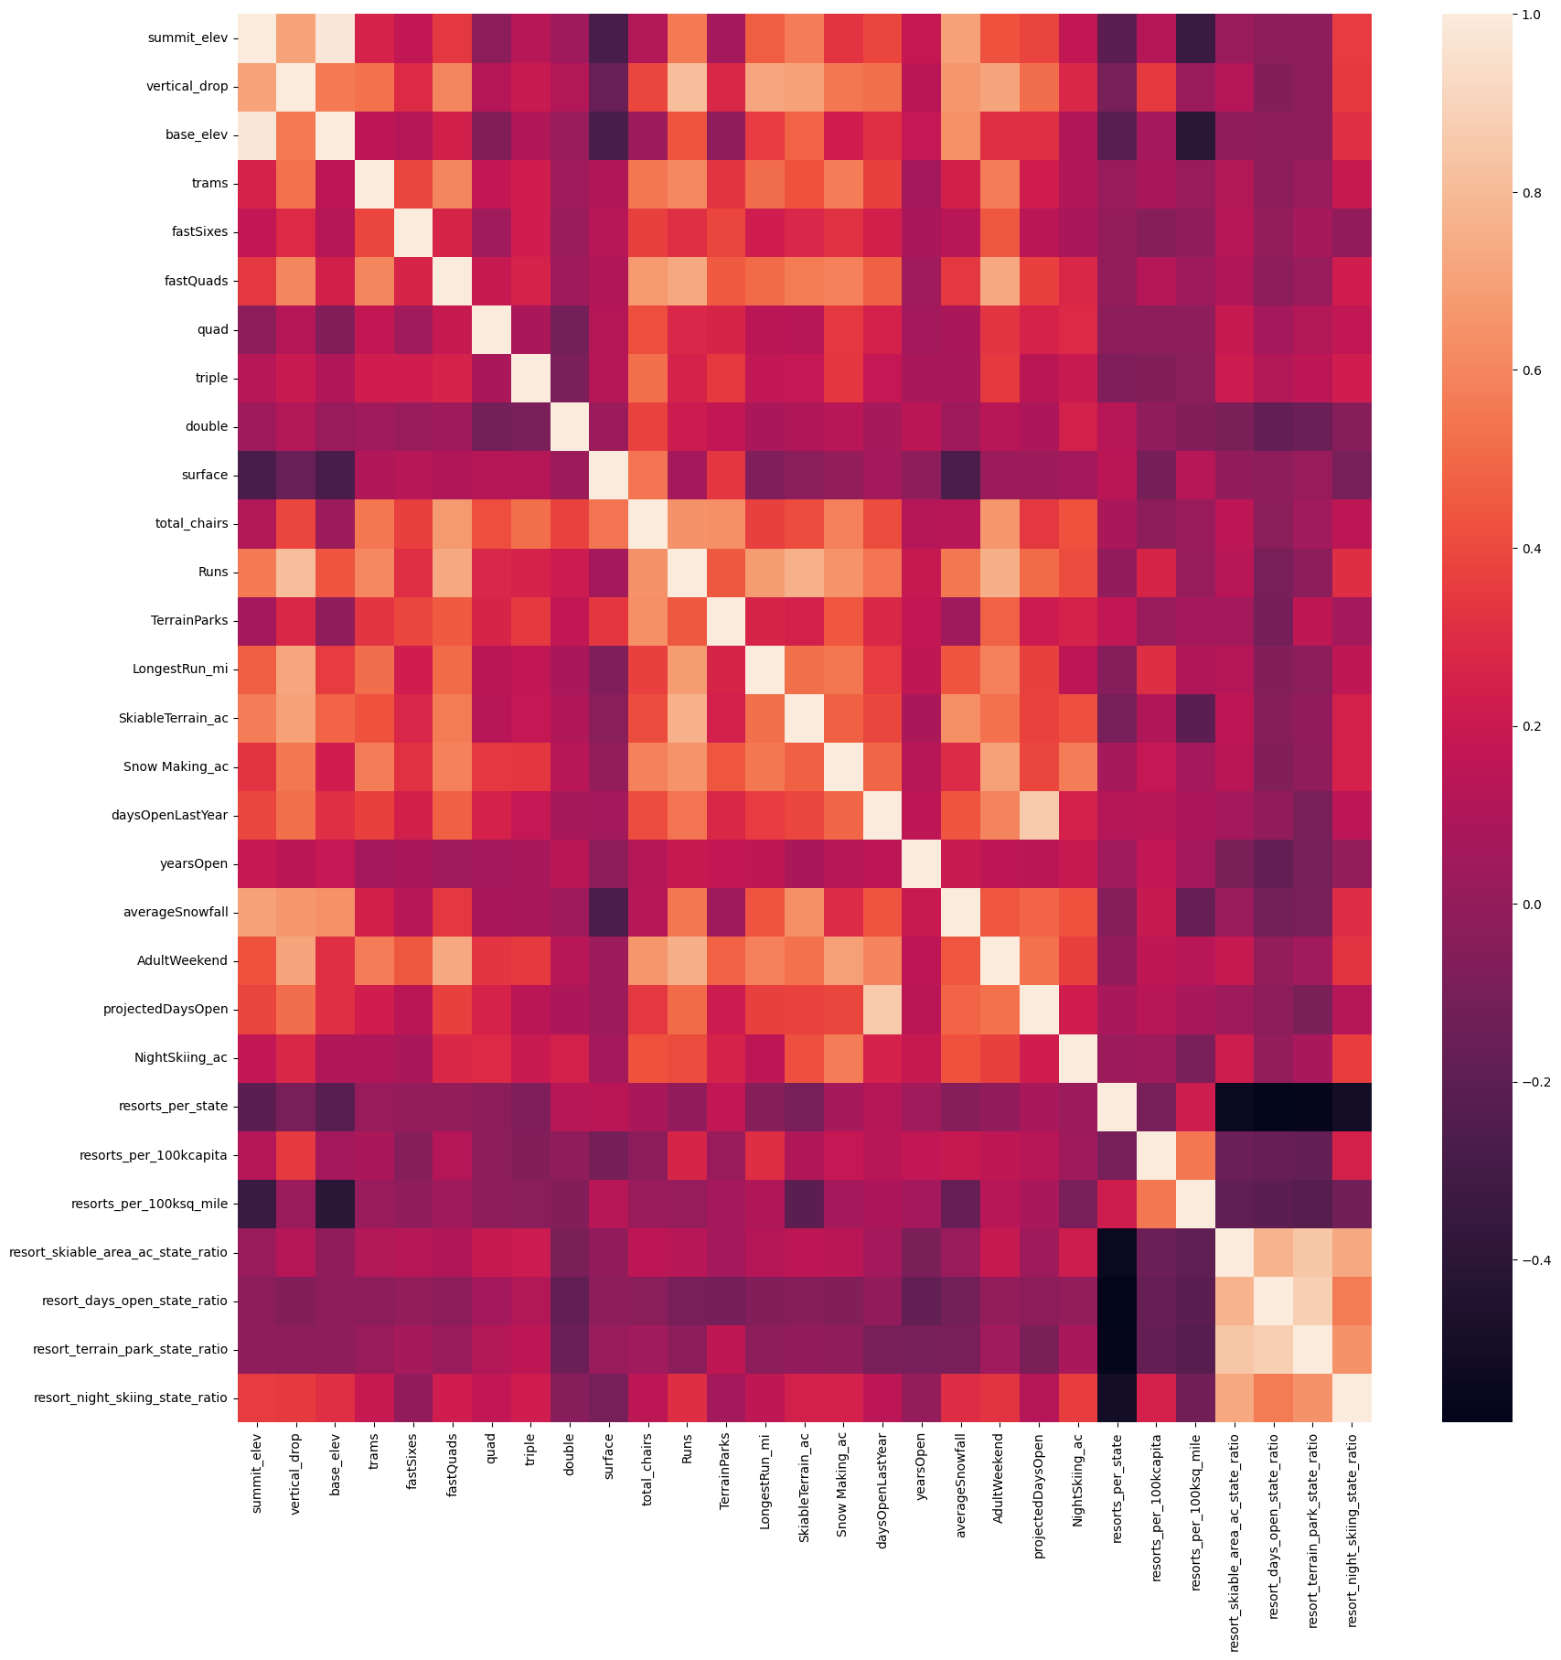
Key Findings
Correlation: After cleaning and organizing our data, we were able to see the relationship between the features and the ticket price at a glance.
Top 5:
Vertical Drop
Fast Quads
Runs
Total Chairs
Resort-Population Ratio

Slide 4
Modeling
Ticket Price Prediction for Big Mountain Resort
Predicted Ticket Price: Our model predicts a ticket price of $95.87.
Recommendation: Considering the model's absolute error, we confidently recommend setting the ticket price at $85.58.
Revenue Impact:
Price Increase per Ticket: $4.58
Number of person per year: 350,000
Number of ticket per person:5
Total Revenue Increase:
$4.58 * 350,000 * 5 = $8,015,000 ⬆
Projected Revenue Growth:
This adjustment translates to a 5.65% increase in revenue. 🚀
What Model We Used?
We experimented with various scaling methods and models to minimize prediction error. The Random Forest algorithm yielded the best results, achieving an absolute error of $10.39.

Slide 5
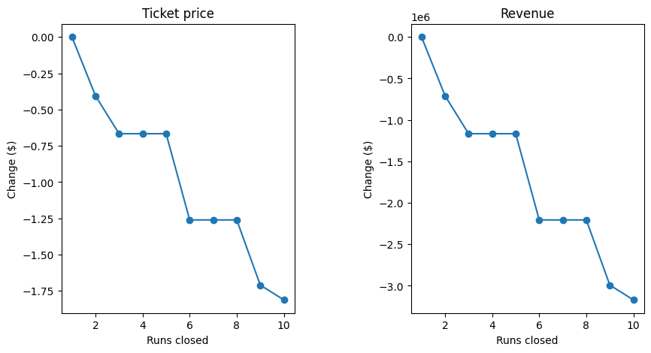
We Found a Treasure!
Cost-Saving Opportunity
Big Mountain Resort can close a run with no cost on Ticket Price.
Daily Savings: By closing one run, Big Mountain Resort can save approximately $1,500* per day.
That will have no impact on the ticket price!
*$1,500 is a our guess for cost of one run..

Slide 6
How much will be saved?
1500 x 123* = $184,500
Per Year
*Big Mountain Resort was open 123 days past year.

Slide 7
Next steps
Now that we understand the impact of each operation on the ticket price, we can make more informed decisions. By analyzing the cost of each operation at Big Mountain Resort together with you, we can strategically decide where and how much to cut from operations to optimize efficiency and maintain profitability.

Slide 8
Summary & Conclusion
We have determined the optimal ticket price range for Big Mountain Resort.
We have identified the key features of the resort that significantly impact ticket pricing.
By continuing to work closely with Big Mountain Resort, we can further refine our strategies to optimize and maximize revenue.
Implementing these insights will ensure we achieve our financial goals while maintaining an excellent guest experience.

