Slide 1


MINISTRY OF JHARKHAND
SIH1369
Online integrated platform for projects taken up by the student of various universities/college
TABLE 21
VAISHNAVI CHATURVEDI
C-46141
ABES INSITUTE OF TECHNOLOGY
Smart Education
ORGANISATION NAME:
PS Code:
Problem Statement Title:
Team Name:
Team Leader Name:
Institute Code (AISHE):
Institute Name:
Theme Name :
SMART INDIA HACKATHON 2023

Slide 2
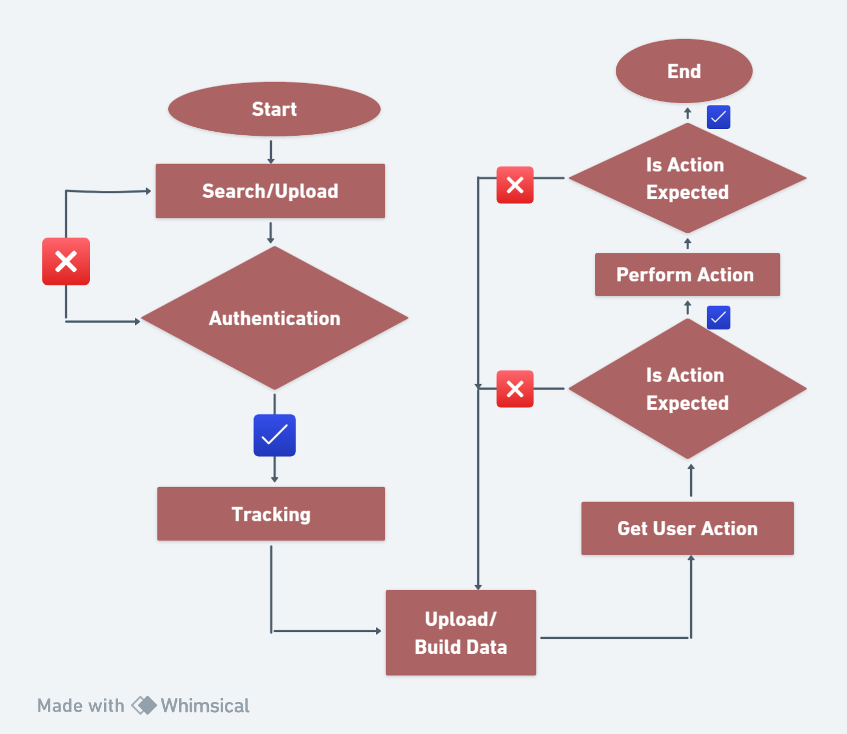
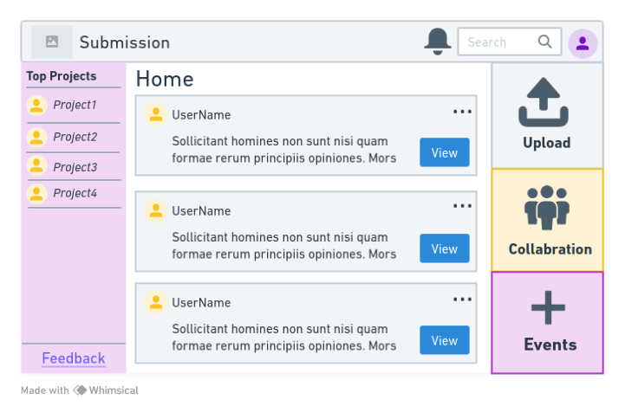
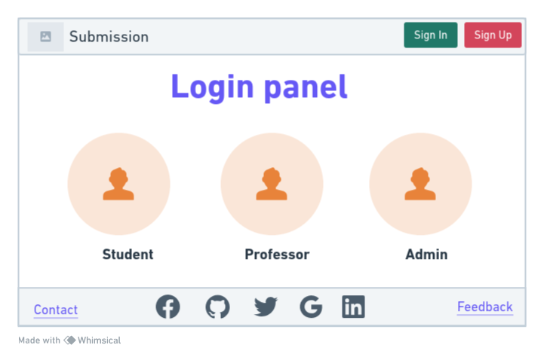





INSTANCE OF APPROACH
FLOW CHART
Assemble your portal team.
Decide on your development approach.
Plan for portal content integration.
Identify the tools and services your portal requires.
Define the basic organizational scheme for your portal.
Design a consistent layout and look for your portal pages.
Define security needs your portal, its pages, and resources.
Decide which applications may need to be integrated into the portal.
PORTAL’S APPROACH
PEOPLE INTEGRATION
MULTI-CHANNEL ACCESS
Portal
Collaboration
INFORMATION INTEGRATION
Business
Intelligence
Knowledge
Management
PROCESS INTEGRATION
Integration
Broker
Business Process
Management
LAYOUT
TECHNOLOGY STACK

Slide 3
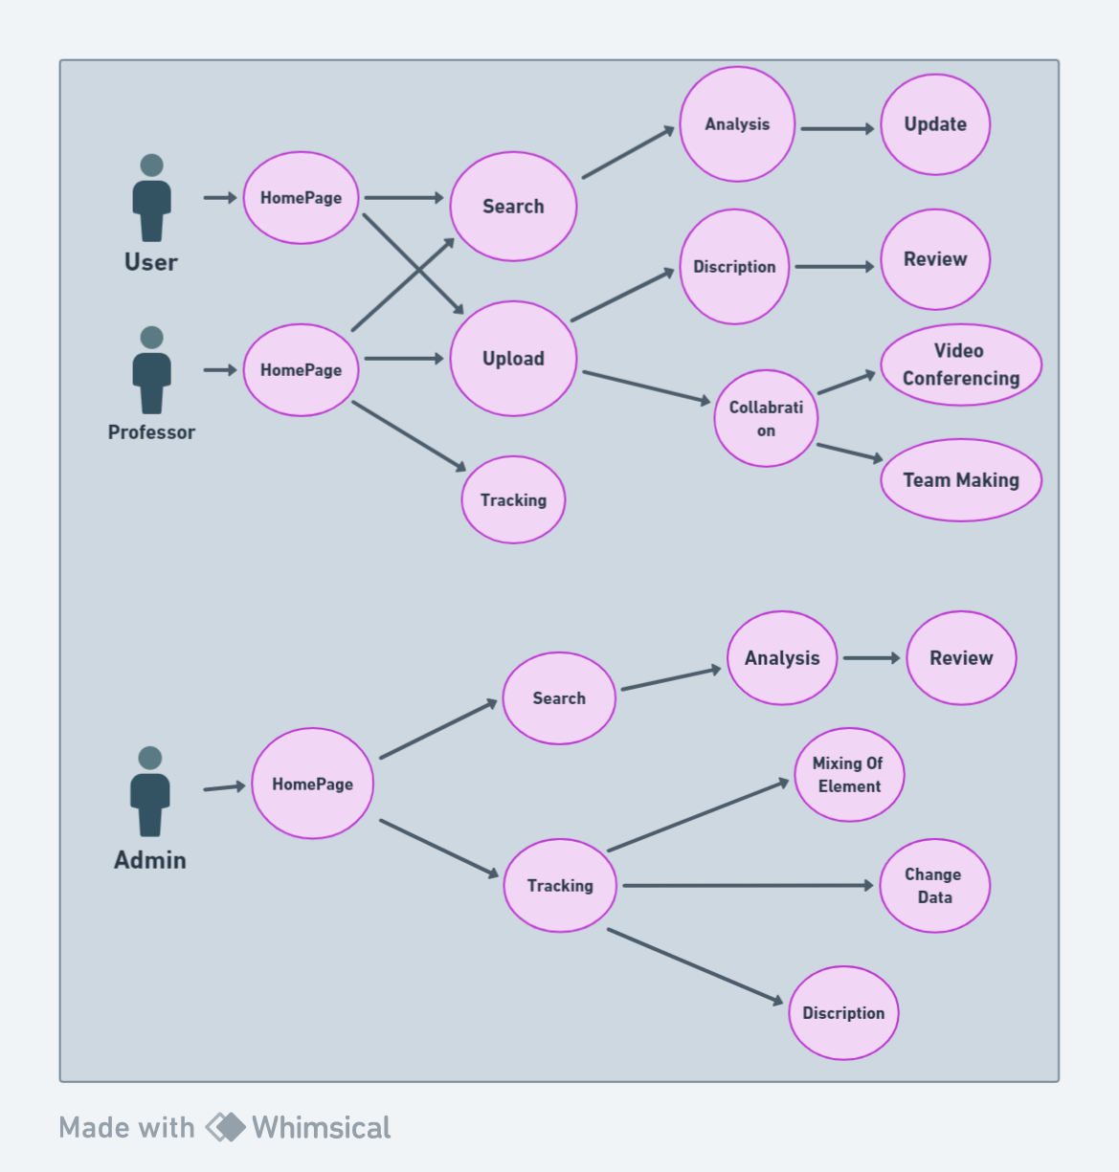
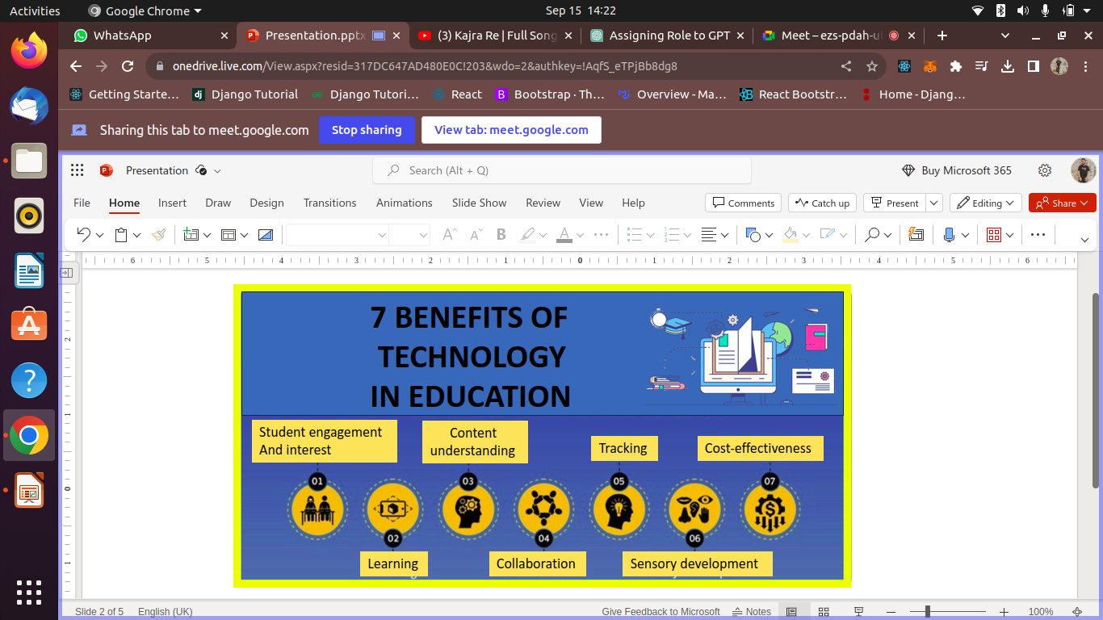
USER CASE
ADVANTAGES
WORKING PRINCIPLE
Text-Based Interaction: I interact with users through text-based communication, receiving commands and providing responses.
Information and Guidance: I can offer information and guidance related to project uploads, repositories, and other aspects of managing code and projects.
Assistance and Education: I aim to assist users by explaining procedures, providing examples, and answering questions related to project management and code hosting.
Text Generation: I generate text responses based on the input and context provided by users, drawing from my pre-trained knowledge.
DEPENDENCIES
Documentation and Collaboration Tools:
Monitoring and Analytics
Email Service
File Upload Handling
Database
Authentication System
Tracking System

Slide 4
TEAM MEMBER DETAILS
NAME
STREAM
BRANCH
YEAR
VAISHNAVI
CSE(AI)
BTECH
3rd
AYUSHI
IT
BTECH
3rd
SAKSHAM
IT
BTECH
3rd
ANURAG
IT
BTECH
3rd
RITIK
IT
BTECH
3rd
HIMANSHU
CSE(DS)
BTECH
2nd

