Slide 1
MVTS: A Frame Work for Maritime Vehicle Tracking
Presented by :
Md. Emruz Hossain
ID: 1204084 Department of CSE, CUET
Supervised by:
Dr. Mohammad Shamsul Arefin
Professor Department of CSE, CUET

Slide 2
List of Contents
Introduction
Motivation
Related Work
Objective
Methodology
SWOT Analysis
Conclusion
References

Slide 3
Introduction
Maritime vehicle tracking system is GPS/GSM based tracking system.
It is an important system to modernize water transport system.
Automatic overload detection and warning system can increase passenger safety.
An proper tracking system will improve vessels efficiency and passenger services.

Slide 4
Motivation
Information of Waterways of Bangladesh:
More than 700 rivers.
About 24,000 km total waterway.
5,968 km is navigable by mechanized vessels.
Major transportation media for southern region of Bangladesh.
Every year transport millions of passengers and millions of cargo.
Cheapest transportation medium in Bangladesh.

Slide 5
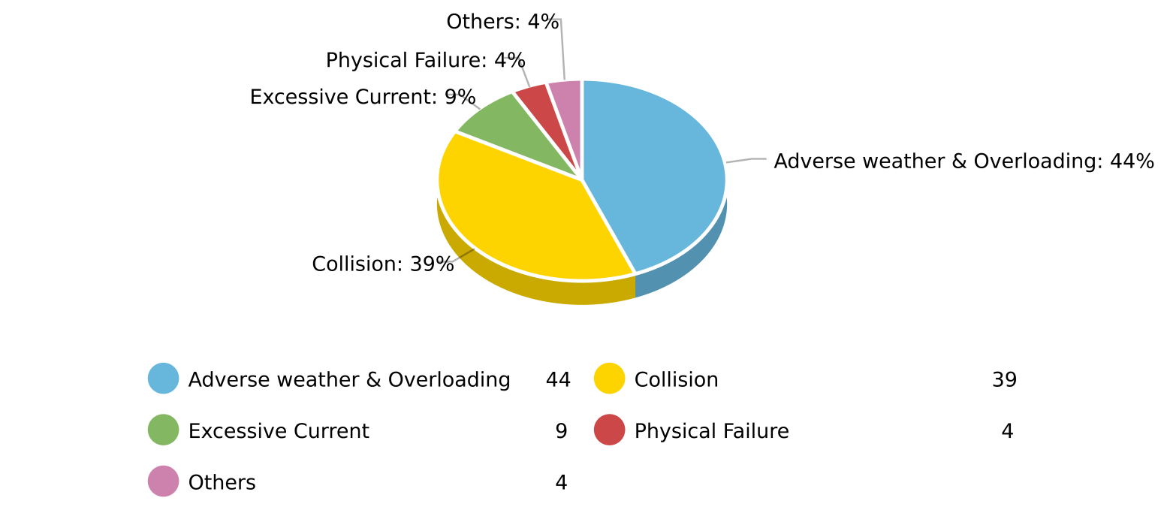
Motivation(Contd.)
Overview of maritime accidents:
Adverse weather and overloading are main reasons of accidents.

Slide 6
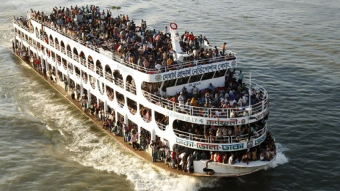
Motivation(Contd.)
Overview of maritime accidents:
Adverse weather and overloading are main reasons of accidents.
Vessels are dangerously overloaded during special occasion like Eid and Puja.

Slide 7
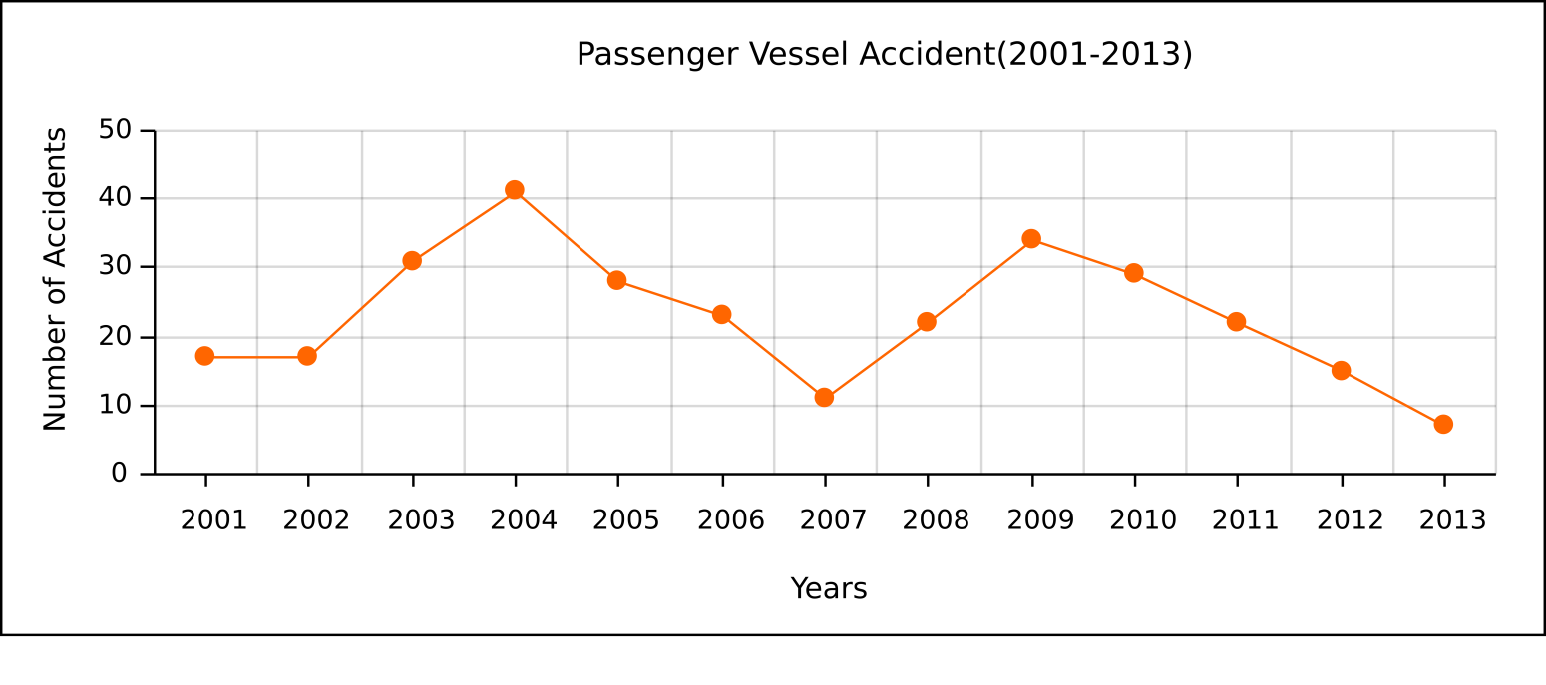
Motivation(Contd.)
Overview of maritime accidents:
Adverse weather and overloading are main reasons of accidents.
Vessels are dangerously overloaded during special occasion like Eid and Puja.
Average 22 accidents happen in every year.

Slide 8
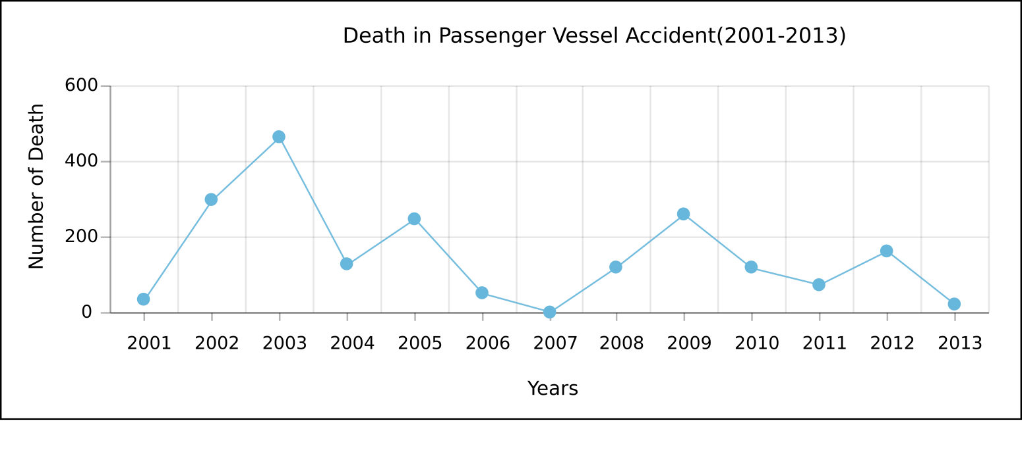
Motivation(Contd.)
Overview of maritime accidents:
Adverse weather and overloading are main reasons of accidents.
Vessels are dangerously overloaded during special occasion like Eid and Puja.
Average 22 accidents happened in every year.
More than 150 people die each year.

Slide 9
Motivation(Contd.)
Overview of maritime accidents:
Adverse weather and overloading are main reasons of accidents.
Vessels are dangerously overloaded during special occasion like Eid and Puja.
Average 22 accidents happen in every year.
More than 150 people die each year.

Slide 10
Related Work
Launch disasters in Bangladesh: A geographical study(N.A. Huq et al., 2006)
Work done:
Distributed accidents according to geographical location.
Found collision as main reason of accidents.
Identified overloading and poor vessel condition as second major causes of accidents.
Limitation:
Did not propose any system to reduce maritime accidents.

Slide 11
Related Work(Contd.)
Collision of marine vehicles in Bangladesh: A study on accident characteristics (Z. I. Awal et al., 2010)
Work done:
Studied on more than 450 accident cases.
Analyzed accidents in different aspects.
Found that major number of accidents happened because of sessional storm combined with overloading.
Limitation:
Did not propose any system to reduce maritime accidents.

Slide 12
Related Work(Contd.)
An innovation approach for improving passenger vessels safety level: Overload problem (N.F.S.A. Rahman et al., 2014)
Work done:
Proposed a system to detect overload using High Capacity Compressor(HCC).
Proposed “Elevator Concept” to handle overloaded condition.
Limitation:
HCC can be easily bypassed.
“Elevator Concept” increase loading and unloading time of a vessel.

Slide 13
Related Work(Contd.)
Low cost marine black box design(I.K. Abir et al., 2015)
Work done:
Designed a low cost black box for maritime vessels.
Limitation:
Only store data for investigation purpose of a maritime accident.
Did not proposed any system to reduce accidents.

Slide 14
Objective
To detect overload condition.
To track the location of vessels in real time based on GPS/GSM.
To provide drivers a way to know the location of other vessels.
To provide passengers a way to know the status of their desired vessel.

Slide 15
Methodology
Communication Module
Overload Handling
Server
GPS
GSM
Vessel Monitoring
Administrator
User App Server
Display
Central Monitoring Unit
Alarm
Engine
Load Status
Ardunio
Ardunio
Location
Load Sensor
Left Load Sensor
Expected Time to Reach Destination
Right Load Senosr
Overload Detector
Passenger App
Lean Angle Detector

Slide 16
Methodology
Communication Module
GPS monitoring
Server
GPS
GSM
Vessel Monitoring
Administrator
User App Server
Display
Central Monitoring Unit
Alarm
Engine
Load Status
Ardunio
Ardunio
Location
Load Sensor
Left Load Sensor
Expected Time to Reach Destination
Right Load Senosr
Overload Detector
Passenger App
Lean Angle Detector

Slide 17
Methodology
Communication Module
Emergency situation reporting
Server
GPS
GSM
Vessel Monitoring
Administrator
User App Server
Display
Central Monitoring Unit
Alarm
Engine
Load Status
Ardunio
Ardunio
Location
Load Sensor
Left Load Sensor
Expected Time to Reach Destination
Right Load Senosr
Overload Detector
Passenger App
Lean Angle Detector

Slide 18







SWOT Analysis
GPS/GSM system is now well known.
Almost every region of the country is under the cover of GSM network.
Cost for overload detection system is not high.
New system for riverine vessel sector.
Initial cost for setup the system.
Monthly cost for GPS/GSM system.
STRENGTH
WEAKNESS
SWOT
Profit centric attitude of vessel owners.
Inadequate vessels in proportion to number of passengers.
Untracked country boat.
Promising for improving passenger service.
Possible to map low depth area.
Better vessel scheduling.
THREAT
OPPURTUNITY

Slide 19
Conclusion
Accidents can be reduced in a great number by preventing vessels from carrying overloaded passengers and goods.
Emergency help can be sent to any vessel in case of any undesirable situation by notifying nearest rescue team.
System will help to operate vessels at night and foggy environment.
It will improve safety of passengers.

Slide 20
References
[1] Bangladesh Inland Water Transport Authority (BIWTA), “Information of waterways”, [Online]. Available at: http://www.biwta.gov.bd/website/?page id=2]
[2] The Gurdian, (2013, Nov 6), “Potentials of inland water transport in Bangladesh”, [Online]. Available at: http://www.theguardianbd.com/potentials-inland-water-transport-bangladesh/
[3] MediaBangladesh.net, “3.41 trillion taka Bangladesh budget for 2016-17 fiscal year”, [Online]. Available at: http://www.mediabangladesh.net/2-95-trillion-bangladesh-budget-2016-17/
[4] Arab News (2014, May 16), “12 dead as Bangla ferry carrying hundreds sinks”, [On-line]. Available at: http://www.arabnews.com/news/571451?page=1&quicktabs stat2=0#
[5] Dhaka Tribune (2014, May 5), “Above 4,000 deaths from launch accidents in 38 years”, [Online]. Available at: http://archive.dhakatribune.com/bangladesh/2014/may/05/above-4000-deaths-launch accidents-38-years

Slide 21
References(Contd.)
[6] Z. I. Awal, M. R. Islam and M. Hoque, “Collision of marine vehicles in Bangladesh: A study on accident characteristics”, in proc. Disaster Prevention and Management, vol. 19, no. 5, pp. 582-595, Nov. 2010.
[7] N. A. Huq and A. M. Dewan, “Launch disasters in Bangladesh: A geographical study”, in proc. Geografia - Malaysian Journal of Society and Space, vol. 2, pp. 19-30, Aug. 2006.
[8] A. K. Azad, “Riverine passenger vessel disaster in Bangladesh: Options for mitigation and safety”, M.S. thesis, Dept. Disaster Management, BRAC University, Dhaka, Bangladesh, 2009.
[9] N. S. F. A. Rahman and H. Z. Rosli, “An innovation approach for improving passen- ger vessels safety level: Overload problem”, in proc. IJBTS, vol. 2, no. 2, Dec. 2014.
[10] I. K. Abir, R. Rafique and S. Roy, “Low cost marine black box design”, M.S. thesis, Dept. Elect. Eng., BRAC University, Dhaka, Bangladesh, Aug. 2015.

Slide 22
Thank You

