Slide 1
face of fonts | 字之魂
Choosing an appropriate typeface is difficult due to the large libraries available on the internet and the subjective nature of design. Currently most typeface recommendation systems available to people are textbooks and blogs. We implement machine learning algorithms to analyse the correlation between typeface design and its semiotic meaning and thus recommend an appropriate typeface.
Our research culminates in a data-driven approach that takes in short sentences and recommends a font based on the meaning conveyed. This approach, overlooked by traditional Natural Language Processing techniques will improve the discovery of semantic meaning in text by incorporating contextual analysis. (deep learning)
APPROACH 1:
LIBLINEAR
PARAMETERS
Tweaking of parameters to obtain optimal results
LOGISTIC REGRESSION
Obtain probability estimates of each font
VECTOR COMPOSITION
Composition of all font vectors with weights from probability estimate
APPROACH 2:
CNN
EMBEDDINGS
Used GoogleNews to map each word to a vector; represents the relationship between words
PARAMETERS
Tweaking of parameters to obtain optimal results
TEXT2FONT.H5
Obtain probability estimates of each font
Notes:
Double check the introduction
turn the approach white

Slide 2




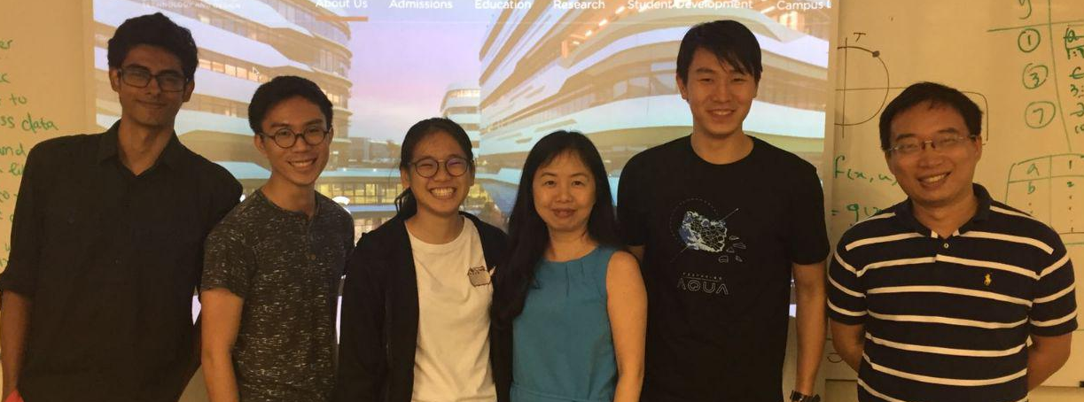
We tested our model against award winning branding and their typographies; and this is our result:
custom brand font
recommended font 1
recommended font 2
The team consists three first-year undergraduate students from Singapore University of Technology and Design.
Special thanks to:
Ganesh Chandrasekaran, USA
Prof Zhaorong, Singapore
Prof Luwei, Singapore
Notes:
Demonstrate our best work well
Give some context as to what we are comparing against

