Slide 1
Tensorflow Programming
2017 Tsinghua Deep Learning Summer School
Wenguang Chen
Dept. of Computer Science and Technology
Tsinghua University

Slide 2

Hello World: handwritten digits classification
?
0
0
0
0
0
0
0
0
1
0
0
1
8
9
28*28 pixels
10*1 one-hot vector
MNIST = Mixed National Institute of Standards and Technology
Download the dataset at http://yann.lecun.com/exdb/mnist/

Slide 3
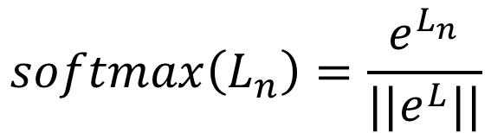
Simple model: softmax classification
784 pixels
$$h\left(x\right)=softmax(X.W+b)$$
28x28
pixels
...
where
...
$$softmax\left(L_{n}\right)=\frac{e^{L_{n}}}{||e^{L}||}$$
softmax
0
1
2
9

Slide 4




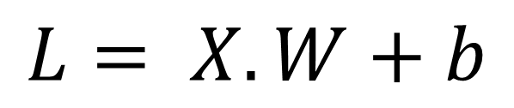

For efficiency, 100 images at a time
10 columns
^{w}0,0 ^{w}1,0 ^{w}2,0 ^{w}3,0 ^{w}4,0 ^{w}5,0 ^{w}6,0 ^{w}7,0 ^{w}8,0
^{w}0,1 ^{w}1,1 ^{w}2,1 ^{w}3,1 ^{w}4,1 ^{w}5,1 ^{w}6,1 ^{w}7,1 ^{w}8,1
^{w}0,2 ^{w}1,2 ^{w}2,2 ^{w}3,2 ^{w}4,2 ^{w}5,2 ^{w}6,2 ^{w}7,2 ^{w}8,2
^{w}0,3 ^{w}1,3 ^{w}2,3 ^{w}3,3 ^{w}4,3 ^{w}5,3 ^{w}6,3 ^{w}7,3 ^{w}8,3
^{… w}0,9
^{… w}1,9
^{… w}2,9
^{… w}3,9
^{… w}4,9
^{… w}5,9
^{… w}6,9
^{… w}7,9
^{… w}8,9
$$W$$
784 lines
x
x
x
$$L= X.W+b$$
X : 100 images, one per line, flattened
x
x
x
x
…
x
^{w}783,0 ^{w}783,1 ^{w}783,2
^{… w}783,9
^{L}0,0 ^{L}0,1 ^{L}0,2 ^{L}0,3 ^{L}1,0 ^{L}1,1 ^{L}1,2 ^{L}1,3 ^{L}2,0 ^{L}2,1 ^{L}2,2 ^{L}2,3 ^{L}3,0 ^{L}3,1 ^{L}3,2 ^{L}3,3 ^{L}4,0 ^{L}4,1 ^{L}4,2 ^{L}4,3
…
^{L}99,0 ^{L}99,1 ^{L}99,2
……L_{0,9}
^{… L}1,9
^{… L}2,9
^{… L}3,9
^{… L}4,9
^{… L}99,9
+
b₀ b₁ b₂ b₃ … b₉
$$X$$
$$b$$
+ Same biases on all lines

Slide 5

Loss function
0 | 1 | 2 | 3 | 4 | 5 | 6 | 7 | 8 | 9
0 | 0 | 0 | 0 | 0 | 0 | 1 | 0 | 0 | 0
Cross entropy:
computed probabilities
actual probabilities, “one-hot” encoded
$$−\sum{Y_{i}.log⁡(hx_{i})}$$
this is a “6”
0.1 | 0.2 | 0.1 | 0.3 | 0.2 | 0.1 | 0.9 | 0.2 | 0.1 | 0.1
0 | 1 | 2 | 3 | 4 | 5 | 6 | 7 | 8 | 9

Slide 6
Training process (pseudo code)
for iteration in range(1:100):
for batch in mini_batches:
x, y = batch.input, batch.label
hx = softmax(Wx + b)
loss = sum(y * log(hx))
gradw = grad(loss, W)
gradb = grad(loss, b)
W += gradw * alpha
b += gradb * alpha
784 pixels
28x28
pixels
...
softmax
...
0
1
2
9

Slide 7
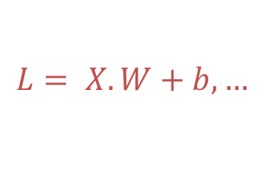

Coding deep learning: challenges
Running matrix operations efficiently
Getting derivatives right
Scheduling operations
Distributed training
Debugging
$$L= X.W+b,…$$
$$gradw=grad\left(loss, W\right), …$$

Slide 8
Challenges
Running matrix operations efficiently
Getting derivatives right
Scheduling operators
Distributed training
Debugging

Slide 9
Running matrix operations efficiently
Everyone can write matrix multiplication, but very few can do it efficiently…
c = (double *) calloc(sizeof(double), n*n);
/* Multiply n x n matrices a and b */
void mmm(double *a, double *b, double *c, int n) {
int i, j, k;
for (i = 0; i < n; i++)
for (j = 0; j < n; j++)
for (k = 0; k < n; k++)
c[i*n + j] += a[i*n + k] * b[k*n + j];
}

Slide 10
Example: Matrix Multiplication
c = (double *) calloc(sizeof(double), n*n);
/* Multiply n x n matrices a and b */
void mmm(double *a, double *b, double *c, int n) {
int i, j, k;
for (i = 0; i < n; i++)
for (j = 0; j < n; j++)
for (k = 0; k < n; k++)
c[i*n + j] += a[i*n + k] * b[k*n + j];
}
j
c
a
b
=
*
i

Slide 11
Blocked Matrix Multiplication
c = (double *) calloc(sizeof(double), n*n);
/* Multiply n x n matrices a and b */
void mmm(double *a, double *b, double *c, int n) {
int i, j, k;
for (i = 0; i < n; i+=B)
for (j = 0; j < n; j+=B)
for (k = 0; k < n; k+=B)
/* B x B mini matrix multiplications */
for (i1 = i; i1 < i+B; i++)
for (j1 = j; j1 < j+B; j++)
for (k1 = k; k1 < k+B; k++)
c[i1*n+j1] += a[i1*n + k1]*b[k1*n + j1];
}
matmult/bmm.c
j1
c
a
b
c
=
*
+
i1
Block size B x B

Slide 12
Running matrix operations efficiently
Fortunately, matrix operations are standard:
Matrix-matrix multiplication, matrix-vector multiplication, matrix addition, matrix-vector addition, …
MKL, OpenBLAS, cuBLAS, …

Slide 13
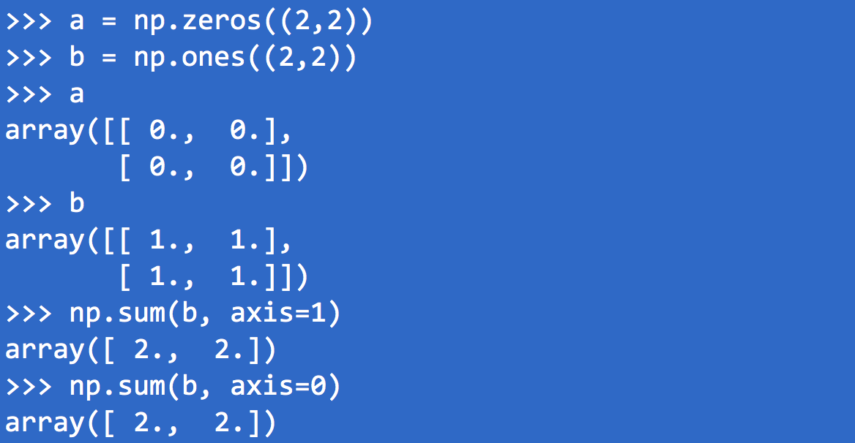
Programming with Matrix
A quick review on Numpy’s matrix support
What is the result of c = np.sum(b, axis=1) + np.sum(a, axis=0)?

Slide 14
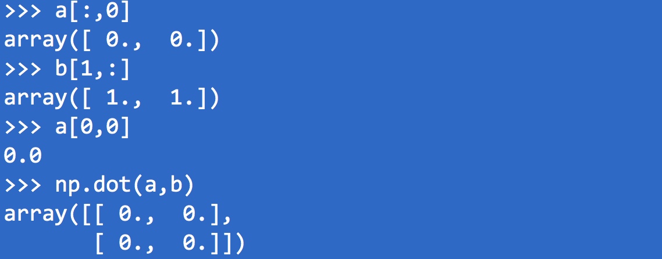
Numpy(cont’d)
What is the result of a[1,2] ?

Slide 15
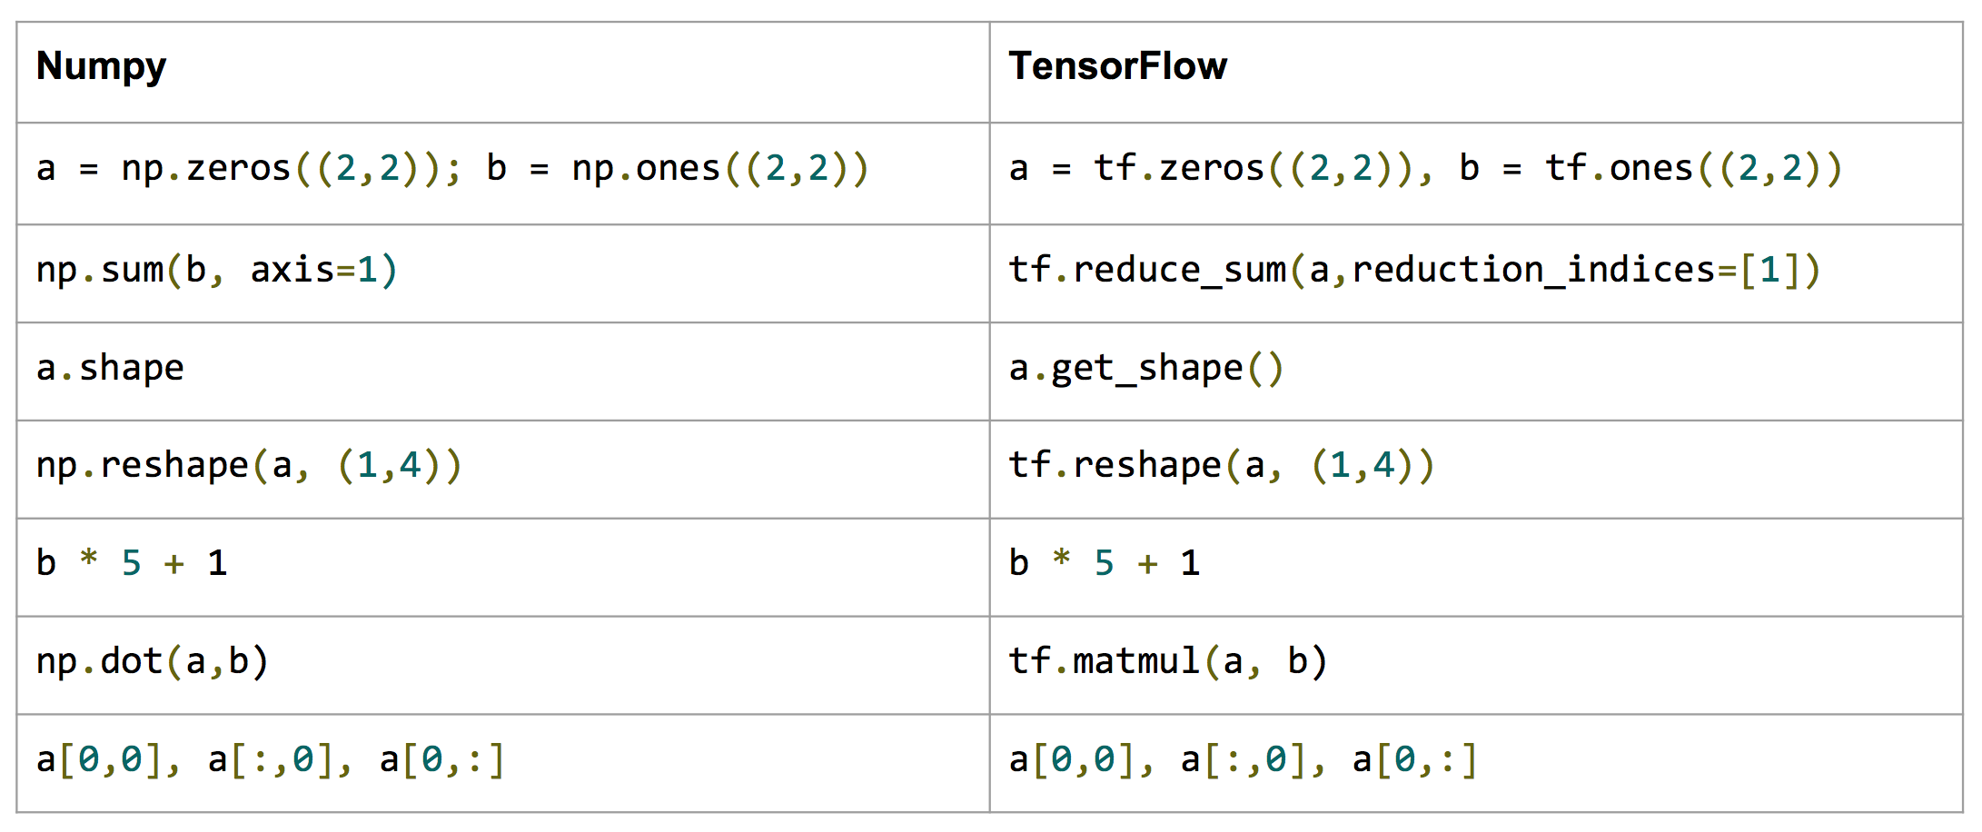
Numpy to Tensorflow*
*Stanford CS224d Tensorflow Tutorial

Slide 16
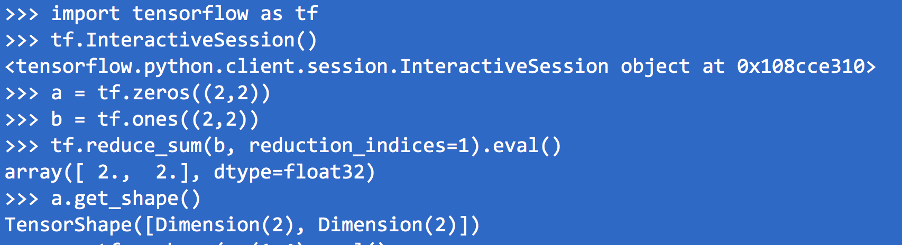
Do it in Tensor

Slide 17
Is Numpy good enough for NN?
Numpy does not include common operations in NN such as Softmax, RELU, sigmoid, …
Does not has support for GPU( as well as other accelerators)
Tensorflow support more NN specific functions, and more hardware platform

Slide 18
Example code in Tensorflow
tensor shapes:
X[100, 748]
W[748,10]
b[10]
HX = tf.nn.softmax(tf.matmul(X, W) + b)
matrix multiply
broadcast on all lines
Underlying implementation leverages matrix libraries like cuDNN and MKL

Slide 19
Why we need eval and session?

Slide 20
Phases of Tensorflow Programs
Phase 1
Build a computation graph(Neural Network)
At this phase, no real calculation operations are triggered
Phase 2
Compute
Usually triggered by run()
X
W
Y
*
dot
b
+
reduce_sum
softmax
minus
log
cross_entropy

Slide 21
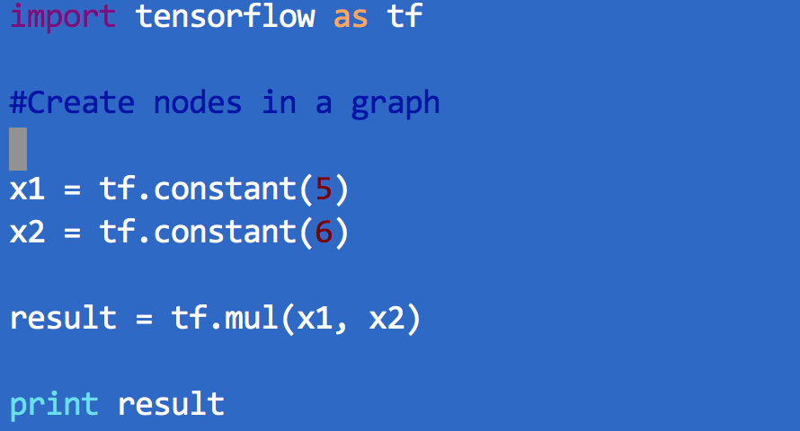
Another simple example – No session

Slide 22
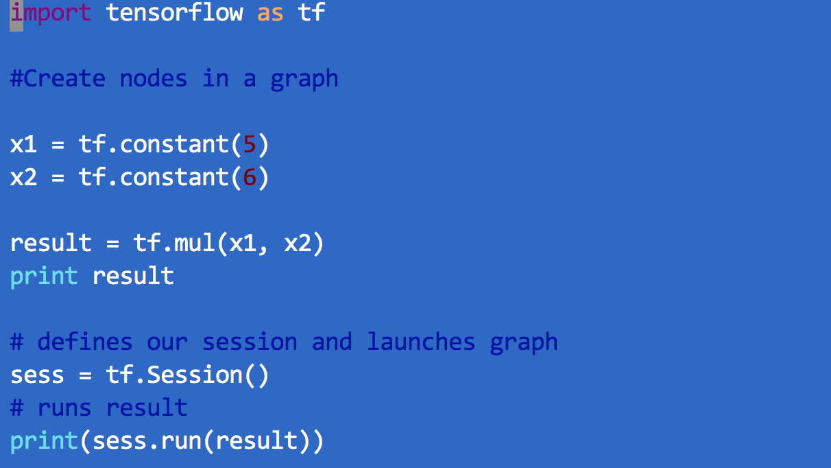
Use session and run

Slide 23
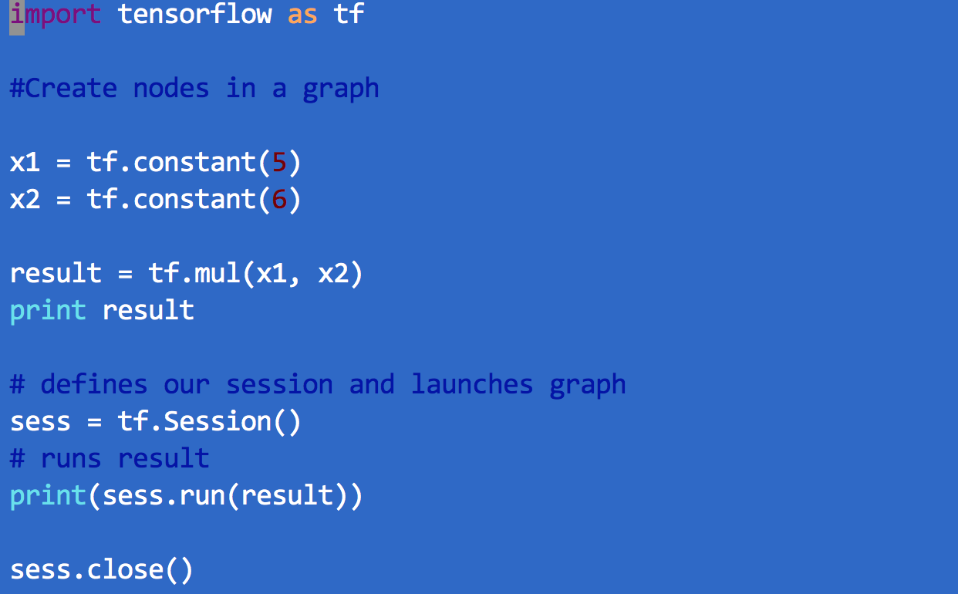
Close session

Slide 24
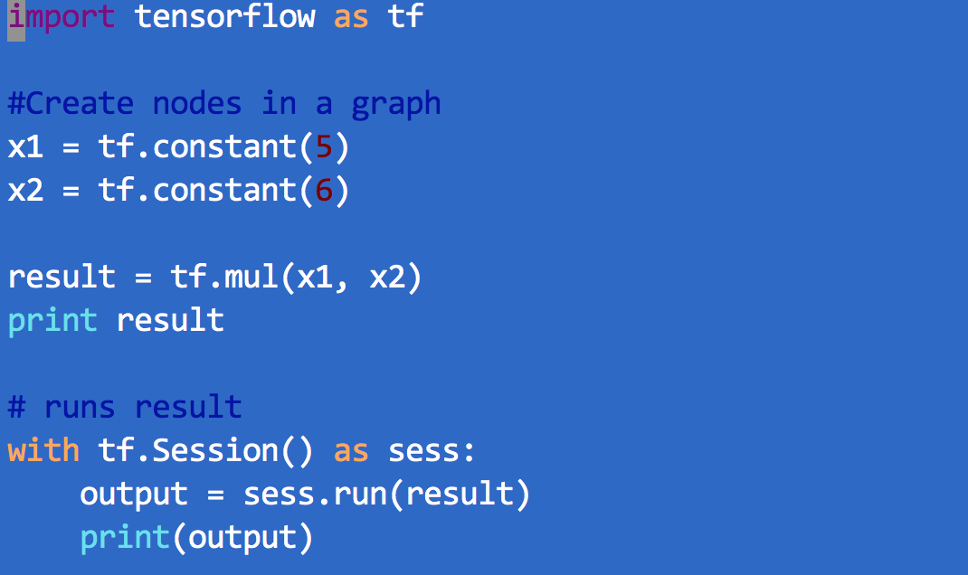
“With” statement

Slide 25
Back to the previous example
InteractiveSession : Keep a default session open
c.eval() : session.run(c)

Slide 26
Challenges
Running matrix operations efficiently
Getting derivatives right
Scheduling operators
Distributed training
Debugging

Slide 27
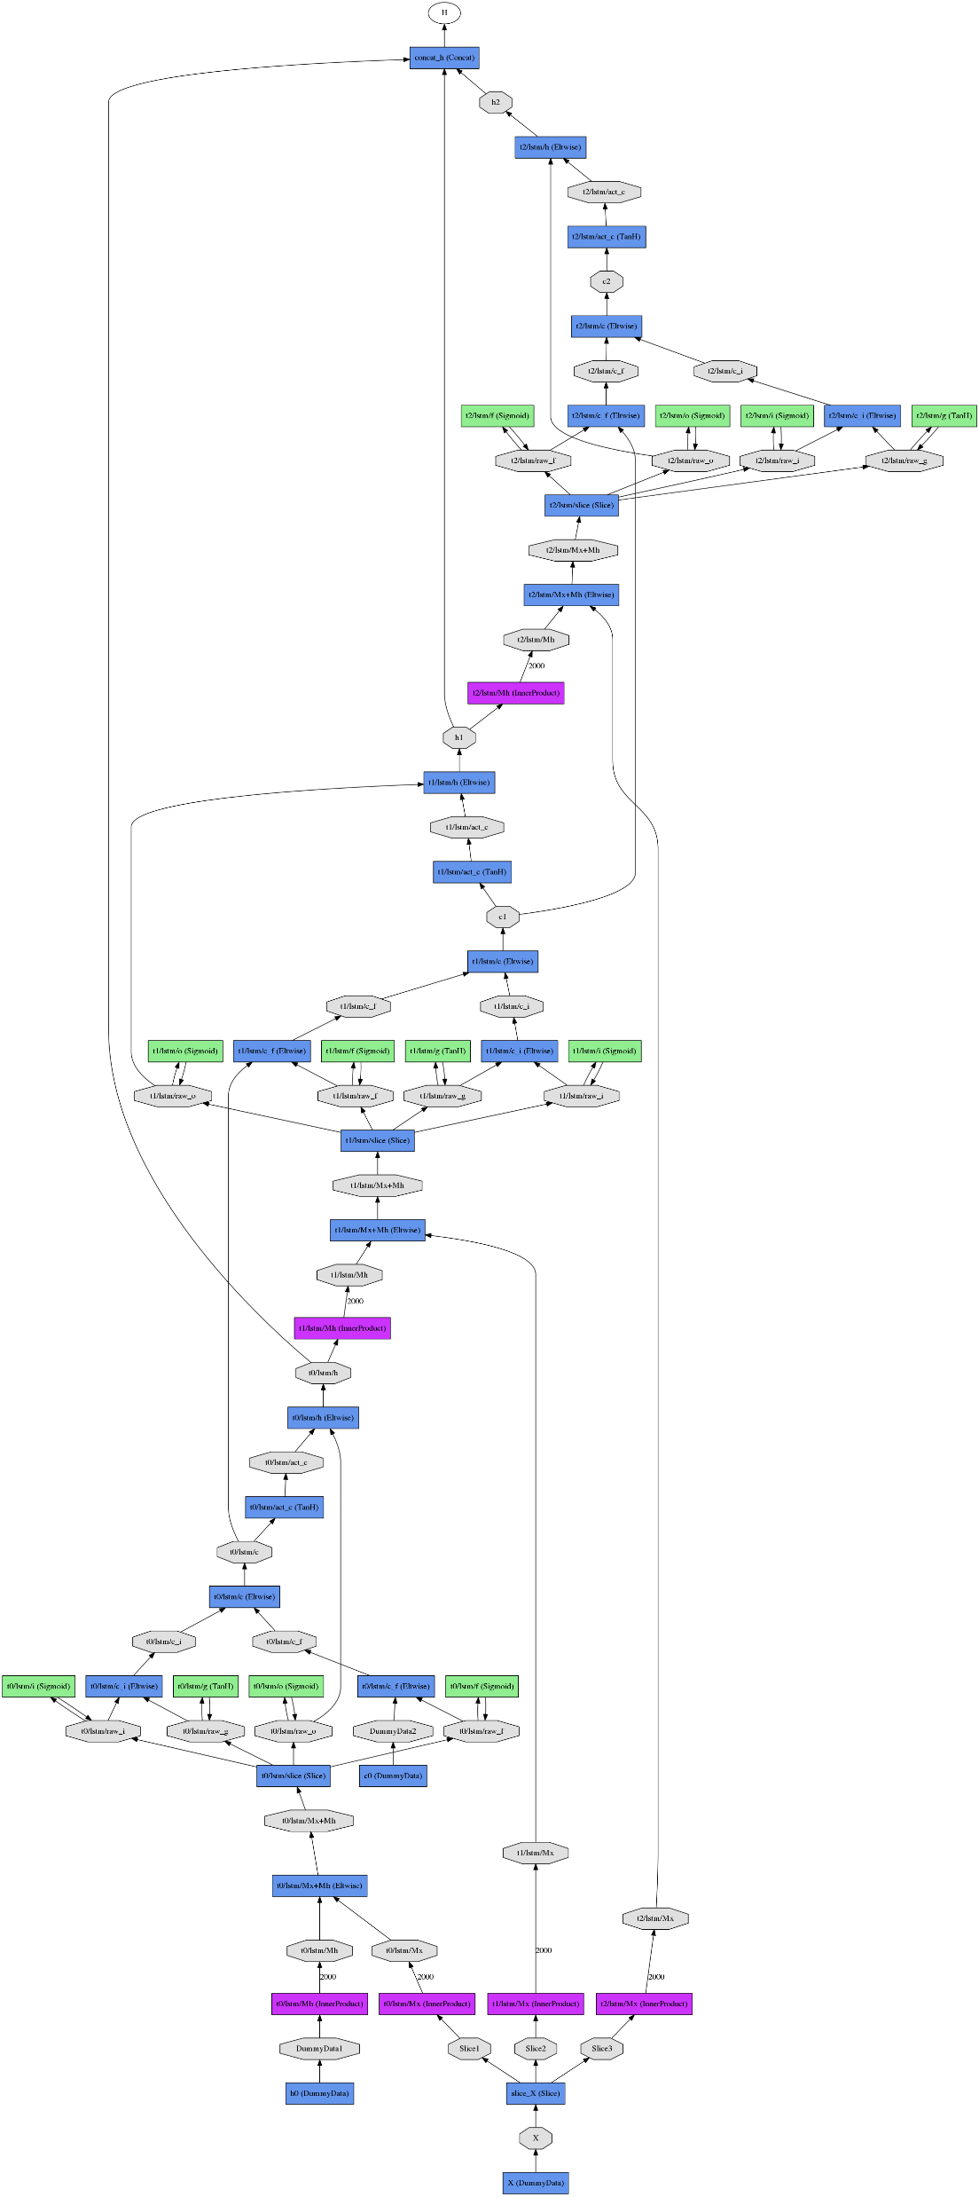
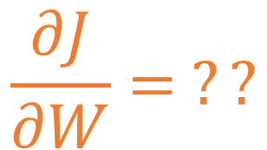
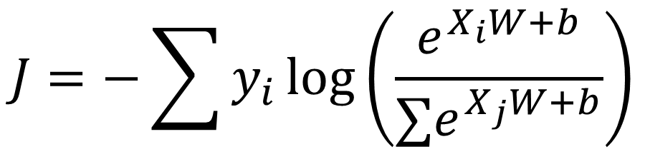
Getting derivatives right
$$J=−\sum{y_{i}\log\left(\frac{e^{X_{i}W+b}}{∑e^{X_{j}W+b}}\right)}$$
$$\frac{∂J}{∂W}= ??$$
Calculating derivatives by hand is error-prone
Especially with complex networks
We should do it automatically

Slide 28




Automatically calculate derivatives
Describe the network as a function
X is unknown at the time of definiation
W and b have initial values, but should be changed during training
10 columns
^{w}0,0 ^{w}1,0 ^{w}2,0 ^{w}3,0 ^{w}4,0 ^{w}5,0 ^{w}6,0 ^{w}7,0 ^{w}8,0
^{w}0,1 ^{w}1,1 ^{w}2,1 ^{w}3,1 ^{w}4,1 ^{w}5,1 ^{w}6,1 ^{w}7,1 ^{w}8,1
^{w}0,2 ^{w}1,2 ^{w}2,2 ^{w}3,2 ^{w}4,2 ^{w}5,2 ^{w}6,2 ^{w}7,2 ^{w}8,2
^{w}0,3 ^{w}1,3 ^{w}2,3 ^{w}3,3 ^{w}4,3 ^{w}5,3 ^{w}6,3 ^{w}7,3 ^{w}8,3
^{… w}0,9
^{… w}1,9
^{… w}2,9
^{… w}3,9
^{… w}4,9
^{… w}5,9
^{… w}6,9
^{… w}7,9
^{… w}8,9
$$W$$
784 lines
x
x
x
$$L= X.W+b$$
X : 100 images, one per line, flattened
x
x
x
x
…
x
^{w}783,0 ^{w}783,1 ^{w}783,2
^{… w}783,9
^{L}0,0 ^{L}0,1 ^{L}0,2 ^{L}0,3 ^{L}1,0 ^{L}1,1 ^{L}1,2 ^{L}1,3 ^{L}2,0 ^{L}2,1 ^{L}2,2 ^{L}2,3 ^{L}3,0 ^{L}3,1 ^{L}3,2 ^{L}3,3 ^{L}4,0 ^{L}4,1 ^{L}4,2 ^{L}4,3
…
^{L}99,0 ^{L}99,1 ^{L}99,2
……L_{0,9}
^{… L}1,9
^{… L}2,9
^{… L}3,9
^{… L}4,9
^{… L}99,9
+
b₀ b₁ b₂ b₃ … b₉
$$X$$
$$b$$
+ Same biases on all lines

Slide 29
Placeholders and variables
Both are symbols
Variables are used to represent weights that need to be trained (W and b)
Placeholders are used for non-changing data (X, Y)

Slide 30
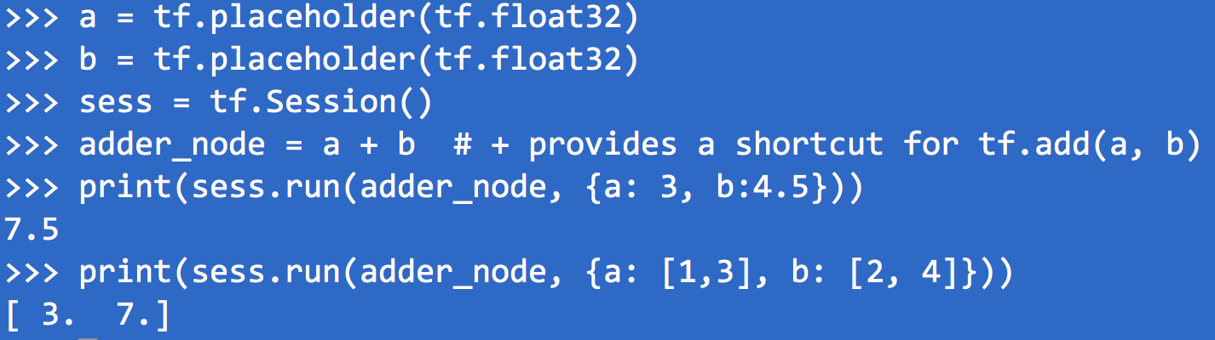
Placeholder Example

Slide 31
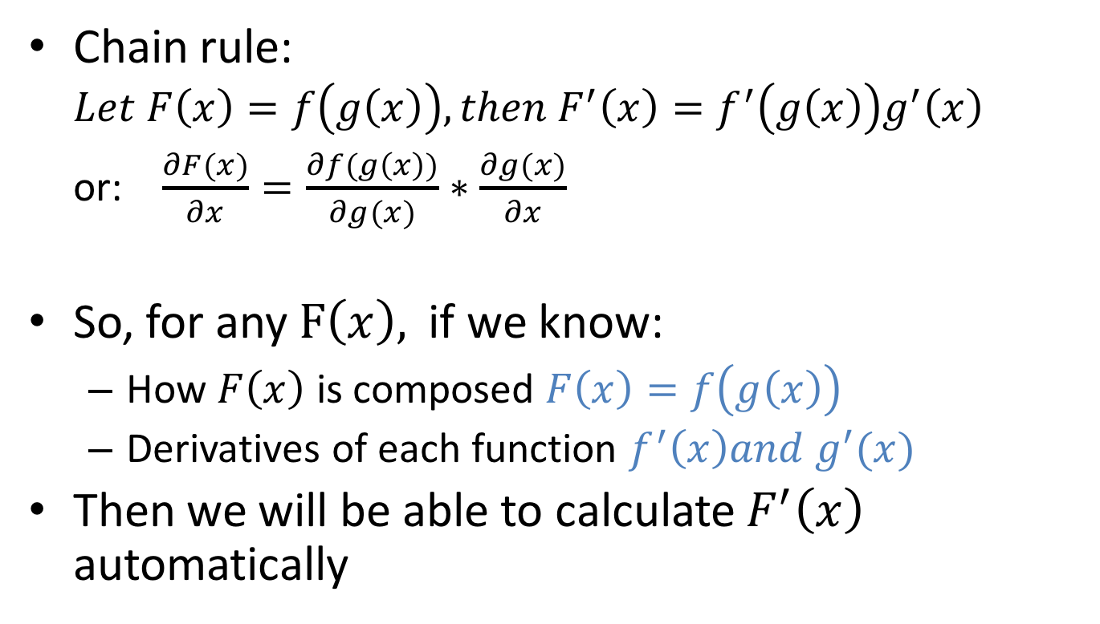
Auto-derivative: principle
Chain rule:
$$Let F\left(x\right)=f\left(g\left(x\right)\right), then F^{′}\left(x\right)=f^{′}\left(g\left(x\right)\right)g^{′}\left(x\right)$$
or: $\frac{∂F(x)}{∂x}=\frac{∂f(g\left(x\right))}{∂g(x)}∗\frac{∂g(x)}{∂x}$
So, for any $F\left(x\right),$ if we know:
How $F\left(x\right)$ is composed $F\left(x\right)=f\left(g\left(x\right)\right)$
Derivatives of each function $f^{′}\left(x\right)and g^{′}(x)$
Then we will be able to calculate $F^{′}\left(x\right)$ automatically

Slide 32
Auto-derivative: tracking dependencies
Tracking function composition through symbolic graph
Code
Symbolic Graph
A = tf.Variable(‘A’)
B = tf.Variable(‘B’)
A
B
*
C = A * B
D = tf.Variable(‘D’)
C
D
*
E = C * D
E
E = A * B * D

Slide 33
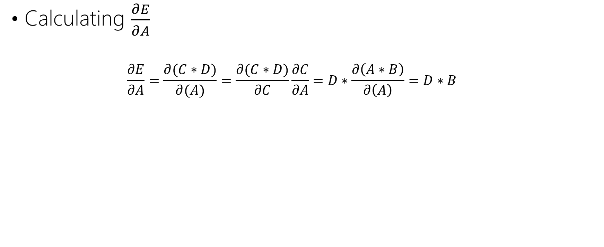


Auto-derivative: using dependencies
Calculating $\frac{∂E}{∂A}$
$$\frac{∂E}{∂A}=\frac{∂(C∗D)}{∂(A)}=\frac{∂(C∗D)}{∂C}\frac{∂C}{∂A}=D∗\frac{∂\left(A∗B\right)}{∂\left(A\right)}=D∗B$$
forward pass
backward propagation
A
B
B
*
C
D
$$\frac{∂C}{∂A}$$
D
*
*
E
$$\frac{∂E}{∂A}$$
Notes:
the partial derivative of E with respect to A

Slide 34



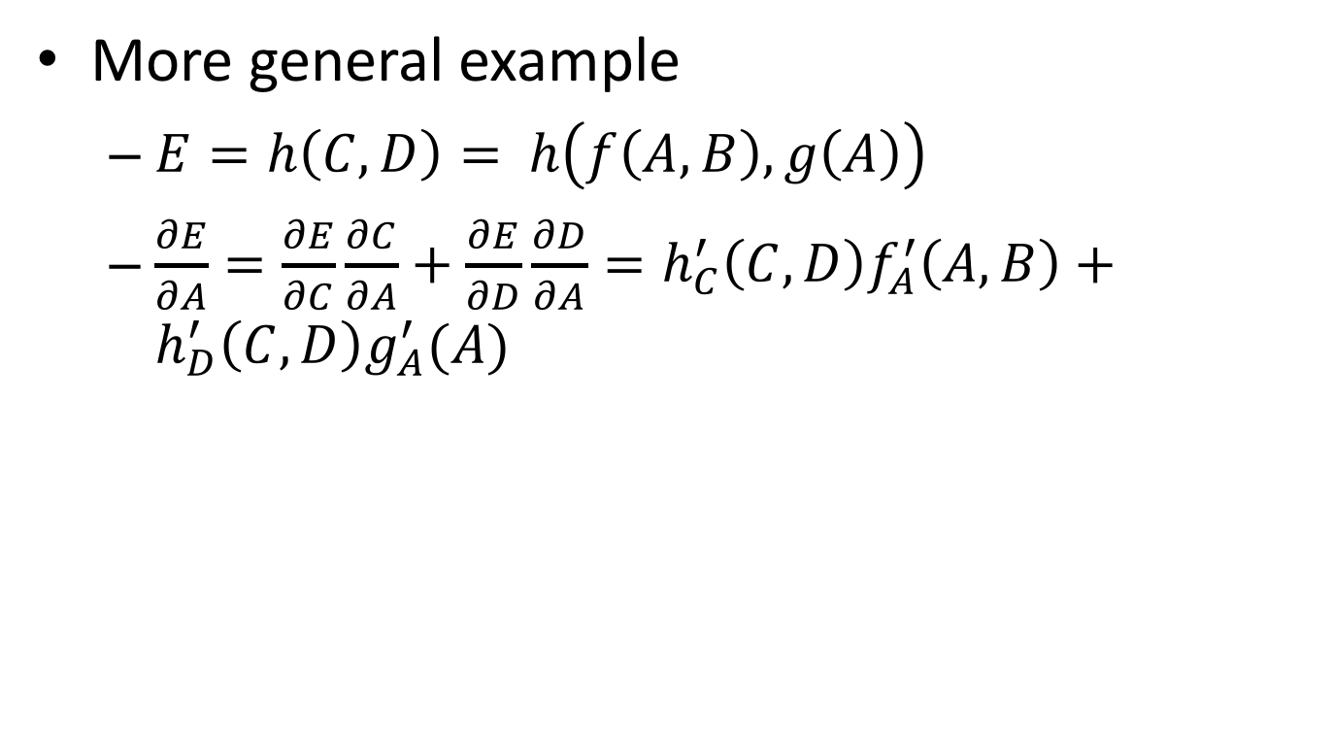



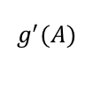




Auto-derivative: more general example
More general example
$E={h\left(C, D\right)=}_{ }h\left(f\left(A,B\right), g\left(A\right)\right)$
$\frac{∂E}{∂A}=\frac{∂E}{∂C}\frac{∂C}{∂A}+\frac{∂E}{∂D}\frac{∂D}{∂A}=h_{C}^{′}\left(C,D\right)f_{A}^{′}\left(A,B\right)+h_{D}^{′}\left(C,D\right)g_{A}^{′}(A)$
B
A
$$g^{′}$$
C
D
B
A
$$f^{′}$$
$$h_{C}^{′}$$
$$h_{D}^{′}$$
f
g
$$f_{ }^{′}(A,B)$$
$$g_{ }^{′}(A)$$
$$h_{C}^{′}\left(C,D\right)$$
$$h_{D}^{′}\left(C,D\right)$$
C
D
$$h_{C}^{′}\left(C,D\right)f_{A}^{′}\left(A,B\right)$$
$$h_{D}^{′}\left(C,D\right)g_{A}^{′}(A)$$
h
E
+
$$\frac{∂E}{∂A}$$

Slide 35
Auto-derivatives: usage
backward() is defined for every native operation (matmul, softmax, sigmoid, …)
User writes “symbolic” code to construct the forward graph
tf.gradients() provides auto calculated derivatives

Slide 36
Example auto derivative code
HX = tf.nn.softmax(tf.matmul(X, W) + b)
J = -tf.reduce_sum(Y * tf.log(HX))
gradw = tf.gradients(J, W)
gradb = tf.gradients(J, b)
X, Y, W, b, HX, J are all symbols
This is like writing a formula, then feed each symbol with real data

Slide 37
Build the Tensorflow Graph
Placeholder variables used to change the input to the graph.
Model variables that are going to be optimized so as to make the model perform better.
The model which is essentially just a mathematical function that calculates some output given the input in the placeholder variables and the model variables.
A cost measure that can be used to guide the optimization of the variables.
An optimization method which updates the variables of the model.

Slide 38
Feeding data to symbol
training step
initialisation
import tensorflow as tf
X = tf.placeholder(tf.float32, [None, 28, 28, 1])
Y = tf.placeholder(tf.float32, [None, 10])
W = tf.Variable(tf.zeros([784, 10]))
b = tf.Variable(tf.zeros([10]))
init = tf.initialize_all_variables()
# model
HX = tf.nn.softmax(
tf.matmul(tf.reshape(X,[-1, 784]), W) + b)
# loss function
cross_entropy = -tf.reduce_sum(Y * tf.log(HX))
# % of correct answers found in batch
is_correct = tf.equal(tf.argmax(HX,1), tf.argmax(Y,1))
accuracy = tf.reduce_mean(tf.cast(is_correct,tf.float32))
optimizer = tf.train.GradientDescentOptimizer(0.003) train_step = optimizer.minimize(cross_entropy)
sess = tf.Session()
sess.run(init)
for i in range(10000):
# load batch of images and correct answers
batch_X, batch_Y = mnist.train.next_batch(100)
train_data={X: batch_X, Y: batch_Y}
# train
sess.run(train_step, feed_dict=train_data)
# success ? add code to print it
a,c = sess.run([accuracy, cross_entropy], feed=train_data)
# success on test data ?
test_data={X:mnist.test.images, Y:mnist.test.labels}
a,c = sess.run([accuracy, cross_entropy], feed=test_data)
model
Run
success metrics

Slide 39
What the code really does
X
W
Y
Creates a computation graph
Run for 1000 iterations:
Feed each mini-batch to X and Y
Calculate loss function (cross_entropy)
Calculate the gradients with auto-derivatives
Update W and b
optimizer.minimize(cross_entropy)
*
dot
b
+
reduce_sum
softmax
minus
log
cross_entropy

Slide 40
Challenges
Running matrix operations efficiently
Getting derivatives right
Scheduling operators
Distributed training

Slide 41
Scheduling operators
A lot of operators to be run
Multiple devices: CPU, GPU, FPGA, network…
Doing it right: dependency tracking
Efficiency: parallelism
Restrictions: GPU memory limit

Slide 42
Read dependency
Code
Dependency Order
A = 2
B = A + 1
C = A + 2
D = B * C
A = 2
C = A + 2
B = A + 1
D = B * C
dependency
operations

Slide 43
Write dependency
Code
Dependency Order
A = 2
B = A + 1
…
B = A * 2
A = 2
B = A + 1
B = A * 1

Slide 44
Implicit dependency: delete
Code
Dependency Order
A = 2
B = A + 1
…
A.__del__()
A = 2
B = A + 1
A.__del__()

Slide 45
Implicit dependency: shared resource
Code
Dependency Order
rnd = RandomGenerator()
# The usages of same random number generator need to be serialized.
B = rnd.uniform(10, -10)
C = rnd.uniform(10, -10)
rnd=RandomGenerator()
B=rnd.unifrom()
C=rnd.uniform()

Slide 46
Tracking dependency with DAG
Directed Acyclic Graph, in which:
Operation is a node
Dependency is an edge
Operation with no incoming edges can be executed
Satisfied dependency edge is removed
A = 2
C = A + 2
B = A + 1
D = B * C

Slide 47
Tracking dependency with DAG
A = 2
C = A + 2
B = A + 1
D = B * C

Slide 48
Tracking dependency with DAG
A = 2
C = A + 2
B = A + 1
D = B * C

Slide 49
Tracking dependency with DAG
A = 2
C = A + 2
B = A + 1
D = B * C

Slide 50
Tracking dependency with DAG
A = 2
C = A + 2
B = A + 1
D = B * C

Slide 51
Tracking dependency with DAG
A = 2
C = A + 2
B = A + 1
D = B * C

Slide 52
Tracking dependency with DAG
A = 2
C = A + 2
B = A + 1
D = B * C

Slide 53
Scheduling for efficiency
Different scheduling policy may yield different performance
Breath-first:
high parallelism
high memory pressure
Depth-first:
low parallelism
good temporal locality
small memory footprint
Critical path first:
Nodes on critical path always get highest priority

Slide 54
Scheduling with resource constraint
GPU memory is very limited: 12GB maximum
GPU need as much parallelism as possible
Need to balance parallelism and memory consumption

Slide 55
Challenges
Running matrix operations efficiently
Getting derivatives right
Scheduling operators
Distributed training

Slide 56
Distributed Tensorflow
Enables training on multiple machines
Implemented with Parameter Server
Allows both synchronous and asynchronous training

Slide 57
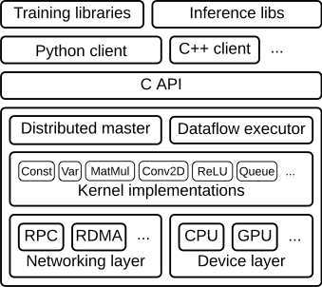
Summary: Tensorflow architecture

Slide 58
Are there better ways to write neural Network?
Writing Tensorflow applications is like writing functions
Use placeholders and variables to represent the function
Neural network layers are presented by matrix multiplication
Specify cost function and optimizer
We are going to talk on Keras in the afternoon

Slide 59
Lab
Subset of CAPTCHA
Step 1
Run a existing program
Step 2
Given a Keras program with missing statement, make it running
Step 2
Improve the network to get better result

