Slide 1
CPU Scheduler Project
BY: EMMANUEL OLAYEMI (GRADUATE) & CYRIL EKOKWE (UNDERGRAD)
CPU Scheduler Project • Academic Presentation

Slide 2
Agenda
Section 1
A
- Project Overview
- Test Results
- Scheduling Algorithm Outputs
- Algorithm Comparison
- Findings and Conclusion
CPU Scheduler Project • Academic Presentation

Slide 3
Project Overview
Section 2
O
This CPU Scheduler Simulator implements multiple scheduling algorithms:
- Round Robin
- Non-Preemptive Priority with Aging
- Preemptive Priority
- Multilevel Queue
- Multilevel Feedback Queue
The simulator reports performance metrics, including waiting time, turnaround time, response time, CPU utilization, throughput, and total simulation time.
CPU Scheduler Project • Academic Presentation

Slide 4
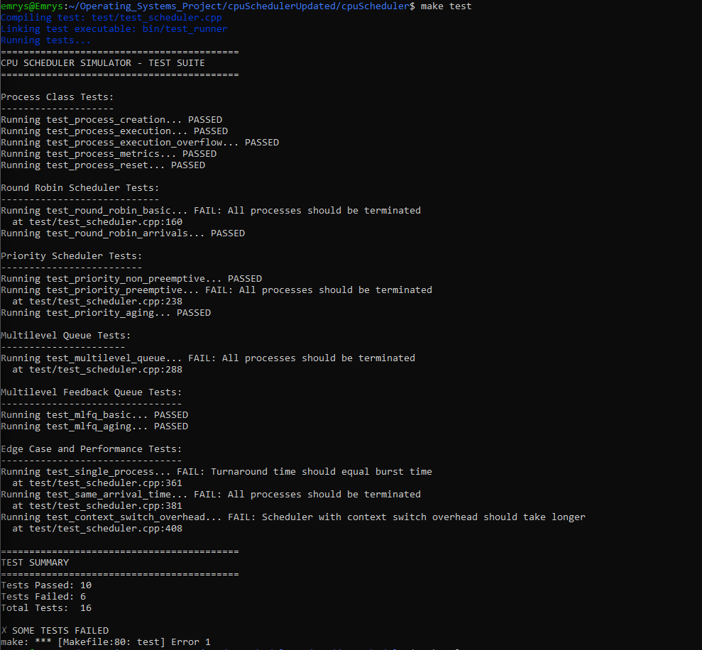
Test Results (Pass/Fail)
Section 3
T
CPU Scheduler Project • Academic Presentation

Slide 5
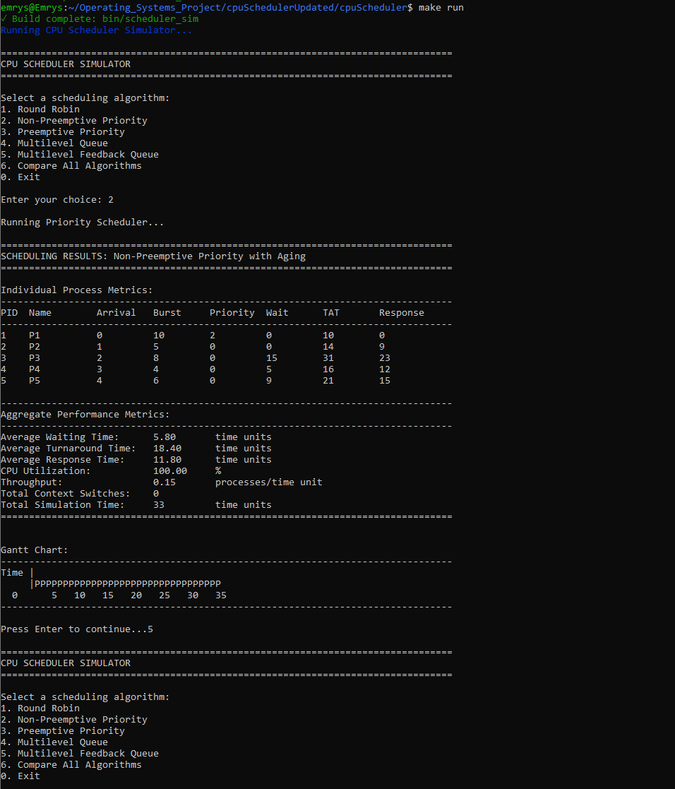
Non-Preemptive Priority Output
Section 4
S
CPU Scheduler Project • Academic Presentation

Slide 6
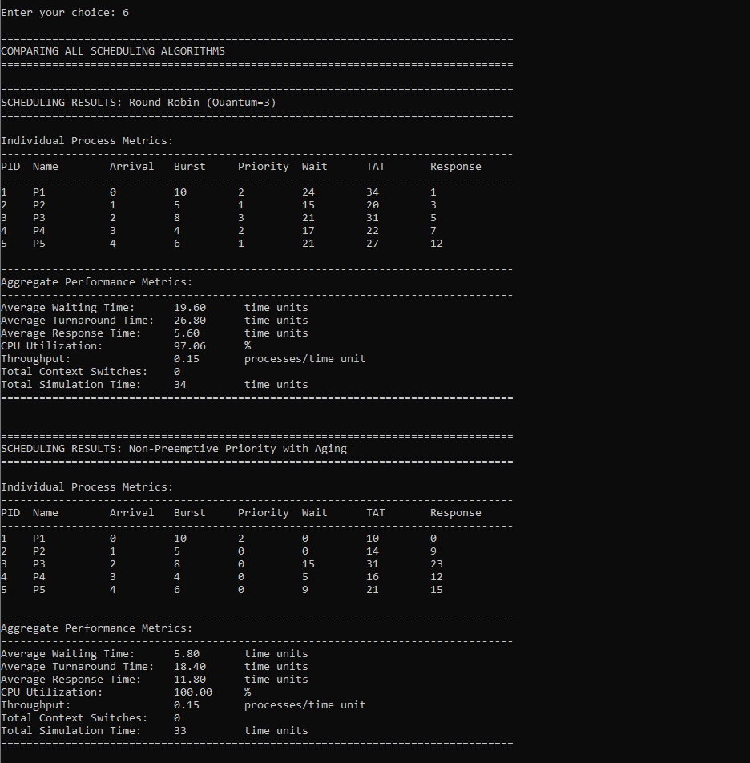
Algorithm Comparison 1
Section 5
S
CPU Scheduler Project • Academic Presentation

Slide 7
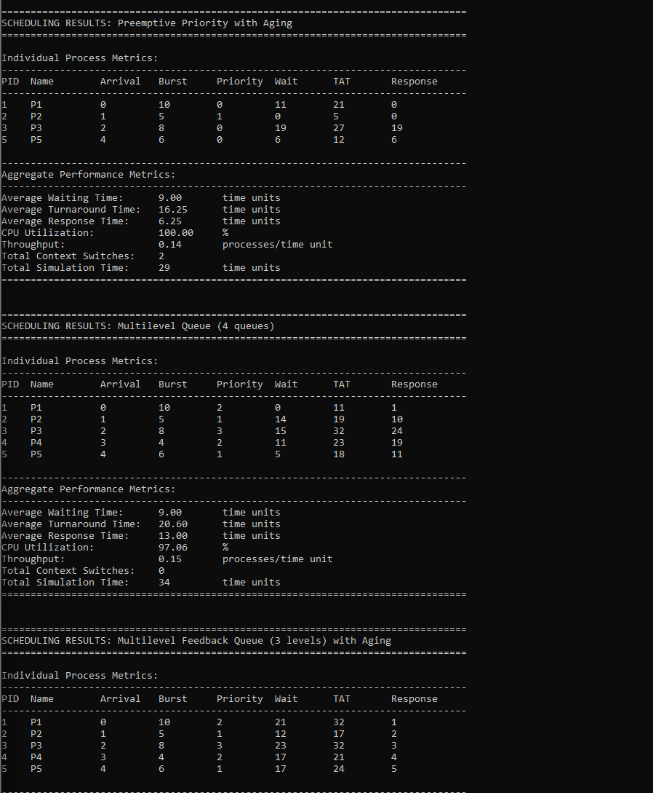
Algorithm Comparison 2
Section 6
S
CPU Scheduler Project • Academic Presentation

Slide 8
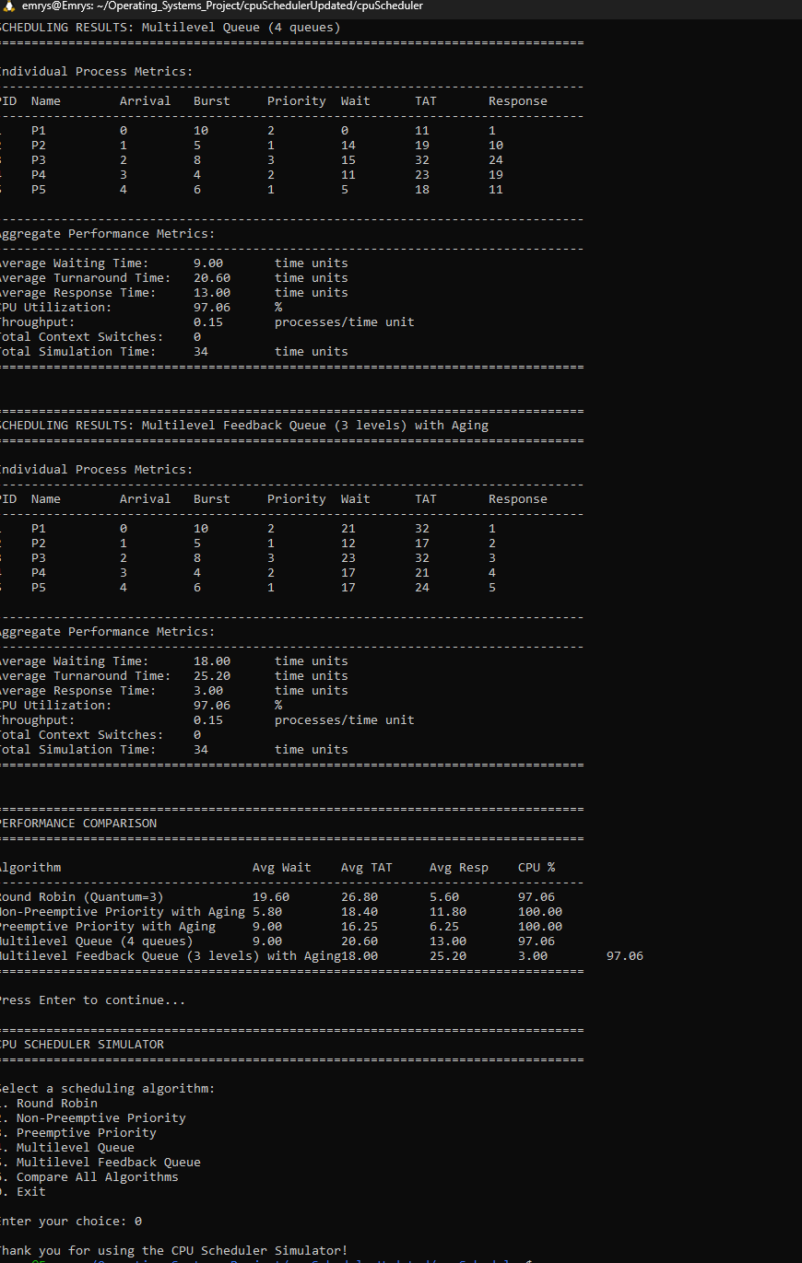
Algorithm Comparison 3
Section 7
S
CPU Scheduler Project • Academic Presentation

Slide 9
Conclusion
Section 8
S
This CPU Scheduler Project demonstrates the behavior and tradeoffs of multiple scheduling algorithms.
The included visuals illustrate performance variations between algorithms, highlighting
strengths and weaknesses relevant to real operating system scheduling.
CPU Scheduler Project • Academic Presentation

