Slide 1




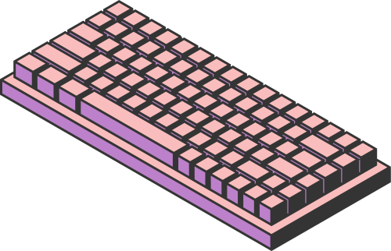
Andrea Morando - 4604844
Davide Miggiano - 4840761
CRIME MONITORING
IN LOS ANGELES
Page 01

Slide 2

DATASET
The data used in this project originates from two primary datasets provided by the City of Los Angeles. The first dataset covers crime incidents from 2020 to 2024, while the second contains the Police Stations position. These datasets were merged and cleaned to form a comprehensive and unified database.
The starting datasets were modified via Open Refine and Python scripts
Page 02

Slide 3
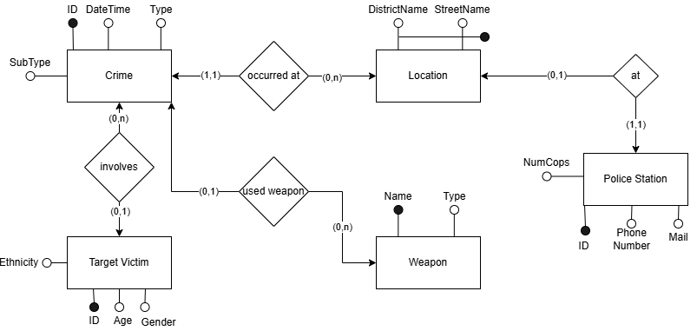
CONCEPTUAL SCHEMA
Page 03

Slide 4
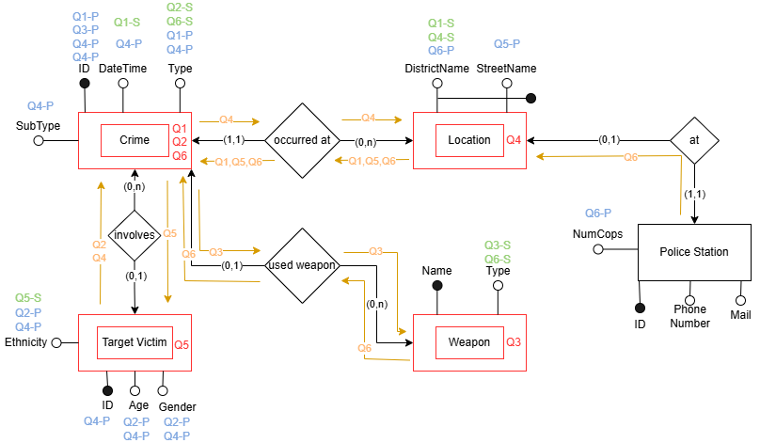
ANNOTATED SCHEMA
Page 04

Slide 5
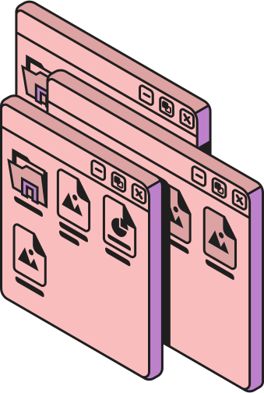
MONGODB
Document-Based
Stores data in JSON-like documents
Schema-flexible, supporting nested structures and dynamic fields.
Powerful indexing and query capabilities (e.g., aggregations, full-text search).
Supports horizontal scaling via sharding.
Ideal for applications requiring high read efficiency and complex queries.
Page 05

Slide 6


CASSANDRA
Column-Family
Uses a distributed, decentralized architecture (peer-to-peer model).
Designed for high availability and fault tolerance.
Optimized for write-heavy workloads with log-structured storage.
Uses partitioning and replication for scalability.
Favors eventual consistency over strong consistency for performance.
Page 06

Slide 7


NEO4J
Graph-based
Uses a node-edge model for representing relationships.
Supports ACID transactions with an optimized graph traversal engine.
Designed for highly connected data and complex relationship queries.
Uses index-free adjacency, ensuring fast lookups in deep relationships.
Shard/partition problem, due to how links will be navigated
Page 07

Slide 8

MODEL
SELECTION
OUR APPLICATION CHARACTERISTICS:
Predominantly read-intensive workloads.
High availability as a critical requirement.
Some consistency constraints, particularly for certain operations.
No need for batch processing.
Highly relational queries to address the interconnected nature of our data
MONGODB WAS DISCARDED FOR:
CASSANDRA WAS DISCARDED FOR:
Unintuitive Relationship Handling: MongoDB struggles with efficiently
managing highly relational queries. If the future workloads will include topological info MongoDB is not suitable for this kind of queries.
Rigid Schema Requirements: Cassandra requires denormalized tables tailored to specific queries, which conflicts with the dynamic and diverse query scenarios of our application.
Lack of Query Flexibility: Cassandra’s design is ill-suited for future workload changes, which are likely in the dynamic context of crime analysis.
Page 08

Slide 9

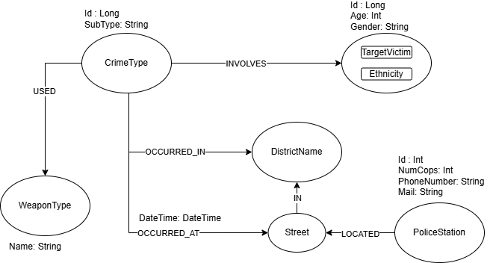
MODEL
SELECTION
OUR APPLICATION CHARACTERISTICS:
Predominantly read-intensive workloads.
High availability as a critical requirement.
Some consistency constraints, particularly for certain operations.
No need for batch processing.
Highly relational queries to address the interconnected nature of our data
NEO4J CONSIDERATIONS
Graph-Centric Model
Efficient Query Language
Directly Reflecting the Conceptual Schema
Optimized for Read-Intensive Workloads
Low Write-Workloads
Consistency Guarantees
CA-Oriented Design
Page 09

Slide 10
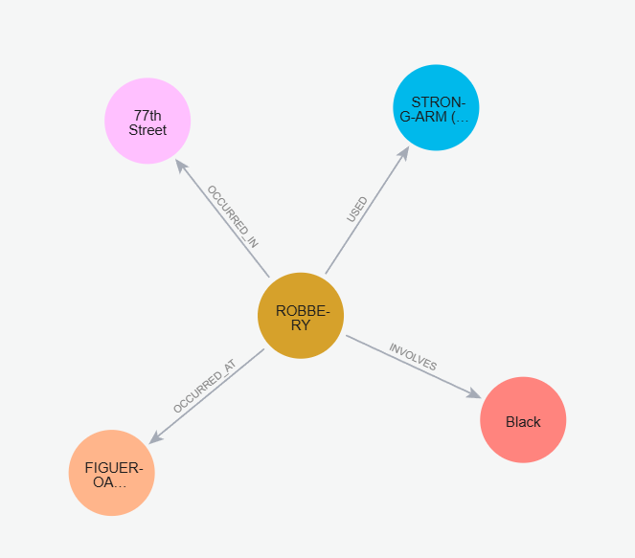
CHOSEN NEO4J
ARCHITECTURE
The labels assigned to the nodes in the Neo4j graph play a crucial role in query performance, reducing or even eliminating the need for additional indexing
Efficient Label-Based Lookups
Natural Graph Traversal Optimization
Low Cardinality of Labels
Pattern Matching Instead of Index-Based Queries
Graph Queries Favor Relationships Over Index Lookups
Page 10

Slide 11
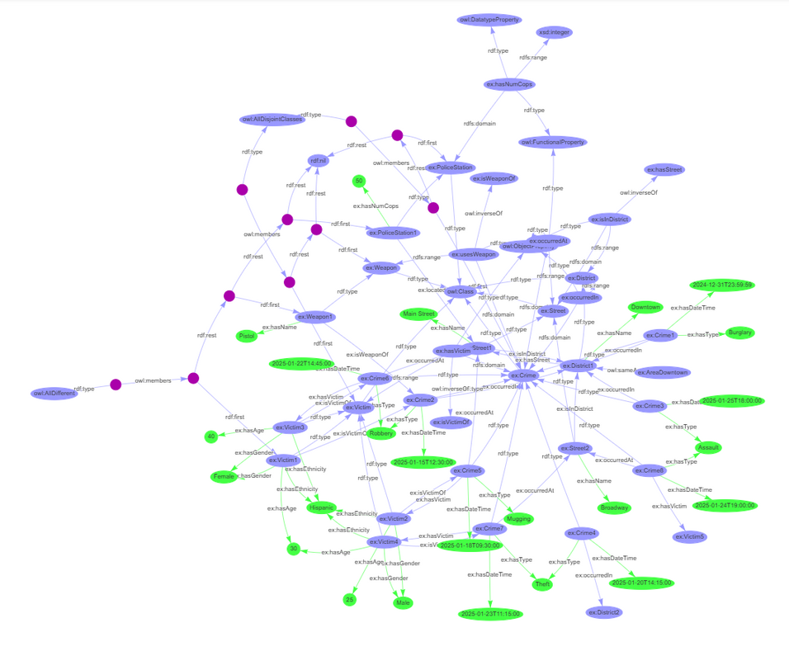

RDF/RDFS/OWL
The modeled classes and most of the property are derived directly from the label of the nodes and the type of the edge related to the implementation in Neo4J.
We have both property related to other resources (ex: occurredIn) and property related to literal (ex: HasAge)
Page 11

Slide 12

SPARQL
We implemented some workload query trying to use different constructors:
1) Find all crimes and their type that occurred in a given district and in a given time
interval (SELECT, FILTER)
2)Identify all victims of a specific crime type (CONSTRUCT)
3) Given an ethnicity, find all streets where that ethnicity has experienced crimes,
sorted by the number of crimes (SELECT, GROUP BY, ORDER BY, COUNT)
Page 12

