Slide 1


EXAMPLE-DEPENDENT COST-SENSITIVE CLASSIFICATION applications in financial risk modeling and marketing analytics September 15, 2015 Alejandro Correa Bahnsen with Djamila Aouada, SnT Björn Ottersten, SnT

Slide 2
Motivation
Classification: predicting the class of a set of examples given their features.
Standard classification methods aim at minimizing the errors
Such a traditional framework assumes that all misclassification errors carry the same cost
This is not the case in many real-world applications: Credit card fraud detection, churn modeling, credit scoring, direct marketing.

Slide 3
Motivation
Credit card fraud detection, failing to detect a fraudulent transaction may have an economical impact from a few to thousands of Euros, depending on the particular transaction and card holder.
Credit scoring, accepting loans from bad customers does not have the same economical loss, since customers have different credit lines, therefore, different profit.
Churn modeling, misidentifying a profitable or unprofitable churner has a significant different economic result.
Direct marketing, wrongly predicting that a customer will not accept an offer when in fact he will, may have different financial impact, as not all customers generate the same profit.

Slide 4
Agenda
Motivation
Cost-sensitive classification
Background
Real-world cost-sensitive applications
Credit card fraud detection, churn modeling, credit scoring, direct marketing
Proposed cost-sensitive algorithms
Bayes minimum risk, cost-sensitive logistic regression, cost-sensitive decision trees, ensembles of cost-sensitive decision trees
Experiments
Experimental setup, results
Conclusions
Contributions, future work

Slide 5
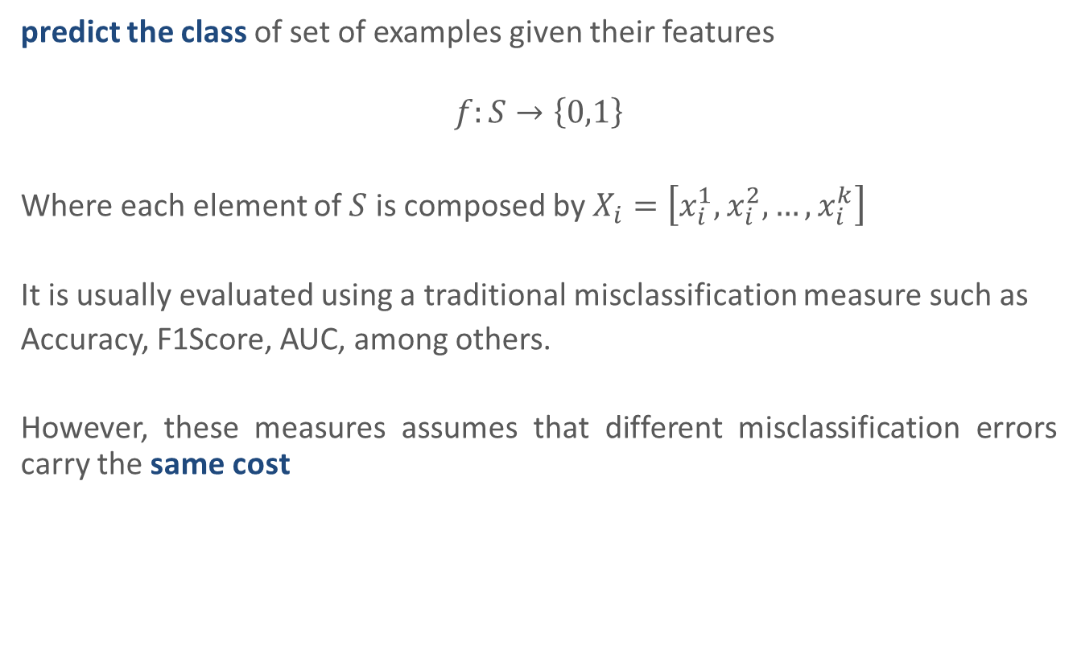
Background - Binary classification
predict the class of set of examples given their features
$$f:S→\left\{0,1\right\}$$
Where each element of $S$ is composed by $X_{i}=\left[x_{i}^{1},x_{i}^{2},…,x_{i}^{k}\right]$
It is usually evaluated using a traditional misclassification measure such as
Accuracy, F1Score, AUC, among others.
However, these measures assumes that different misclassification errors carry the same cost

Slide 6

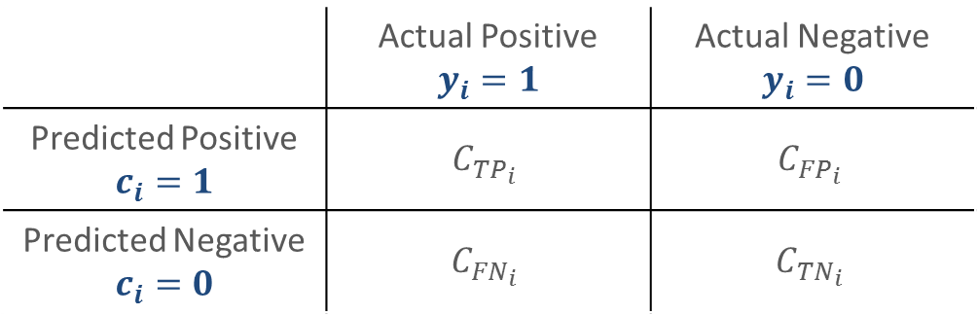
Background - Cost-sensitive evaluation
We define a cost measure based on the cost matrix [Elkan 2001]
From which we calculate the $Cost$of applying a classifier to a given set
$$Cost\left(f\left(S\right)\right)=\sum_{i=1}^{N}{y_{i}\left(c_{i}C_{{TP}_{i}}+\left(1−c_{i}\right)C_{{FN}_{i}}\right)+\left(1−y_{i}\right)\left(c_{i}C_{{FP}_{i}}+\left(1−c_{i}\right)C_{{TN}_{i}}\right)}$$
 | Actual Positive $$y_{i}=1$$ | Actual Negative $$y_{i}=0$$
Predicted Positive $$c_{i}=1$$ | $$C_{{TP}_{i}}$$ | $$C_{{FP}_{i}}$$
Predicted Negative $$c_{i}=0$$ | $$C_{{FN}_{i}}$$ | $$C_{{TN}_{i}}$$

Slide 7
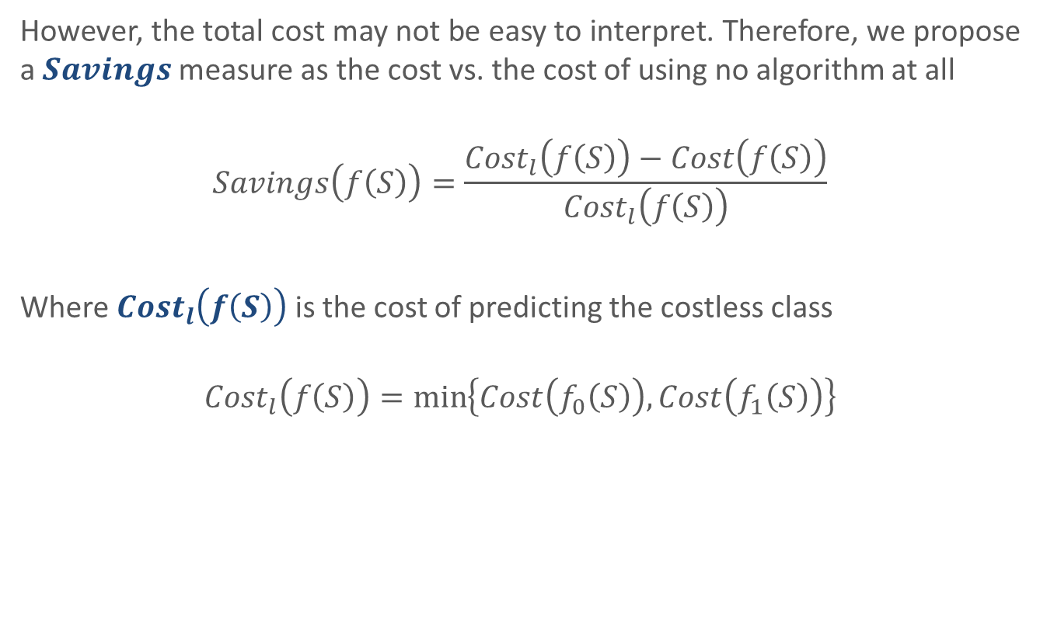
Background - Cost-sensitive evaluation
However, the total cost may not be easy to interpret. Therefore, we propose a $Savings$measure as the cost vs. the cost of using no algorithm at all
$$Savings\left(f\left(S\right)\right)=\frac{{Cost}_{l}\left(f\left(S\right)\right)−Cost\left(f\left(S\right)\right)}{{Cost}_{l}\left(f\left(S\right)\right)}$$
Where ${Cost}_{l}\left(f\left(S\right)\right)$ is the cost of predicting the costless class
$${Cost}_{l}\left(f\left(S\right)\right)=\min_{}\left\{Cost\left(f_{0}\left(S\right)\right),Cost\left(f_{1}\left(S\right)\right)\right\}$$

Slide 8
Background - State-of-the-art methods
Research in example-dependent cost-sensitive classification has been narrow, mostly because of the lack of publicly available datasets [Aodha and Brostow 2013].
Standard approaches consist in re-weighting the training examples based on their costs:
Cost-proportionate rejection sampling [Zadrozny et al. 2003]
Cost-proportionate oversampling [Elkan 2001]

Slide 9
Agenda
Motivation
Cost-sensitive classification
Background
Real-world cost-sensitive applications
Credit card fraud detection, churn modeling, credit scoring, direct marketing
Proposed cost-sensitive algorithms
Bayes minimum risk, cost-sensitive logistic regression, cost-sensitive decision trees, ensembles of cost-sensitive decision trees
Experiments
Experimental setup, results
Conclusions
Contributions, future work

Slide 10
Credit card fraud detection
Estimate the probability of a transaction being fraud based on analyzing customer patterns and recent fraudulent behavior
Issues when constructing a fraud detection system [Bolton et al., 2002]:
Skewness of the data
Cost-sensitivity
Short time response of the system
Dimensionality of the search space
Feature preprocessing

Slide 11
Credit card fraud detection
Credit card fraud detection is a cost-sensitive problem. As the cost due to a false positive is different than the cost of a false negative.
False positives: When predicting a transaction as fraudulent, when in fact it is not a fraud, there is an administrative cost that is incurred by the financial institution.
False negatives: Failing to detect a fraud, the amount of that transaction is lost.
Moreover, it is not enough to assume a constant cost difference between false positives and false negatives, as the amount of the transactions varies quite significantly.

Slide 12
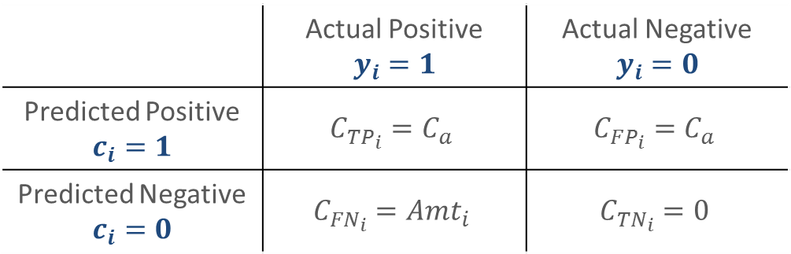
Credit card fraud detection
Cost matrix
A. Correa Bahnsen, A. Stojanovic, D. Aouada, and B. Ottersten, “Cost Sensitive Credit Card Fraud Detection Using Bayes Minimum Risk,” in 2013 12th International Conference on Machine Learning and Applications. Miami, USA: IEEE, Dec. 2013, pp. 333–338.
 | Actual Positive $$y_{i}=1$$ | Actual Negative $$y_{i}=0$$
Predicted Positive $$c_{i}=1$$ | $$C_{{TP}_{i}}=C_{a}$$ | $$C_{{FP}_{i}}=C_{a}$$
Predicted Negative $$c_{i}=0$$ | $$C_{{FN}_{i}}={Amt}_{i}$$ | $$C_{{TN}_{i}}=0$$

Slide 13
Credit card fraud detection
Raw features
Attribute | name Description
Transaction ID | Transaction identification number
Time | Date and time of the transaction
Account number | Identification number of the customer
Card number | Identification of the credit card
Transaction type | ie. Internet, ATM, POS, ...
Entry mode | ie. Chip and pin, magnetic stripe, ...
Amount | Amount of the transaction in Euros
Merchant code | Identification of the merchant type
Merchant group | Merchant group identification
Country | Country of trx
Country 2 | Country of residence
Type of card | ie. Visa debit, Mastercard, American Express...
Gender | Gender of the card holder
Age | Card holder age
Bank Issuer | bank of the card

Slide 14
Credit card fraud detection
Transaction aggregation strategy [Whitrow, 2008]
Raw Features
TrxId | Time | Type | Country | Amt
1 | 1/1 18:20 | POS | Lux | 250
2 | 1/1 20:35 | POS | Lux | 400
3 | 1/1 22:30 | ATM | Lux | 250
4 | 2/1 00:50 | POS | Ger | 50
5 | 2/1 19:18 | POS | Ger | 100
6 | 2/1 23:45 | POS | Ger | 150
7 | 3/1 06:00 | POS | Lux | 10
Aggregated Features
No Trx last 24h | Amt last 24h | No Trx last 24h same type and country | Amt last 24h same type and country
0 | 0 | 0 | 0
1 | 250 | 1 | 250
2 | 650 | 0 | 0
3 | 900 | 0 | 0
3 | 700 | 1 | 50
2 | 150 | 2 | 150
3 | 400 | 0 | 0

Slide 15
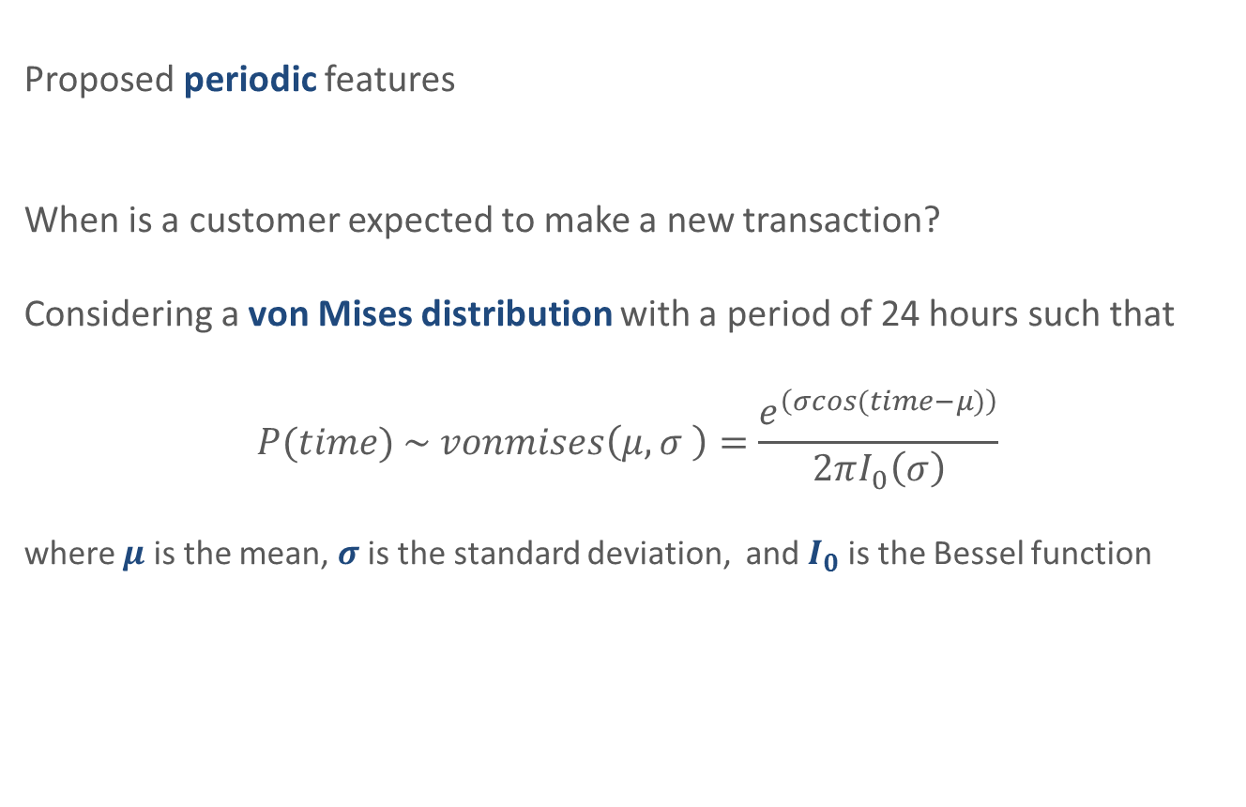
Credit card fraud detection
Proposed periodic features
When is a customer expected to make a new transaction?
Considering a von Mises distribution with a period of 24 hours such that
$$P(time) \sim vonmises\left(μ,σ \right)=\frac{e^{\left(σcos(time−μ)\right)}}{2πI_{0}\left(σ\right)}$$
where $μ$ is the mean, $σ$ is the standard deviation, and $I_{0}$ is the Bessel function

Slide 16
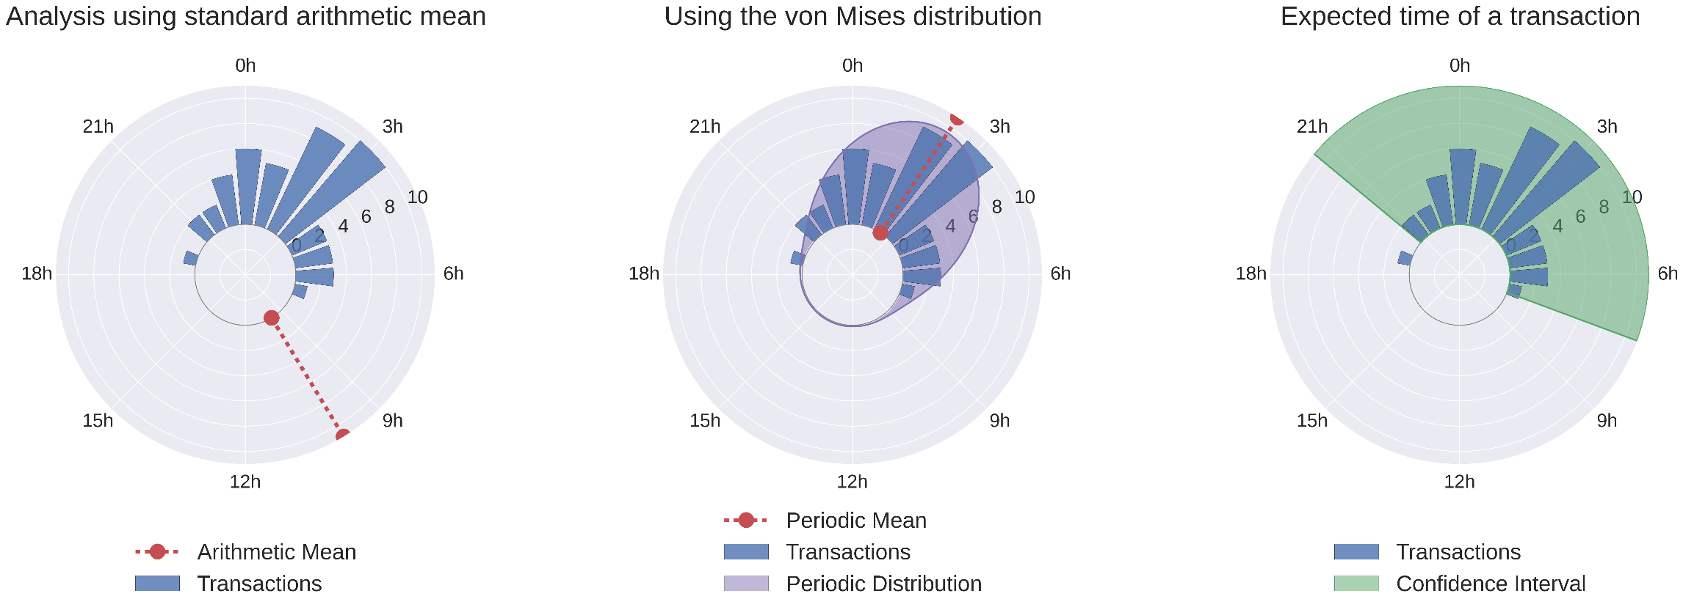
Credit card fraud detection
Proposed periodic features
A. Correa Bahnsen, A. Stojanovic, D. Aouada, and B. Ottersten, “Feature Engineering Strategies for Credit Card Fraud Detection” submitted to Expert Systems with Applications.

Slide 17
Credit scoring
Classify which potential customers are likely to default a contracted financial obligation based on the customer’s past financial experience.
It is a cost-sensitive problem as the cost associated with approving a bad customer, i.e., false negative, is quite different from the cost associated with declining a good customer, i.e., false positive. Furthermore, the costs are not constant among customers. This is because loans have different credit line amounts, terms, and even interest rates.

Slide 18
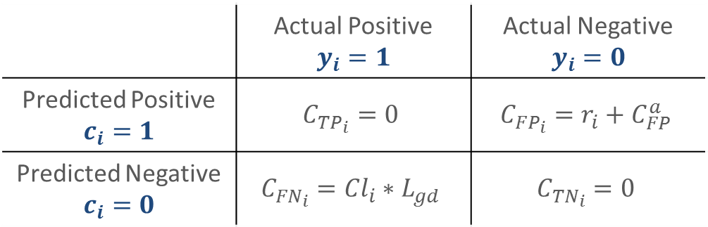
Credit scoring
Cost matrix
A. Correa Bahnsen, D. Aouada, and B. Ottersten, “Example-Dependent Cost-Sensitive Logistic Regression for Credit Scoring,” in 2014 13th International Conference on Machine Learning and Applications. Detroit, USA: IEEE, 2014, pp. 263–269.
 | Actual Positive $$y_{i}=1$$ | Actual Negative $$y_{i}=0$$
Predicted Positive $$c_{i}=1$$ | $$C_{{TP}_{i}}=0$$ | $$C_{{FP}_{i}}=r_{i}+C_{FP}^{a}$$
Predicted Negative $$c_{i}=0$$ | $$C_{{FN}_{i}}={Cl}_{i}∗L_{gd}$$ | $$C_{{TN}_{i}}=0$$

Slide 19
Churn modeling
Predict the probability of a customer defecting using historical, behavioral and socioeconomical information.
This tool is of great benefit to subscription based companies allowing them to maximize the results of retention campaigns.

Slide 20


Churn modeling
Churn management campaign [Verbraken, 2013]
Churn Model Prediction
Customer Base
Predicted Churners
Predicted Non-Churners
Active Customers
$$γ$$
TP: Actual Churners
$$1−γ$$
FP: Actual Non-Churners
Inflow
Outflow
New Customers
1
Effective Churners
FN: Actual Churners
1
1
TN: Actual Non-Churners

Slide 21





Churn modeling
Financial evaluation of a churn campaign
A. Correa Bahnsen, A. Stojanovic, D. Aouada, and B. Ottersten, “A novel cost-sensitive
framework for customer churn predictive modeling,” Decision Analytics, vol. 2:5, 2015.
Churn Model Prediction
Customer Base
Predicted Churners
Predicted Non-Churners
Active Customers
$$C_{o}+C_{a}$$
TP: Actual Churners
$$CLV+C_{a}$$
FP: Actual Non-Churners
Inflow
Outflow
New Customers
$$C_{o}+C_{a}$$
Effective Churners
FN: Actual Churners
$$CLV$$
$$0$$
TN: Actual Non-Churners

Slide 22
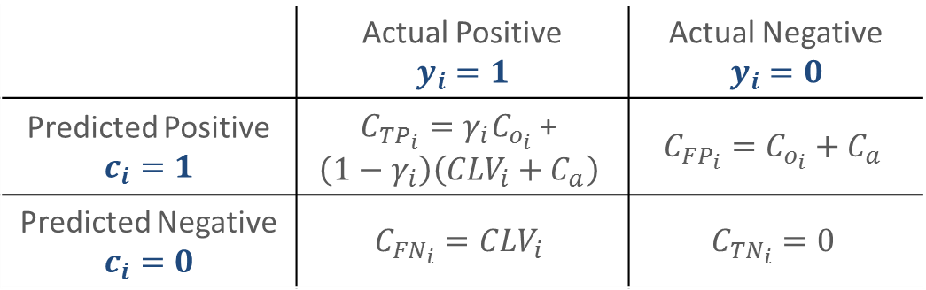
Churn modeling
Cost matrix
A. Correa Bahnsen, A. Stojanovic, D. Aouada, and B. Ottersten, “A novel cost-sensitive
framework for customer churn predictive modeling,” Decision Analytics, vol. 2:5, 2015.
 | Actual Positive $$y_{i}=1$$ | Actual Negative $$y_{i}=0$$
Predicted Positive $$c_{i}=1$$ | $C_{{TP}_{i}}=γ_{i}C_{o_{i}}$ + $$\left(1−γ_{i}\right)\left({CLV}_{i}+C_{a}\right)$$ | $$C_{{FP}_{i}}=C_{o_{i}}+C_{a}$$
Predicted Negative $$c_{i}=0$$ | $$C_{{FN}_{i}}={CLV}_{i}$$ | $$C_{{TN}_{i}}=0$$

Slide 23
Direct marketing
Classify those customers who are more likely to have a certain response to a marketing campaign.
This problem is example-dependent cost sensitive, as the false positives have the cost of contacting the client, and false negatives have the cost due to the loss of income by failing to making the an offer to the right customer.

Slide 24
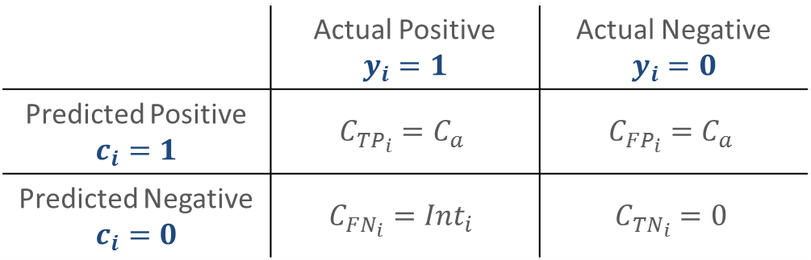
Direct marketing
Cost matrix
A. Correa Bahnsen, A. Stojanovic, D. Aouada, and B. Ottersten, “Improving Credit Card Fraud Detection with Calibrated Probabilities,” in Proceedings of the fourteenth SIAM International Conference on Data Mining, Philadelphia, USA, 2014, pp. 677 – 685.
 | Actual Positive $$y_{i}=1$$ | Actual Negative $$y_{i}=0$$
Predicted Positive $$c_{i}=1$$ | $$C_{{TP}_{i}}=C_{a}$$ | $$C_{{FP}_{i}}=C_{a}$$
Predicted Negative $$c_{i}=0$$ | $$C_{{FN}_{i}}={Int}_{i}$$ | $$C_{{TN}_{i}}=0$$

Slide 25
Agenda
Motivation
Cost-sensitive classification
Background
Real-world cost-sensitive applications
Credit card fraud detection, churn modeling, credit scoring, direct marketing
Proposed cost-sensitive algorithms
Bayes minimum risk, cost-sensitive logistic regression, cost-sensitive decision trees, ensembles of cost-sensitive decision trees
Experiments
Experimental setup, results
Conclusions
Contributions, future work

Slide 26
Proposed cost-sensitive algorithms
Bayes minimum risk
A. Correa Bahnsen, A. Stojanovic, D. Aouada, and B. Ottersten, “Cost Sensitive Credit Card Fraud Detection Using Bayes Minimum Risk,” in 2013 12th International Conference on Machine Learning and Applications. Miami, USA: IEEE, Dec. 2013, pp. 333–338.
Probability calibration for Bayes minimum risk (BMR)
A. Correa Bahnsen, A. Stojanovic, D. Aouada, and B. Ottersten, “Improving Credit Card Fraud Detection with Calibrated Probabilities,” in Proceedings of the fourteenth SIAM International Conference on Data Mining, Philadelphia, USA, 2014, pp. 677 – 685.
Cost-sensitive logistic regression (CSLR)
A. Correa Bahnsen, D. Aouada, and B. Ottersten, “Example-Dependent Cost-Sensitive Logistic Regression for Credit Scoring,” in 2014 13th International Conference on Machine Learning and Applications. Detroit, USA: IEEE, 2014, pp. 263–269.
Cost-sensitive decision trees (CSDT)
A. Correa Bahnsen, D. Aouada, and B. Ottersten, “Example-Dependent Cost-Sensitive Decision Trees,” Expert Systems with Applications, vol. 42:19, 2015.
Ensembles of cost-sensitive decision trees (ECSDT)
A. Correa Bahnsen, D. Aouada, and B. Ottersten, “Ensemble of Example-Dependent Cost-Sensitive Decision Trees,” IEEE Transactions on Knowledge and Data Engineering, vol. under review, 2015.

Slide 27
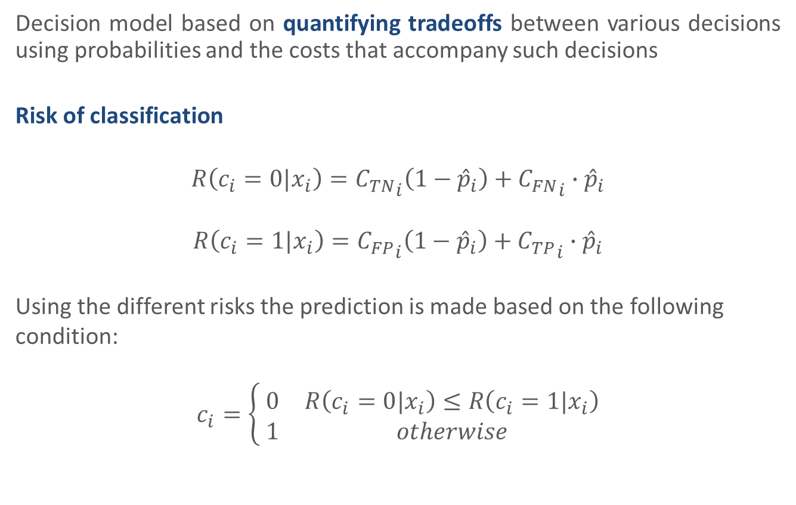
Bayes Minimum Risk
Decision model based on quantifying tradeoffs between various decisions using probabilities and the costs that accompany such decisions
Risk of classification
$$R\left(c_{i}=0|x_{i}\right)={C_{TN}}_{i}\left(1−{\hat{p}}_{i}\right)+{C_{FN}}_{i}∙{\hat{p}}_{i}$$
$$R\left(c_{i}=1|x_{i}\right)={C_{FP}}_{i}\left(1−{\hat{p}}_{i}\right)+{C_{TP}}_{i}∙{\hat{p}}_{i}$$
Using the different risks the prediction is made based on the following condition:
$$c_{i}=\left\{\begin{matrix} 0 & R\left(c_{i}=0|x_{i}\right)≤R\left(c_{i}=1|x_{i}\right) \\ 1 & otherwise\end{matrix}\right.$$

Slide 28
Probability Calibration
When using the output of a binary classifier as a basis for decision making, there is a need for a probability that not only separates well between positive and negative examples, but that also assesses the real probability of the event [Cohen and Goldszmidt 2004]
is the positive rate and
is the predicted probability

Slide 29
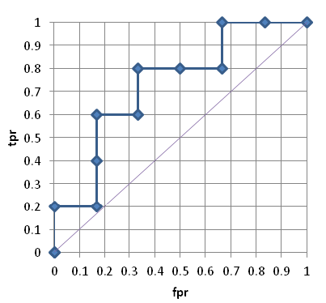
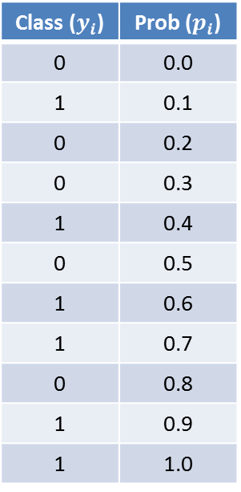
Probability Calibration
ROC Convex Hull calibration [Hernandez-Orallo et al. 2012]
Class ($y_{i}$) | Prob ($p_{i}$)
0 | 0.0
1 | 0.1
0 | 0.2
0 | 0.3
1 | 0.4
0 | 0.5
1 | 0.6
1 | 0.7
0 | 0.8
1 | 0.9
1 | 1.0
ROC Curve

Slide 30
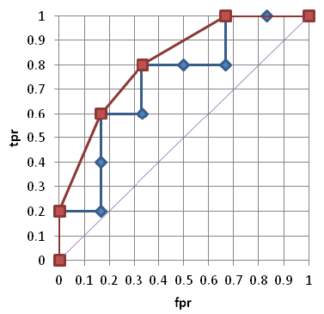
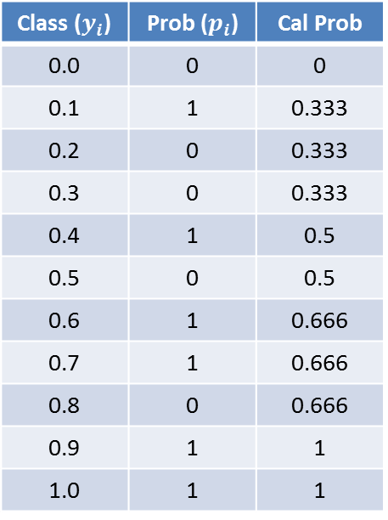
Probability Calibration
ROC Convex Hull calibration
Class ($y_{i}$) | Prob ($p_{i}$) | Cal Prob
0.0 | 0 | 0
0.1 | 1 | 0.333
0.2 | 0 | 0.333
0.3 | 0 | 0.333
0.4 | 1 | 0.5
0.5 | 0 | 0.5
0.6 | 1 | 0.666
0.7 | 1 | 0.666
0.8 | 0 | 0.666
0.9 | 1 | 1
1.0 | 1 | 1
ROC Convex Hull Curve
the calibrated probabilities are extracted by first grouping the probabilities according to the points in the ROCCH curve, and then the calibrated probabilities are equal to the slope for each group.

Slide 31
Probability Calibration
Calibrated probabilities

Slide 32
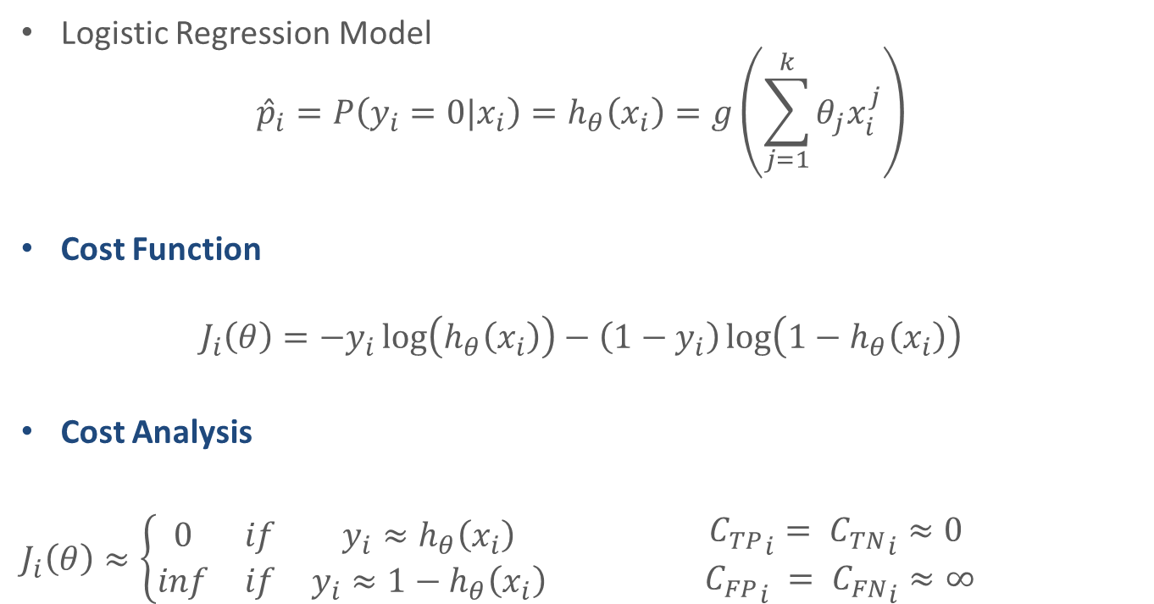
Cost-Sensitive Logistic Regression
Logistic Regression Model
$${\hat{p}}_{i}=P\left(y_{i}=0|x_{i}\right)=h_{θ}\left(x_{i}\right)=g\left(\sum_{j=1}^{k}{θ_{j}x_{i}^{j}}\right)$$
Cost Function
$$J_{i}\left(θ\right)=−y_{i}\log\left(h_{θ}\left(x_{i}\right)\right)−\left(1−y_{i}\right)\log\left(1−h_{θ}\left(x_{i}\right)\right)$$
Cost Analysis
$J_{i}\left(θ\right)≈\left\{\begin{matrix}0 & if & y_{i}≈h_{θ}\left(x_{i}\right) \\ inf & if & y_{i}≈1−h_{θ}\left(x_{i}\right)\end{matrix}\right.$ $\begin{matrix}{{ C}_{TP}}_{i}={{ C}_{TN}}_{i}≈0 \\ {{ C}_{FP}}_{i} ={{ C}_{FN}}_{i}≈∞\end{matrix}$

Slide 33
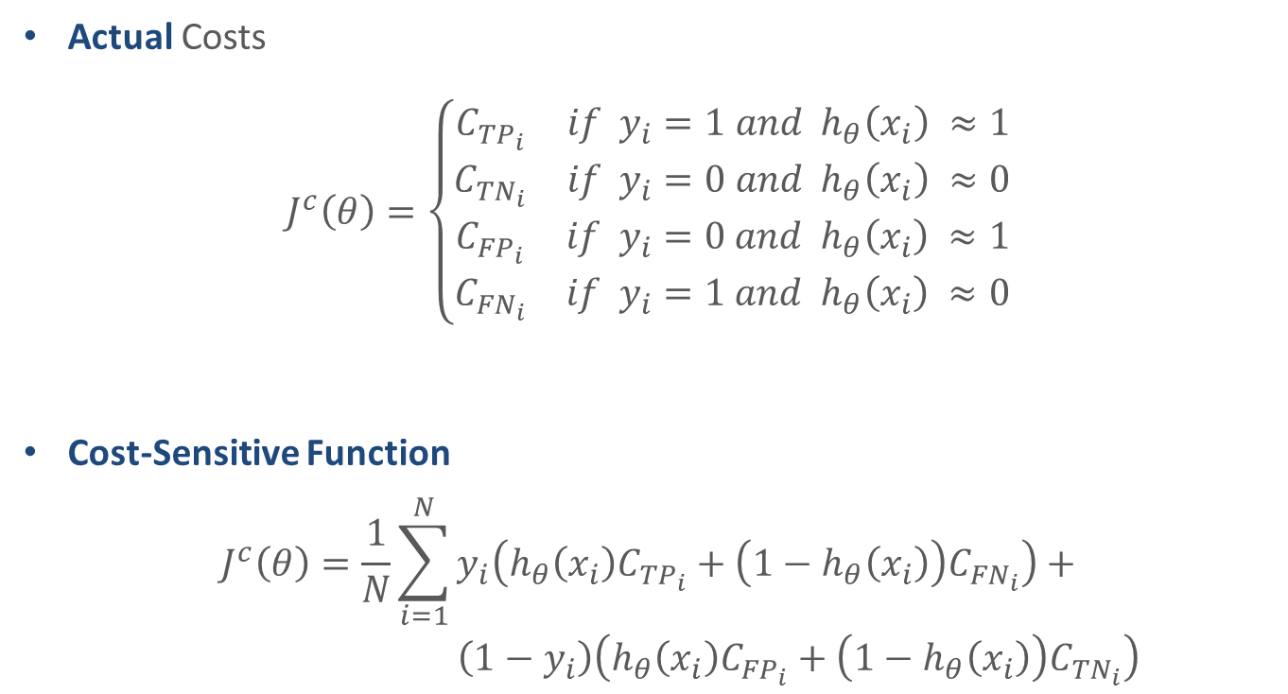
Cost-Sensitive Logistic Regression
Actual Costs
$$J^{c}\left(θ\right)=\left\{\begin{matrix}\begin{matrix}C_{{TP}_{i}} & if{ y}_{i}=1 and h_{θ}\left(x_{i}\right) ≈1 \\ C_{{TN}_{i}} & if{ y}_{i}=0 and h_{θ}\left(x_{i}\right) ≈0\end{matrix} \\ \begin{matrix}C_{{FP}_{i}} & if{ y}_{i}=0 and h_{θ}\left(x_{i}\right) ≈1 \\ C_{{FN}_{i}} & if{ y}_{i}=1 and h_{θ}\left(x_{i}\right) ≈0\end{matrix}\end{matrix}\right.$$
Cost-Sensitive Function
$$J^{c}\left(θ\right)=\frac{1}{N}\sum_{i=1}^{N}{y_{i}\left(h_{θ}\left(x_{i}\right)C_{{TP}_{i}}+\left(1−h_{θ}\left(x_{i}\right)\right)C_{{FN}_{i}}\right)+}$$
$\left(1−y_{i}\right)\left(h_{θ}\left(x_{i}\right)C_{{FP}_{i}}+\left(1−h_{θ}\left(x_{i}\right)\right)C_{{TN}_{i}}\right)$

Slide 34
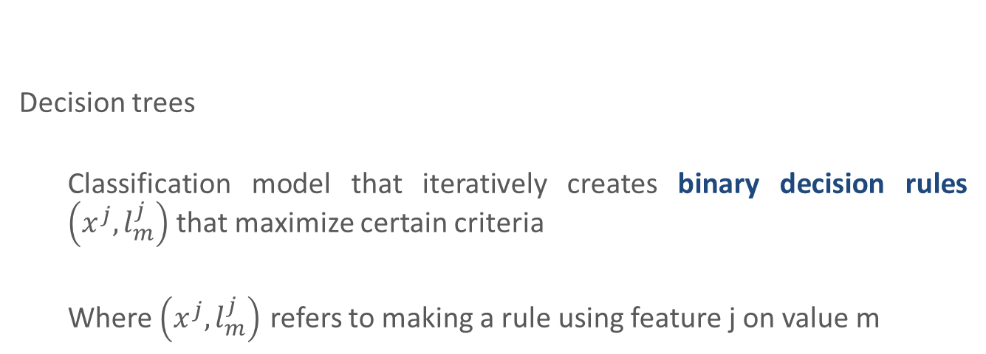
Cost-Sensitive Decision trees
Decision trees
Classification model that iteratively creates binary decision rules $\left(x^{j},l_{m}^{j}\right)$ that maximize certain criteria
Where $\left(x^{j},l_{m}^{j}\right)$ refers to making a rule using feature j on value m

Slide 35
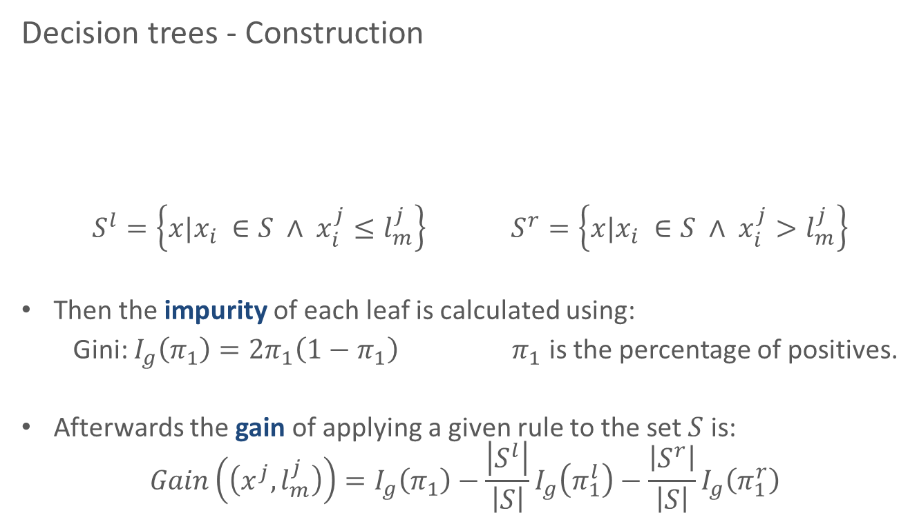

Cost-Sensitive Decision trees
Decision trees - Construction
$S^{l}=\left\{x|x_{i} ∈S ∧ x_{i}^{j}≤l_{m}^{j}\right\}$ $S^{r}=\left\{x|x_{i} ∈S ∧ x_{i}^{j}>l_{m}^{j}\right\}$
Then the impurity of each leaf is calculated using:
Gini: $I_{g}\left(π_{1}\right)=2π_{1}\left(1−π_{1}\right) π_{1}$ is the percentage of positives.
Afterwards the gain of applying a given rule to the set $S$ is:
$$Gain\left(\left(x^{j},l_{m}^{j}\right)\right)=I_{g}\left(π_{1}\right)−\frac{\left|S^{l}\right|}{\left|S\right|}I_{g}\left(π_{1}^{l}\right)−\frac{\left|S^{r}\right|}{\left|S\right|}I_{g}\left(π_{1}^{r}\right)$$
S
$$\left(x^{j},l_{m}^{j}\right)$$
S
S

Slide 36
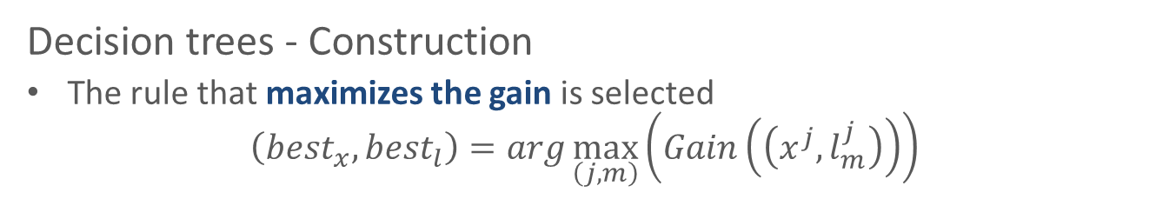
Cost-Sensitive Decision trees
Decision trees - Construction
The rule that maximizes the gain is selected
$$\left({best}_{x},{best}_{l}\right)=arg\max_{\left(j,m\right)}\left(Gain\left(\left(x^{j},l_{m}^{j}\right)\right)\right)$$
The process is repeated until a stopping criteria is met:
S
S
S
S
S
S
S
S
S
S
S

Slide 37
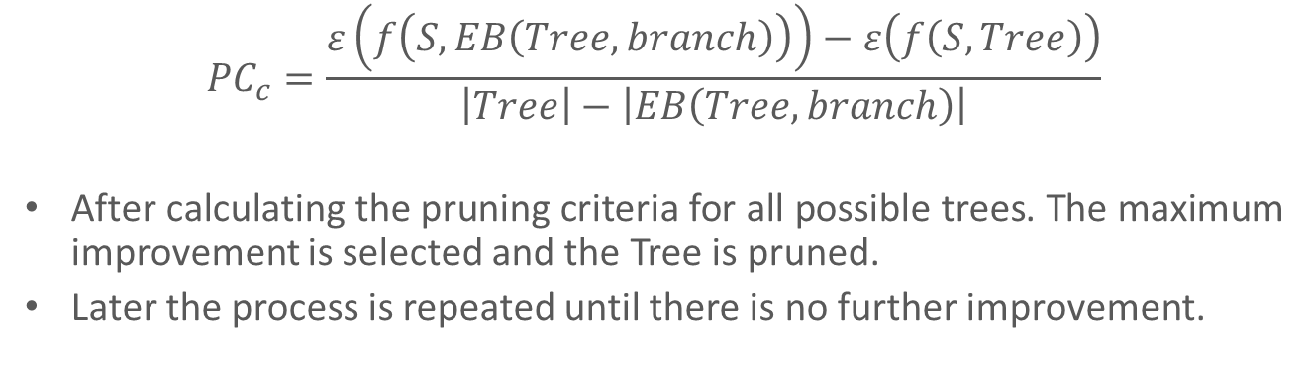
Cost-Sensitive Decision trees
Decision trees - Pruning
Calculation of the Tree error and pruned Tree error
S
S
S
S
S
S
S
S
S
S
S
S
S
S
S
S
S
S
S
S
S
S
S
S
S
$${PC}_{c}=\frac{ε\left(f\left(S,EB\left(Tree,branch\right)\right)\right)−ε\left(f\left(S,Tree\right)\right)}{\left|Tree\right|−\left|EB\left(Tree,branch\right)\right|}$$
After calculating the pruning criteria for all possible trees. The maximum improvement is selected and the Tree is pruned.
Later the process is repeated until there is no further improvement.

Slide 38
Cost-Sensitive Decision trees
Maximize the accuracy is different than maximizing the cost.
To solve this, some studies had been proposed method that aim to introduce the cost-sensitivity into the algorithms [Lomax 2013].
However, research have been focused on class-dependent methods [Draper et al. 1994; Ting 2002; Ling et al. 2004; Li et al. 2005; Kretowski and Grzes 2006; Vadera 2010]
We proposed:
Example-dependent cost based impurity measure
Example-dependent cost based pruning criteria

Slide 39
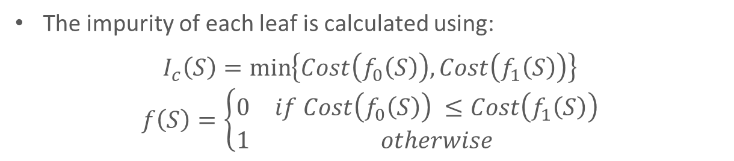
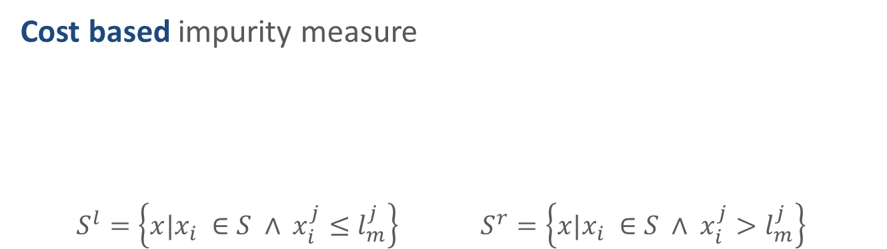
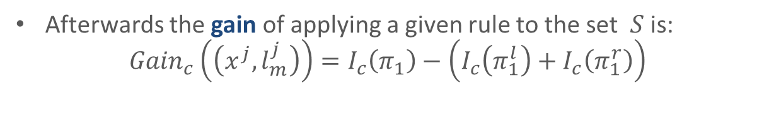
Cost-Sensitive Decision trees
Cost based impurity measure
$S^{l}=\left\{x|x_{i} ∈S ∧ x_{i}^{j}≤l_{m}^{j}\right\}$ $S^{r}=\left\{x|x_{i} ∈S ∧ x_{i}^{j}>l_{m}^{j}\right\}$
S
$$\left(x^{j},l_{m}^{j}\right)$$
S
S
The impurity of each leaf is calculated using:
$$I_{c}\left(S\right)=\min_{}\left\{Cost\left(f_{0}\left(S\right)\right),Cost\left(f_{1}\left(S\right)\right)\right\}$$
$$f\left(S\right)=\left\{\begin{matrix}0 & if Cost\left(f_{0}\left(S\right)\right) ≤Cost\left(f_{1}\left(S\right)\right) \\ 1 & otherwise\end{matrix}\right.$$
Afterwards the gain of applying a given rule to the set $S$ is:
$${Gain}_{c}\left(\left(x^{j},l_{m}^{j}\right)\right)=I_{c}\left(π_{1}\right)−\left(I_{c}\left(π_{1}^{l}\right)+I_{c}\left(π_{1}^{r}\right)\right)$$

Slide 40
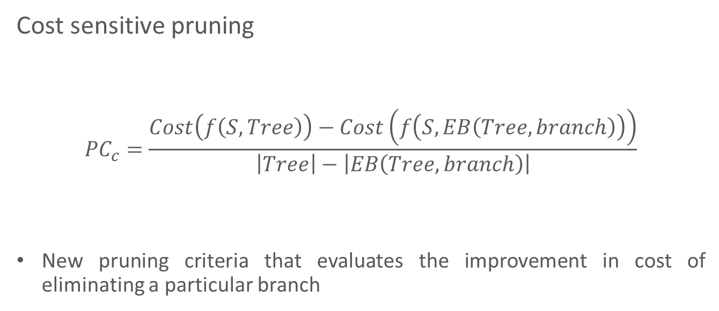
Cost-Sensitive Decision trees
Cost sensitive pruning
$${PC}_{c}=\frac{Cost\left(f\left(S,Tree\right)\right)−Cost\left(f\left(S,EB\left(Tree,branch\right)\right)\right)}{\left|Tree\right|−\left|EB\left(Tree,branch\right)\right|}$$
New pruning criteria that evaluates the improvement in cost of eliminating a particular branch

Slide 41

Ensembles of Cost-Sensitive Decision trees
Typical ensemble is made by combining T different base classifiers. Each base classifiers is trained by applying algorithm M in a random subset
$M_{j}←M\left(S_{j}\right) ∀_{j} ∈ \left\{1,…,T\right\}$

Slide 42
Ensembles of Cost-Sensitive Decision trees
The core principle in ensemble learning, is to induce random perturbations into the learning procedure in order to produce several different base classifiers from a single training set, then combining the base classifiers in order to make the final prediction.

Slide 43
Ensembles of Cost-Sensitive Decision trees
Training set
1
2
3
4
5
6
7
8
Bagging
Pasting
Random forest
Random patches
8
7
1
9
6
1
5
4
2
2
8
6
5
3
1
1
2
8
4
1
4
3
2
6
1
1
1
1
5
5
5
8
8
8
1
1
1
4
4
4
4
4
4
2
2
2
1
1
1

Slide 44
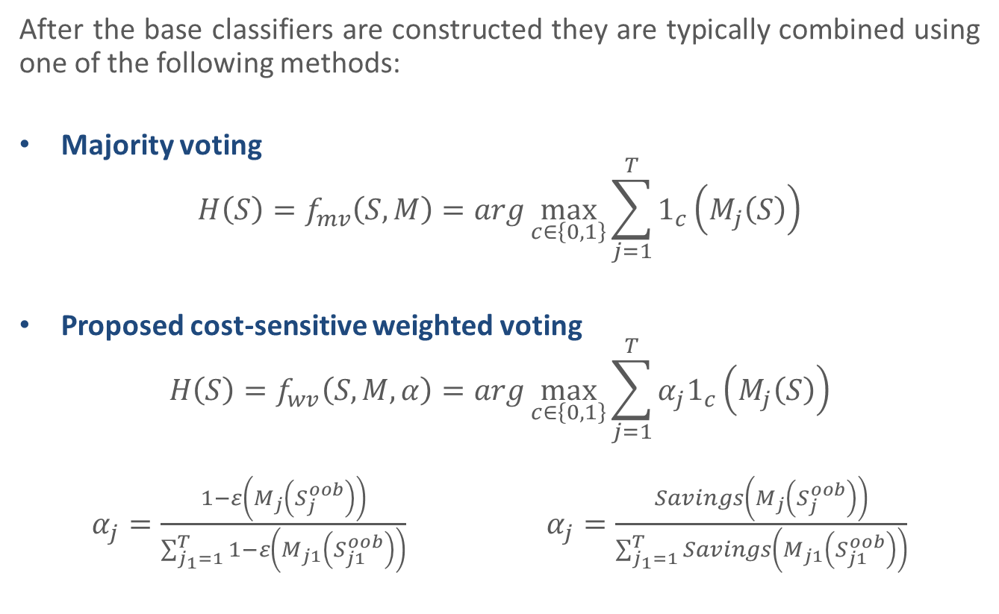
Ensembles of Cost-Sensitive Decision trees
After the base classifiers are constructed they are typically combined using one of the following methods:
Majority voting
$$H\left(S\right)=f_{mv}\left(S,M\right)=arg\max_{c∈\left\{0,1\right\}}{\sum_{j=1}^{T}{1_{c}\left(M_{j}\left(S\right)\right)}}$$
Proposed cost-sensitive weighted voting
$$H\left(S\right)=f_{wv}\left(S,M,α\right)=arg\max_{c∈\left\{0,1\right\}}{\sum_{j=1}^{T}{α_{j}1_{c}\left(M_{j}\left(S\right)\right)}}$$
$α_{j}=\frac{1−ε\left(M_{j}\left(S_{j}^{oob}\right)\right)}{\sum_{j_{1}=1}^{T}{1−ε\left(M_{j1}\left(S_{j1}^{oob}\right)\right)}}$ $α_{j}=\frac{Savings\left(M_{j}\left(S_{j}^{oob}\right)\right)}{\sum_{j_{1}=1}^{T}{Savings\left(M_{j1}\left(S_{j1}^{oob}\right)\right)}}$

Slide 45
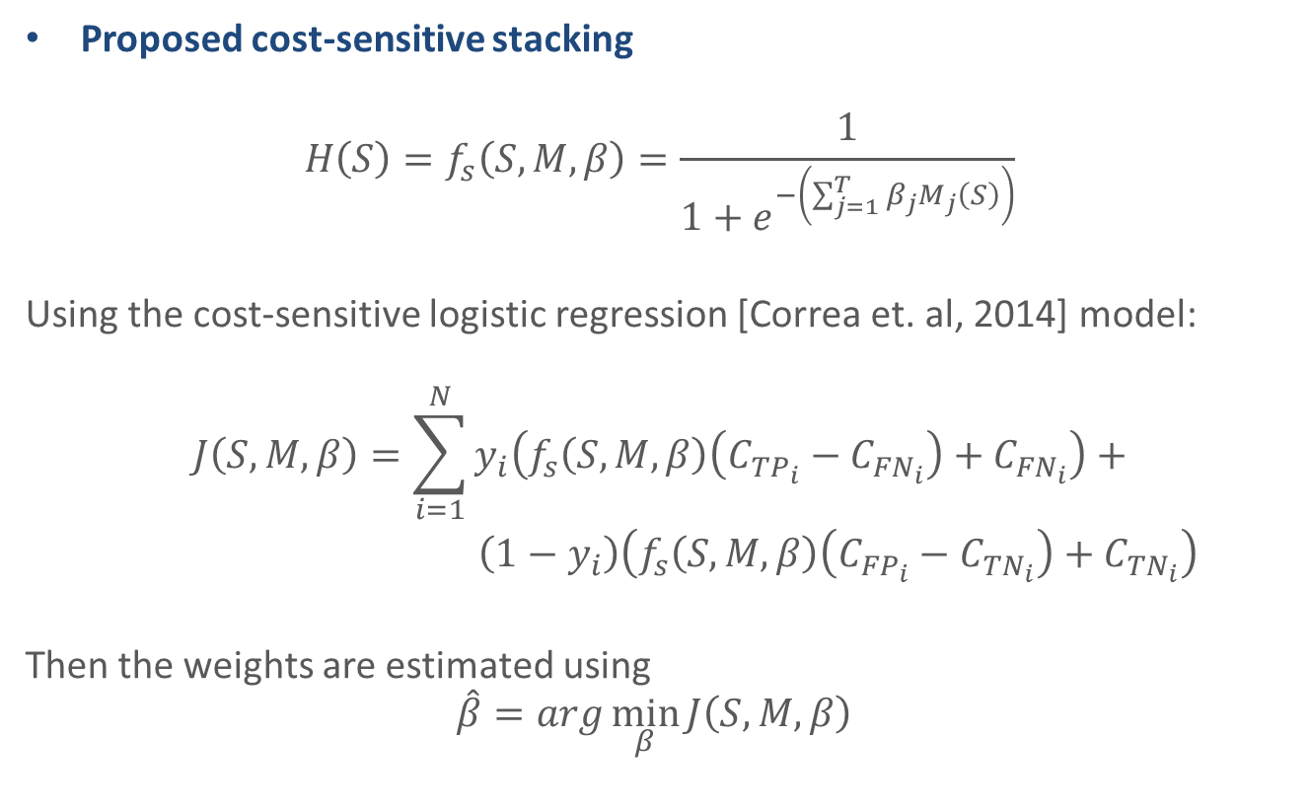
Ensembles of Cost-Sensitive Decision trees
Proposed cost-sensitive stacking
$$H\left(S\right)=f_{s}\left(S,M,β\right)=\frac{1}{1+e^{−\left(\sum_{j=1}^{T}{β_{j}}M_{j}\left(S\right)\right)}}$$
Using the cost-sensitive logistic regression [Correa et. al, 2014] model:
$$J\left(S,M,β\right)=\sum_{i=1}^{N}{y_{i}\left(f_{s}\left(S,M,β\right)\left(C_{{TP}_{i}}−C_{{FN}_{i}}\right)+C_{{FN}_{i}}\right)}+$$
$\left(1−y_{i}\right)\left(f_{s}\left(S,M,β\right)\left(C_{{FP}_{i}}−C_{{TN}_{i}}\right)+C_{{TN}_{i}}\right)$
Then the weights are estimated using
$$\hat{β}=arg\min_{β}{J\left(S,M,β\right) }$$

Slide 46


Ensembles of Cost-Sensitive Decision trees
Base classifiers
For j in 1..T:
Subsample from training set
$S_{j}←$Subsample($S$)
Train a CSDT on $S_{j}$
$$M_{j}←M(S_{j})$$
Estimate the weight
$$α_{j}←savings\left(M_{j}\left({S_{j}}_{}^{oob}\right)\right)$$
Combination
Select combination method:
Majority voting
$$H←f_{mv}\left(S,M\right)$$
CS-Weighted voting
$$H←f_{mv}\left(S,M,α\right)$$
CS-Stacking
$$β←argmin J(S,M,β)$$
$$H←f_{s}\left(S,M,β\right)$$
The subsampling can be done either by: Bagging, pasting, random forest or random patches

Slide 47
Agenda
Motivation
Cost-sensitive classification
Background
Real-world cost-sensitive applications
Credit card fraud detection, churn modeling, credit scoring, direct marketing
Proposed cost-sensitive algorithms
Bayes minimum risk, cost-sensitive logistic regression, cost-sensitive decision trees, ensembles of cost-sensitive decision trees
Experiments
Experimental setup, results
Conclusions
Contributions, future work

Slide 48
Experimental setup - Datasets
Database | # Examples | % Positives | Cost (Euros)
Fraud | 1,638,772 | 0.21% | 860,448
Churn | 9,410 | 4.83% | 580,884
Kaggle Credit | 112,915 | 6.74% | 8,740,181
PAKDD09 Credit | 38,969 | 19.88% | 3,117,960
Direct Marketing | 37,931 | 12.62% | 59,507

Slide 49
Experimental setup - Methods
Cost-insensitive (CI):
Decision trees (DT)
Logistic regression (LR)
Random forest (RF)
Under-sampling (u)
Cost-proportionate sampling (CPS):
Cost-proportionate rejection-sampling (r)
Cost-proportionate over-sampling (o)
Bayes minimum risk (BMR)
Cost-sensitive training (CST):
Cost-sensitive logistic regression (CSLR)
Cost-sensitive decision trees (CSDT)

Slide 50
Experimental setup - Methods
Ensemble cost-sensitive decision trees (ECSDT):
Random inducers:
Bagging (CSB)
Pasting (CSP)
Random forest (CSRF)
Random patches (CSRP)
Combination:
Majority voting (mv)
Cost-sensitive weighted voting (wv)
Cost-sensitive staking (s)

Slide 51
Experimental setup
Each experiment was carry out 50 times
For the parameters of the algorithms a grid search was made
Results are measured by savings
Then the Friedman ranking is calculated for each method

Slide 52
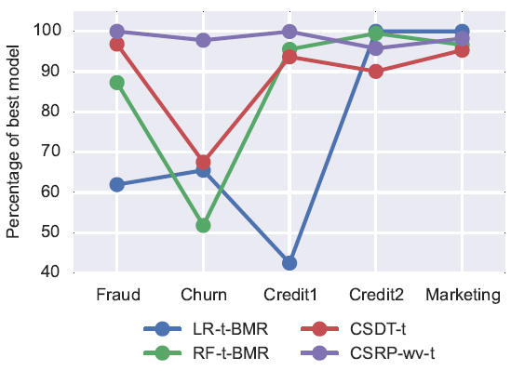
Results
Percentage of the highest savings
Database | Algorithm | Savings
Fraud | CSRP-wv-t | 0.73
Churn | CSRP-s-t | 0.17
Credit1 | CSRP-mv-t | 0.52
Credit2 | LR-t-BMR | 0.31
Marketing | LR-t-BMR | 0.51

Slide 53
Results
Results of the Friedman rank of the savings (1=best, 28=worst)
Family | Algorithm | Rank
ECSDT | CSRP-wv-t | 2.6
ECSDT | CSRP-s-t | 3.4
ECSDT | CSRP-mv-t | 4
ECSDT | CSB-wv-t | 5.6
ECSDT | CSP-wv-t | 7.4
ECSDT | CSB-mv-t | 8.2
ECSDT | CSRF-wv-t | 9.4
BMR | RF-t-BMR | 9.4
ECSDT | CSP-s-t | 9.6
ECSDT | CSP-mv-t | 10.2
ECSDT | CSB-s-t | 10.2
BMR | LR-t-BMR | 11.2
CPS | RF-r | 11.6
CST | CSDT-t | 12.6
Family | Algorithm | Rank
CST | CSLR-t | 14.4
ECSDT | CSRF-mv-t | 15.2
ECSDT | CSRF-s-t | 16
CI | RF-u | 17.2
CPS | LR-r | 19
BMR | DT-t-BMR | 19
CPS | LR-o | 21
CPS | DT-r | 22.6
CI | LR-u | 22.8
CPS | RF-o | 22.8
CI | DT-u | 24.4
CPS | DT-o | 25
CI | DT-t | 26
CI | RF-t | 26.2

Slide 54
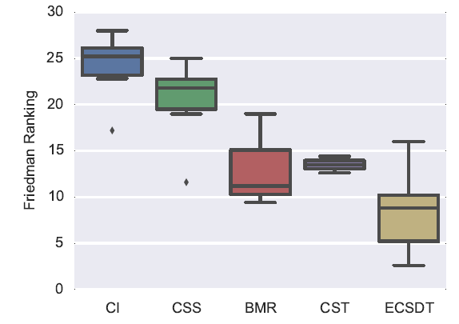
Results
Results of the Friedman rank of the savings organized by family

Slide 55
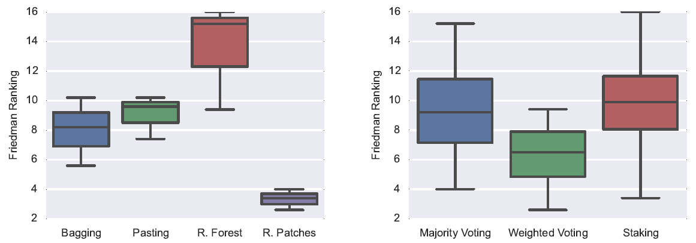
Results within the ECSDT family
By combination method
By random inducer

Slide 56
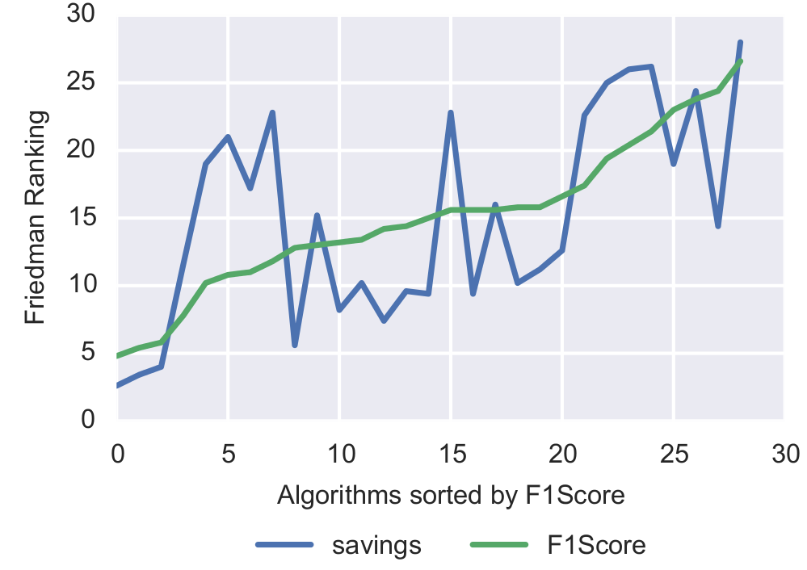
Results
Comparison of the Friedman ranking of the savings and F1Score sorted by F1Score ranking

Slide 57
Agenda
Motivation
Cost-sensitive classification
Background
Real-world cost-sensitive applications
Credit card fraud detection, churn modeling, credit scoring, direct marketing
Proposed cost-sensitive algorithms
Bayes minimum risk, cost-sensitive logistic regression, cost-sensitive decision trees, ensembles of cost-sensitive decision trees
Experiments
Experimental setup, results
Conclusions
Contributions, future work

Slide 58
Conclusions
New framework for example dependent cost-sensitive classification
Using five databases, from four real-world applications: credit card fraud detection, churn modeling, credit scoring and direct marketing, we show that the proposed algorithms significantly outperforms the state-of-the-art cost-insensitive and example-dependent cost-sensitive algorithms
Highlight the importance of using the real example-dependent financial costs associated with the real-world applications

Slide 59
Future research directions
Multi-class example-dependent cost-sensitive classification
Cost-sensitive calibration
Staking cost-sensitive decision trees
Example-dependent cost-sensitive boosting
Online example-dependent cost-sensitive classification

Slide 60
Contributions - Papers
Date | Name | Conference / Journal | Status
July 2013 | Cost Sensitive Credit Card Fraud Detection using Bayes Minimum Risk | IEEE International Conference on Machine Learning and Applications | Published
October 2013 | Improving Credit Card Fraud Detection with Calibrated Probabilities | SIAM International Conference on Data Mining | Published
June 2014 | Credit Scoring using Cost-Sensitive Logistic Regression | IEEE International Conference on Machine Learning and Applications | Published
October 2014 | Example-Dependent Cost-Sensitive Decision Trees | Expert Systems with Applications | Published
January 2015 | A novel cost-sensitive framework for customer churn predictive modeling | Decision Analytics | Published
March 2015 | Ensemble of Example-Dependent Cost-Sensitive Decision Trees | IEEE Transactions on Knowledge and Data Engineering | Under review
March 2015 | Feature Engineering Strategies for Credit Card Fraud Detection | Expert Systems with Applications | Under review
June 2015 | Detecting Credit Card Fraud using Periodic Features | IEEE International Conference on Machine Learning and Applications | In Press

Slide 61
Contributions - Software
costcla is a Python module for cost-sensitive machine learning built on top of Scikit-Learn, SciPy and distributed under the 3-Clause BSD license.
In particular, it provides:
A set of example-dependent cost-sensitive algorithms
Different real-world example-dependent cost-sensitive datasets.
Installation
pip install costcla
Documentation: https://pythonhosted.org/costcla/
Development: https://github.com/albahnsen/CostSensitiveClassification

Slide 62
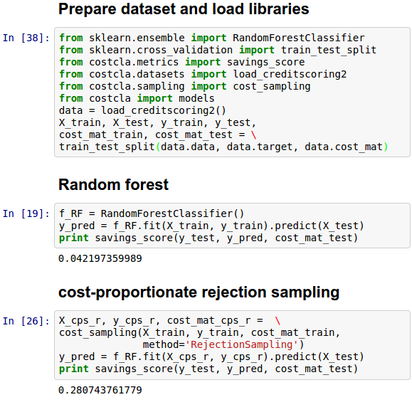
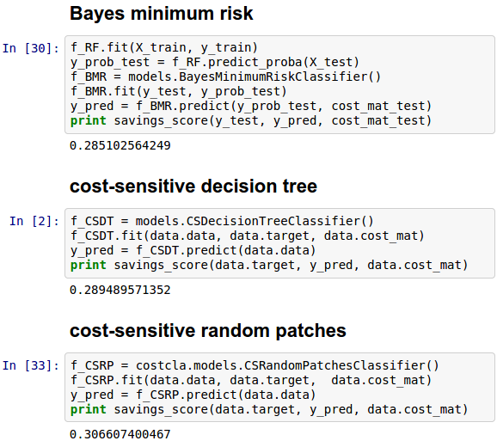
Contributions - Software

Slide 63
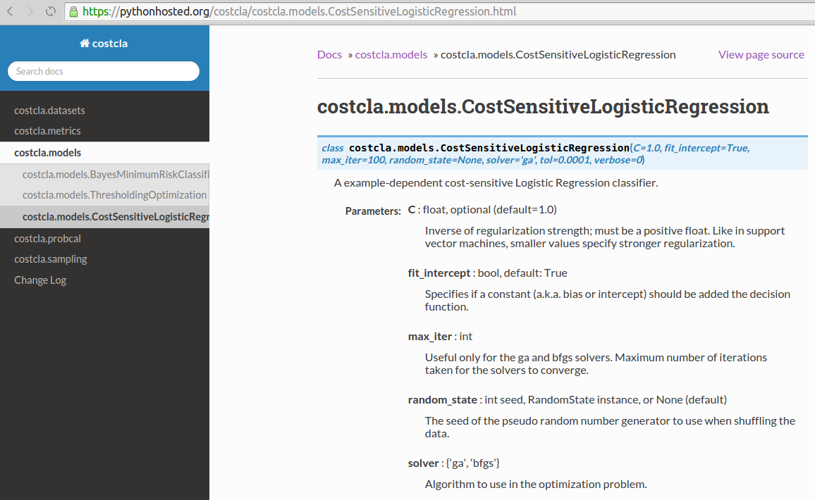
Contributions - Software

Slide 64
Contributions - Talks
Venue | Presentation name
Data Science Luxembourg meeting, 2013 | Credit Card Fraud Detection: From Theory to Practice
SAS Global Forum 2013, San Francisco | Using the Boosting Technique to Improve the Predictive Power of a Credit Risk Model
SAS Analytics Conference 2013, London | Credit Card Fraud Detection: From Theory to Practice
European Conference on Data Analysis 2013, Luxembourg | Data Analysis for Credit Card Fraud Detection
Data Science Luxembourg meeting, 2014 | Example-Dependent Cost-Sensitive Credit Scoring
KU Leuven Data Mining Research Group, 2014 | Cost-Sensitive Credit Card Fraud Detection
Presentation at Feedzai group, 2014, Lisbon | Advances in Credit Card Fraud Detection
SAS Analytics Conference, 2014, Frankfurt | Maximizing a Churn Campaign's Profitability With Cost-Sensitive Predictive Analytics
Latin American Conference on Fraud, 2015, Bogota | Fraud Analytics: Preventing Fraud in the era of BigData
PyData Berlin 2015 | Example-Dependent Cost-Sensitive Credit Scoring using CostCla

Slide 65
Contributions – Other activities
Location | Activity
CETREL, 2014 | CETREL Feasibility study
Luxembourg, 2013 - 2015 | Organizer of Data Science Luxembourg Group (400 Members)
CETREL, 2013 - 2014 | Creation of the Risk Alert System
Denmark Technical University, August 2013 | Summer School, Advanced Topics in Machine Learning
Dallas, December 2013 | Program committee of the Data Mining Case Studies and Practice Prize Workshop 2013
The Hague, September 2014 | Program committee of the IEEE Joint Intelligence and Security Informatics Conference 2014
Baltimore, May 2015 | Program committee of the IEEE Joint Intelligence and Security Informatics Conference 2015

Slide 66
Thank You!!
Alejandro Correa Bahnsen

Slide 67
Contact information
Alejandro Correa Bahnsen
University of Luxembourg
albahnsen.com
al.bahnsen@gmail.com
http://www.linkedin.com/in/albahnsen
https://github.com/albahnsen/CostSensitiveClassification

