Slide 1
UVM – A Verification Methodology standard
The first verification methodology to be standardized.
Built on the Open Verification Methodology (OVM).
UVM is derived based on concepts and code from the Verification
Methodology Manual (VMM),

Slide 2
Class Library
Provides the building blocks needed to develop
→ Reusable verification components and test
→ Environments in System Verilog.
Global Class → Provides list of types, variables, functions, and tasks defined in the uvm_pkg scope.
Base Class → Provide the basic building blocks for Verification Environment
Reporting Class → provide a facility for issuing reports (messages) with consistent formatting
Factory Class → As name indicates, used to manufacture (create) UVM objects and components
Phasing Class → Defines the phases of the verification environment.
Configuration & → provide a configuration database used to store and retrieve both configuration
Resource Class time and run time properties.
Sychronization class → Provides event synchronization for process.

Slide 3
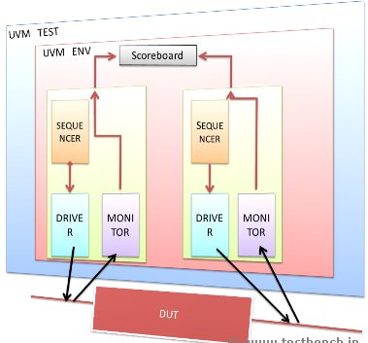
UVM Environment
A Typical UVM Environment looks as below

Slide 4
Verification Components
uvm verification component classes - Derived from uvm_component class
some of uvm component classes
uvm_agent
uvm_monitor
uvm_scoreboard
uvm_driver
uvm_sequencer
uvm_env and uvm_test are also extended from uvm_component.

Slide 5
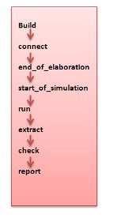
Phases
Build → Construction of the components / ports and exports with configs.
Connect → Connections between ports and exports are made here.
End of Elaboration → Phase to configure the components if any required
Start of Simulation → Prints the Banners and topology
Run → The Body of the Test Executed with all other thread forked off
Extract → All required information are gathered.
Check → Check the results of the extracted information
Report → Reporting of the comparision / information / error is done here.

Slide 6
Top-Down & Bottom-up
Build method call recommended in top-down fashion
uvm_test_top.t_env [uvm_test_top.t_env] Build
uvm_test_top.t_env.ag1 [uvm_test_top.t_env.ag1] Build
uvm_test_top.t_env.ag1.drv [uvm_test_top.t_env.ag1.drv] Build
uvm_test_top.t_env.ag1.mon [uvm_test_top.t_env.ag1.mon] Build
Connect method call recommended in bottom-up fashion
uvm_test_top.t_env.ag1.drv [uvm_test_top.t_env.ag1.drv] Connect
uvm_test_top.t_env.ag1.mon [uvm_test_top.t_env.ag1.mon] Connect
uvm_test_top.t_env.ag1 [uvm_test_top.t_env.ag1] Connect
uvm_test_top.t_env [uvm_test_top.t_env] Connect

Slide 7
UVM REPORTING
provides an interface to the UVM reporting facility
An Example :
uvm_report_info - Provides the message in the report.
(string id, string message, int verbosity=UVM_MEDIUM, string filename="",int line=0)
A unique id to form a group of messages.
The message text
If configured Verbosity '<' or '=' to the effective verbosity level → Report is issued. → Message is Displayed

Slide 8
Reporting Methods Contd..
uvm_report_warning
uvm_report_error
uvm_report_fatal
UVM Actions → Methods which defines various actions which can be taken
UVM_NO_ACTION → No Action to be taken
UVM_DISPLAY → Display to std output
UVM_LOG → Write to File
UVM_COUNT → Count Max value till exit
UVM_EXIT → Terminates Simulation

Slide 9
UVM TRANSACTION
It is a data item, processed by the DUT
Extended from a uvm_transactions class or uvm_sequence_item class
In other words, a typedef of uvm_sequence_item.
Core Utilities → Used to model, transform or operate on transactions.
Print → Prints the object's property
Record → Records the object's property
Copy → Returns a deep copy of the objects.
Compare → Deep Compares the object with the object in RHS argument
Pack → Bitwise concatenation of object's properties into an array
Unpack → Extract properties out from an array.
Clone → Creates and returns an Exact copy of the objects
Create → Allocates a new object of same Type

Slide 10
UVM CONFIGURATION
A mechanism in which
→ higher level components in a hierarchy can configure the lower level components variables
A set_config_* Method can be used to configure the components
Where a '*' indicates an int or a string or an Object
Functions to set the configurations
function void set_config_int (string inst_name, string field_name, uvm_bitstream_t value)
function void set_config_string (string inst_name, string field_name, string value)
function void set_config_object (string inst_name, string field_name, uvm_object value, bit clone = 1)
string inst_name → Hierarchical string path
string field_name → Name of the field
bitstream_t value → a integral value that can be with in a range.
bit clone → If set, the object is cloned.

Slide 11
UVM Factory
Defines a separate method for creating the objects.
objects are constructed dynamically based on the specification type of the object.
Three basic steps to be followed for using uvm factory
Registration
Construction
Overriding

Slide 12
Registration
When a class is defined,
→ its type has to be registered with the uvm factory
Registration is required for name-based overriding
`uvm_component_utils(class_type_name)
`uvm_component_param_utils(class_type_name #(params))
`uvm_object_utils(class_type_name)
`uvm_object_param_utils(class_type_name #(params))
uvm_*_param_utils are used for parameterized classes
uvm_*_utils are used for non - parameterized classes
The ' * ' denotes object or component
class packet #(type T=int) extends uvm_object; class driver extends uvm_component;
`uvm_object_param_utils(packet #(T)) `uvm_component_utils(driver)
endclass endclass

Slide 13
Construction
To construct a UVM based component or object
→ the static method create() should be used.
static function T create(string name, uvm_component parent, string context = " ")
Create() → returns an instance of component type, T.
EXAMPLE:
class_type object_name;
object_name = clss_type::type_id::create("object_name",this);
No need of the parent handle as second argument [in case of classes based on UVM_objects]

Slide 14
Overriding
user can override the registered classes or objects
→ Based on name string or class-type.
4 methods to Override
1) function void set_inst_override_by_type (uvm_object_wrapper original_type, uvm_object_wrapper override_type, string full_inst_path )
→ Overrides instances of 'original type' with 'override Type'
→ “Override_type" is extended from"original_type".
2)function void set_inst_override_by_name
→ All the instances with name "Original_type_name" will be overriden with objects of name "override_type_name"
3)function void set_type_override_by_type
→ overrides the type of the object
4)function void set_type_override_by_name
→ overrides the name of the original_type_name with the name of override_type_name

Slide 15
UVM Sequences
Uvm_sequence_item class
The Base class which holds the sequences
uvm_transaction class is extended based on this class
uvm_sequence
A class which defines the pattern of the a sequence
User extends this class and create a new sequence of transactions
Provides the interfaces necessary in creation of streams of sequence items
uvm_sequencer
Coordinates sequence and driver
Sends the transaction to driver
Gets the response from the driver (optional)
Arbitrates between the parallel sequences when multiple sequences are running

Slide 16
TLM interfaces
Using TLM interfaces
→ Transactions developed by extending uvm_sequence_item can be transferred b/n components.
Advantages
Higher level abstraction
Reusable (plug and Play)
Less code
Easy to implement thus achieves faster Simulations
TLM Terminologies for components
Producer → A component which generates a transaction.
Consumer → A component which consumes the transaction.
Initiator: → A component which initiates process.
Target → A component which responds to initiator.

Slide 17
Interfaces
Required for connecting the components to each other.
ports, exports and implementation and analysis ports are the interfaces (applies for control flow)
Port → An Interface that requires an implementation
Import → An interfaces provides an implementation
Export → An Interface used to route transaction interfaces to other layers of the hierarchy.
Analysis → Interface used to distribute transactions to passive components.
For Communication within a layer [Producer or Consumer] of the Hierarchy.
→ Port and imp ports are used
For Communication with the outer layer of the Hierarchy.
→ Port and exports are used
For Broadcast Communication
→ Analysis Port and Analysis exports are used

Slide 18
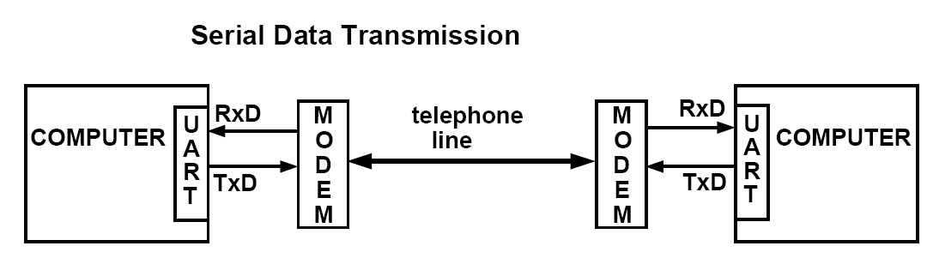
UART
UART (Universal Asynchronous Receiver/Transmitter)
A microchip embedded on to the CPU board as an interface to provide the means of communication in terms of transmission and reception of data.
provides the Data Terminal Equipment(DTE) interface to the computer for the exchange of data with modems and other serial devices.

Slide 19
A UART
On outbound transmission of ‘computer data’
Converts → parallel to serial bit stream making compatible with the serial device.
On inbound transmission of ‘external data’
Converts → serial bit stream into bytes making compatible with computer
Adds a parity bit (if enabled) on outbound transmissions
Checks the parity of incoming bytes (if enabled) and discards the parity bit
Adds start and stop bits on outbound and strips them from inbound transmissions
Handles interrupts.

Slide 20
Additional Features
Configurable 5, 6, 7, or 8 bits per character
Configurable even, odd, or no parity with enable/disable
Programmable baud generator with maximum rate up to1.5 Mbits/sec with 16 X input clock
Modem control interface with RTS and CTS.
Auto CTS and RTS enable functions.
Status reporting capabilities
Error bits detection - [Parity, frame, overrun]
Software compatible with 16550 UARTs

Slide 21

UART Frame
A Simple General UART Frame
A General UART Frame is comprised of
A Start Bit
8 Data Bits
A Parity Bit
A Stop bit
The Data bits and stop bits are yet configurable
The Parity bit is optional

Slide 22
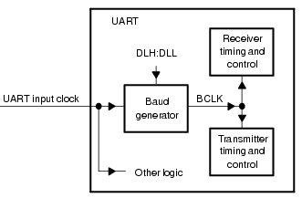
Baud Generator
Baud Generator with Input Clock from Processor
UART bit clock = 1/6 of CPU clock.
Supports up to 1.5 Mbps
maximum data rate
By default, the clock to this module is disabled.
User should enable the clock to this module by programming.

Slide 23
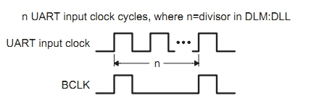
UART I/P Clock and Baud Clock
DLM - Divisor Latch Higher Byte
DLL - Divisor Latch Lower Byte
Processor provides input clock with a programmed frequency to UART
Baud generator divides it by a divisor to produce a baud clock (BCLK).
1 Baud Clock = UART input clock / Divisor range (1 to (2^16 - 1))
Baud Clk Freq = 16 X Baud Rate (16 times)
Divisor = (UART input clock frequency) / (Desired baud rate X 16)

Slide 24
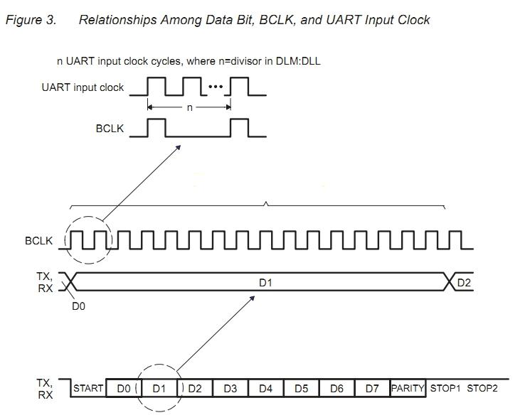
Each Transmitted and received bits lasts for 16 Baud Clks
When receiving , the bit is sampled in the 8th BCLK cycle

Slide 25
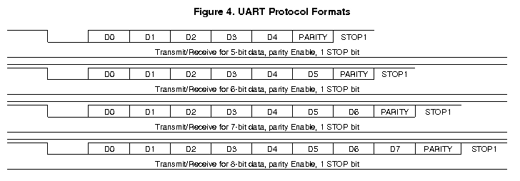
Protocol Formats
Trnsmitter sends start, data (5-8), parity and stop (1 or 2) bits
Exception in Reception of the frame is
→ Receiver detects only 1 stop bit after the data bits

Slide 26
Transmitter
Waits for the CTS and Reset signals to go active low.
Transmits the bits serially over the Tx line after CTS goes low.
Transmission of bits depends on the Baud clk. (16 Bclk / bit)
Idle state of the serial Tx line is active high ‘logic 1’
Follows the below order of transmission .
→ 1 START bit
→ data bits (5, 6, 7, 8)
→ 1 PARITY bit (optional)
→ STOP bit (1, 2)

Slide 27
Receiver
When receiver needs data it makes sure whether RTS is triggered [1 to 0] and Reset is low.
Rx serial input is an active low signal and thus Idle state is ‘logic 1’
Rx waits after the RTS is Triggered.
When Rx goes active low identifies that the start bit is arrived.
Receives the next bits as shown in the order.
→ 1 START bit
→ data bits (5, 6, 7, 8)
→ 1 PARITY bit (optional)
→ 1 STOP bit
Detects only one stop bit
If no start bit detected after stop bit -- RTS will be released and remains in the idle state .
Identifies the error bits [Parity, frame and overrun] once Rx receives the parity bit.

Slide 28
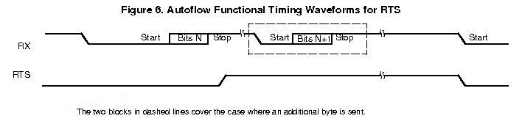
RTS Behavior
RTS when triggered, indicates that more data is required
RTS is released when a stop bit is detected on the Rx.
Once RTS is released, if Rx has a change in transition gives overrun error
RTS will be automatically trigerred on more time after Rx detects a stop bit

Slide 29
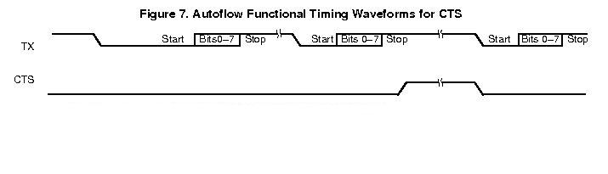
CTS Behavior
CTS when goes low that is active, indicates the Tx for transmission
If CTS goes high before the mid of the last STOP bit of the current byte,
→ Transmitter finishes sending the current byte
→ Also, stops before sending the next byte.

Slide 30
Loopback Control Mode
A Mode to verify the communication paths without connecting to another UART.
The transmit and receive data paths are Verified.
The CTS and RTS paths will also be verified.
In the Loop back control mode
→ The RTS and CTS are connected to each other
→ The Tx and the Rx are connected to each other
The overrun error indication bit is eliminated in this mode.

Slide 31
UART UVC Architecture
Top Module
Test
Env
Agent
Score Board
Sequencer
Driver
Monitor
Monitor
Virtual Interface
DUT

Slide 32
Hierarchy and Components
A UART environment is connected with one more UART by taking an
instance of the same.
The Top level contains the Test
The Test Contains the UART environment and an instance of it.
The components in the Environment are
Agent
Monitor for Received data
Scoreboard
Further, the Agent contains the
A Sequencer
A Driver
A Monitor for Transmitted data

Slide 33
Transaction class
The Transaction class is extended from uvm_seq_item.
The Object contains the frame comprised of
→ A start bit
→ 5-8 databits
→ A parity bit
→ A stop bit
Some Default constraints for the bits
Function to calculate the Parity with the Mode.
A Post Randomization function - Parity Calculation Implemented.

Slide 34
Sequence and Sequencer
Sequence
→ A Sequence with the Correct Parity
→ A Sequence with the error parity Injection
→ A Sequence with no parity.
→ Includes the Reporting Macro for the report of information or error.
Sequencer
→ Encapsulated within the Agent
→ The Sequencer to hold and arrange the sequences of different transactions

Slide 35
Driver
The Driver is encapsulated with in an Agent
Drives the transaction provided by the sequencer over Tx line
Drives the RTS whenver there is a need of Data
Includes Baud clk and Functions for Synchronization.

Slide 36
Driver Operation
A Virtual Interface is built in the Build Phase
An instance of the transaction is been created.
An instance of the config class is been created
Gets the sequence from sequencer through seq_item_port
Drives the transaction based on interface's reset and config RTS and interface's CTS
Drives the RTS depending on the interface's CTS and reset signals.

Slide 37
Monitor For sent Transaction
Encapsulated within the Agent.
Gets the transmitted data over Tx
Does a coverage on the transmitted data with
→ Correct Parity
→ Wrong parity
Puts the Transaction into its Analysis Port

Slide 38
Monitor For Received Transaction
Encapsulated within the Environment
Gets the received data over Rx
Holds Parity Calculator Function to check received parity bit.
Reports an error in case of reception of a wrong Parity or error bits.
Puts the Transaction into its Analysis Port.
Does a coverage on the transmitted data with
→ Correct Parity
→ Wrong parity
→ Frame Error

Slide 39
Interface
Contains the Uart input clk and the Reset Signal
Holds the UARTs Signals Tx, Rx, RTS and
CTS.
In the loopback Mode
→ The Tx and Rx are connected and
→ The RTS and CTS are connected.

Slide 40
Scoreboard
Two Analysis Implement exports are created.
Two transaction type queues are created for expected and actual data.
The Transmitted transaction and Received Transaction are pushed into the queues.
It compares both the transactions and provides
→ The report info on Transaction match
→ The report on the Transaction mismatch

Slide 41
Agent
Instances are created to its components
Virtual Interface is created and assigned to it and its child components
An instance for the config class is created.
The config object is assigned to it and all its child components
An instance is created to itself .
It will be connected with its child components in connect phase.

Slide 42
Environment
Create the instances for the Agent Receiver Monitor and the Scoreboard.
Get the virtual interface handle.
Get the configuration by taking the configuration class instance.
Build the components in the Build phase.
In connect Phase.
→ Bind the receiver Monitor and Scoreboard
→ Bind the Agent port to the Scoreboard.
Includes the Other required UVM Phases.

Slide 43
Test
Two Different Instances of Environments are created in the build phase.
A Virtual interface is created.
An instance for all oter components.
An instance is created for the config class.
Both the instances are connected in the connected phase
Make the desired connection by using the hierarchical Path name of the instances.

Slide 44
Top Module
The interface is instantiated
Set the interface as the root and pass it in the top module.
The root interface is set made virtual.
All the required Macro or Macro headers
A clock is generated
Run the test

Slide 45
Configuration Class
The Configuration class is extended from uvm_object.
Holds the Configuration for Baud Generator and divider.
Holds the configuration for RTS and CTS enable.
Configuration for Data, parity and stop bits.
Configuration for Loopback Mode operation
Constraints for the above configuration.

Slide 46
Plan for Test
The Plan for Test includes –
A Sequence with correct Parity bit
A sequence with a wrong stop bit
A sequence with an injection of wrong parity bit.
A sequence without a stop bit in the frame.
Coverage on
The frame size
All the data bits
Parity with correct and wrong type.

