Slide 1
C card churners data analysis
MENU
ANALYSIS
CONTACT
Group 3 (no pun intended)
Credit

Slide 2
Hello!
MENU
ANALYSIS
CONTACT
Data ANALYSIS

Slide 3
INTRODUCTION
MENU
ANALYSIS
CONTACT
Data ANALYSIS
A manager at the bank is disturbed with more and more customers leaving their credit card services. They would really appreciate if one could predict for them who is going to get churned so they can proactively go to the customer to provide them better services and turn customers' decisions in the opposite direction.

Slide 4
CONTENTS
MENU
ANALYSIS
CONTACT
Data ANALYSIS
*determine this with the group

Slide 5
Key questions
MENU
ANALYSIS
CONTACT
Comparing gender and age to credit card users that have stayed and left?
Does gender/age/marital status and dependents affect how long they have stayed with the bank? What’s the family situation like?
How long have they been inactive? Compare this between the existing and left customers and is there someway we can predict which existing customers will leave?
The relationship of credit card users in relation to education and income levels – do higher education and income correlate? Are they more likely to stay with the bank? Does the number of dependents tie into this? People with a lower income and more dependents more likely to leave?
The relationship between card category and income? Are those with higher income on a better card? Are they more likely to stay or leave?
Do total transaction levels tie in with income levels? And is there any correlation between transaction amounts and how long customers have been inactive?

Slide 6
and Visualisation
MENU
ANALYSIS
CONTACT
Data ANALYSIS
analysis

Slide 7
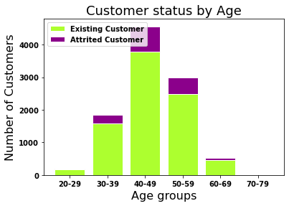
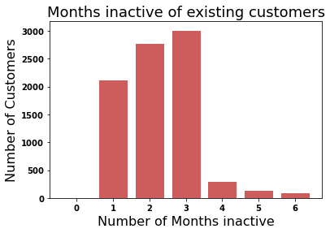
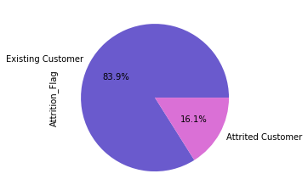
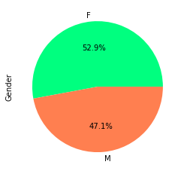
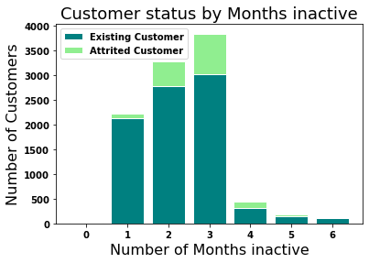
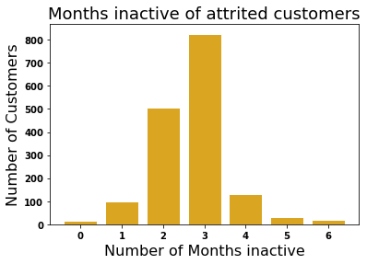
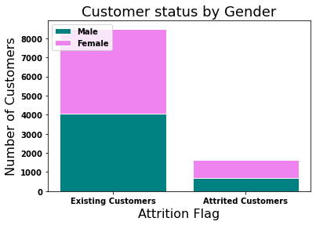
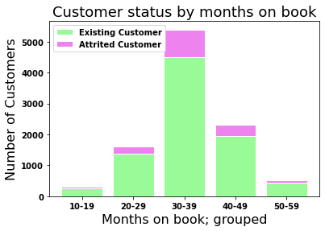
Q1: *insert q later*
MENU
ANALYSIS
CONTACT
Data ANALYSIS

Slide 8
Insert map from api her if we get there
MENU
ANALYSIS
CONTACT
Data ANALYSIS

Slide 9

METHODS, TECHNIQUES AND TOOLS
MENU
ANALYSIS
CONTACT
Data ANALYSIS
Do you know what helps you make your point clear? Lists like this one:
They’re simple
You can organize your ideas clearly
You’ll never forget to buy milk!
And the most important thing: the audience won’t miss the point of your presentation

Slide 10
DATA PROCESSING
MENU
ANALYSIS
CONTACT
Data ANALYSIS
NEPTUNE
JUPITER
VENUS
It’s the farthest planet from the Sun
CERES
Venus is the second planet from the Sun
MARS
saturn
Mars is actually a very cold place
mercury

Slide 11
THANKS!
MENU
ANALYSIS
CONTACT
Data ANALYSIS
Do you have any questions?
youremail@freepik.com
+91 620 421 838
yourcompany.com
Please keep this slide for attribution

Slide 12
Any questions
MENU
ANALYSIS
CONTACT
Data ANALYSIS

Slide 13
METHODOLOGIES
10%
25%
20%
45%
MENU
ANALYSIS
CONTACT
Data ANALYSIS
Venus is the second planet from the Sun
Jupiter is the biggest planet of them all
It’s the closest planet to the Sun
Mars is actually a very cold place

Slide 14
BUDGET
MENU
ANALYSIS
CONTACT
Data ANALYSIS
VENUS
Venus is the second planet from the Sun
$ 1,300.000
$ 30,000
$ 9,000
MERCURY
MARS
Mercury is the closest planet to the Sun
Despite being red, Mars is a cold place

Slide 15
ANALYSIS RESULTS
MENU
ANALYSIS
CONTACT
VARIABLE | MODEL 1 | MODEL 2 | MODEL 1 | MODEL 3
Despite being red, Mars is actually a very cold place | –0.234 | 0.836 | –0.742 | 0.600
Venus is the second planet from the Sun in the Solar System | –0.135 | 0.642 | –0.982 | –0.102
Mercury is the closest planet to the Sun and the smallest one | –0.309 | 0.752 | 0.173 | 0.500
Jupiter is a gas giant and the biggest planet in the Solar System | 0.604 | –0.378 | 0.402 | 0.109

Slide 16
THIS IS A TABLE
MENU
ANALYSIS
CONTACT
Data ANALYSIS
SEARCH TERM | SUM OF IMPRESSIONS | TOTAL COST | RETURN
Term 2387 | 109 | $ 898,982 | 8265 %
Term 4028 | 222 | $ 1,982.000 | 2987 %
Term 3105 | 245 | $ 123,49 | 4087 %
Term 2098 | 154 | $ 120,000 | 1287 %

Slide 17
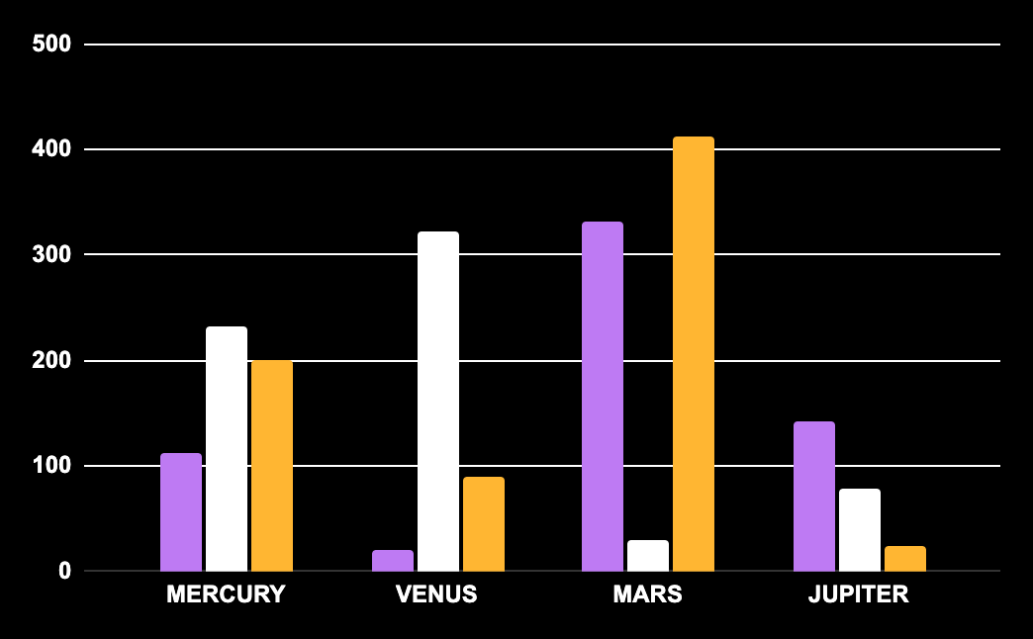
RISK ANALYSIS
MENU
ANALYSIS
CONTACT
Data ANALYSIS
MARS
Mars is actually a cold place. It’s full of iron oxide dust
NEPTUNE
It’s the farthest planet from the Sun. It's also the fourth-largest
venus
Follow the link in the graph to modify its data and then paste the new one here. For more info, click here
It’s the second planet from the Sun in the Solar System

Slide 18
Fonts & colors used
This presentation has been made using the following fonts:
Bebas Neue
(https://fonts.google.com/specimen/Bebas+Neue)
Arimo
(https://fonts.google.com/specimen/Arimo)
#ffffff
#0e166c
#921d87
#ffb632
#ffe485
#be7af3
#51127c

Slide 20
JANUARY
FEBRUARY
MARCH
APRIL
MAY
JUNE
PHASE 1
Task 1
Task 2
PHASE 2
Task 1
Task 2
JANUARY
FEBRUARY
MARCH
APRIL
PHASE 1
Task 1
Task 2

Slide 23
...and our sets of editable icons
You can resize these icons without losing quality.
You can change the stroke and fill color; just select the icon and click on the paint bucket/pen.
In Google Slides, you can also use Flaticon’s extension, allowing you to customize and add even more icons.

Slide 24
Educational Icons
Medical Icons

Slide 25
Business Icons
Teamwork Icons

Slide 26
Help & Support Icons
Avatar Icons

Slide 27
Creative Process Icons
Performing Arts Icons

Slide 28
Nature Icons

Slide 29
SEO & Marketing Icons

Slide 30


