Slide 1
Clickbait classifier
Distributed NLP & Naïve Bayes ML pipeline
in PySpark 2.4.7 Ubuntu, Python 3.5.
Script & presentation by Emy Kay
https://github.com/Emzilla-01/clickbait/blob/master/Clickbait_main.ipynb

Slide 2
Can you tell what is clickbait vs news?
“On average, users over 65 shared nearly seven times as many articles from fake news domains as the youngest age group.” Guess, Nagler, Tucker https://advances.sciencemag.org/content/5/1/eaau4586.full

Slide 3
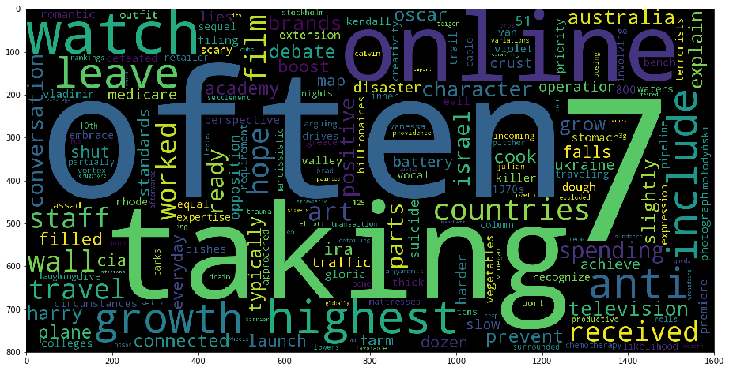
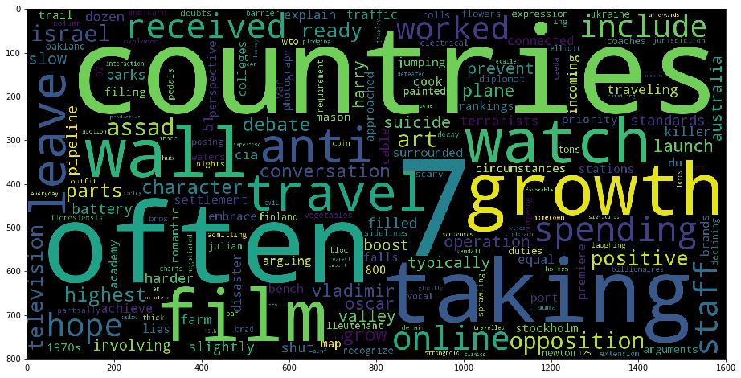
Can you tell which is clickbait vs news?
unigrams per label
A
B

Slide 4
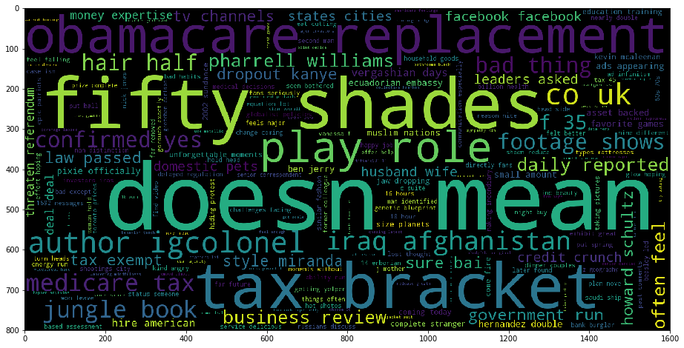
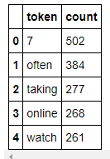
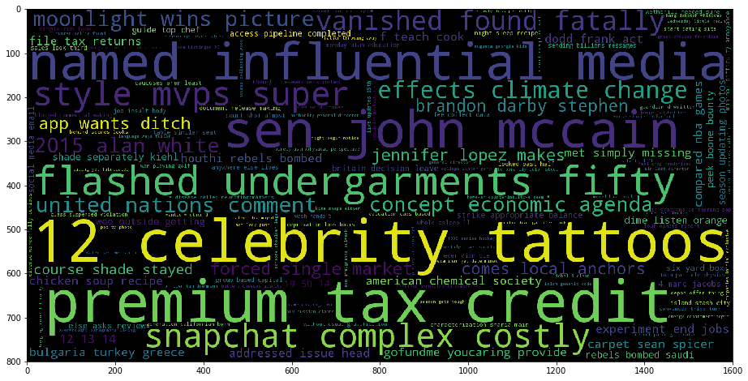
Can you tell?
A
1-3grams A sample

Slide 5
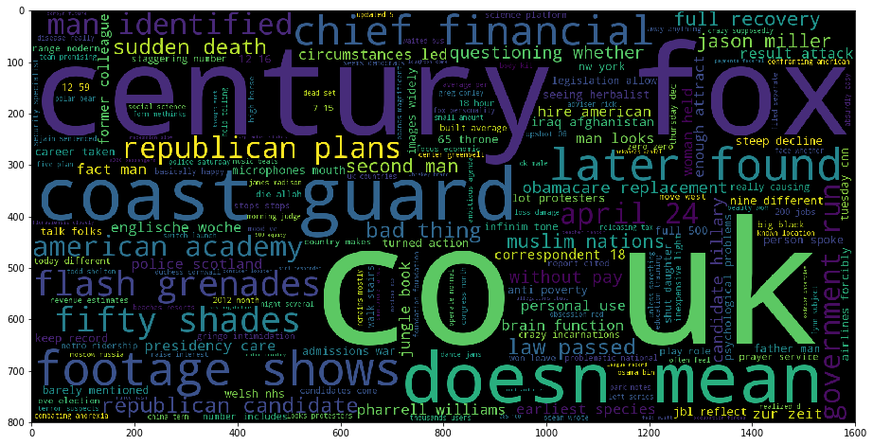
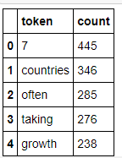
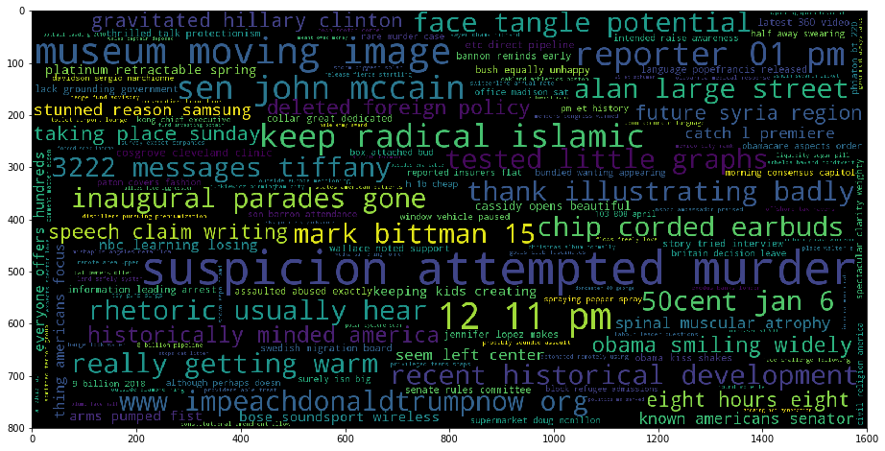
Can you tell?
B
1-3grams B sample

Slide 6
A
B
Can you tell which is news and which is clickbait?
How to deploy a bot to distinguish between text classes more efficiently than a human monitor?
Business applications:
social media monitoring, marketing response, spam filtering, fraud detection

Slide 7
Overview of app
We have a labeled dataset of ‘clickbait’ or ‘news’
https://www.kaggle.com/c/clickbait-news-detection/ dataset source
This could represent any comparison between two corpuses or collections of documents
Collections are randomly sampled by label into 1600 clickbait + 1600 news labeled documents
NaiveBayes vocabulary comparison is compared on processed most common 1,2,3gram phrases of tokens [‘str0’,’str1’…], [‘certain topic’, ‘a phrase’] text document
Each label per dataset may show skew in certain topics
commonality of topics programmatically & manually trimmed to exclude certain topics
Accuracy ~.66 in initial stages of binary classifier + trimming approaching ~68.9%

Slide 8
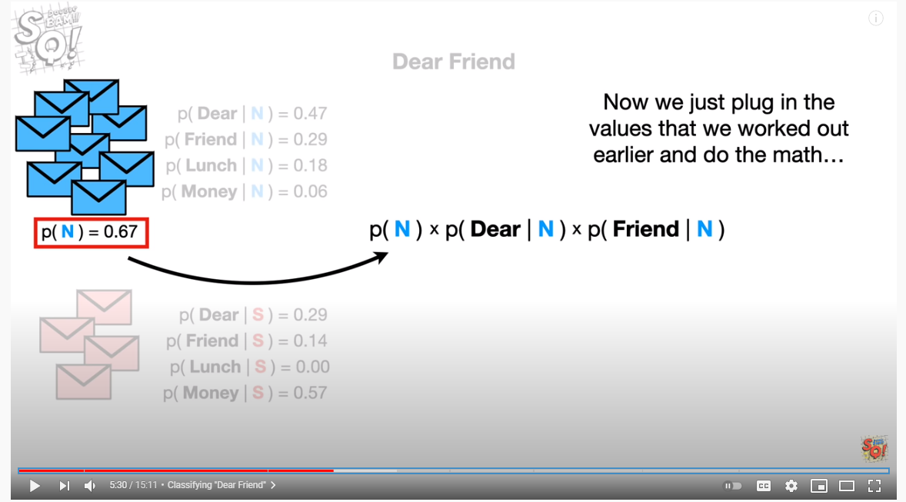
Naïve Bayes pyspark application

Slide 9
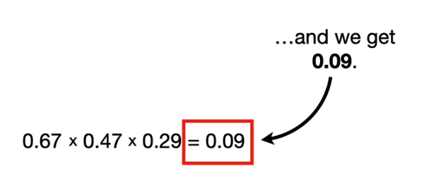
Naïve Bayes pyspark application

Slide 10
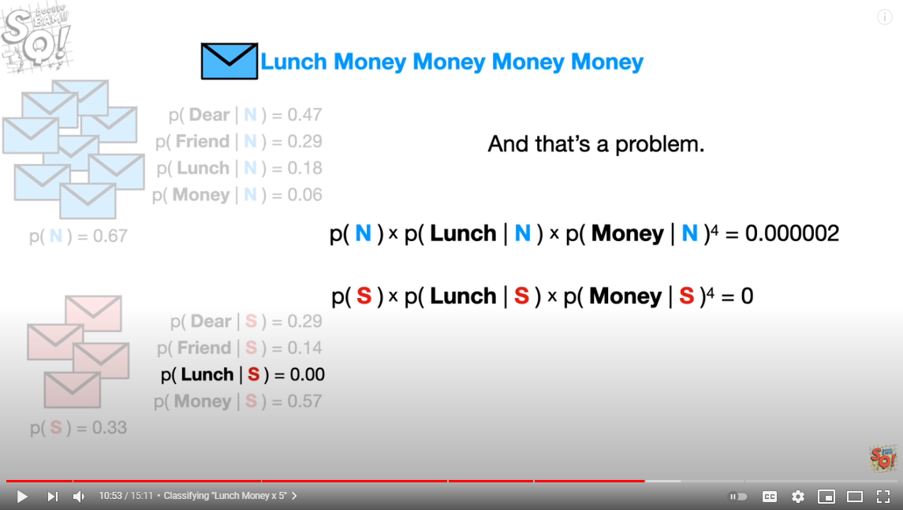
https://www.youtube.com/watch?v=O2L2Uv9pdDA

Slide 11
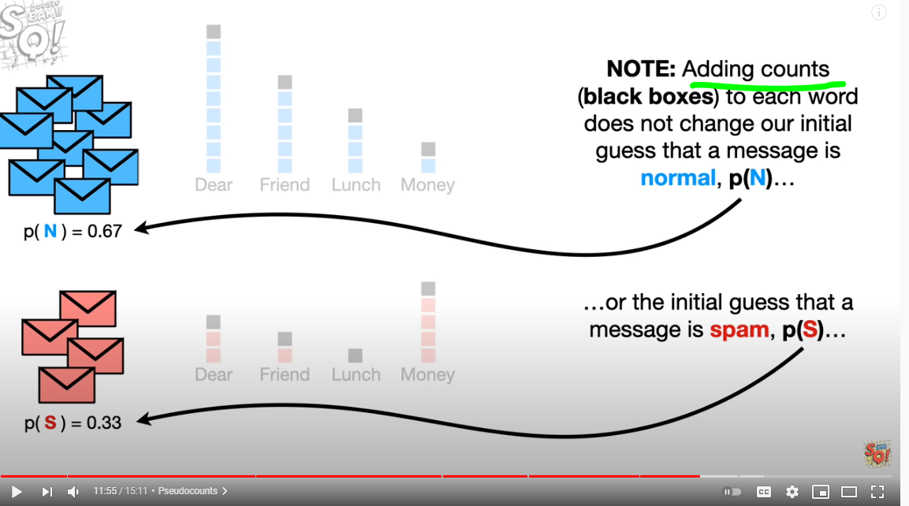
https://www.youtube.com/watch?v=O2L2Uv9pdDA

Slide 12
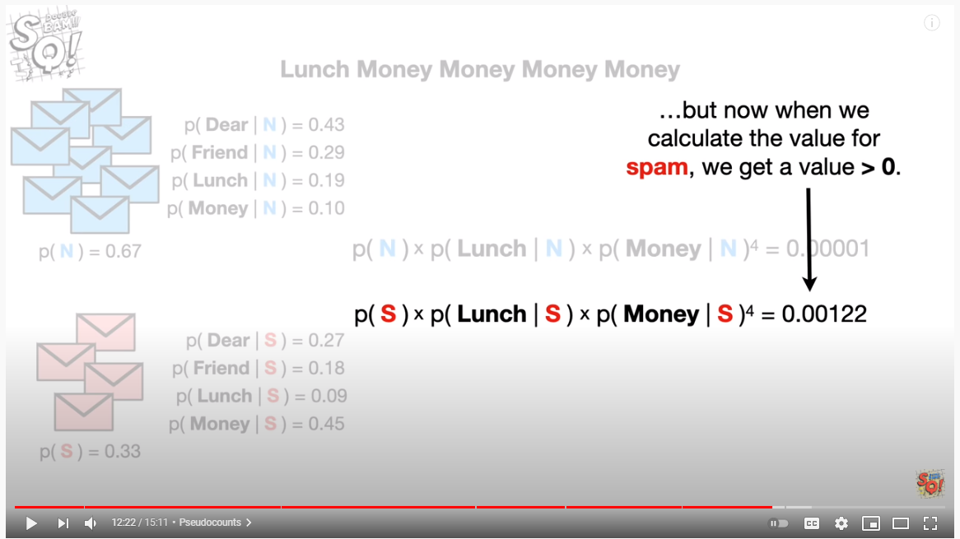
https://www.youtube.com/watch?v=O2L2Uv9pdDA

Slide 13
https://github.com/Emzilla-01/clickbait/blob/master/Clickbait_main.ipynb
Pyspark session config
Text preprocessing
Tokenization
Stemming, lemming, reduction of dictionary vs. accuracy
N-grams
Tokenization in pyspark types
Classification in pyspark types

Slide 14
imports
import re
from copy import deepcopy
from pyspark.ml.feature import Tokenizer, StopWordsRemover, NGram, HashingTF, IDF, CountVectorizer, StringIndexer #Word2Vec, OneHotEncoder, RegexTokenizer,
from pyspark.sql.functions import col, udf, length, avg, lit, concat, size, array, countDistinct
from pyspark.sql.types import IntegerType, StringType, ArrayType
from pyspark.ml.classification import NaiveBayes
from pyspark.ml.evaluation import MulticlassClassificationEvaluator
from pyspark.sql import SparkSession
from nltk.stem import SnowballStemmer
from nltk.stem import WordNetLemmatizer

Slide 15
requirements & versions
Ubuntu
Python
Pyspark
HDFS
Oracle VMDK – gcp productization of images?

