Slide 1
Innovative Product Development
DataKraft Corps.
Akshansh Dwivedi
(60018220103)
Bhavvya Jain
(60018220108)
Pranav Pawar
(60018220032)
Rajvardhan Singh Chib (60018230106)
Optimization in Multilingual TTS for Accent & Emotions

Slide 2
ABSTRACT
Text-to-Speech (TTS) systems have improved significantly over the past couple of years, and yet, the problem of correctly rendering a variety of multilingual accents and emotions in synthesized speech is still a major problem. This project puts forward a new approach to optimizing multilingual TTS, with the accents and emotional expressiveness of diverse Indic languages. Inspired by existing models, we try to meet the cultural nuances of synthetic speech with our TTS framework. The significant features of our system include the offering of being able to take in a textual prompt alongside a description of the desirable speaker characteristics and environment features providing easy customizable speech as per the users’ choice of tone and style. Our model framework is transferable and utilizable in various environments and cultures with just simple text and description of the speaker. Such listening tests with native speakers indicate a strong increase in perceived naturalness and cultural authenticity. This research contributes to multilingual TTS, offering a scalable framework for accent adaptation and emotional synthesis, applicable in localized virtual assistants, education technology, and accessible content creation.

Slide 3
IDEA & APPROACH DETAILS
Problem Statement
Objectives
Existing TTS systems in-adequately represent Indian English accents and lack emotional expressiveness, leading to unnatural speech, poor user engagement, and cultural underrepresentation. This limitation hinders effective communication in voice-based applications, particularly in educational and informational contexts, and contributes to a broader digital divide. There is a critical need for a TTS model specifically designed for Indian accents with enhanced emotional modulation to deliver natural, culturally authentic, and expressive speech, bridging the gap in user satisfaction and cultural inclusivity in voice-based technologies.
Enhance Voice Quality
Multilingual Support
Optimize Existing Models
User Customization: Provide options for users to customize the voice output, including tone, pitch, speed, and emotional expression.

Slide 4
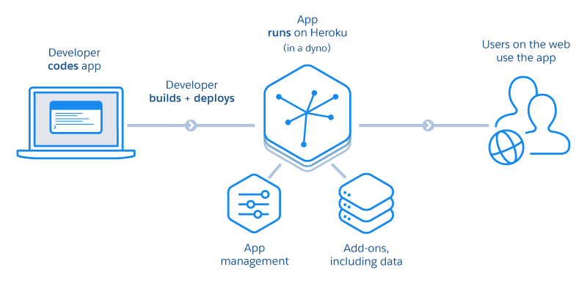
NOVELTY OF WORK
Area of Work:
Natural Language Processing
Method:
Transfer Learning & Deep Learning
Embedding of Emotions & Accents
Language Transliteration Algorithms
Efficiency of the technique:
Quick generation
Better than some competitors
Economy:
AI-As-A-Service(AIaaS/PaaS)

Slide 5
Our Idea Approach
Step 1
Step 2
Step 3
Step 4
Literature Review
Dataset Collection
Preprocessing & Feature Engineering
Model Architecture
Step 5
Step 6
Step 7
Adding Emotion & Accent Embeddings
Transfer learning & Fine tuning
Evaluation & Optimization

Slide 6
Literature Review & Existing Systems
Name | Key Points | Research Gap
English-Hindi Transliteration using Multiple Similarity Metrics | Improving transliteration accuracy between English and Hindi by incorporating multiple similarity criteria. | Does not address the challenge of transliteration in context-dependent scenarios
Investigating Emotion Embedding based TTS Models under limited data | Zhu model performs well on the emotion vs neutral speech task, StrengthNet model performs poorly even with larger training sets. | The paper does not explore the effect of training time on the Zhu et al. (2019) methodology, which has a high computational complexity.
Creating Accented TTS English voices to facilitate second language learning | Accented text-to-speech (TTS) voices can significantly enhance second language learning | Does not explore the long-term impact of accented TTS voices on learners' speaking proficiency and sustained effectiveness.
Multilingual Emotional Text-to-Speech by Cross-speaker and Cross-lingual Emotion Transfer | StrengthNet & Data Preparation | Models performed well on the emotion vs. neutral task but poorly on the emotion classification task

Slide 7
Literature Review & Existing Systems
Name | Key Points | Research Gap
A Review of Deep Learning Based Speech Synthesis | Deep bidirectional LSTM, and sequence to sequence models, have been applied to speech synthesis. | Exploring semi-structured or supervised learning techniques for efficiency.
Natural language guidance of high-fidelity text-to-speech with synthetic annotations | Labeling and controlling various aspects of speaker identity, style, and recording conditions in tts synthesis using natural language descriptions. | Enhancing controllability, improving naturalness further and adapting to specific domains
OpenVoice: Versatile Instant Voice Cloning | Decoupled Framework, Cross Lingual Approach needs lesser data | Tone Color Cloning
SpeechT5: Unified-Modal Encoder-Decoder Pre-Training for Spoken Language Processing | Encoder-decoder framework. Outperforms other TTS architecture. | Using larger models, and more unlabeled data for pre-training as well as extending speech T5 to multi-lingual spoken language processing task.

Slide 8
Common Limitations
Multilingual Support
Unexplored path of Transliteration
Lack of emotion
Lack of research in Indic Languages
Available open-source models are difficult to integrate and fine-tune for small SaaS companies who want to integrate TTS.

Slide 9
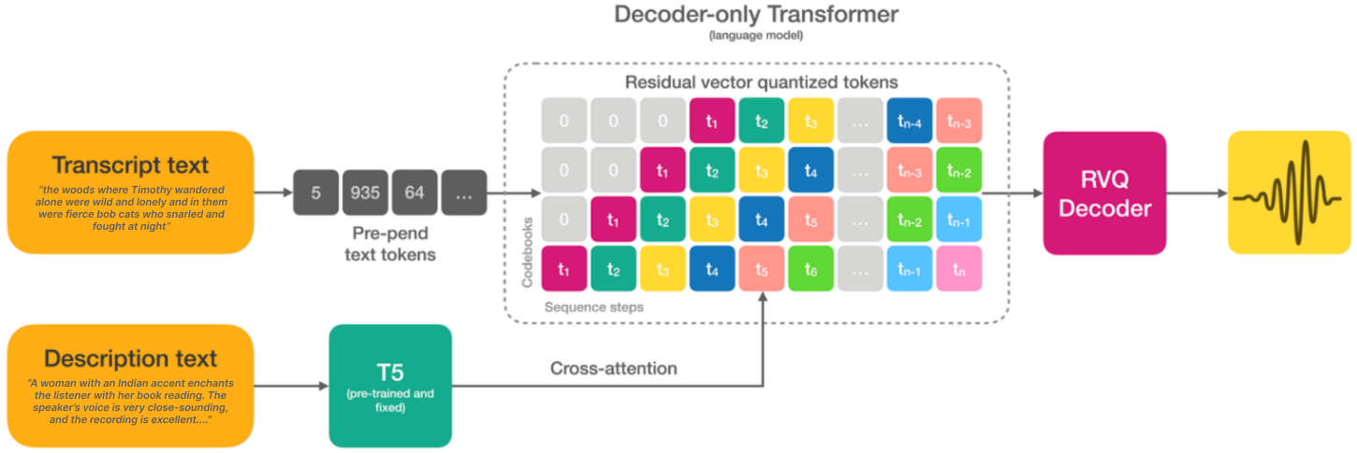
Model Architecture

Slide 10

Results : Indian Accent
Prompt | Description | Audio
Can you tell me if there is a lift in the building? | Akshansh delivers his words quite expressively, in a very confined sounding environment with clear audio quality. He speaks fast.
I immediately filled my electric kettle with filtered water to prepare my morning coffee.
I go to work by public transport. It is a 1 hour transit.
Although I had my internships going on, I scored well in my exams.

Slide 11
Results : Hindi
Prompt | Description | Audio
इंतज़ार करने वालों को सिर्फ़ उतना ही मिलता है जितना कोशिश करने वाले छोड़ देते हैं | Male Hindi Speaker, in Hindi delivers his words slowly and clearly, in a very calm sounding environment with clear audio quality. He speaks fast.
तुम मुझे हमेशा सच्चाई बताने की कोशिश करते हो, लेकिन कभी-कभी सच कड़वा होता है
अगर तुम चाहो तो हम इस शनिवार को बाहर घूमने जा सकते हैं
यह किताब मुझे बहुत पसंद आई क्योंकि इसमें दिलचस्प कहानियाँ हैं
उसने अपनी पूरी ज़िन्दगी कठिनाइयों और संघर्षों में बिताई, लेकिन हमेशा अपने परिवार के लिए काम किया, बच्चों को अच्छी शिक्षा देने की कोशिश की और हर मुश्किल घड़ी में हिम्मत से काम लिया, जिससे आज वह सबके लिए एक प्रेरणा बन गया है।

Slide 12
Results : Emotions
Prompt | Description | Audio
Keep this between us, no else can know about this in any way. | Thomas speaks quietly in a whisper.
Keep this between us, no one else can know about this in any way. | Thomas speaks with clear and articulate enunciation.
The day I lost my mom, I have never been the same again. It's been rough. | Thomas speaks with a sad tone.
Keep this between us, no one else can know about this in any way. | Thomas speaks with a neutral tone with no particular emotion in normal speed.

Slide 13
Results : Emotions
Prompt | Description | Audio
Dude the way he delivered was hilarious. <laugh> Totally cracked me up. | Thomas speaks with laughter in his voice.
Did you mean base of the primary section or the whole structure? I am sorry I didn't really understand. | Thomas speaks in a confused tone with confusion in his voice.
I just adopted a golden retriever. It has been the best decision of my life. | Thomas expresses joyfully with happiness in his speech.
When will you reach here it's been *TOO* long. | Thomas expresses importance through his speech with emphasis.

Slide 14
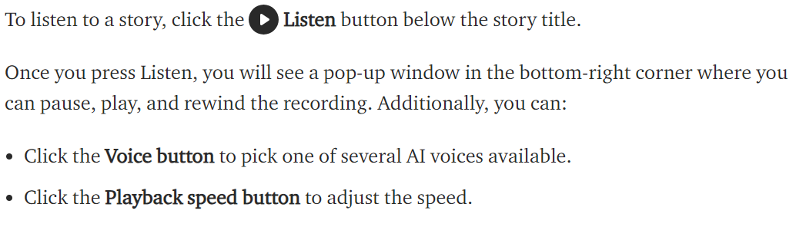
USE CASES
Business Chatbots and AI based Customer Service
Newspapers & Blogs to increase Target Customers
Browser Extensions for Accessibility
Screenless Wearable Tech & AI assistants
Accent based language learning
Cloud based TTS APIs
Transcript based Multilingual Music Verse/Speech Generation on YouTube

Slide 15
CONCLUSION
The Text-To-Speech as a service market is huge and is Growing rapidly as people’s attention span decreases, wearables like Meta Glasses become more common, and language as a barrier becomes thinner and thinner. This creates a huge gap in the Indian Market where there is a lack of authentic accent-oriented Indic language Text-to-Speech models. We aim to cater to this market by working and improving upon our work so far.
DISCUSSION
Open for QnA

Slide 16
References
Link to Drive
https://huggingface.co/En1gma02
Lyth, Dan, and Simon King. "Natural language guidance of high-fidelity text-to-speech with synthetic annotations." arXiv preprint arXiv:2402.01912 (2024).
Qin, Zengyi, Wenliang Zhao, Xumin Yu, and Xin Sun. "Openvoice: Versatile instant voice cloning." arXiv preprint arXiv:2312.01479 (2023).
Ao, Junyi, Rui Wang, Long Zhou, Chengyi Wang, Shuo Ren, Yu Wu, Shujie Liu et al. "Speecht5: Unified-modal encoder-decoder pre-training for spoken language processing." arXiv preprint arXiv:2110.07205 (2021).
Malatji, P. T., M. J. D. Manamela, T. J. Sefara, T. Sefara, and P. Malatji. "Creating accented text-to-speech English voices to facilitate second language learning." In South Africa International Conference on Educational Technologies. 2016.
Zhu, Xinfa, Yi Lei, Tao Li, Yongmao Zhang, Hongbin Zhou, Heng Lu, and Lei Xie. "Metts: Multilingual emotional text-to-speech by cross-speaker and cross-lingual emotion transfer." IEEE/ACM Transactions on Audio, Speech, and Language Processing (2024).
Ning, Yishuang, Sheng He, Zhiyong Wu, Chunxiao Xing, and Liang-Jie Zhang. "A review of deep learning based speech synthesis." Applied Sciences 9, no. 19 (2019): 4050.

