Slide 1
Broget
Content distribution on steroids.

Slide 2
How does Broget work?

Slide 3
Step 1
When downloading a file on your mobile phone, use Broget.
The phone.

Slide 4
Step 2
The link is sent to a download box which gets the file.
The download box.

Slide 5
Step 3
The file is moved from the download box to the phone when they’re on the same network.
The reunion.

Slide 6
But it gets better.

Slide 7
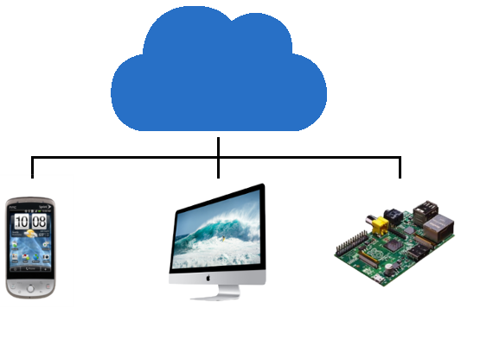
Cloud
Old phones
Home PC
IoT Devices
Broget can push to multiple devices across the internet.

Slide 8
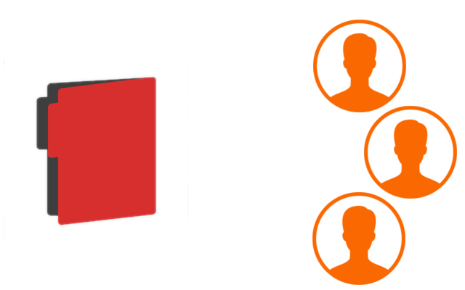
Broget can authenticate multiple users for a single file.

Slide 9
But Broget can be scaled...
Classrooms
Offices
Libraries
Homework is pushed to a class download box. The homework is automatically downloaded to students’ devices when they enter the classroom.
Company download boxes can contain archives of corporate files. Only authorized users can access certain files.
Libraries can maintain large databases of books. Users can reserve

Slide 10
And that's just the beginning.
Restaurants can have open networks which can push advertising, menus and other relevant content to customers.
Wifi networks can be used to deliver region specific content.
A decentralized network can be configured independent of the Internet.
IDs of connected users can be used to track students in schools, colleges and workplaces.

