Slide 1
Audit-Free Cloud Storage via Deniable Attribute-Based Encryption
Po-Wen Chi, Student Member, IEEE and Chin-Laung Lei, Member, IEEE
IEEE TRANSACTIONS ON CLOUD COMPUTING, VOL. 6, NO. 2,
APRIL-JUNE 2018

Slide 2
Outline
Motivation
Preliminaries
System Model
Construction

Slide 3
Motivation

Slide 4




Coercer intervention
Ask for releasing secret keys
KGC
Database
Intelligence Agency
Secret key
Encrypted file
User

Slide 5
Preliminaries

Slide 6
CP-ABE
Ciphertext C=
Satisfied
File F | Policy
AND
User A | Attribute X, Attribute Y
OR
Attribute X
Not Satisfied
User B | Attribute Y, Attribute Z
Attribute Z
Attribute Y

Slide 7



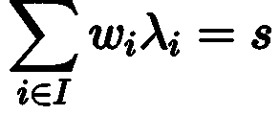


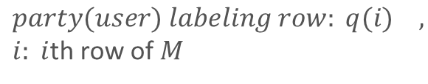






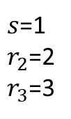


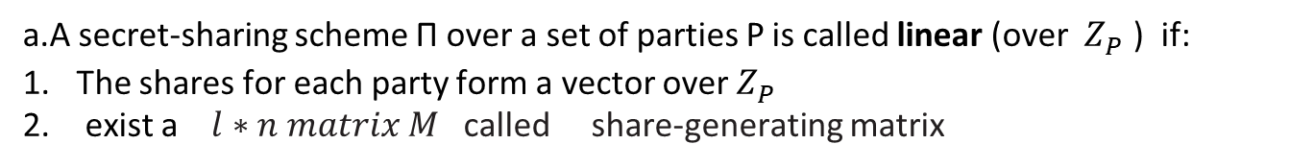

Linear Secret Sharing Schemes
a.A secret-sharing scheme Π over a set of parties P is called linear (over $Z_{P}^{}$) if:
The shares for each party form a vector over $Z_{P}^{}$
exist a $l∗n matrix M$ called share-generating matrix
$$ex:$$
$$P=5$$
$party(user) labeling row: q(i)$ $,$
$i: i$th row of $M$
$q(1)$
1 2 3
4 2 1
3 2 1
3 4 2
$s$=1
$r_{2}$=2
$r_{3}$=3
$$\vec{v}=\left(s,r_{2},…,r_{n}\right)∈Z_{P}^{}$$
parts =4
$q(2)$
$q(3)$
=
$λ_{1}$=$4 λ_{2}$=$1 λ_{3}$=0 $λ_{4}$=2
$λ_{i}=M_{i}\vec{v}$, $∀ⅈ∈\left\{1,⋯,l\right\}$
$q(3)$
threshold =3
party1
b.Every linear secret sharing-scheme according to the above definition enjoys the linear reconstruction property:
party2
party3
party4
$S$ : party set
$$q$$
Exist
such that

Slide 8
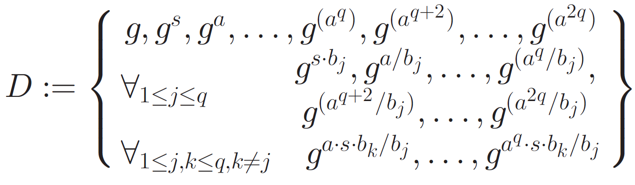
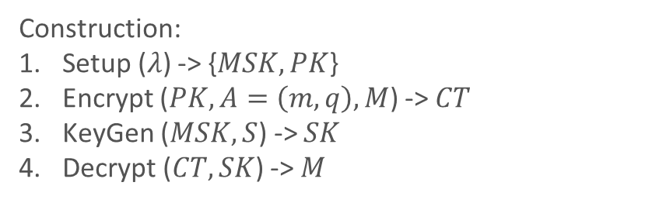


Waters CP-ABE
Construction:
Setup ($λ$) -> {$MSK,PK$}
Encrypt ($PK,A=\left(m,q\right),M$) -> $CT$
KeyGen ($MSK,S$) -> $SK$
Decrypt ($CT,SK$) -> $M$
Access Structrue:
1 layer threshold
Hard Problem:
Decisional q-parallel BDHE assumption
$\left(p,G,G_{T},g,e\right)$ $ⅇ:G×G→G_{T}$
$$a,s,b_{1},…,b_{q}∈Z_{p}$$
is negligible
Proc. 14th Int. Conf. Practice Theory Public Key Cryptography Conf. Public Key Cryptography, 2011

Slide 9



Deniable Encryption Scheme
Type:
When determined fake message
ad hoc
plan-ahead✓
Who provides convincing fake evidence
sender
receiver
both (bi-deniability) ✓
Number of sets of algorithms
full (only one)
Multi-distributional (one for normal, and one for deniable) ✓
Interacion between sender and receiver
interactive
non-interactive ✓
Secret key
Correct message
Fake key
or test failed
Fake message
✓: proposed scheme

Slide 10

Chameleon Hash
Common 2-input hash
m
H(m)
Random r
Chameleon hash
trapdoor
m
CH(m,r)
Random r

Slide 11
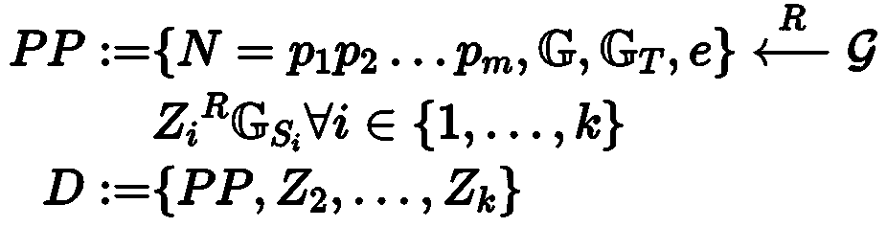



Composit Order Bilinear Groups
Prime order bilinear groups: $\left(p,G,G_{T},g,e\right)$ $ⅇ:G×G→G_{T}$
element form: $g^{a}$ ,$a∈Z_{P}$
$${N=p}_{1}p_{2}…p_{m}$$
$\left(N,G,G_{T},g_{1},g_{2},…,g_{m},e\right)$ $ⅇ:G×G→G_{T}$
element form: $g_{1}^{a_{1}}g_{2}^{a_{2}}…g_{m}^{a_{m}}$ ,$a_{1},a_{2},…,a_{m}∈Z_{N}$
subgroups: ${G_{p_{1}},G_{p_{2}},…,G_{p_{m}}}_{}$ each are orthogonal that
$G_{p_{x}}×G_{p_{y}}→1$ ,$x≠y$
General Subgroup Decision Assumption
There is
is negligible

Slide 12
System Model

Slide 13

System Model
1. Setup / DenSetup
8. Verify
6. OpenEnc / DenOpenEnc
7. OpenDec / DenOpenDec
KGC
Database
Coercer
3. Encrypt / DenEnc
2. KeyGen / DenKeyGen
4. Decrypt
Data user
Data owner

Slide 14
Construction

Slide 15
Construction
Normal encryption part Deniable encryption part
Setup 8. DenSetup
KeyGen 9. DenKeyGen
Encrypt 10. DenEnc
Decrypt 11. DenOpenEnc
OpenEnc 12. DenOpenDec
OpenDec
Verify

Slide 16






Setup
Setup($λ$) -> {$PP,MSK$}
$\left(N,G,G_{T},g_{1},g_{2},g_{3},e\right)$ $ⅇ:G×G→G_{T}$
subgroups: ${G_{p_{1}},G_{p_{2}},G_{p_{3}}}_{}$
$${N=p}_{1}p_{2}p_{3}$$
Hash function $H_{1}:{\left\{0,1\right\}}^{∗}→G_{p_{3}}$
Random: $α,β∈Z_{N}^{}$
Public parameter: $PP=\left\{G,e,H_{1},g_{1}g_{3},{{\left(g_{1}g_{3}\right)}^{β},e(g_{1}g_{3},g_{1}g_{3})}^{α}\right\}$
Master secret key: $MSK={\left(g_{1}g_{3}\right)}^{α}$

Slide 17


DenSetup
DenSetup($λ$) -> {$PP,MSK,PK$}
Public parameter: $PP=same as in Setup(λ)$
Master secret key: $MSK=$ $\left\{{\left(g_{1}g_{3}\right)}^{α},g_{1}g_{2}g_{3},{\left(g_{1}g_{2}g_{3}\right)}^{α}\right\}$
Public key: $PK={\{g_{2}g_{3},{{\left(g_{2}g_{3}\right)}^{β},{e\left(g_{3},g_{3}\right)}^{α},e(g_{2}g_{3},g_{2}g_{3})}^{α}\}}^{}$

Slide 18
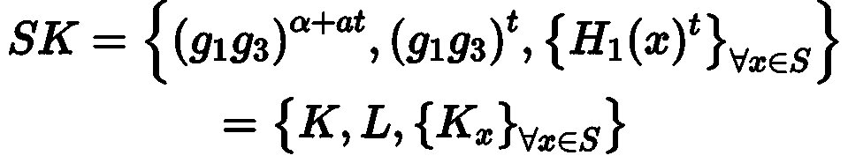



KeyGen
KeyGen($MSK,S$) -> $SK$
Random: $t∈Z_{N}^{}$
Secret key:
$$β$$

Slide 19
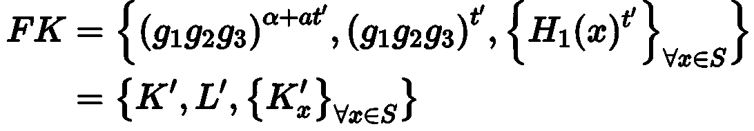




DenKeyGen
DenKeyGen($MSK,S$) -> $\{SK,FK\}$
Random: $t^{′}∈Z_{N}^{}$
Secret key: $SK=same as in KeyGen(MSK,S)$
Fake key:
$$β$$

Slide 20














Encrypt
Encrypt($PP,M,A=(m,q)$) -> $C$
$m$:$l$*n matrix
$$\vec{v}=\left(s,y_{2},…,y_{n}\right)∈Z_{N}^{n}$$
$m_{i}$: $i$th row of $m$
$$\vec{r}=\left(r_{1},…,r_{l}\right)∈Z_{N}^{l}$$
$λ_{i}=m_{i}\vec{v}$, $∀ⅈ∈\left\{1,⋯,l\right\}$
Random string:$t_{0}$, $t_{1}$
$b_{0}$, $b_{1}$ $∈\left\{1,0\right\}$
$$A_{b_{0}}=M⋅{e(g_{1}g_{3},g_{1}g_{3})}^{αs}$$
$$R$$
$$A_{{1−b}_{0}}⇐ G_{T}$$
$$B={\left(g_{1}g_{3}\right)}^{s}$$
$C_{i}={\left(g_{1}g_{3}\right)}^{βλ_{i}}H_{1}$ ${(q(i))}^{−r_{i}}$
$$D_{i}={\left(g_{1}g_{3}\right)}^{r_{i}},i=1,…,l$$
$V={H\left(M,t_{b_{1}}\right)≠}^{}$ $H\left(A_{{1−b}_{0}}⋅{e\left(g_{1}g_{3},g_{1}g_{3}\right)}^{−αs},t_{{1−b}_{1}}\right)$

Slide 21





DenEncrypt
DenEnc($PP,PK,M,M^{′},A$) -> $C^{′}$
$$A_{b_{0}}^{′}=M⋅{e(g_{3}, g_{3})}^{αs}$$
$$A_{1−b_{0}}^{′}=M^{′}⋅{e(g_{2}g_{3},g_{2}g_{3})}^{αs}$$
$$B^{′}={\left(g_{2}g_{3}\right)}^{s}$$
$C_{i}^{′}={\left(g_{2}g_{3}\right)}^{βλ_{i}}H_{1}$ ${(q(i))}^{−r_{i}}$
$$D_{i}^{′}={\left(g_{1}g_{3}\right)}^{r_{i}},i=1,…,l$$
$V={CH\left(M,t_{b_{1}}\right)=}^{}$ $CH\left(M^{′},t_{{1−b}_{1}}\right)$

Slide 22

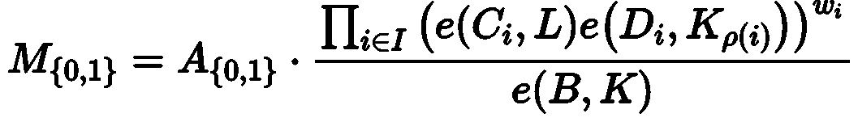








Decrypt
Decrypt($PP,SK,C$) -> $\{M,⊥\}$
If attribute set S satisfies access structure A:
Define:
This algorithm finds
such that
$$q$$
Then computes :
 | Normal ciphertext | Deniable ciphertext
Secret key | Correct message | Correct message
Fake key | Correct message | Fake message
$$q$$
$$M_{i} ,$$
If $v_{i,j}==V$
Result:
$$⊥ ,$$
$$otherwise$$

Slide 23

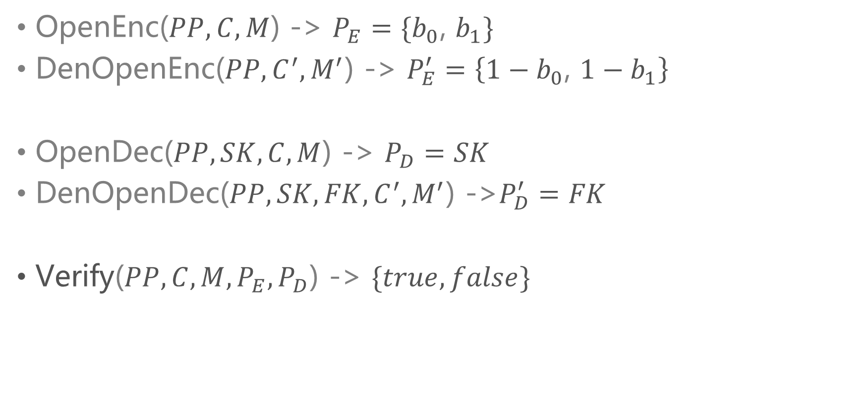



Verify
OpenEnc($PP,C,M$) -> $P_{E}=\{b_{0}\text{,} b_{1}\}$
DenOpenEnc($PP,C^{′},M^{′}$) -> $P_{E}^{′}=\left\{1−b_{0}\text{,} 1−b_{1}\right\}$
OpenDec($PP,SK,C,M$) -> $P_{D}=SK$
DenOpenDec($PP,SK,FK,C^{′},M^{′}$) ->$P_{D}^{′}=FK$
Verify($PP,C,M,P_{E},P_{D}$) -> $\{true,false\}$
$$true,$$
If $Decrypt(PP,P_{D},C)==M$
Result:
$$false ,$$
$$otherwise$$

Slide 24
Thank You

