Slide 1
F1 RACE STRATEGY ADVISOR
Which pit strategy maximizes finishing outcome?
THE FINDING
In wet street-circuit conditions, the strategy that maximizes P(top 10) is NOT the same as the strategy that maximizes P(top 5). A team optimizing only for points survival may be giving up top-5 upside.
👤 User
Race engineer · pit wall
"The decision this tool supports is: which stop count gives the best probability of finishing top 10 vs top 5 — and do they agree?"
⏱ Decision window
Pre-race briefing + laps 20–30
🎯 Decision
1-stop vs 2-stop tyre strategy
TARGET 1
TARGET 2
is_top10 Points survival (positions 1–10)
is_top5 Top-end conversion (positions 1–5)
IIT414W · F1 Race Strategy Advisor · Ariel Van Kilsdonk & David Hernández
1

Slide 2
Approach
Data · Split · Model · Calibration
📊 DATA
📅 TEMPORAL SPLIT (LOCKED)
🤖 MODEL
2,447 driver-race entries 6 seasons · 2019–2024 47 raw columns
TRAIN
2019–2021
1,132 rows
Calibrated Logistic Regression One-hot categorical features Platt scaling on 2022 block only
CALIB
2022
426 rows
TEST
2023–2024
889 rows
FEATURE CLASSIFICATION
PRE-RACE PREDICTORS
SCENARIO INPUTS (what-if controls)
AUDIT-ONLY (never model inputs)
qualifying_position · constructor_tier · circuit_type
n_stops · compound_sequence
weather_actual · safety_car · pace aggregates
Calibration: model fit on 2019–2021 → Platt sigmoid on 2022 → test set 2023–2024 evaluated ONCE. All reported probabilities are calibrated.
IIT414W · F1 Race Strategy Advisor · Ariel Van Kilsdonk & David Hernández
2

Slide 3
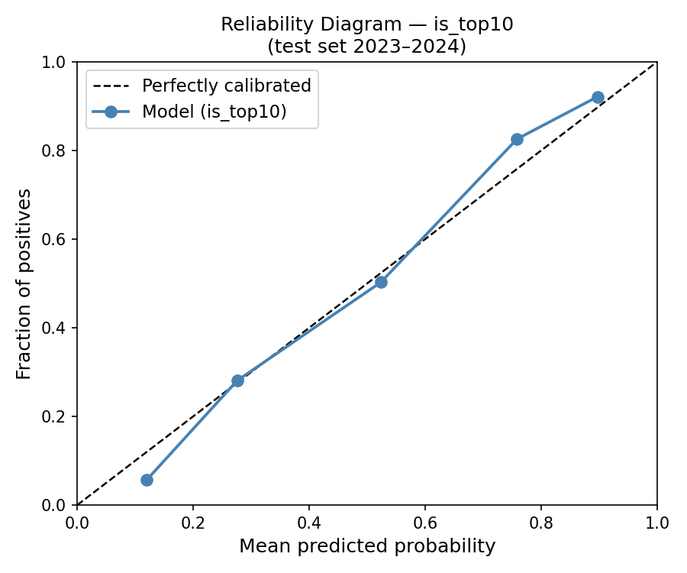
Results
Calibrated model vs baselines · test set 2023–2024
Target
Model
Brier ↓
ROC-AUC ↑
vs Baseline
is_top10
Calibrated Logistic Reg.
0.1447
0.8726
Beats heuristic Does NOT beat docent floor (0.1320)
is_top5
Calibrated Logistic Reg.
0.0958
0.9217
Beats heuristic baseline (0.1227) ▲ −0.0269 Brier
⚠ is_top10 does NOT beat the docent floor (0.1320). We report this honestly.
Fig. 1 — is_top10 reliability diagram
WHAT THIS MEANS FOR A STRATEGY ENGINEER
• is_top10 — competitive but below docent floor: use for scenario comparison only, not deployment. • is_top5 — meaningfully beats the heuristic: the expansion target adds real signal beyond the grid-rule.
IIT414W · F1 Race Strategy Advisor · Ariel Van Kilsdonk & David Hernández
3

Slide 4
The Strategy Trade-off
Wet street circuit · P1 grid · Top constructor — where the two targets disagree
Scenario: qualifying P1 · top constructor · street circuit · wet race (RF stress-test; weather_actual used as conditioning slice, not model feature)
Strategy
P(top 10) · is_top10
P(top 5) · is_top5
no_stop
0.2499
0.2722
one_stop
0.7196
0.6014 ★ BEST
two_stop
0.7251 ★ BEST
0.5956
three_plus_stop
0.7150
0.5714
⚡ DISAGREEMENT: is_top10 prefers two_stop (0.7251) · is_top5 prefers one_stop (0.6014) A team optimizing only for points survival would choose the wrong strategy for top-5 upside. The heuristic grid-rule cannot expose this — it assigns the same probability regardless of stop count.
IIT414W · F1 Race Strategy Advisor · Ariel Van Kilsdonk & David Hernández
4

Slide 5
Verdict & Deployment Conditions
RECOMMENDATION
Use this tool for structured scenario comparison when you need to distinguish between the points-survival-optimal strategy and the top-5-optimal strategy. Do not use as a single-number oracle. Use alongside pace data and expert judgment.
WE DO NOT RECOMMEND DEPLOYING THIS TOOL UNLESS:
1
Re-evaluated on ≥1 future season beyond 2024 achieving Brier ≤ 0.1320 on is_top10
2
Scenario sensitivity validated on ≥3 real race disagreement cases where our preferred strategy differed from the observed team decision
3
Calibration for wet and midfield slices remains within ±0.02 Brier of the overall test-set score on the new evaluation season
Key limitations: strategy confounding with car pace · no qualifying time gaps (column empty) · safety car binary only · 2019–2024 era only
IIT414W · F1 Race Strategy Advisor · Ariel Van Kilsdonk & David Hernández
5

Slide 6
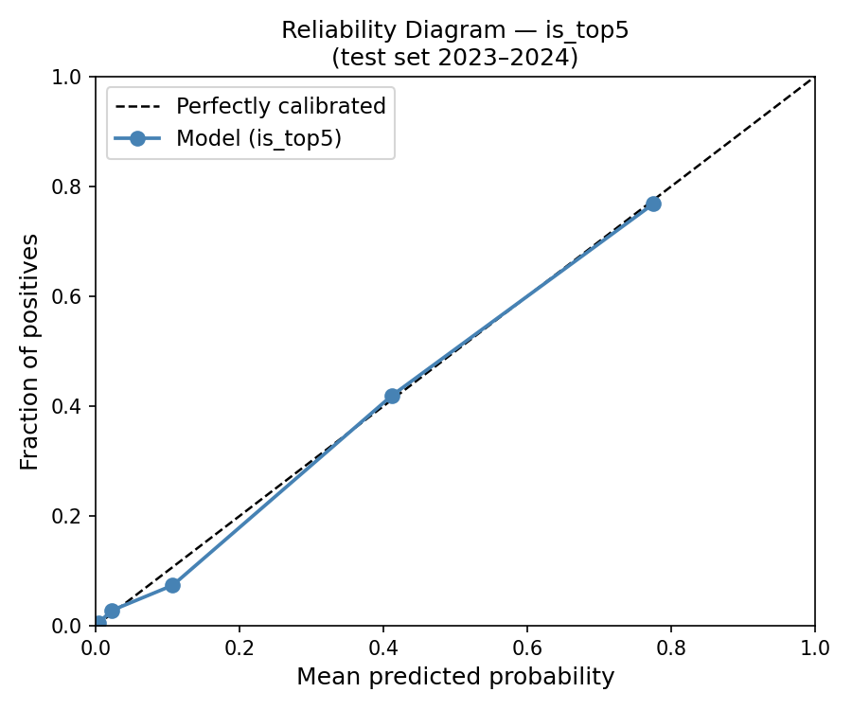
Backup — Slice Analysis & Calibration is_top5
Show only if asked · not part of the 7-minute pitch
Strategy type
Constructor tier
Weather
Slice
top10
top5
Slice
top10
top5
Slice
top10
top5
no_stop
0.0442
0.0281
backmarker
0.1295
0.0078
dry
0.1451
0.0923
one_stop
0.1559
0.1045
front
0.1121
0.1972
wet
0.1425
0.1183
two_stop
0.1350
0.0899
midfield
0.1700
0.1210
three_plus_stop
0.1521
0.0967
WORST SLICES (Q&A ready)
• is_top10 hardest: midfield (Brier 0.1700) — model near decision boundary • is_top5 hardest: front constructors (Brier 0.1972) — overconfidence near podium • Both targets degrade in wet conditions — strategy confounding is strongest there
Fig. 2 — is_top5 reliability diagram (test 2023–2024)
6
IIT414W · F1 Race Strategy Advisor · Ariel Van Kilsdonk & David Hernández

