Slide 1
Operating system raw disk & raid disk
Name : Enaam Jamal Aldany
Dr. Saeed Alzebda
21/11/2018

Slide 2
RAW DISK
* Definition : allows the user to view and analyze the raw sectors of all physical disks and partitions (including mounted images) attached to the system.
******************
* Provides : the ability to perform a deeper inspection of a drive, looking beyond the data stored in the file system's files and directories.
1

Slide 3
RAW DISK
* Required : if information of interest is suspected to be hidden within the raw sectors of the drive, which are not normally accessible via normal operating system mechanisms (e.g. free clusters, file slack space).
******************
* features : to forensics analysis such as text/hex searching, highlighting of relevant disk offsets, and decoding of known disk structures (such as MBR, GPT)
2

Slide 4
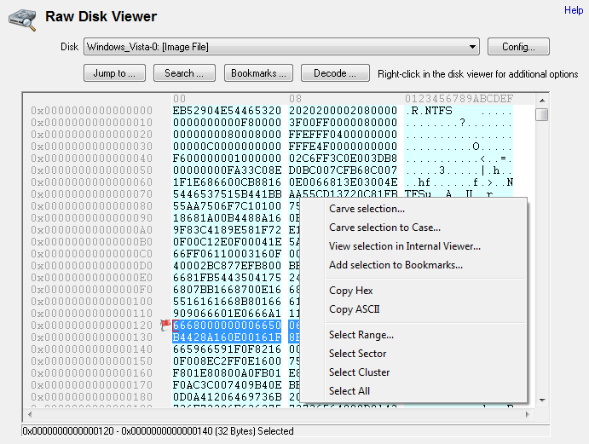
RAW DISK
3

Slide 5
RAID DISK
* Definition : can rebuild a single RAID image from a set of physical disk images belonging to a RAID array.
******************
* Able To : properly image systems with RAID configurations for forensics analysis is sometimes challenging, due to the fact that having access to the RAID parameters (such as the RAID level and stripe size) that were used may not be possible.
4

Slide 6
RAID DISK
* features :
Fault-Tolerance : Life-saving discs have many problems with HDD or SSD storage during storage.
Performance : Note The performance of various storage solutions within the matrix has changed in the read and write rates compared to the presence of one disk outside the matrix.
Capacity : Storage space that enables you to collect separate disks from small entities into a single entity with a large storage space.
5

Slide 7
RAID DISK
* RAID technology is divided into three ways :
Striping : The disk array divides the flow of data into small units with specific spaces and then writes them one by one, which increases the performance of the disks in that way.
Mirroring : The matrix stores a copy of the data on all its members in one time, which increases the performance of the storage disks in addition to avoiding errors that may occur to those disks during the operation.
Parity : enables the storage disks to deal with the data as a single block. While the loss of one of the members of the matrix, one of the disks stopped working, the missing data is recalculated and distributed again on the matrix.
6

Slide 8
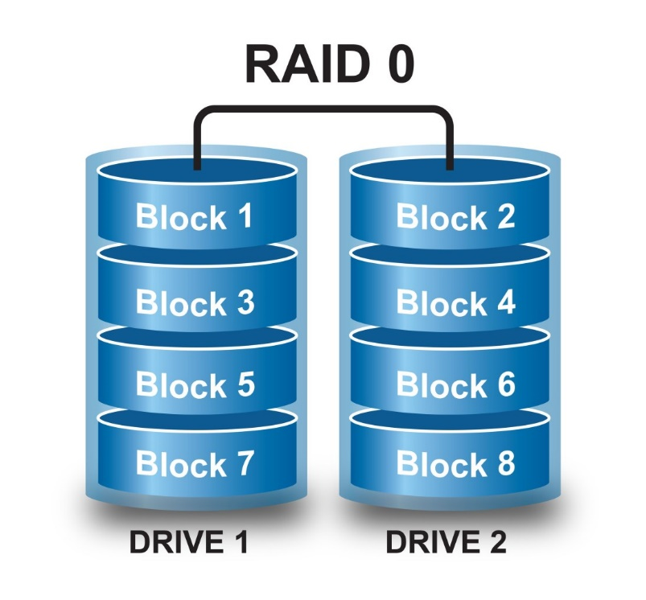
RAID DISK
* The following RAID levels are supported :
RAID 0 : The first level of RAID depends on the stripping method, which is characterized by higher reading rates for both solid state and mechanical disks . This level is used mainly in the personal systems of those looking for the highest performance of the disks and sacrifice the preservation of data, where often will not be important data which can be dispensed with.
7

Slide 9
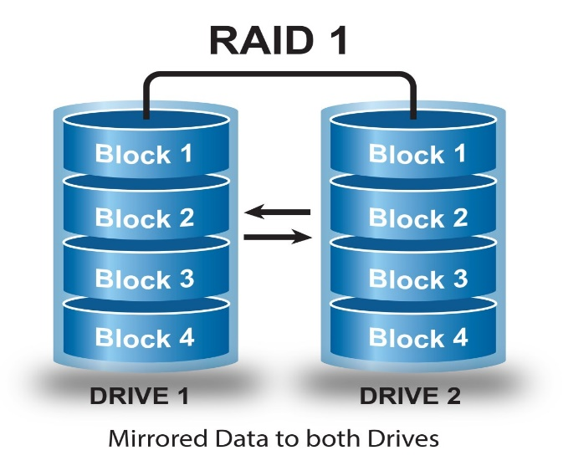
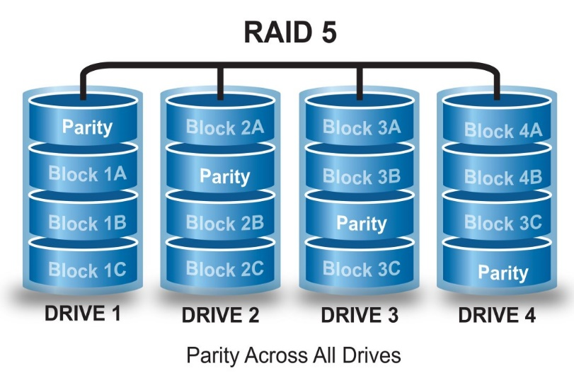
RAID DISK
RAID 1 : The second level depends on the second method Mirroring, when the fall of one of the two disks continue to operate matrix and allow the user to deal with the data until the repair or replace the damaged disk.
RAID 5 : This level combines the Parity method of handling data as a single block and relying on part of the first striping method, which is the speed of reading. This level is constantly characterized by a matrix at work that even dropped or stopped one disk from working.
8

Slide 10
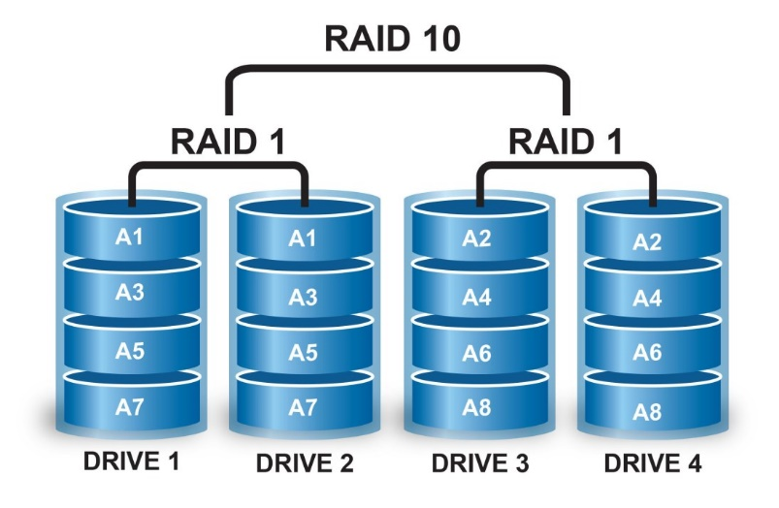
RAID DISK
RAID 1+0 : It depends on the first and second levels in the way data is handled and maintained, with the user enjoying the high speed of both reading and writing and the ability to preserve the available data.
9

Slide 11
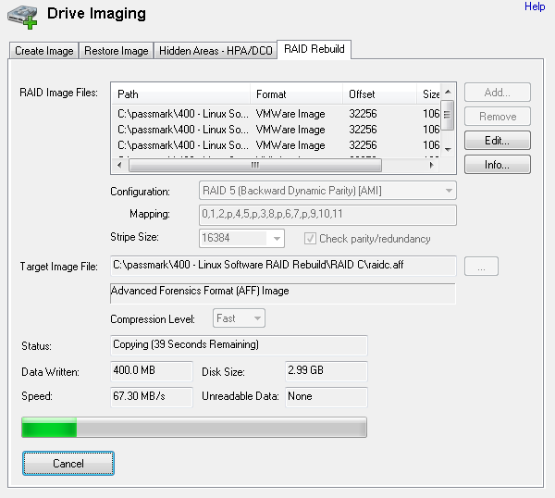
RAID DISK
Once the RAID parameters are known, they can be used to rebuild the RAID logical image.
10

Slide 12
References :
https://www.osforensics.com/raw-disk-viewer.html
https://www.osforensics.com/rebuild-raid.html
http://arabhardware.net
https://en.wikipedia.org/wiki/Rawdisk
https://en.wikipedia.org/wiki/Raiddisk

