Slide 1
STOCK ANALYSIS
Presented by: Sreeja Enabothula
Date: 17th April 2025

Slide 2
Abstract
This project presents a system for analyzing historical stock market data using Python, MySQL, and data visualization tools.
Stock data is imported from CSV files into a structured database, enabling efficient querying and filtering by date and symbol.
Users can view detailed statistics such as high, low, and volume for a given date, or visualize closing price trends over a selected range. The project aims to provide an interactive and informative platform for understanding stock performance and making data-driven insights.
It provides tools for filtering stock data by symbol or date and visualizes trends using Plotly.

Slide 3
Objective
• Collect, store, and analyze stock market data
• Visualize stock trends for selected symbols
• Enable dynamic filtering by date or symbol
• Provide insights into stock movements (volume, highs, lows)

Slide 4
Tools & Technologies
Languages & Libraries: Python, Pandas, Plotly, MySQL Connector
Database: MySQL
Visualization: Plotly Express
Plotly is an open-source Python library used to create interactive data visualizations like line charts, bar charts, scatter plots, and more.

Slide 5
PROJECT WORKFLOW
Step 1: Data Collection
Stock data is initially stored in a CSV file.
The file includes columns such as: date, symbol, open, high, low, close, and volume.
Step 2: Database Setup
A MySQL database is created with a table named stocks.
Each row in the table represents one day of trading data for one stock.
Step 3: Data Ingestion
The CSV data is loaded using Pandas.
Each row is inserted into the database using mysql.connector.

Slide 6
Step 4: User Input Users are prompted to enter: A stock symbol (e.g., AAPL) A date range for trend visualization A specific date for viewing detailed stats Step 5: Data Retrieval Based on input, SQL queries retrieve relevant data: Closing prices for visualization Full stats (high, low, volume) for a specific date Step 6: Data Visualization Plotly is used to create interactive line charts showing stock price movements over time. Users can hover to view specific data points, zoom in/out, or export visuals.

Slide 7
Database Design
Table Name: stocks
Schema:
- id (Primary Key, INT AUTO_INCREMENT)
- date (DATE)
- symbol (VARCHAR)
- open, high, low, close (FLOAT)
- volume (BIGINT)

Slide 8
Data Analysis Features
User Inputs:
- Stock Symbol
- Date Range
- Specific Date
Outputs:
- Price trends over time
- Daily stats (high, low, volume)

Slide 9
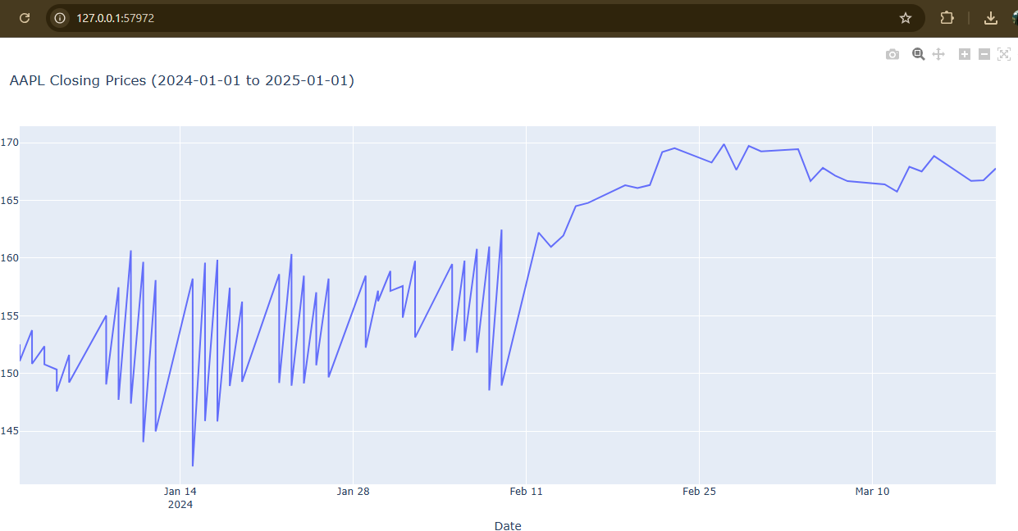
Visualizations

Slide 10
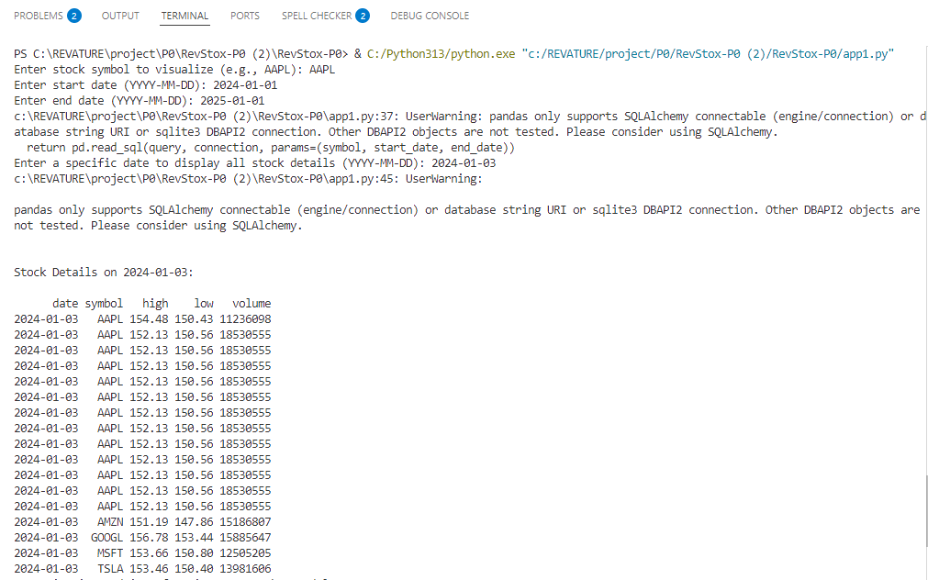
Sample Output

Slide 11
Conclusion
The project demonstrates how historical stock data can be turned into meaningful insights using data processing, database management, and visualization techniques. It forms a strong base for enhancements like real-time API integration, machine learning for price prediction, or deploying a full web dashboard.

Slide 12
THANK YOU

