Slide 1
JavaSE
Instructor:
Charles Cao, Founder of Service ECVictor Inc.
Sr. Software Development Engineer in Expedia
10+ Years of Software development experience
Chandler Zhu, Java Tech Lead of CGI
10+ Years of Software development experience
Notes:
‹#›

Slide 2
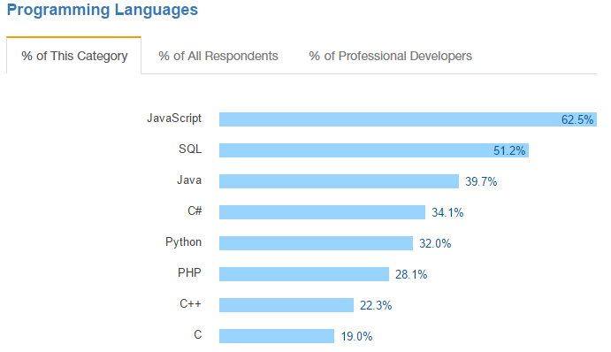
Introduction
Java Platform, Standard Edition (Java SE) lets you develop and deploy Java applications on desktops and servers, as well as in today's demanding embedded environments. Java offers the rich user interface, performance, versatility, portability, and security that today's applications require.
Notes:
‹#›

Slide 3
ECV Learning Eco-system
JavaSE -> QA Automation Testing -> Internship -> Landing a job
Easy to learn
Great amount of job opportunities
JaveSE -> JaveEE -> Internship -> Landing a job
More effort needed
Better career potential

Slide 4
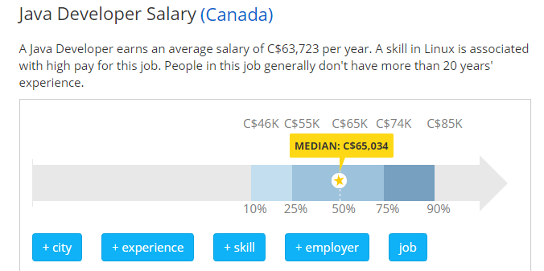
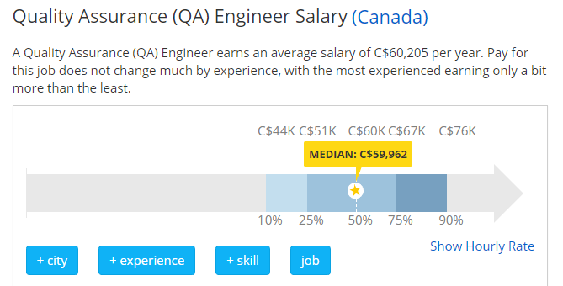
Job Market
Notes:
‹#›

Slide 5
Self Introduction
Please take 2-3 minutes to introduce yourself to the class and try to present relevant information.
Be a good listener!
It’s the time to show!

Slide 6
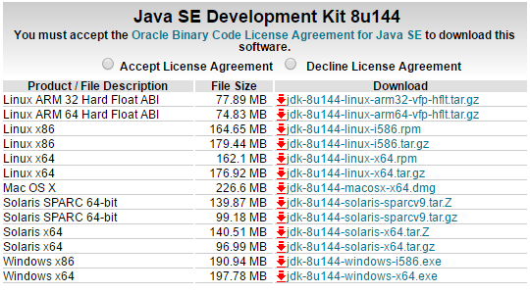
System Requirements
Go to Oracle official website and download JDK according to your operating system.
Notes:
‹#›

Slide 7
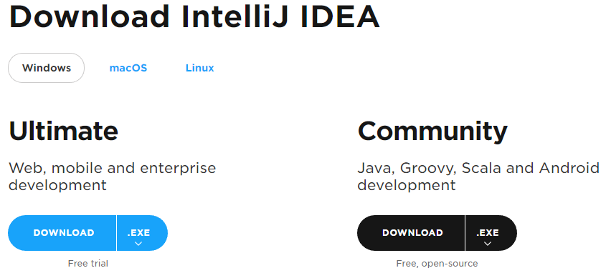
System Requirements
Download IntelliJ from Jet brain:
https://www.jetbrains.com/idea/download/#section=windows

Slide 8
JVM
JVM stands for Java virtual machine.
At run-time (when the program is running), the JVM reads and interprets .class files and executes the program's instructions on the native hardware platform for which the JVM was written. The JVM interprets the bytecode just as a CPU would interpret assembly-language instructions.
All java processes are running in JVM, no separate process can be seen from outside.
JVM can run on most operating systems in the market, makes it cross-platform.
Compile once, run everywhere!
Notes:
‹#›

Slide 9
Hello World!
Main method is the entry point of a java program.
Let’s try the following code:
public class MainExample { public static void main(String[] args) { String helloWorld = "Hello World!"; System.out.println(helloWorld); } }
Notes:
‹#›

Slide 10
Primitive Data Types
byte: The byte data type is an 8-bit signed two's complement integer.
short: The short data type is a 16-bit signed two's complement integer.
int: By default, the int data type is a 32-bit signed two's complement integer,
long: The long data type is a 64-bit two's complement integer.
float: Float data type is a single-precision 32-bit IEEE 754 floating point
double: double data type is a double-precision 64-bit IEEE 754 floating point
boolean: boolean data type represents one bit of information
char: char data type is a single 16-bit Unicode character
Notes:
‹#›

Slide 11
Operators
Arithmetic Operators: + - * / ++ --
Relational Operators: == < < != >= <=
Logical Operators: && ||
Assignment Operators: = += -= *= /=
Notes:
‹#›

Slide 12
Variables
A variable provides us with named storage that our programs can manipulate. Each variable in Java has a specific type, which determines the size and layout of the variable's memory; the range of values that can be stored within that memory; and the set of operations that can be applied to the variable.
int a, b, c; // Declares three ints, a, b, and c. int a = 10, b = 10; // Example of initialization byte B = 22; // initializes a byte type variable B. double pi = 3.14159; // declares and assigns a value of PI. char a = 'a'; // the char variable is initialized with value 'a'
String str = “hello world” //the String is assiged to value “hello world”

Slide 13
String
The most useful/popular Data type(Object)
The most direct way to create a string is to write:
String greeting = "Hello world!";
As with any other object, you can create String objects by using the new keyword and a constructor. The String class has thirteen constructors that allow you to provide the initial value of the string using different sources, such as an array of characters:
char[] helloArray = { 'h', 'e', 'l', 'l', 'o', '.' };
String helloString = new String(helloArray);
System.out.println(helloString);
Notes:
‹#›
‹#›

Slide 14
Manipulation of String
Creation: String str = “abc”;
Length: int length = str.length();
Concatenating: String con = str + “cba”;
Substring: str.subString(1);
Equals: “abc”.equals(str)
IndexOf: int index = str.indexOf(“c”);
Split: String[] strs = str.split(“”);
Notes:
‹#›

Slide 15
Constants and Final Keyword
Java does not directly support constants. However, a final variable is effectively a constant.
The static modifier causes the variable to be available without loading an instance of the class where it is defined. The final modifier causes the variable to be unchangeable.
e.g.
public static final int MAX_UNITS = 25;
Notes:
‹#›

Slide 16
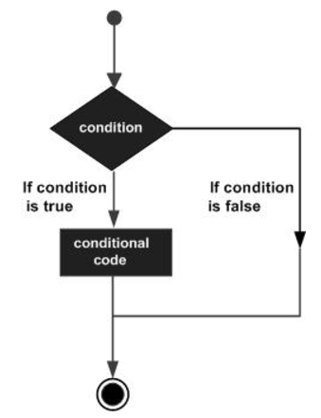
Decision Making
if Statement
if (boolean expression){
//do something if true
}
else Statement
if (boolean expression) {
//do something if true
else {
//do something if false
}
Notes:
‹#›

Slide 17
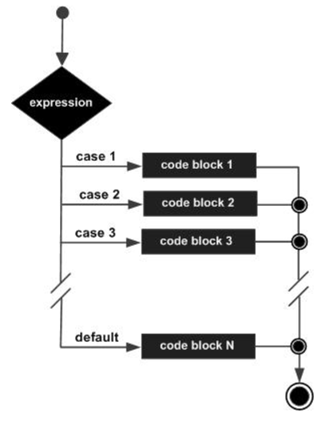
Decision Making
switch(expression) { case value : // Statements break; // optional case value : // Statements break; // optional // You can have any number of case statements. default : // Optional // Statements }
Notes:
‹#›

Slide 18
Loop
The most popular loop in Java
for(expression 1; expression 2;expression 3){
}
for(declaration : expression) { // Statements }
Notes:
‹#›

Slide 19
Loop
while (expression)
{ statement(s) }
do
{ statement(s) }
while (expression);
Notes:
‹#›

Slide 20
Package & Import
A package is a namespace for organizing classes and interfaces in a logical manner. Placing your code into packages makes large software projects easier to manage.
Import: Import statement is a way of giving the proper location for the compiler to find that particular class.
import java.io.*;

Slide 21
Object & Class
Object − An object is a software bundle of related state and behavior. Software objects are often used to model the real-world objects that you find in everyday life. This lesson explains how state and behavior are represented within an object, introduces the concept of data encapsulation, and explains the benefits of designing your software in this manner.
Class − In the real world, you'll often find many individual objects all of the same kind. There may be thousands of other bicycles in existence, all of the same make and model. Each bicycle was built from the same set of blueprints and therefore contains the same components. In object-oriented terms, we say that your bicycle is an instance of the class of objects known as bicycles. A class is the blueprint from which individual objects are created.
Notes:
‹#›

Slide 22
Object(instance) & Class
The new keyword:
Car car =new Car();
Constructor: Every class has a constructor. If we do not explicitly write a constructor for a class, the Java compiler builds a default constructor for that class.
Each time a new object is created, at least one constructor will be invoked.

Slide 23
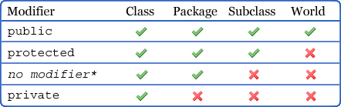
Members & Modifiers
Variables
Modifier
Scope
Static
This keyword
Methods
Modifier
Access level
Static
This keyword
Notes:
‹#›

Slide 24
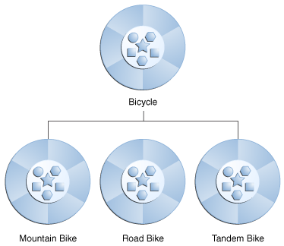
Inheritance
Inheritance provides a powerful and natural mechanism for organizing and structuring your software. This section explains how classes inherit state and behavior from their superclasses, and explains how to derive one class from another using the simple syntax provided by the Java programming language.

Slide 25
Inheritance
Overriding and overloading
The real object type in the run-time, not the reference variable's type, determines which overridden method is used at runtime. In contrast, reference type determines which overloaded method will be used at compile time.
Polymorphism applies to overriding, not to overloading.
Overriding is a run-time concept while overloading is a compile-time concept.

