Slide 1
JavaSE
Instructor:
Charles Cao, Founder of Service ECVictor Inc.
Sr. Software Development Engineer in Expedia
10+ Years of Software development experience
Chandler Zhu, Java Tech Lead of CGI
10+ Years of Software development experience
Notes:
‹#›

Slide 2
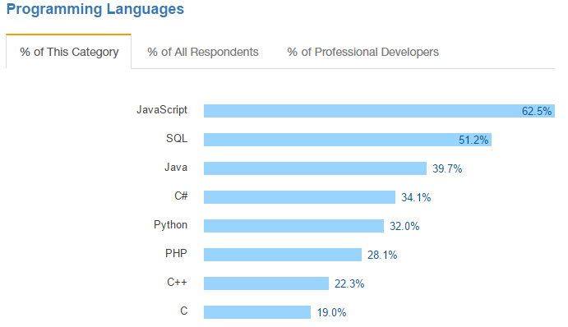
Introduction
Java Platform, Standard Edition (Java SE) lets you develop and deploy Java applications on desktops and servers, as well as in today's demanding embedded environments. Java offers the rich user interface, performance, versatility, portability, and security that today's applications require.
Notes:
‹#›

Slide 3
ECV Learning Eco-system
JavaSE -> QA Automation Testing -> Internship -> Landing a job
Easy to learn
Great amount of job opportunities
JaveSE -> JaveEE -> Internship -> Landing a job
More effort needed
Better career potential

Slide 4
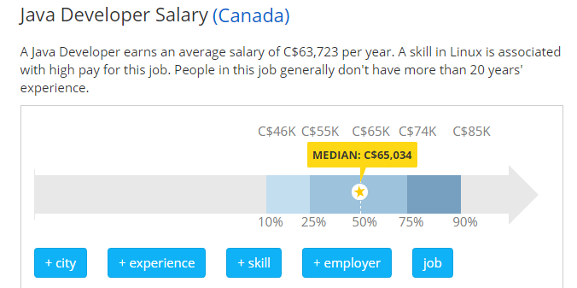
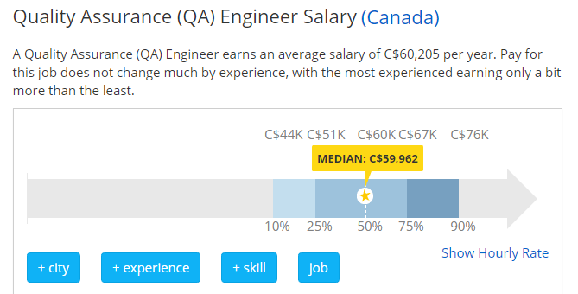
Job Market
Notes:
‹#›

Slide 5
Self Introduction
Please take 2-3 minutes to introduce yourself to the class and try to present relevant information.
Be a good listener!
It’s the time to show!

Slide 6
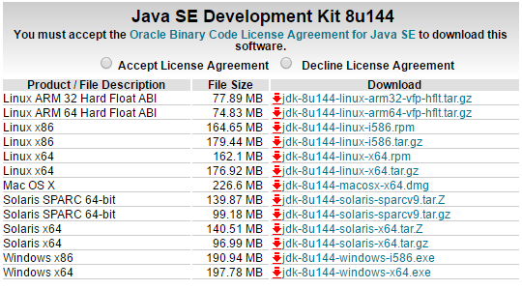
System Requirements
Go to Oracle official website and download JDK according to your operating system.
Notes:
‹#›

Slide 7
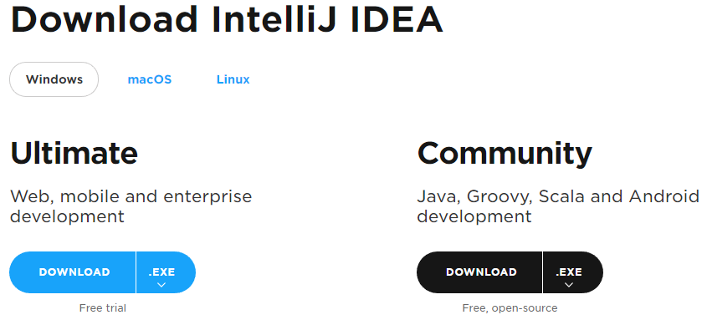
System Requirements
Download IntelliJ from Jet brain:
https://www.jetbrains.com/idea/download/#section=windows

Slide 8
JVM
JVM stands for Java virtual machine.
At run-time (when the program is running), the JVM reads and interprets .class files and executes the program's instructions on the native hardware platform for which the JVM was written. The JVM interprets the bytecode just as a CPU would interpret assembly-language instructions.
All java processes are running in JVM, no separate process can be seen from outside.
JVM can run on most operating systems in the market, makes it cross-platform.
Compile once, run everywhere!
Notes:
‹#›

Slide 9
Hello World!
Main method is the entry point of a java program.
Let’s try the following code:
public class MainExample { public static void main(String[] args) { String helloWorld = "Hello World!"; System.out.println(helloWorld); } }
Notes:
‹#›

Slide 10
Primitive Data Types
byte: The byte data type is an 8-bit signed two's complement integer.
short: The short data type is a 16-bit signed two's complement integer.
int: By default, the int data type is a 32-bit signed two's complement integer,
long: The long data type is a 64-bit two's complement integer.
float: Float data type is a single-precision 32-bit IEEE 754 floating point
double: double data type is a double-precision 64-bit IEEE 754 floating point
boolean: boolean data type represents one bit of information
char: char data type is a single 16-bit Unicode character
Notes:
‹#›

Slide 11
Operators
Arithmetic Operators: + - * / ++ --
Relational Operators: == < < != >= <=
Logical Operators: && ||
Assignment Operators: = += -= *= /=
Notes:
‹#›

Slide 12
Variables
A variable provides us with named storage that our programs can manipulate. Each variable in Java has a specific type, which determines the size and layout of the variable's memory; the range of values that can be stored within that memory; and the set of operations that can be applied to the variable.
int a, b, c; // Declares three ints, a, b, and c. int a = 10, b = 10; // Example of initialization byte B = 22; // initializes a byte type variable B. double pi = 3.14159; // declares and assigns a value of PI. char a = 'a'; // the char variable is initialized with value 'a'
String str = “hello world” //the String is assiged to value “hello world”

Slide 13
String
The most useful/popular Data type(Object)
The most direct way to create a string is to write:
String greeting = "Hello world!";
As with any other object, you can create String objects by using the new keyword and a constructor. The String class has thirteen constructors that allow you to provide the initial value of the string using different sources, such as an array of characters:
char[] helloArray = { 'h', 'e', 'l', 'l', 'o', '.' };
String helloString = new String(helloArray);
System.out.println(helloString);
Notes:
‹#›
‹#›

Slide 14
Manipulation of String
Creation: String str = “abc”;
Length: int length = str.length();
Concatenating: String con = str + “cba”;
Substring: str.subString(1);
Equals: “abc”.equals(str)
IndexOf: int index = str.indexOf(“c”);
Split: String[] strs = str.split(“”);
Notes:
‹#›

Slide 15
Constants and Final Keyword
Java does not directly support constants. However, a final variable is effectively a constant.
The static modifier causes the variable to be available without loading an instance of the class where it is defined. The final modifier causes the variable to be unchangeable.
e.g.
public static final int MAX_UNITS = 25;
Notes:
‹#›

