Slide 1
JavaSE
Instructor:
Charles Cao, Founder of Service ECVictor Inc.
Sr. Software Development Engineer in Expedia
10+ Years of Software development experience
Chandler Zhu, Java Tech Lead of CGI
10+ Years of Software development experience
Notes:
31

Slide 2
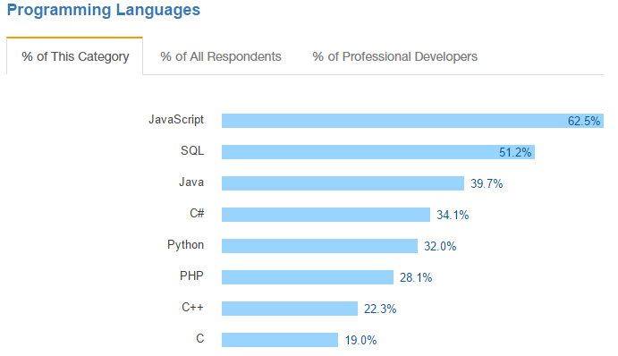
Introduction
Java Platform, Standard Edition (Java SE) lets you develop and deploy Java applications on desktops and servers, as well as in today's demanding embedded environments. Java offers the rich user interface, performance, versatility, portability, and security that today's applications require.
Notes:
31

Slide 3
ECV Learning Eco-system
JavaSE -> QA Automation Testing -> Internship -> Landing a job
Easy to learn
Great amount of job opportunities
JaveSE -> JaveEE -> Internship -> Landing a job
More effort needed
Better career potential
Notes:
<number>
<number>

Slide 4
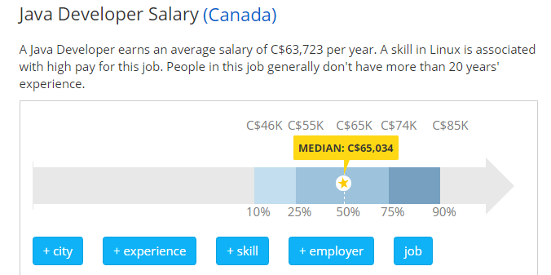
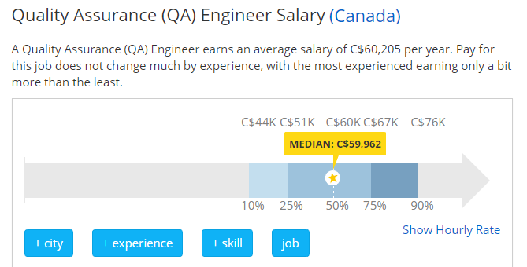
Job Market
Notes:
31

Slide 5
Self Introduction
Please take 2-3 minutes to introduce yourself to the class and try to present relevant information.
Be a good listener!
It’s the time to show!

Slide 6
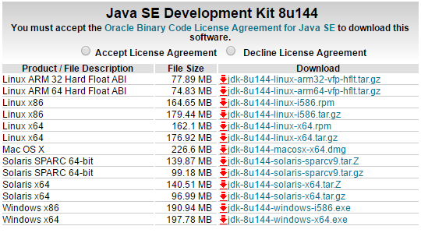
System Requirements
Go to Oracle official website and download JDK according to your operating system.
Notes:
31

Slide 7
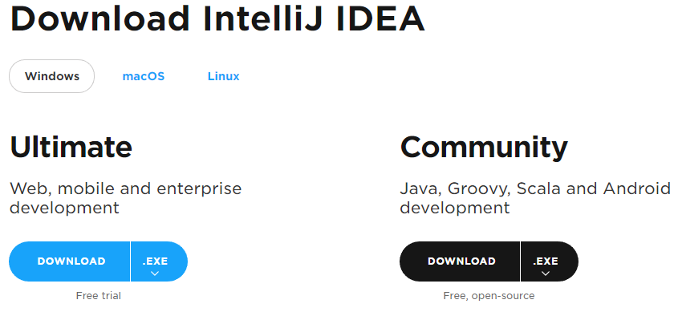
System Requirements
Download IntelliJ from Jet brain:
https://www.jetbrains.com/idea/download/#section=windows
Notes:
<number>
<number>

Slide 8
JVM
JVM stands for Java virtual machine.
At run-time (when the program is running), the JVM reads and interprets .class files and executes the program's instructions on the native hardware platform for which the JVM was written. The JVM interprets the bytecode just as a CPU would interpret assembly-language instructions.
All java processes are running in JVM, no separate process can be seen from outside.
JVM can run on most operating systems in the market, makes it cross-platform.
Compile once, run everywhere!
Notes:
31

Slide 9
Hello World!
Main method is the entry point of a java program.
Let’s try the following code:
public class MainExample { public static void main(String[] args) { String helloWorld = "Hello World!"; System.out.println(helloWorld); } }
Notes:
31

Slide 10
Primitive Data Types
byte: The byte data type is an 8-bit signed two's complement integer.
short: The short data type is a 16-bit signed two's complement integer.
int: By default, the int data type is a 32-bit signed two's complement integer,
long: The long data type is a 64-bit two's complement integer.
float: Float data type is a single-precision 32-bit IEEE 754 floating point
double: double data type is a double-precision 64-bit IEEE 754 floating point
boolean: boolean data type represents one bit of information
char: char data type is a single 16-bit Unicode character
Notes:
31

Slide 11
Operators
Arithmetic Operators: + - * / ++ --
Relational Operators: == < < != >= <=
Logical Operators: && ||
Assignment Operators: = += -= *= /=
Notes:
31

Slide 12
Variables
A variable provides us with named storage that our programs can manipulate. Each variable in Java has a specific type, which determines the size and layout of the variable's memory; the range of values that can be stored within that memory; and the set of operations that can be applied to the variable.
int a, b, c; // Declares three ints, a, b, and c. int a = 10, b = 10; // Example of initialization byte B = 22; // initializes a byte type variable B. double pi = 3.14159; // declares and assigns a value of PI. char a = 'a'; // the char variable is initialized with value 'a'
String str = “hello world” //the String is assiged to value “hello world”
Notes:
<number>
<number>

Slide 13
String
The most useful/popular Data type(Object)
The most direct way to create a string is to write:
String greeting = "Hello world!";
As with any other object, you can create String objects by using the new keyword and a constructor. The String class has thirteen constructors that allow you to provide the initial value of the string using different sources, such as an array of characters:
char[] helloArray = { 'h', 'e', 'l', 'l', 'o', '.' };
String helloString = new String(helloArray);
System.out.println(helloString);
Notes:
31
31

Slide 14
Manipulation of String
Creation: String str = “abc”;
Length: int length = str.length();
Concatenating: String con = str + “cba”;
Substring: str.subString(1);
Equals: “abc”.equals(str)
IndexOf: int index = str.indexOf(“c”);
Split: String[] strs = str.split(“”);
Notes:
31

Slide 15
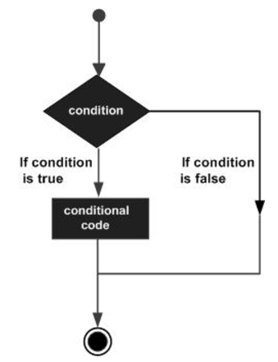
Decision Making
if Statement
if (boolean expression){
//do something if true
}
else Statement
if (boolean expression) {
//do something if true
else {
//do something if false
}
Notes:
31

Slide 16
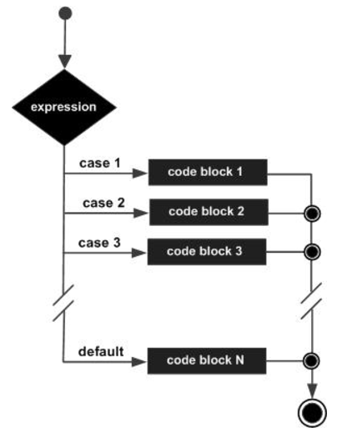
Decision Making
switch(expression) { case value : // Statements break; // optional case value : // Statements break; // optional // You can have any number of case statements. default : // Optional // Statements }
Notes:
31

Slide 17
Loop
The most popular loop in Java
for(expression 1; expression 2;expression 3){
}
for(declaration : expression) { // Statements }
Notes:
31

Slide 18
Loop
while (expression)
{ statement(s) }
do
{ statement(s) }
while (expression);
Notes:
31

Slide 19
Package & Import
A package is a namespace for organizing classes and interfaces in a logical manner. Placing your code into packages makes large software projects easier to manage.
Import: Import statement is a way of giving the proper location for the compiler to find that particular class.
import java.io.*;

Slide 20
Object & Class
Object − An object is a software bundle of related state and behavior. Software objects are often used to model the real-world objects that you find in everyday life. This lesson explains how state and behavior are represented within an object, introduces the concept of data encapsulation, and explains the benefits of designing your software in this manner.
Class − In the real world, you'll often find many individual objects all of the same kind. There may be thousands of other bicycles in existence, all of the same make and model. Each bicycle was built from the same set of blueprints and therefore contains the same components. In object-oriented terms, we say that your bicycle is an instance of the class of objects known as bicycles. A class is the blueprint from which individual objects are created.
Notes:
31

Slide 21
Object(instance) & Class
The new keyword:
Car car =new Car();
Constructor: Every class has a constructor. If we do not explicitly write a constructor for a class, the Java compiler builds a default constructor for that class.
Each time a new object is created, at least one constructor will be invoked.
Notes:
<number>
<number>

Slide 22
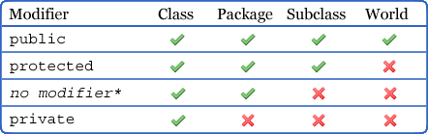
Members & Modifiers
Variables
Modifier
Scope
Static
This keyword
Methods
Modifier
Access level
Static
This keyword
Notes:
31

Slide 23
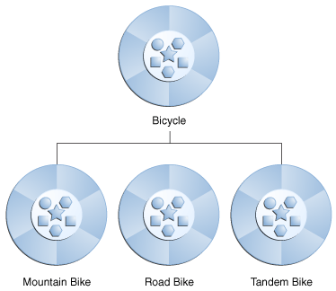
Inheritance
Inheritance provides a powerful and natural mechanism for organizing and structuring your software. This section explains how classes inherit state and behavior from their superclasses, and explains how to derive one class from another using the simple syntax provided by the Java programming language.

Slide 24
Private member in a superclass
A subclass does not inherit the private members of its parent class. However, if the superclass has public or protected methods for accessing its private fields, these can also be used by the subclass.
A nested class has access to all the private members of its enclosing class—both fields and methods. Therefore, a public or protected nested class inherited by a subclass has indirect access to all of the private members of the superclass.
Notes:
31

Slide 25
Abstract Class/Method
An abstract class is a class that is declared abstract—it may or may not include abstract methods. Abstract classes cannot be instantiated, but they can be subclassed.
An abstract method is a method that is declared without an implementation (without braces, and followed by a semicolon), like this: abstract void moveTo(double deltaX, double deltaY);
If a class includes abstract methods, then the class itself must be declared abstract, as in:
public abstract class GraphicObject {
abstract void draw(); }
When an abstract class is subclassed, the subclass usually provides implementations for all of the abstract methods in its parent class. However, if it does not, then the subclass must also be declared abstract.
Notes:
<number>
<number>

Slide 26
Interface
In the Java programming language, an interface is a reference type, similar to a class, that can contain only constants, method signatures, default methods, static methods, and nested types. Method bodies exist only for default methods and static methods. Interfaces cannot be instantiated—they can only be implemented by classes or extended by other interfaces. Extension is discussed later in this lesson.
Defining an interface is similar to creating a new class:
public interface OperateCar {
public void drive();//no implementation
}
Notes:
<number>
<number>

Slide 27
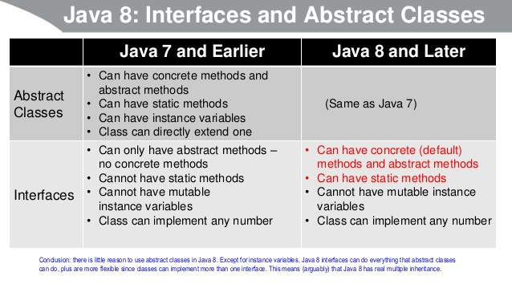
Interface vs Abstract class
Notes:
<number>
<number>

Slide 28
Object-oriented Programming
Polymorphism: When one task is performed by different ways i.e. known as polymorphism. For example: to convince the customer differently, to draw something e.g. shape or rectangle etc.
In java, we use method overloading and method overriding to achieve polymorphism.
Abstraction is the process of abstraction in Java is used to hide certain details and only show the essential features of the object. In other words, it deals with the outside view of an object (interface).
Encapsulation is a process of binding or wrapping the data and the codes that operates on the data into a single entity. This keeps the data safe from outside interface and misuse. One way to think about encapsulation is as a protective wrapper that prevents code and data from being arbitrarily accessed by other code defined outside the wrapper.
Notes:
<number>
<number>

Slide 29
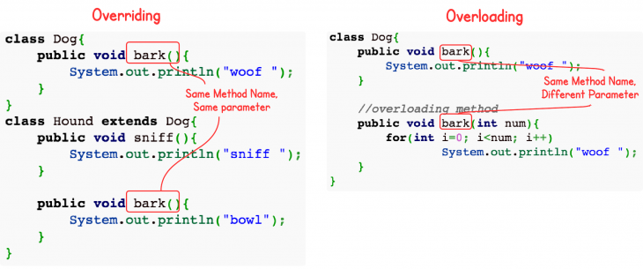
Overriding vs Overloading
Notes:
<number>
<number>

Slide 30
Java Bean
An example of Encapsulation:
All properties private (use getters/setters)
A public constructor
Implements Serializable.

Slide 31
Constants and Final Keyword
Java does not directly support constants. However, a final variable is effectively a constant.
The static modifier causes the variable to be available without loading an instance of the class where it is defined. The final modifier causes the variable to be unchangeable.
e.g.
public static final int MAX_UNITS = 25;
Notes:
31

Slide 32
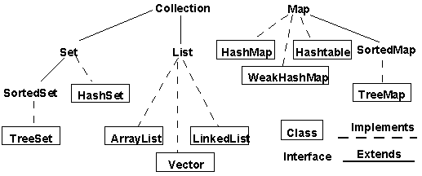
Collection & Map
Notes:
31

Slide 33
ArrayList and HashMap
ArrayList: Resizable-array implementation of the List interface (sub interface of Collection). Implements all optional list operations, and permits all elements, including null. In addition to implementing the List interface, this class provides methods to manipulate the size of the array that is used internally to store the list. (This class is roughly equivalent to Vector, except that it is unsynchronized.)
HashMap: Hash table based implementation of the Map interface. This implementation provides all of the optional map operations, and permits null values and the null key. (The HashMap class is roughly equivalent to Hashtable, except that it is unsynchronized and permits nulls.) This class makes no guarantees as to the order of the map; in particular, it does not guarantee that the order will remain constant over time.
Notes:
31

Slide 34
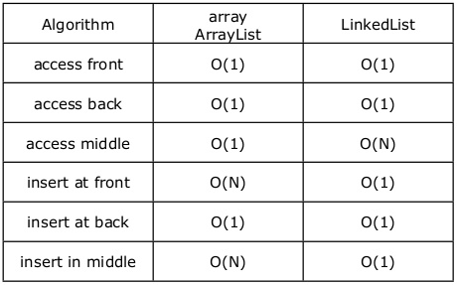
ArrayList vs LinkedList
Notes:
31

Slide 35
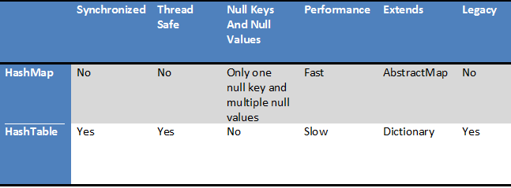
HashMap vs HashTable
Notes:
31

Slide 36
Exception
An exception (or exceptional event) is a problem that arises during the execution of a program. When an Exception occurs the normal flow of the program is disrupted and the program/Application terminates abnormally, which is not recommended, therefore, these exceptions are to be handled.
There are two types built-in Exceptions in Java:
Checked Exception - Compile Time Exception
Unchecked Exception - Runtime Exception
Notes:
31

Slide 37
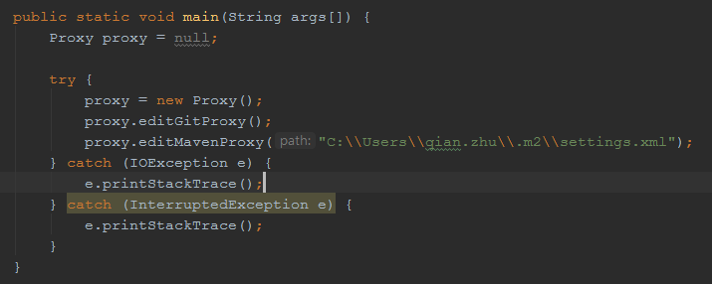
An example of Exception Handling
Notes:
31

Slide 38
Checked Exception
Checked exceptions − A checked exception is an exception that occurs at the compile time, these are also called as compile time exceptions. These exceptions cannot simply be ignored at the time of compilation, the programmer should take care of (handle) these exceptions or the code cannot be compiled.
Example:
IOException, InterruptedException
Notes:
31

Slide 39
Unchecked Exception
Unchecked exceptions − An unchecked exception is an exception that occurs at the time of execution. These are also called as Runtime Exceptions. These include programming bugs, such as logic errors or improper use of an API. Runtime exceptions are ignored at the time of compilation.
Example:
NullPointerException, IndexOutOfBoundsException
Notes:
31

Slide 40
Logical Thinking
Is the NumberFormatException consider a checked exception? No. NumberFormatException is unchecked (= is subclass of RuntimeException). Why?
The number is an user input which can only be decided at Runtime.
Is RuntimeException an unchecked exception? Yes, exactly.
Notes:
31

Slide 41
Exception Handling
Execution order:
System.exit(1) Try {} Catch {} Finally {} Return
Best practice:
Always throw to the highest level possible
Always log exceptions
Notes:
31

Slide 42
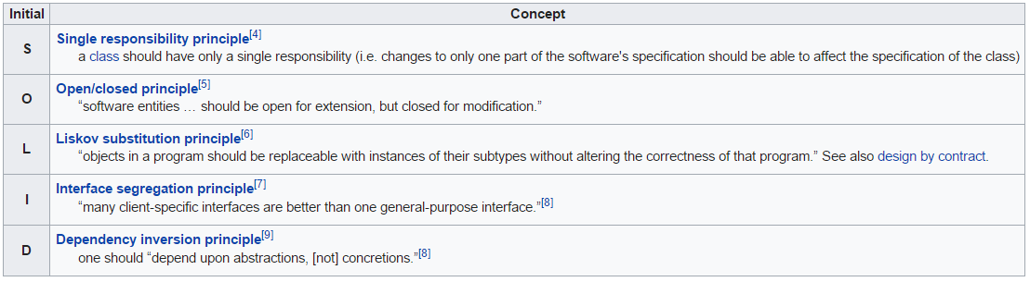
SOLID
Notes:
<number>
<number>

Slide 43
Process and Threads
A process has a self-contained execution environment. A process generally has a complete, private set of basic run-time resources; in particular, each process has its own memory space.
Threads are sometimes called lightweight processes. Both processes and threads provide an execution environment, but creating a new thread requires fewer resources than creating a new process.
Threads exist within a process — every process has at least one. Threads share the process's resources, including memory and open files. This makes for efficient, but potentially problematic, communication.
Java process are not visible because of JVM.
Notes:
31

Slide 44
Java Multithreading
Extends Thread
Implements Runnable/Callable
Implements run() method
new instance
Thread.start();
Notes:
<number>
<number>

Slide 45
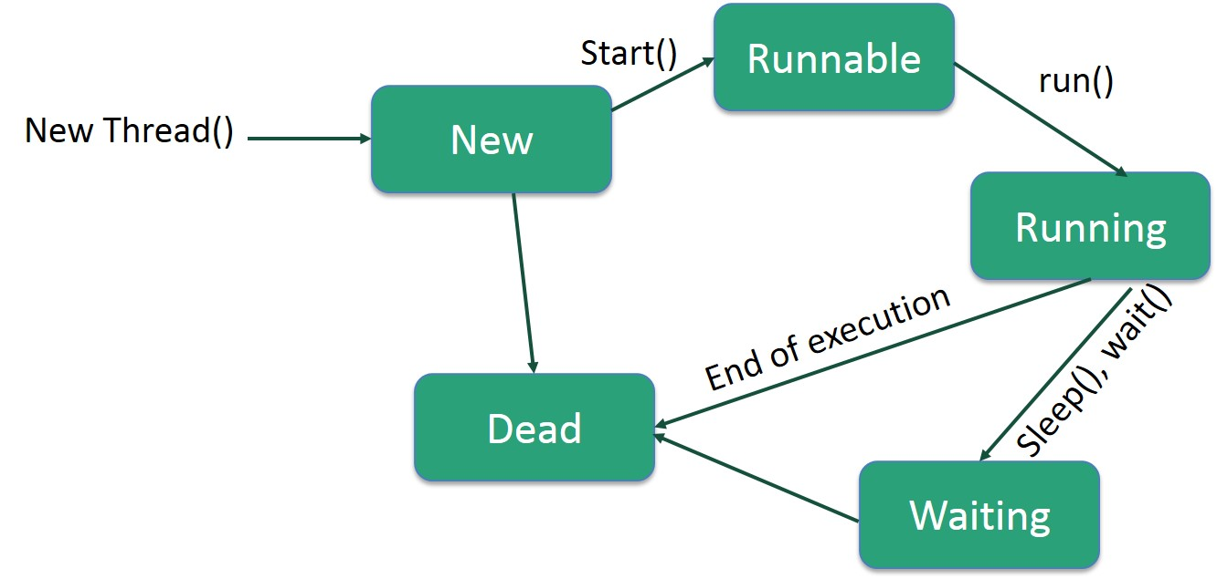
Life Cycle of a Thread
Notes:
31

Slide 46
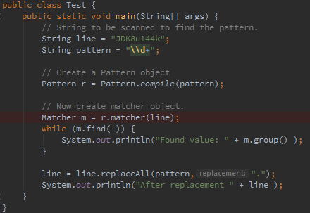
Regular Expression
Notes:
31

Slide 47
Serialization
Serialize an object means to convert its state to a byte stream so that the byte stream can be reverted back into a copy of the object.
Deserialization is the process of converting the serialized form of an object back into a copy of the object.
Why use Serialization:
Communication
Persistence
Notes:
31

Slide 48
Finally
THANK YOU!
MERCI!
Notes:
31

