Slide 1


COMPILER DESIGN • CSA1401
Lexical Analysis and the
Role of the Lexical Analyzer
Presented by:
Goutham Enamala - 192311190
Lexical Analysis
1

Slide 2



Introduction to Compiler
A compiler is a program that bridges human-readable code and machine execution.
Translates
Detects Errors
Optimizes Code
Converts high-level language source code into machine code the CPU can execute.
Identifies lexical, syntax, and semantic errors before the program ever runs.
Improves performance and efficiency of the generated machine code.
Lexical Analysis
2

Slide 3
Compiler Phases
Six sequential phases transform source code into executable machine code.
01
02
03
04
05
06
Lexical Analysis
›
Syntax Analysis
›
Semantic Analysis
›
Intermediate Code
Generation
›
Code Optimization
›
Code Generation
Focus of this presentation: Lexical Analysis is the first phase — every later phase depends on the tokens it produces.
Lexical Analysis
3

Slide 4
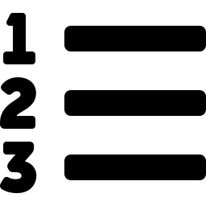


What is Lexical Analysis?
First phase of the compiler
SOURCE CODE
int a = 10;
Converts characters into tokens
↓ lexical analyzer
Removes whitespace and comments
int
a
=
10
;
Sends the resulting tokens to the parser
TOKENS
Ready for syntax analysis
Lexical Analysis
4

Slide 5




Role of the Lexical Analyzer
Four core responsibilities carried out during scanning.
Reads Source Code
Generates Tokens
Scans the program character by character from the input file.
Groups characters into meaningful lexemes and classifies them as tokens.
Detects Lexical Errors
Maintains Symbol Table
Flags invalid identifiers, illegal symbols, and malformed constants.
Records identifiers along with their type, scope, and memory details.
Lexical Analysis
5

Slide 6
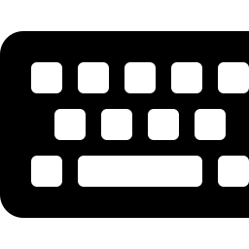
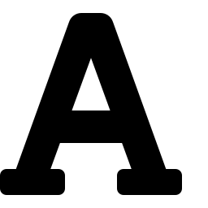
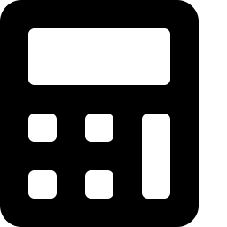

Tokens
A token is a categorized unit of meaning produced by the lexical analyzer.
Example:
int a = 10;
Keyword
Identifier
Operator
Constant
Separator
int
a
=
10
;
Lexical Analysis
6

Slide 7
Token Types
Every token produced by the lexical analyzer falls into one of five categories.
Keywords
Identifiers
Operators
Constants
Separators
Reserved words with fixed meaning, e.g. int, if, return.
Names given to variables, functions, and arrays.
Symbols denoting operations, e.g. +, =, &&.
Fixed literal values such as numbers and characters.
Punctuation marks like ; , ( ) { }.
Lexical Analysis
7

Slide 8


How Lexical Analysis Works
Source code flows through the analyzer and emerges as a token stream for the parser.
→
→
→
Source Code
Lexical Analyzer
Tokens
Parser
Lexical Analysis
8

Slide 9
Symbol Table
A data structure built during lexical analysis to track every identifier in the program.
Identifier
Type
Scope
Memory Location
a
int
local
0x7ffde42
Why it matters: Later compiler phases query the symbol table to check types, resolve scope, and allocate memory correctly.
Lexical Analysis
9

Slide 10
Lexical Errors
Common mistakes the lexical analyzer catches before parsing even begins.
Invalid Identifier
Illegal Symbol
Unclosed String
A name that breaks naming rules, such as starting with a digit.
A character that does not belong to the language's alphabet.
A string literal missing its terminating quotation mark.
2var = 5;
a @ b;
"hello
Lexical Analysis
10

Slide 11
Advantages
Faster Compilation
Early Error Detection
Simplifies Parsing
Simple, specialized scanning is far quicker than parsing raw characters directly.
Lexical mistakes surface immediately, before wasting time on later phases.
The parser works with clean tokens instead of raw, unstructured text.
Lexical Analysis
11

Slide 12


Applications
Compilers
IDEs
Interpreters
C, C++, Java, and Python compilers all begin with a lexical scanning stage.
Editors use lexers for syntax highlighting and real-time error underlining.
Scripting language interpreters tokenize each line before executing it.
Lexical Analysis
12

Slide 13
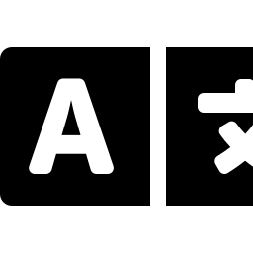
Real-Life Example
Everyday Language
Programming Language
The cat sat
a = 1;
↓ break into words
↓ break into tokens
The
cat
sat
a
=
1
;
Sentence → Words
Program → Tokens
Lexical Analysis
13

Slide 14
Conclusion
Lexical analysis is the first phase of compilation — it converts raw source code into a clean stream of tokens that every later phase depends on.
Lexical Analysis
14

Slide 15
Thank You
14

