Slide 1
A Presentation on LipoBlog : A multiuser blogging Platform
Supervised By
Name: Nayan Kumar Nath
Designation: Lecturer
Department of CSE
Sylhet Engineering College
Team Members:
Enamul Hasan
(2019331503)
Kabir Hussan
(2019331543)

Slide 2
LipoBlog : A Multi-User Blogging Platform

Slide 3
What is LipoBlog ?
Blogging is an amazing way to improve your writing, explore areas of interest in depth, learn the basics of website management and SEO, and — perhaps most importantly, develop clarity of thinking.
LipoBlog is a Blogging website which means broadcast-style communications systems that enable authors to publish articles, opinions or product reviews (known as posts), which can be delivered through stand-alone websites, email, feed syndications systems and social networks. Blogging platforms also enable direct reader participation with the host blogger or with other blog participants by enabling user comments.
LipoBlog allows the user to create, organise, and publish written and visual content online in a blog.

Slide 4



How LipoBlog work ?
LipoBlog allows the user to publish posts, display the date that the post was published, and assign a specific author assigned to the post. These software or web-based services also allow users to tag content with specific categories, making it easier to search for all posts on topic within the blog.
A user can create and manage his personal blog site in lipoblog and after publishing the posts any internet user can read his posts and see his blog site.
Features
Interactive
Easy to Use
Mobile Resposive

Slide 5

Objectives
Improves your writing
Keeps you current
Teaches website management
Build a portfolio
Improves your analytical skills

Slide 6
Tools
Django framework.
Python.
HTML
CSS
BootStrap
Javascript
SQLite
Git and github
Visual Studio code

Slide 7
Programming Language & Database
Programming Language: To build this blogging site we use django framwork. Django is a Free and open-source framework for building web apps with Python language. Django features:
The admin site
Object-relational mapper (ORM)
Authentication
Caching
That's why for back-end operations we use python code.
For front-end we used HTML, CSS, BootStrap.
Database: SQLite Supports relational database . It is an open source database that stores data to a text file on a device. Android comes in with built in SQLite database implementation. SQLite is a local database. It stores data locally so In order to access this database, you don't need to establish any kind of connections for it like JDBC,ODBC e.t.c

Slide 8
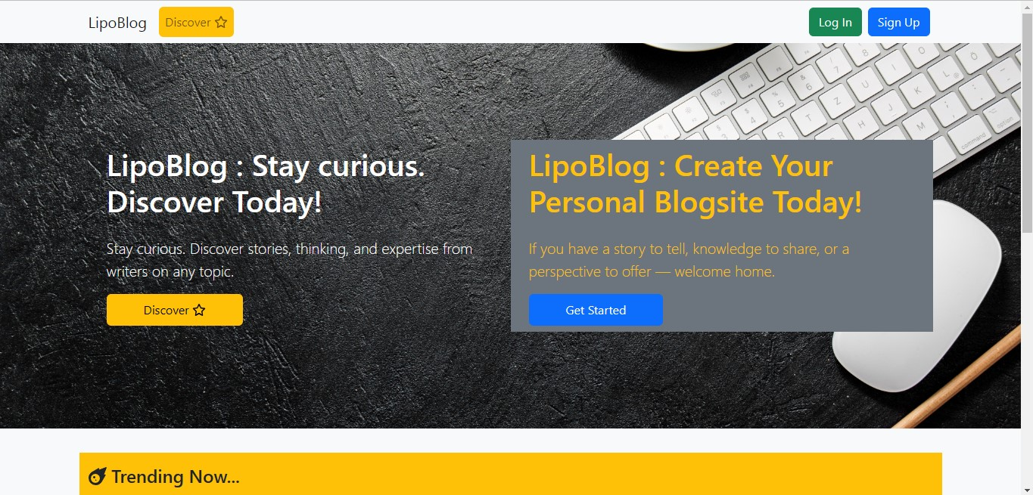
Output

Slide 9
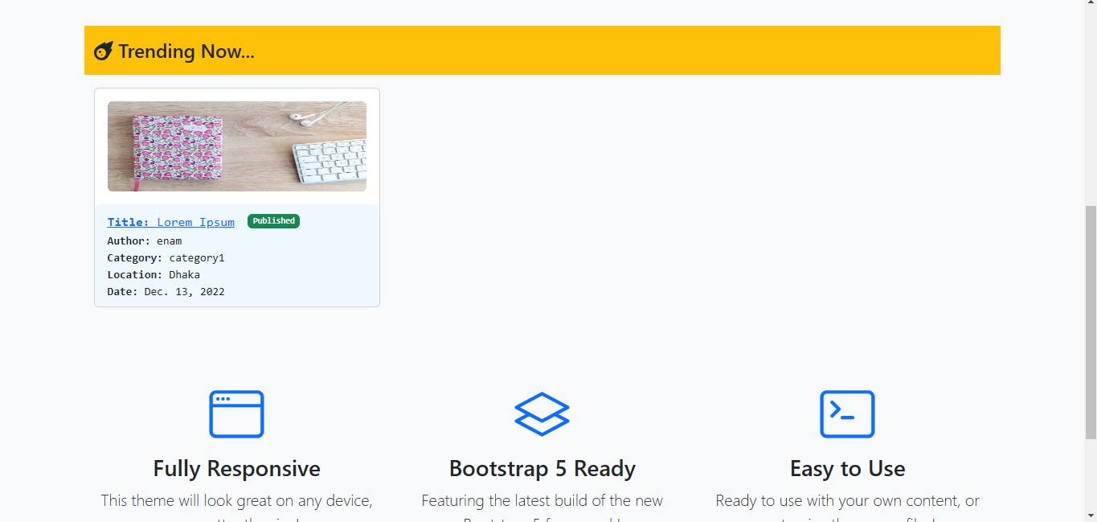
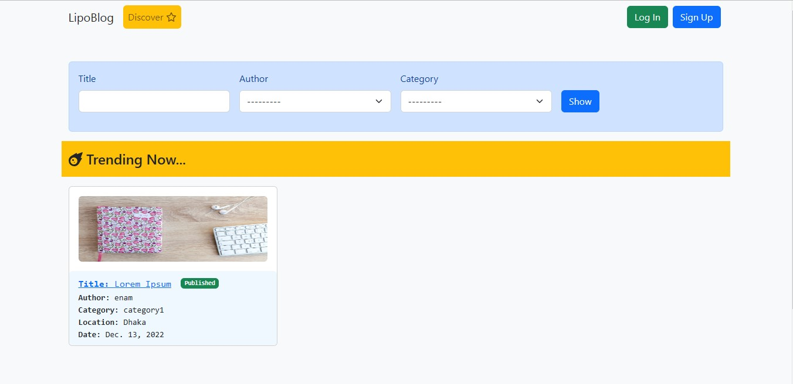
Trending Section:
Discover Page:

Slide 10
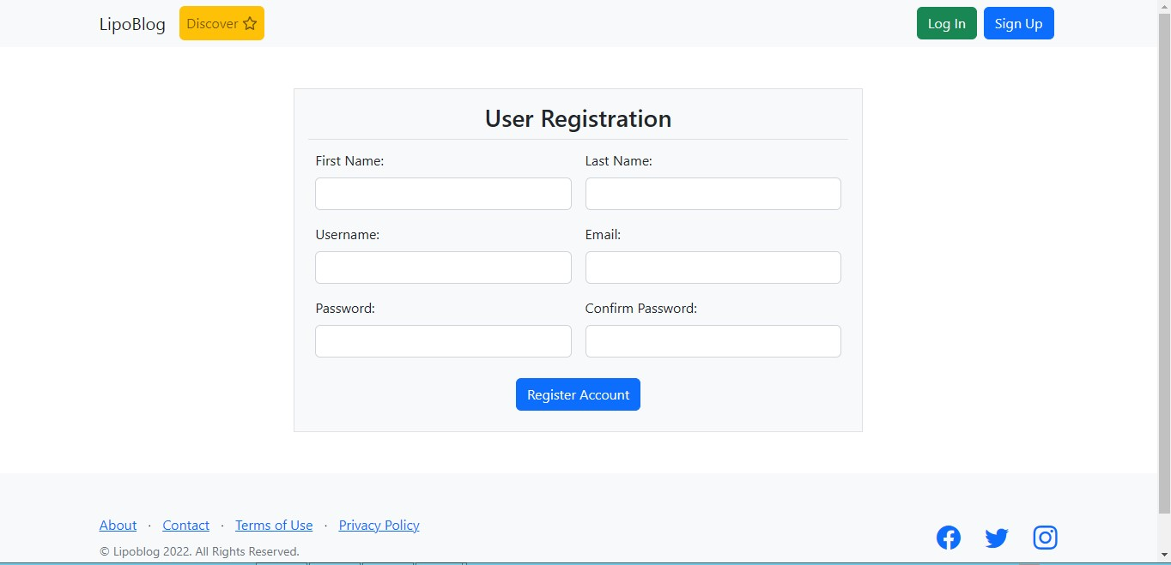
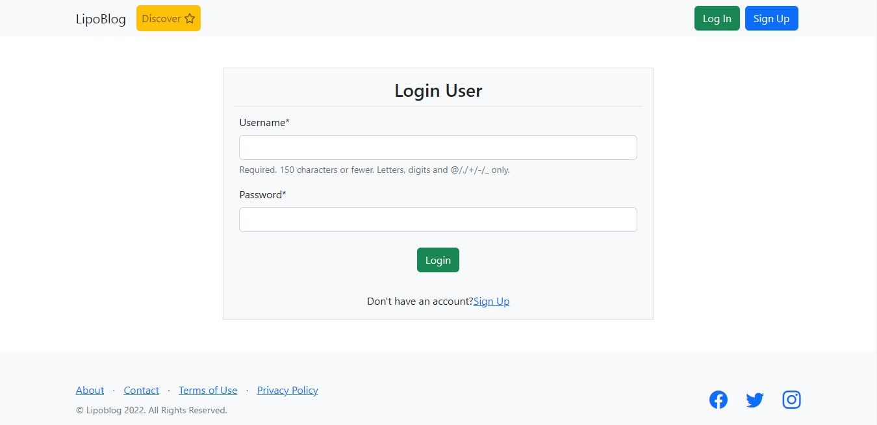
Registration layout
Log in layout

Slide 11
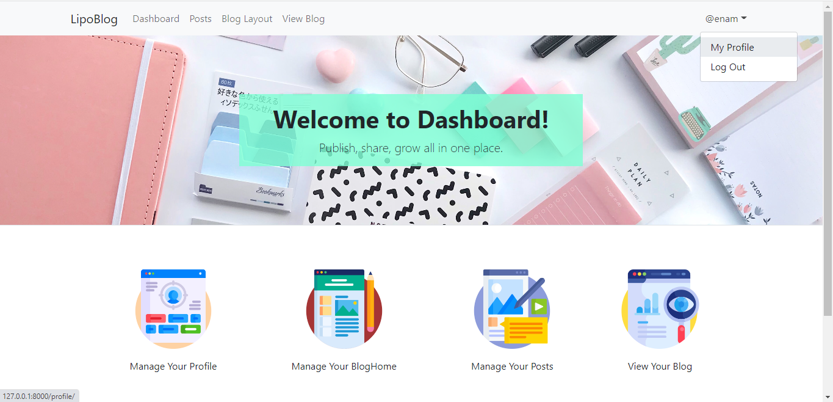
Dashboard page

Slide 12
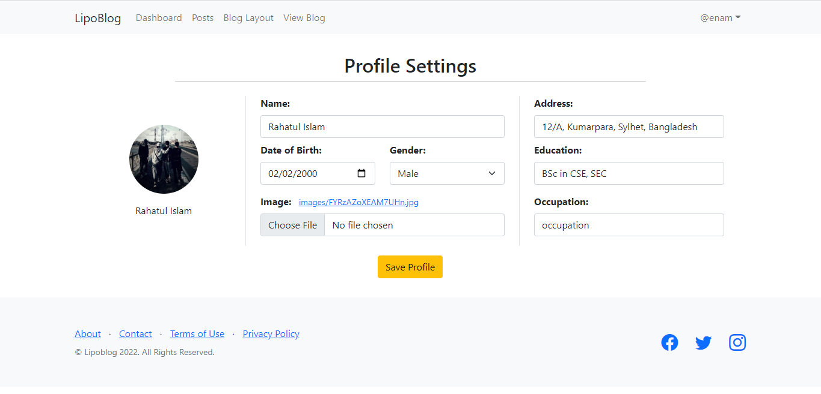
Profile page

Slide 13
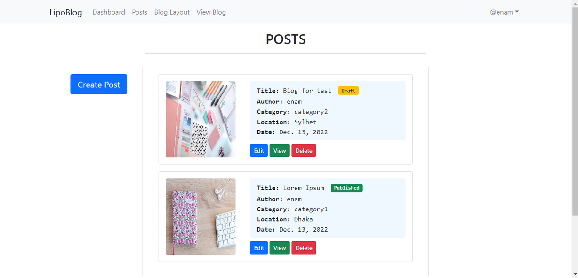
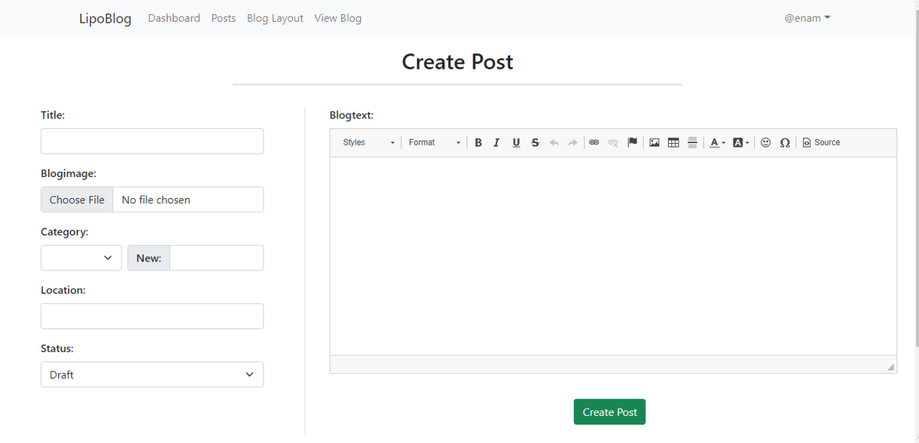
Post layout
Create post layout

Slide 14
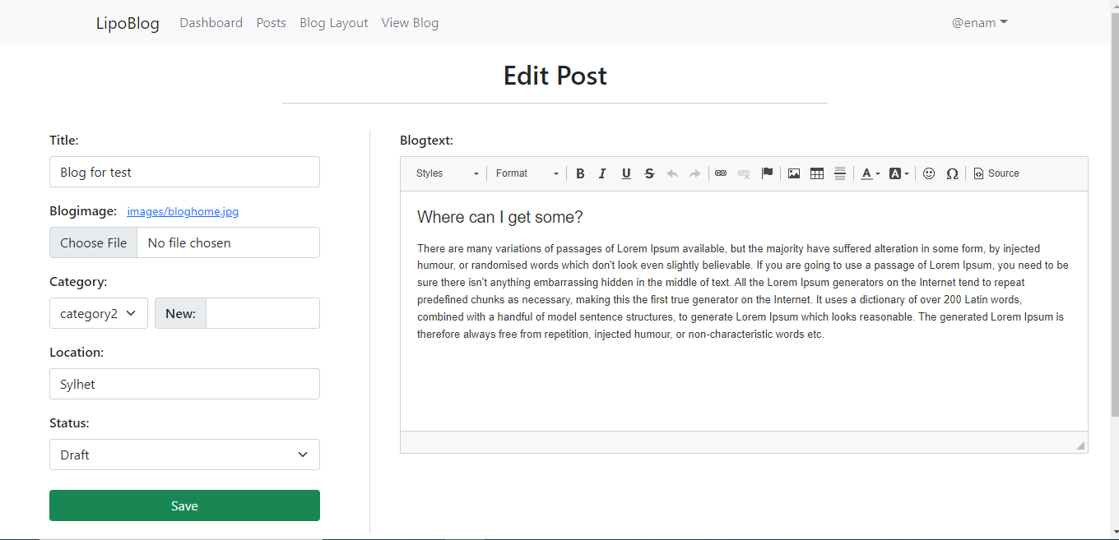
Edit post layout

Slide 15
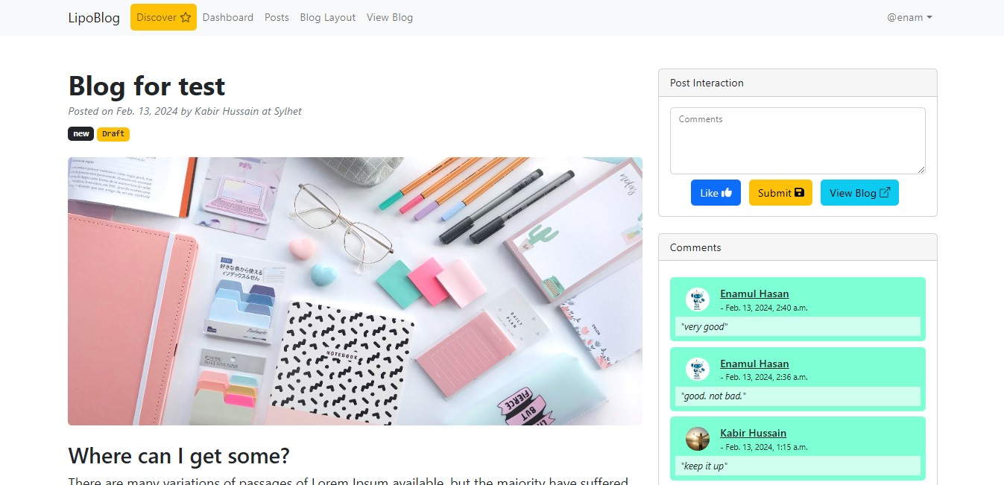
Post View Page

Slide 16
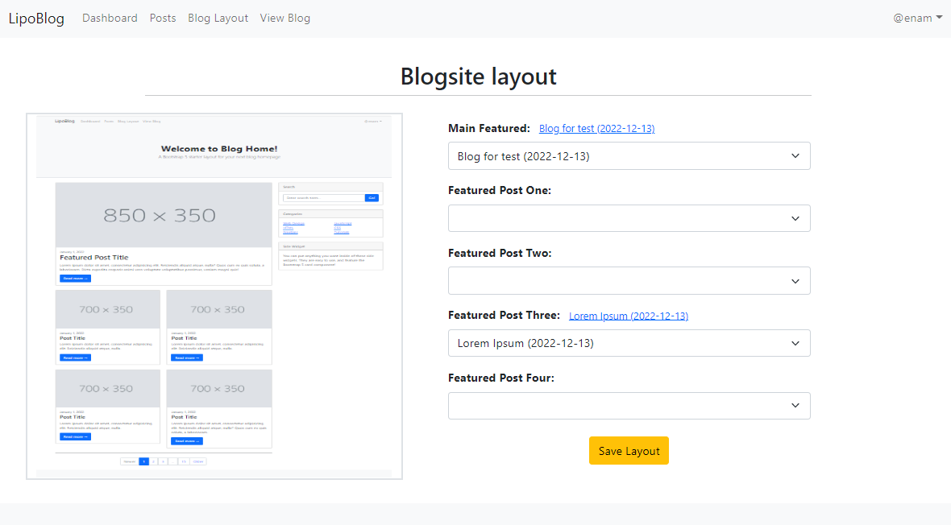
Blog site layouts

Slide 17
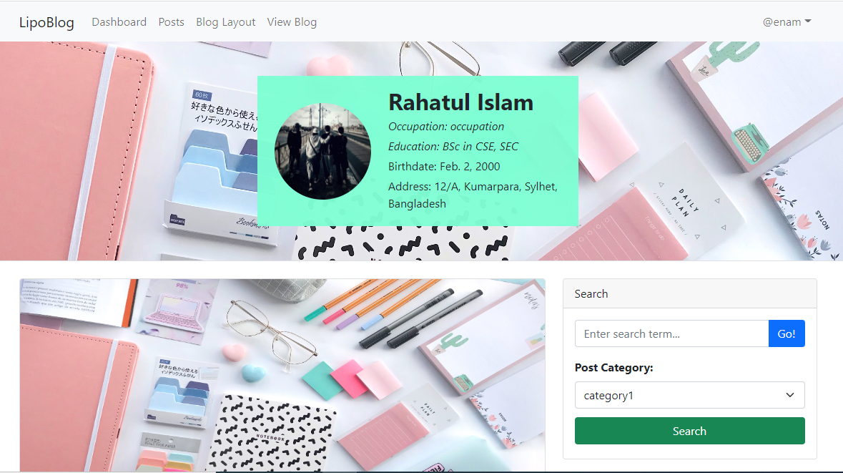

Slide 18
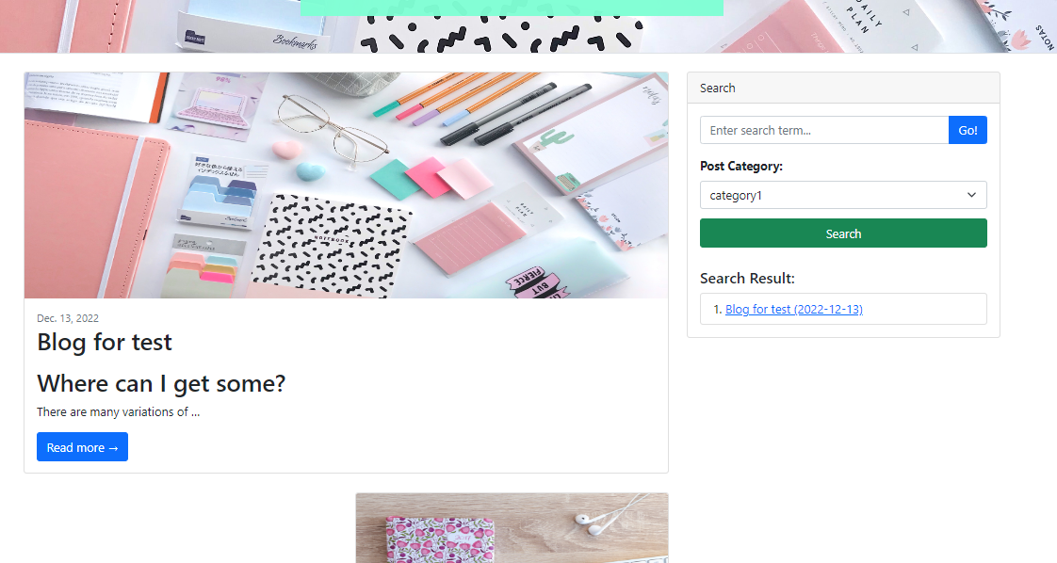

Slide 19
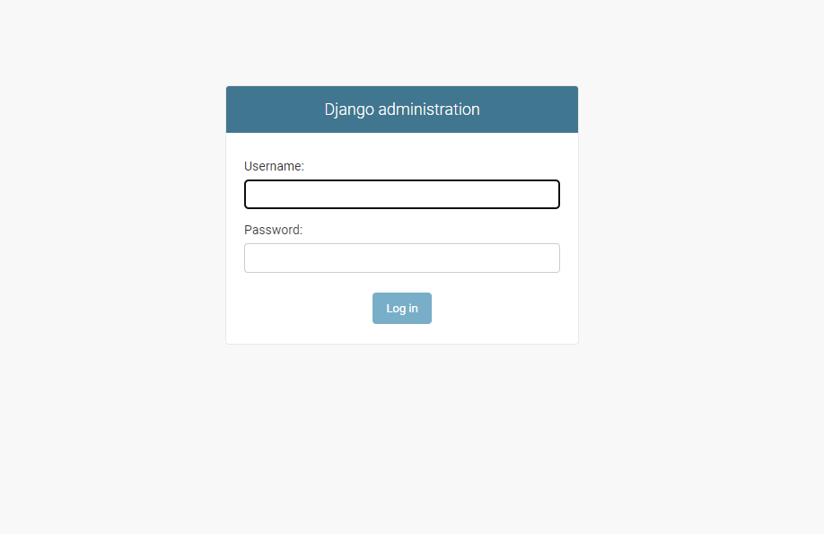
Django Admin Panel log in layout

Slide 20
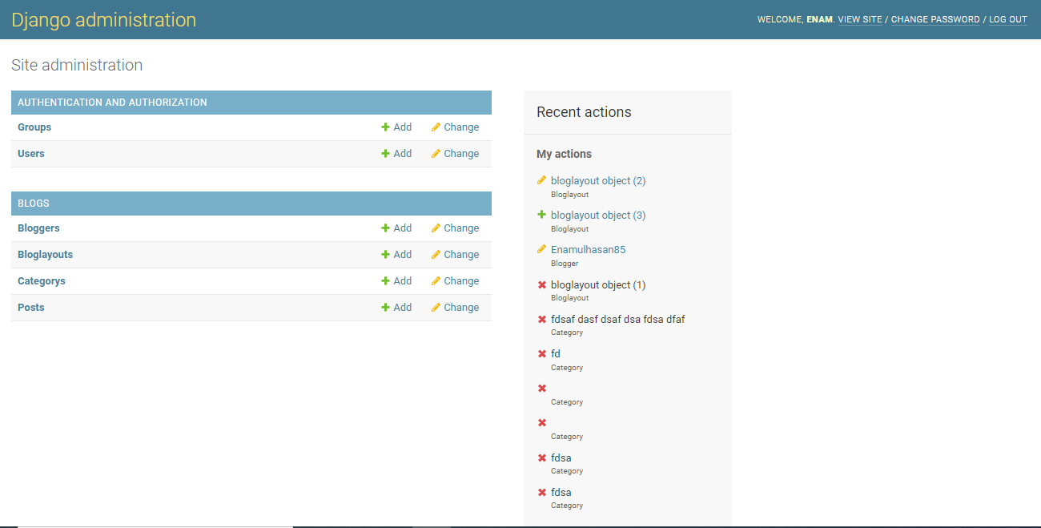
Django Administration

Slide 21
Future Plan
Making the LipoBlog fully dynamic.
Adding a comment option of any viewer of a post.
React options after reading an article.
Linking lipo portfolio with others social media platform like Facebook. Twitter, Instagram etc.
Voting options for a post.
Easy Navigation.
E-mail subscription.
Displaying post in reverse order.
Creating a blog post archive system.
Comment spam protection.
Creating contact method.
Product 1

Slide 22
Conclusion
We design LipoBlog for the bloggers who want to express the new idea of her or his with the people. It’s a multi user blogging system where we can see various kinds of writers and bloggers. Making this blogging platform we learned front-end developing tools like html, css, bootstrap and back-end developing tools like python, Django framework. We also learned about blogging platforms, how to manage them and so on. We hope this site will create new era in Bangladesh's blogging system.
Blogs provide ways for you to not only express your thoughts and (potentially) build an audience, but also build a portfolio of original work at your pace and on your terms.
So yes - I think you should start a blog. Play with it, commit to it. In a year, you’ll be amazed at what you’ve built.

Slide 23
Thank
you!

