Slide 1
Sum
By
Hasan Murad
Lecturer
CSE,UAP

Slide 2
Notation
1 + 2 + 3 + · · · + (n - 1) + n
Where ‘....’ means to complete the pattern established by the surrounding terms
Moreover 3 and (n-1) terms are also redundant
1 + 2 + · · · + n
BUT if we ignore 2 then
1 + · · · + n

Slide 3
Notation
1 + 2 + 3 + · · · + (n - 1) + n
a₁ + a₂ + · · · + a_{n}
Where a_{k} is called a term of the sum and will be a function of k
2¹ +2² + · · · + 2^{n}
Where a_{k} = 2^{k}

Slide 4


Notation
a₁ + a₂ + · · · + a_{n}
The Sigma-notation form
The delimited form

Slide 5


Notation
The squares of all odd positive integers below 100
The Sigma-notation form
The delimited form

Slide 6


Notation
The sum of reciprocals of all prime numbers between 1 and N
The Sigma-notation form
The delimited form

Slide 7


Notation
The biggest advantage of general Sigma-notation is that we can manipulate it more easily than the delimited form.
The Sigma-notation form
The delimited form

Slide 8

Notation
The general form of Sigma-notation
Where a "property P(k)" is any statement about k that can be either true or false.

Slide 9

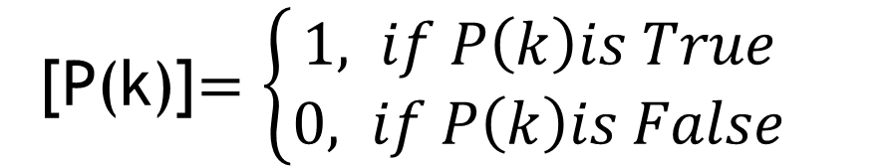
Iverson's convention
[P(k)]$=\left\{\begin{aligned}1, if P\left(k\right)is True \\ &0, if P\left(k\right)is False\end{aligned}\right.$

Slide 10

Notation
The general form of Sigma-notation
The general form of Sigma-notation in Iverson's convention

Slide 11

Notation
The sum of reciprocals of all prime numbers between 1 and N
The Sigma-notation form
The of Sigma-notation form in Iverson's convention

Slide 12


SUMS AND RECURRENCES
The delimited form Sum:
Equivalent recurrence form:

Slide 13

SUMS AND RECURRENCES
Equivalent recurrence form:
If a_{n} =
Then,

Slide 14


SUMS AND RECURRENCES
If a_{n} =
recurrence form
R1 = ?
R2 = ?

Slide 15


SUMS AND RECURRENCES
.
.
.
.

Slide 16


SUMS AND RECURRENCES
If R_{n} = 1, then
A(n) = 1
If R_{n} = n, then
B(n) = n
If R_{n} = n^2, then
2C(n) – B(n) = n^2
2C(n) = n^2+B(n)
2C(n) = n^2+n
C(n) = (n^2+n)/2

Slide 17
SUMS AND RECURRENCES
A(n) = 1
B(n) = n
C(n) = (n^2+n)/2

Slide 18


Example Problem for Recurrences
Ro = a
Rn = R(n-1) + a+b*n
A(n) = 1
B(n) = n
C(n) = (n^2+n)/2
Rn =

Slide 19




Recursive equation to sum
Recursive Equation:
If we divide each side with 2^n:

Slide 20

Recursive equation to sum
Recursive Equation:
Sum Form:
=
=

Slide 21



Generalization
Previous problem
Generalized:

Slide 22




Generalization

Slide 23





Generalization

Slide 24
Generalization

Slide 25
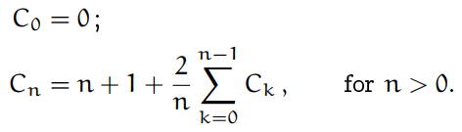



Recursive Equation of Quicksort

Slide 26


Recursive Equation of Quicksort

Slide 27

Recursive Equation of Quicksort

Slide 28
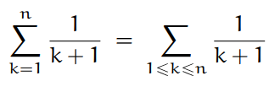
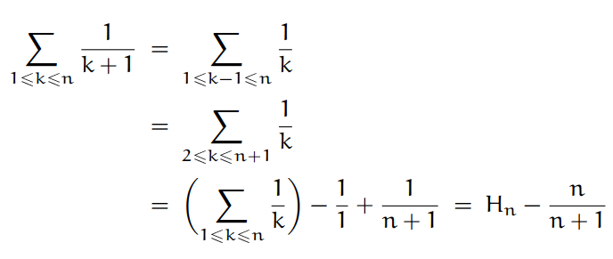
Recursive Equation of Quicksort

Slide 29



Recursive Equation of Quicksort

Slide 30



Manipulation of Sums

Slide 31
Distributive Law
cao + ca1 + ca2 = c(ao+a1+a2)

Slide 32
Associative Law
(ao+bo)+(a1+b1)+(a2+b2) = (ao+a1+a2)+(bo+b1+b2)

Slide 33
Commutative Law
Let p(k) = (k+1)%3
ao+a1+a2 = a1+a2+a0

Slide 34




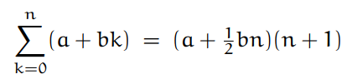
Applications

Slide 35





Perturbation Technique

Slide 36







Perturbation Technique

Slide 37
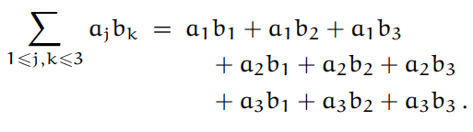


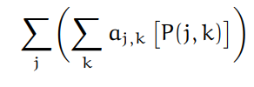

Multiple Sums

Slide 38
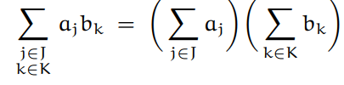






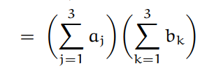

Slide 39


General Methods

Slide 40


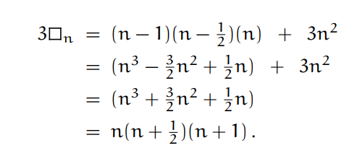
General Methods

Slide 41

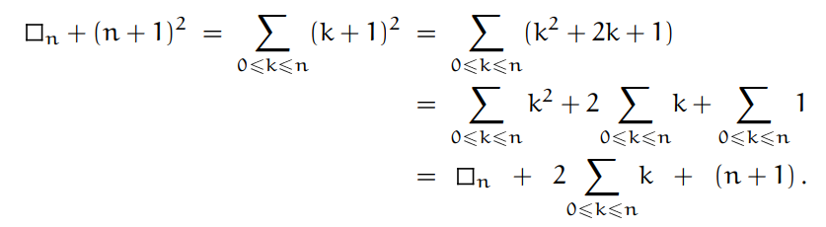

General Methods

Slide 42







General Methods

Slide 43

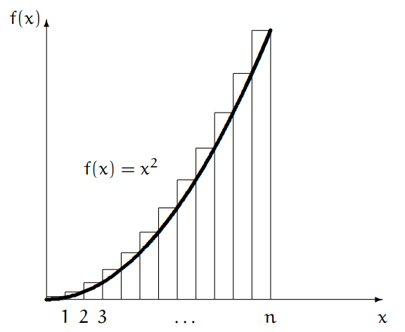





General Methods

Slide 44
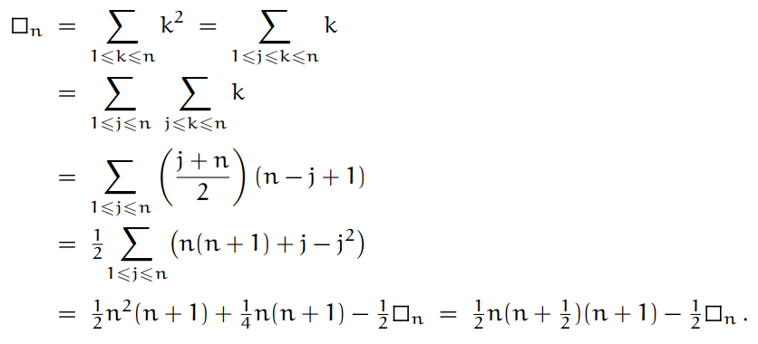
General Methods

Slide 45
Thanks

Slide 46
Tn = 2*T(n-1) +3
Tn = 2*(2*T(n-2)+3)+3
Tn = 2^2*T(n-2)+ 2*3 + 3
Tn = 2^2*( 2* T(n-3) + 3) + 2*3 + 3
Tn = 2^3*T(n-3) + 2^2*3 + 2*3 + 3
…..
Tn = 2^(n-1)*3+…….+2^2*3+2*3+3
Tn = 3*{2^(n-1)+……+2^2+2+1}
Tn = 3*{2^0+2^1+2^2+………..+2^(n-1)}

Slide 47
Tn = 2*T(n-1)+1
Tn + 1 = 2*T(n-1) +2
Tn + 1 = 2*{T(n-1)+1}
Un = Tn + 1 U(0) = T(0) + 1 = 1
U(n-1) = T(n-1) +1
Un = 2*U(n-1) U(n-1) = 2*U(n-2)
Un = 2^2*U(n-2)
…..
Un = 2^n * U(0) = 2^n
Tn +1 = 2^n
Tn = 2^n -1

