Slide 2
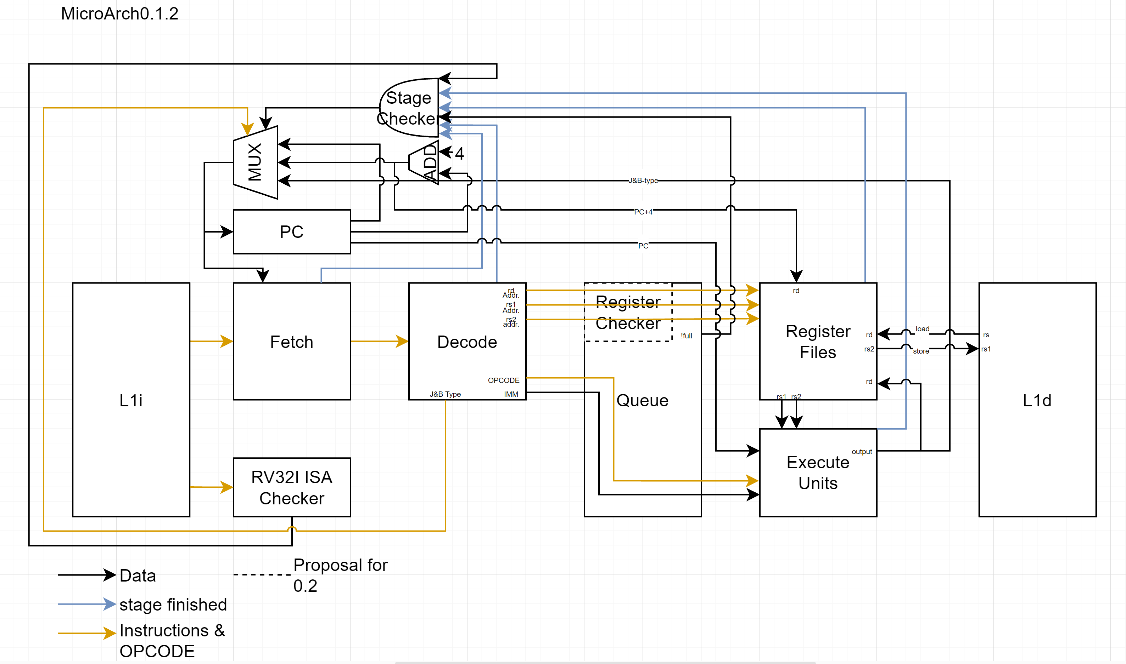
Notes:
MicroArch 0.1.2
Oct 11,2023: -RV32I ISA checker: checks the instruction is for Risc-V 32 bit integer ISA; inst[4:0]=bbb11 (bbb != 111).
-Scheduler: holds and distributes operations to execution units from the decoder
-Register checker (proposal for 0.2.0): Checks the current operation using previous registers on the other stages. Later, this can be used for out-of-order. Placed between the decoder and the scheduler

Slide 3
Pipelined CPU with RV32I compatible
Program Counter
AND
mu x
add
4
PC
IF
ID
EX
WB
L1i
register file
L1d
Fetch
Decode
rs1
rs2
rd1
ALU
Opcode
Imm&sel.
w addr
rd2
W data
mu x
Wb addr
Wb data
N= ID+EX+MA
Notes:
MicroArch 0.1.1
Oct 3, 2023 Make thing simple. Reorganaized.

Slide 4
RV32I practice
AND
0
mu x
add
4
PC
IF
RO/
ID
EX
WB
L1i
register file
L1d
Reorder/Decode
rs1
rs2
inst
32*N bit
rd1
ALU
Opcode
Imm&sel.
w addr
rd2
W data
mu x
Wb addr
Wb data
N= ID+EX+MA
Notes:
MicroArch0.1
Made on Sept 16,2023: initial diagram
Edited on sept 17,2023: added AND with each stages’ done signal.

Slide 5
32bits RISC V Practice
L1i
L1d
Program Counter
Instruction Register
mux
mux
(6)-stage Pipeline
register file
ALU
Notes:
MicroArch 0.0
Sept 15.

Slide 6
Double Register files
Goal: To improve the efficiency of a branch, have a copy of the register file and continue the execution with copied data while checking the branch.
Implementation: it should not take much space and do not create a delay on the main register file.
Example case) CMP Register 3, 00
JE
But instruction 2 ends earlier.
Temporary registers with single-write and triple-read access.
Suggestion: it can be used to prevent WAW? Example case) instruction 1| register 3 <= register 1+ register 2
instruction 2| register 3 <= register 4+ register 5
But instruction 2 ends earlier.
>>> save the output of instruction 2 in register 3-copy. After the instruction 1 is completed, update register 3 with instruction 3.

Slide 7
Funct
If there is a function, this is the location that can check the connection with the function. It can be 2^7 functions

Slide 8
Stage Checker
Goal: When every stage is done, tell program counter to check the next instruction.

Slide 9
Implementing
Mode
R(Register to Register)
I (Immediate)
S (store)
U (Upper immediate)
BASIC OPCODE
NOP

Slide 10
Implementing
Mode
M(2 integers; multiplication and Division)
A(read-modify-write memory)
BASIC OPCODE
NOP

Slide 11
Pre-condition
Determine condition statements, if there are conditions, put a flag, so reorder cannot reorder executed data-> register file. Also, easier to recall back.

Slide 12
Pipelineing
Reorder(length= 2N):
check next N(N=instruction decode+ executions+memory acess) instructions, including the current instruction.
If there are no condition flag,
If it is a same opcode and “expected to be used in same ALU(only for add,sub,addi,subi)”, rename the register, which can cause stall, as es1 or es2 respectively (execution to source). Delay the instruction with Mth lines(M=executions), also put a flag for occupied.
Otherwise, delay the instruction for Nth(N= ID+EX) lines.
Otherwise, put NOP N lines if a register can cause stall.
ALUs: adders, and subtractors can support es1,es2 from itself.

Slide 13
Veriable ALU?
ALU multiplier and divider takes more space and time. If we only need to use add and subtract, should we transform(let’s say we have a module that can read next 10k instructions)
Superscaler: A scheduler for ALUs(holds decoded data and codes). Distribute works to same function ALU

Slide 14
No implementing for this project.
Mode
F(Floating point)
D(double Floating point)
Mode
F(Floating point)
D(double Floating point)

Slide 15
references
https://riscv.org/wp-content/uploads/2017/05/riscv-spec-v2.2.pdf
https://passlab.github.io/CSE564/notes/lecture09_RISCV_Impl_pipeline.pdf
Slide 3: https://learning.edx.org/course/course-v1:LinuxFoundationX+LFD119x+2T2023/block-v1:LinuxFoundationX+LFD119x+2T2023+type@sequential+block@e72ee6a62f7e453e969eb07d6ccac335/block-v1:LinuxFoundationX+LFD119x+2T2023+type@vertical+block@5db7d94ced80405d9030d79c1b780165

