Slide 1

MOBILE APPLICATION FOR PROJECT -
REGISTRATION MODULE ON Clean DELHI STREET FOOD VENDORS

Slide 2
Topics Covered
Introduction
Project Overview
Process Flow
Architecture
Technology
Wireframes

Slide 3
Introduction
Zentech Info Solutions Pvt. Ltd. is an apex IT organisation build with a mission to provide leading technology services. It was founded in 2007 and is an ISO 9001-2008 and ISO 27001-2005 certified company.
Zentech pioneers in providing end-to-end IT support, development and deployment services in ERP, Microsoft, Mobile Technologies, SAP, and IT Infrastructure.
Zentech Proposes to Bid for Registration & KYC compliance on Mobile Application of Delhi Street Food Vendors.

Slide 4
Project Overview
“Project Clean Street Food” mobile application with backend solution is to be designed, developed and operationalized to facilitate for data collection and correction of street food vendors.

Slide 5
Process Flow
Registration via Aadhar Card
Enter username
Try Again
If user
exists
Transaction as per user request
Option/ Results
Display Window
HTTP Request to server
via Wi-Fi
HTTP Request to server
via Wi-Fi
Server queries DB
Server queries DB
Option
selected
Present in users/
list?
Present in DB?
Return Not Found
YES
YES
Insert ISBN into DB

Slide 6

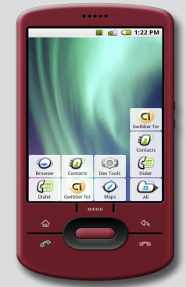
Architecture Overview
Restfull or Soap WebServcies(Spring)
HTTP Request/ Response
Wi-Fi
Hibernate
Architectural Overview
POSTGRE DB

Slide 7
Architecture Overview
Technology that needs to be followed for source code and database development.
Server Side :
Java/J2EE – Spring with Hibernate
IDE- Eclipse
Database- PostgreSQL
Technology that needs to be followed for source code and database development.
Mobile Side:
Android
IDE- Android Studio
Database- Sqlite

Slide 8
Technology
Android SDK
IDE used – Eclipse, Android Studio, SQL Developer
Database – Android (SQLite) & Server Side(Postgre)
Connection to the server is done using the Rest & Soap Web Services
Server Used – JBoss or Apache Tomcat
ORM – Hibernate

Slide 9
Technology
Central server used – Apache Tomcat or Sqlite
A new HTTP client object is created (HttpClient client = new DefaultHttpClient();)
Followed by HTTP GET Request ( HttpGet request = new HttpGet(url); )
On connection establishment, request is processed by the server.
Server returns the appropriate output depending on whether the record is present or not in the DB.

Slide 10

Wire Frames
Screen Designs
Presentation by Zentech Info Solutions Pvt. Ltd.

Slide 11
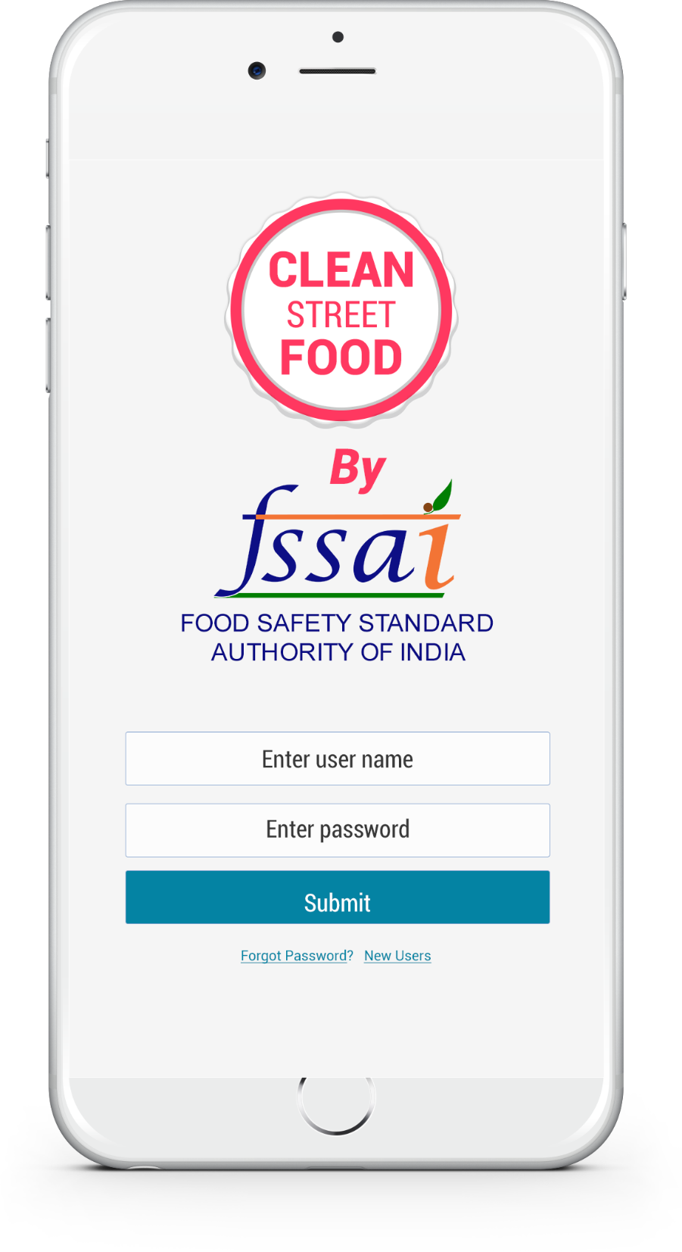


Slide 12

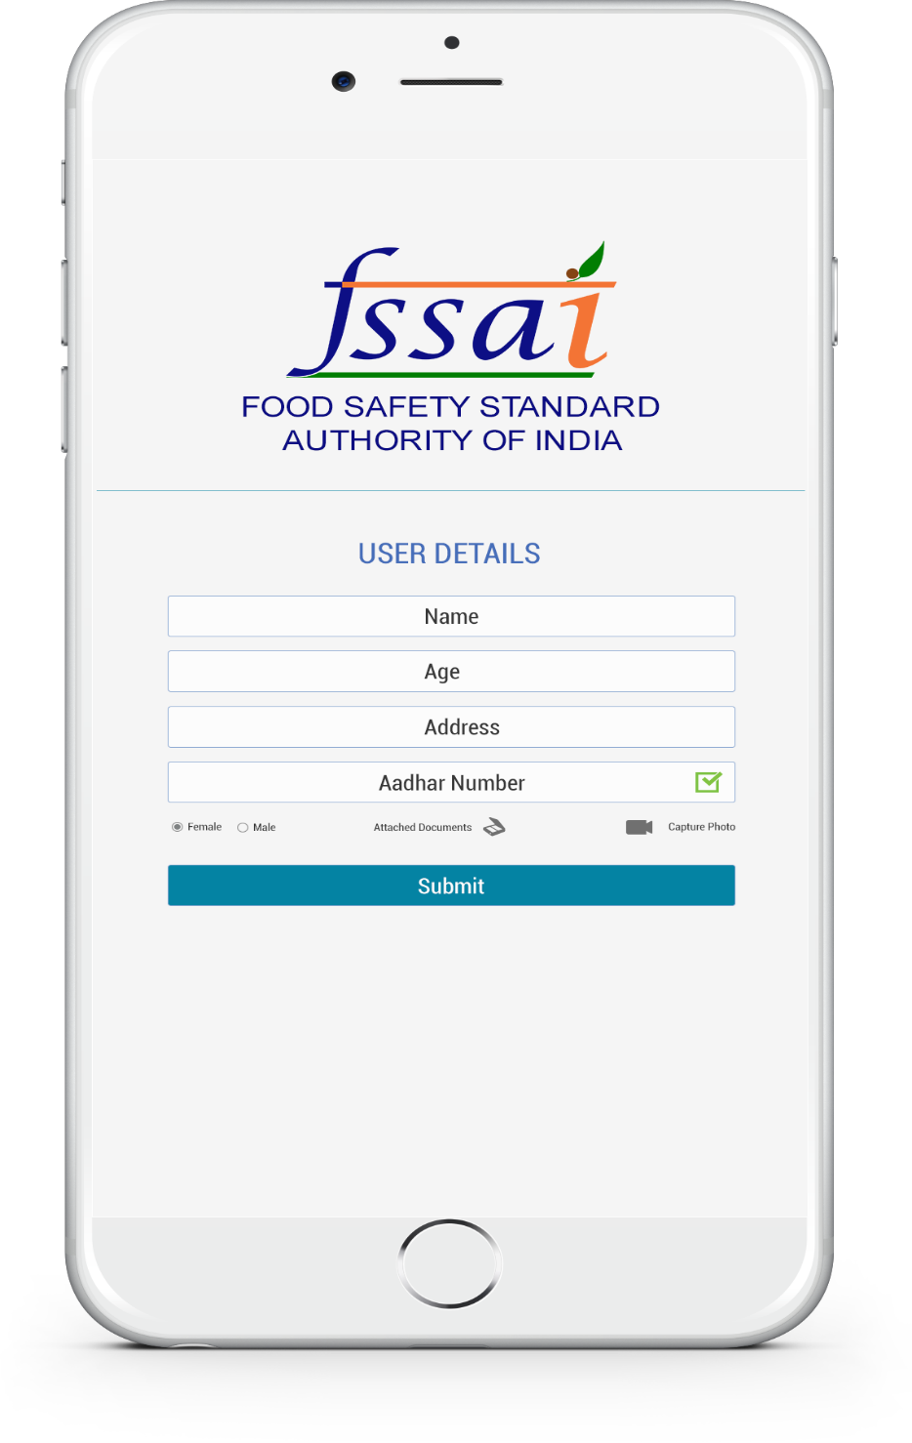

Slide 13
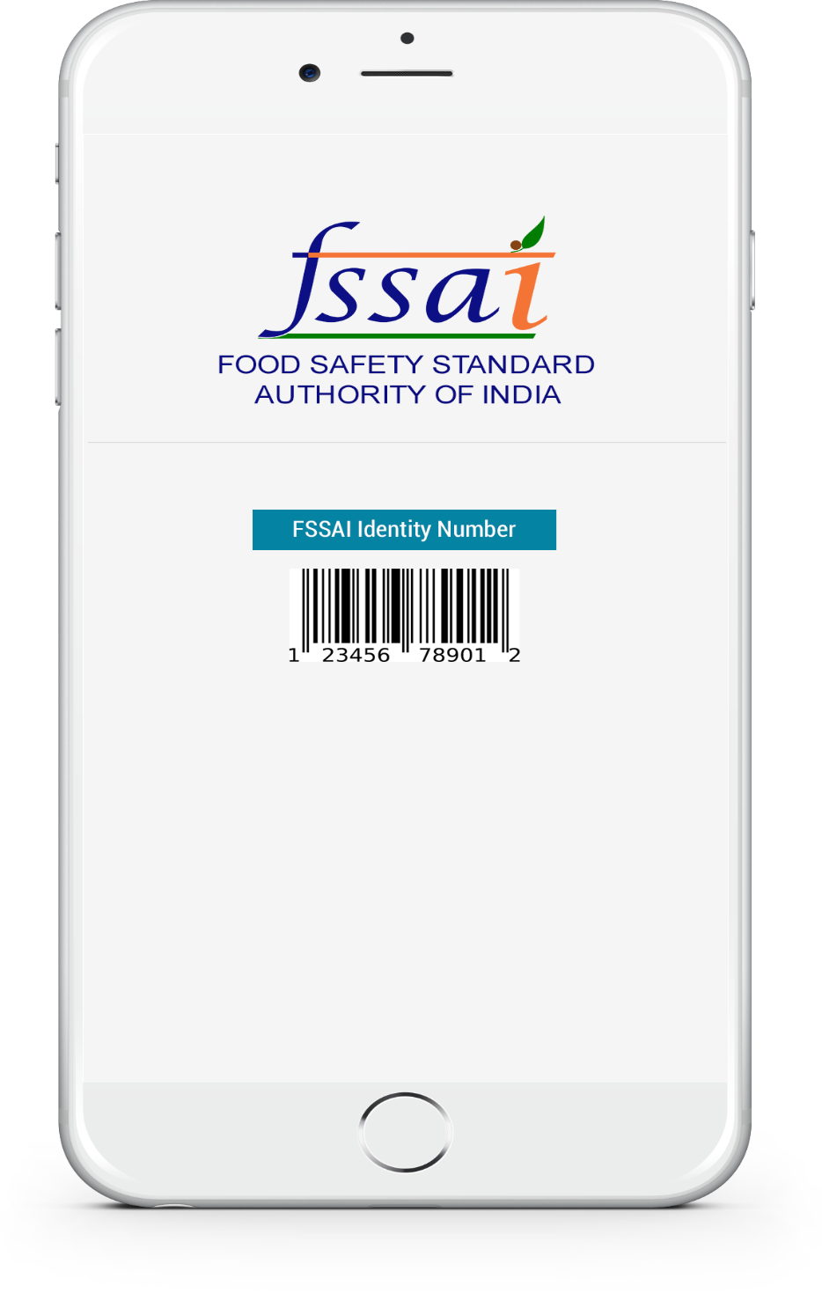

Slide 14
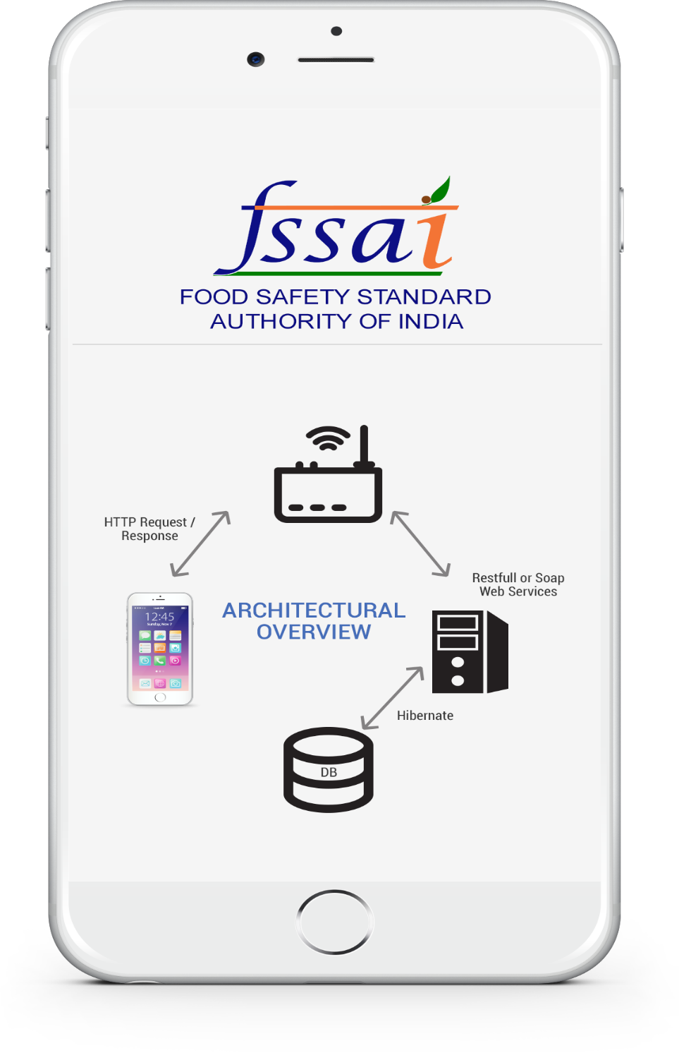

Slide 15


