Slide 1



Visual Studio Launch 2019 by

Slide 2


Novedades de .NET Core 3.0
Software Architect Lead at Encamina
MVP Office Development
http://blogs.encamina.com/desarrollandosobresharepoint
adiaz@encamina.com
Adrián Díaz Cervera
@AdrianDiaz81

Slide 3










Your platform for building anything
DESKTOP
WEB
CLOUD
MOBILE
GAMING
IoT
AI
.NET

Slide 4

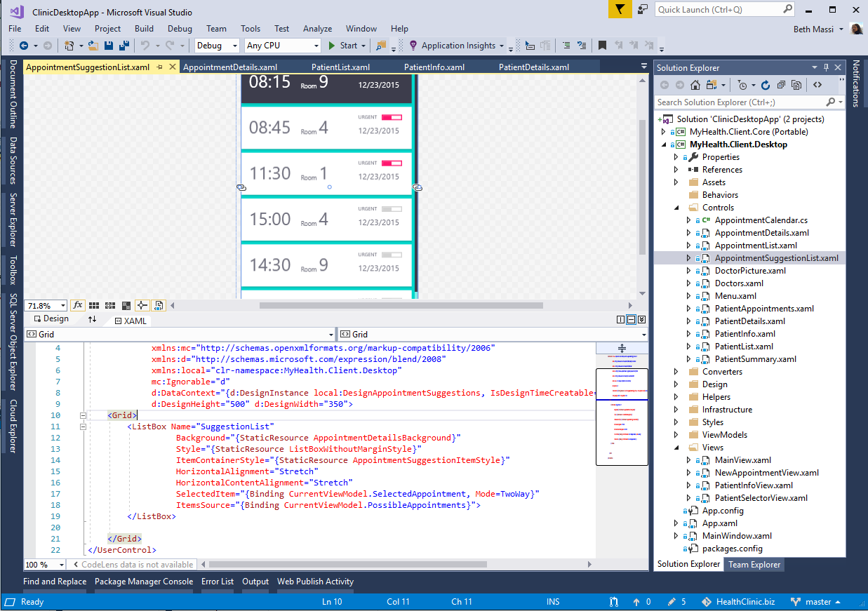
ANNOUNCING
.NET Core 3.0 preview 5
Windows desktop support with WPF and WinForms, also open source
Flexible deployment, side-by-side support and self-contained EXEs
Full-stack web development with C# and Razor
Significant performance improvements
New C# language features for productivity and less errors
dot.net/get-core3

Slide 5
Windows forms and WPF open source momentum
Healthy and active community helping in our Windows desktop repos
112 squashed commits by external contributors
168 forks by the community
186 issues opened by the community
346 pull requests opened by the community
Thank you to our top contributors—Hughbe, MaherJendoubi, zacpwhite

Slide 6



.NET Core 3.0 themes
Windows
desktop apps
Full-stack web development
Artificial intelligence & Machine Learning
Big data

Slide 7
.NET Core 3.0 desktop
Windows forms
WPF
UWP, Unity (coming in the 3.0 wave)
Access to all the Windows 10 APIs

Slide 8

Why Windows desktop on .NET Core?
Deployment flexibility
Side-by-side support
Machine global or app local framework
Self-contained EXEs
Core runtime and API improvements
Performance
X
=

Slide 9
Demo: .NET Core 3.0 for Windows desktop

Slide 10
C# 8.0
static async Task Main(string[] args)
{
IAsyncEnumerable<Customer?> customers
= GetCustomersAsync(args[2..]);
await foreach (Customer? customer in customers)
{
string? name = customer switch
{
null => null,
(null, string ln) => $"Ms/Mr {ln}",
(string fn, string ln) => $"{fn[0]}. {ln}",
};
if (name != null) Console.WriteLine(name);
}
}

Slide 11
C# 8.0
static async Task Main(string[] args)
{
IAsyncEnumerable<Customer?> customers
= GetCustomersAsync(args[2..]);
await foreach (Customer? customer in customers)
{
string? name = customer switch
{
null => null,
(null, string ln) => $"Ms/Mr {ln}",
(string fn, string ln) => $"{fn[0]}. {ln}",
};
if (name != null) Console.WriteLine(name);
}
}
Ranges

Slide 12
C# 8.0
static async Task Main(string[] args)
{
IAsyncEnumerable<Customer?> customers
= GetCustomersAsync(args[2..]);
await foreach (Customer? customer in customers)
{
string? name = customer switch
{
null => null,
(null, string ln) => $"Ms/Mr {ln}",
(string fn, string ln) => $"{fn[0]}. {ln}",
};
if (name != null) Console.WriteLine(name);
}
}
Ranges
Nullable reference types

Slide 13
C# 8.0
static async Task Main(string[] args)
{
IAsyncEnumerable<Customer?> customers
= GetCustomersAsync(args[2..]);
await foreach (Customer? customer in customers)
{
string? name = customer switch
{
null => null,
(null, string ln) => $"Ms/Mr {ln}",
(string fn, string ln) => $"{fn[0]}. {ln}",
};
if (name != null) Console.WriteLine(name);
}
}
Ranges
Nullable reference types
Async streams

Slide 14
C# 8.0
static async Task Main(string[] args)
{
IAsyncEnumerable<Customer?> customers
= GetCustomersAsync(args[2..]);
await foreach (Customer? customer in customers)
{
string? name = customer switch
{
null => null,
(null, string ln) => $"Ms/Mr {ln}",
(string fn, string ln) => $"{fn[0]}. {ln}",
};
if (name != null) Console.WriteLine(name);
}
}
Ranges
Nullable reference types
Async streams
Switch expressions

Slide 15
C# 8.0
static async Task Main(string[] args)
{
IAsyncEnumerable<Customer?> customers
= GetCustomersAsync(args[2..]);
await foreach (Customer? customer in customers)
{
string? name = customer switch
{
null => null,
(null, string ln) => $"Ms/Mr {ln}",
(string fn, string ln) => $"{fn[0]}. {ln}",
};
if (name != null) Console.WriteLine(name);
}
}
Ranges
Nullable reference types
Async streams
Switch expressions
Recursive patterns

Slide 16
C# 8.0
static async Task Main(string[] args)
{
IAsyncEnumerable<Customer?> customers
= GetCustomersAsync(args[2..]);
await foreach (Customer? customer in customers)
{
string? name = customer switch
{
null => null,
(null, string ln) => $"Ms/Mr {ln}",
(string fn, string ln) => $"{fn[0]}. {ln}",
};
if (name != null) Console.WriteLine(name);
}
}
Ranges
Nullable reference types
Async streams
Switch expressions
Recursive patterns
Default implementations
And more…

Slide 17
Demo: C# 8.0

Slide 18
ASP.NET Core 3.0
gRPC
High performance contract-based RPC services with .NET
Works across many languages and platforms
Worker service
Starting point for long running back processes like Windows Server or Linux daemon
Producing or consuming messages from a message queue
Web API’s + identity
Add security and authentication to Web API’s

Slide 19
ASP.NET Core 3.0 Blazor
Full stack web development with C#
You don’t need to know AngularJS, React, Vue, etc.
Take advantage of stability and consistency of .NET
Runs in all browsers
Strongly typed on the client and server
Share C# code with the client and server
Web assembly (optional and in preview)
Native performance
Requires no plugin or code transpilation

Slide 20
Demo: Blazor

Slide 21
RELEASED
.NET Framework 4.8
Released on April 18th, available on Windows Update later in summer
Accessibility improvements in Windows forms & WPF
Improved High DPI support for multi-monitor
JIT: parity with .NET Core 2.1 release
General security, performance, and reliability improvements
dot.net/get-framework

Slide 22
The future of .NET Framework
.NET Framework 4.8 is the last major version of .NET Framework on Windows
Support policy remains the same:
Will always be in Windows
Will be patched with Windows
Will be supported with Windows
Keep existing applications on .NET Framework
Recommend .NET Core for new applications

Slide 23
What comes next for .NET?

Slide 24
The .NET Roadmap
Many
.NETs
2014
.NET FRAMEWORK
.NET CORE
XAMARIN / MONO
Runtime
Runtime
Runtime
Base class library
Core library
Mono class library

Slide 25
The .NET Roadmap
Many
.NETs
.NET
standard
2014
2016
.NET FRAMEWORK
.NET CORE
XAMARIN / MONO
Runtime
Runtime
Runtime
Base class library
Core library
Mono class library
.NET STANDARD

Slide 26
Introducing .NET 5
The .NET Roadmap
Many
.NETs
.NET
standard
.NET
2014
2016
Next
.NET FRAMEWORK
.NET CORE
.NET
XAMARIN / MONO
Runtime
Runtime
Runtime (JIT & native)
Runtime
Core library
Base class library
One base class library
Mono class library
.NET STANDARD

Slide 27
Introducing .NET 5
Supports all .NET application types
Evolution of .NET Core, adding the best of Mono into one unified platform
One BCL implementation, still adheres to .NET Standard
One toolchain (SDK style projects)
Both Just-in-Time (JIT) and native models supported
Interop with Java and Swift

Slide 28
What is not in .NET 5?
Web forms, WCF server and Windows workflow remain on .NET Framework 4.8 only. There are no plans to port these.
Recommendations
ASP.NET Blazor for ASP.NET Web forms (we will provide a migration guide)
gRPC for WCF server and remoting (we will provide a migration guide)
Open source core workflow for Windows workflow (WF): https://github.com/UiPath/corewf

Slide 29




.NET—A unified platform
TOOLS
DESKTOP
WEB
CLOUD
MOBILE
GAMING
IoT
AI
WPF
Windows forms
UWP
ASP.NET
Azure
Xamarin
Unity
ARM32
ARM64
ML.NET
.NET for Apache Spark
VISUAL STUDIO
.NET STANDARD
VISUAL STUDIO FOR MAC
.NET 5
VISUAL STUDIO CODE
INFRASTRUCTURE
RUNTIME COMPONENTS
COMPILERS
LANGUAGES
COMMAND LINE INTERFACE

Slide 30
.NET Schedule
July 2019
.NET Core 3.0
RC
Sept 2019
.NET Core 3.0
Nov 2019
.NET Core 3.1
LTS
Nov 2020
.NET 5.0
Nov 2021
.NET 6.0
LTS
Nov 2022
.NET 7.0
Nov 2023
.NET 8.0
LTS
.NET Core 3.0 release in September
.NET Core 3.1 = Long term support (LTS)
.NET 5.0 release in November 2020
Major releases every year, LTS for even numbered releases
Predictable schedule, minor releases if needed

Slide 31
Muchas Gracias
Para localizar o contactar con ENCAMINA puedes:
Envía un email a:
info@encamina.com
Puedes encontrarnos en
Ven a visitarnos:
https://www.encamina.com/donde-estamos/
O descárgate nuestra App - MyENCAMINA
Llámanos al:
962 698 064

