Slide 1


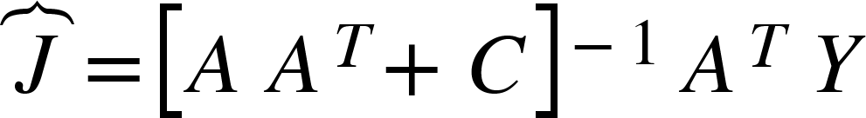
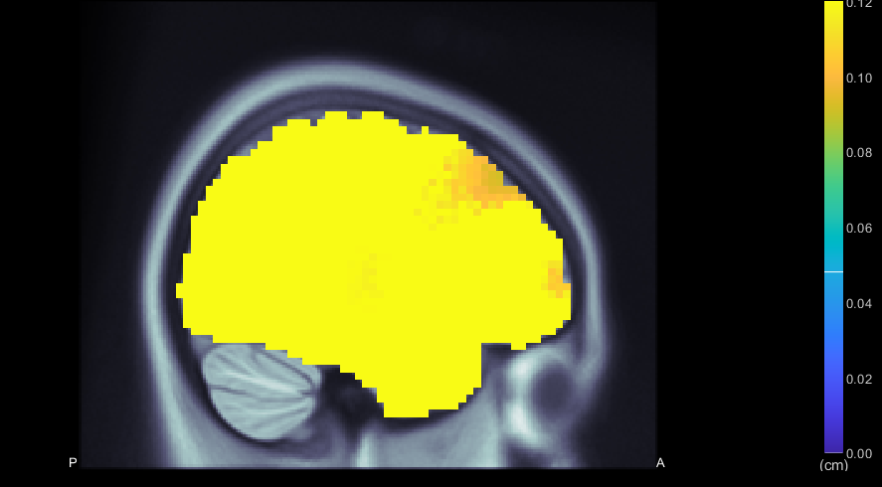
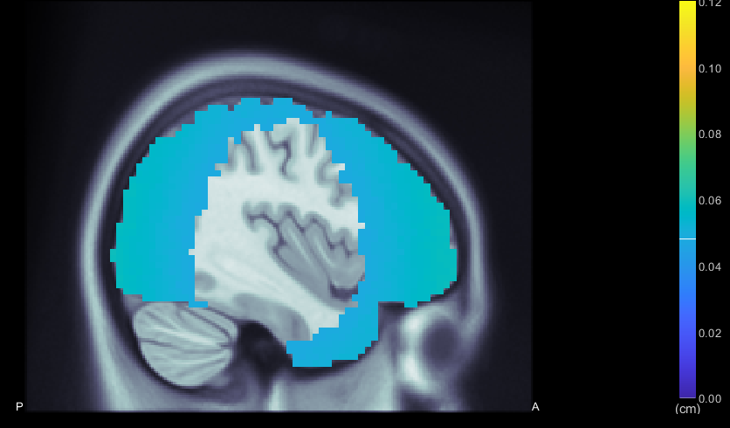
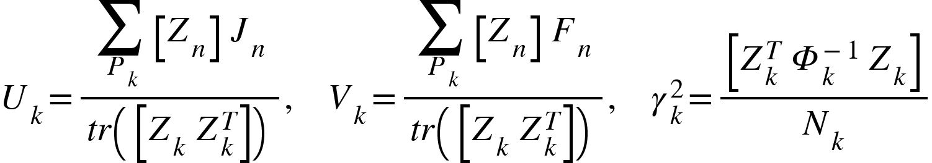
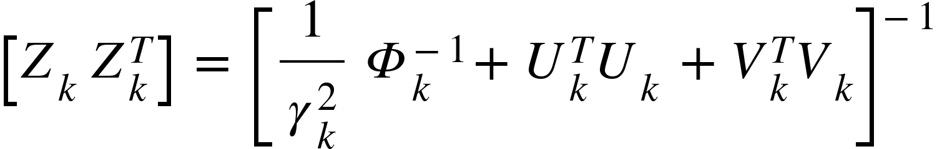

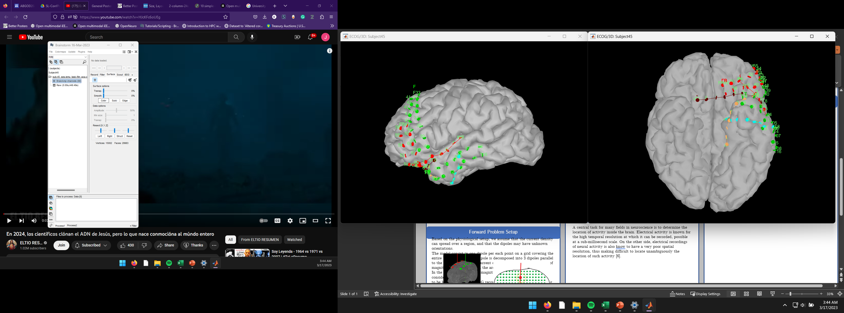
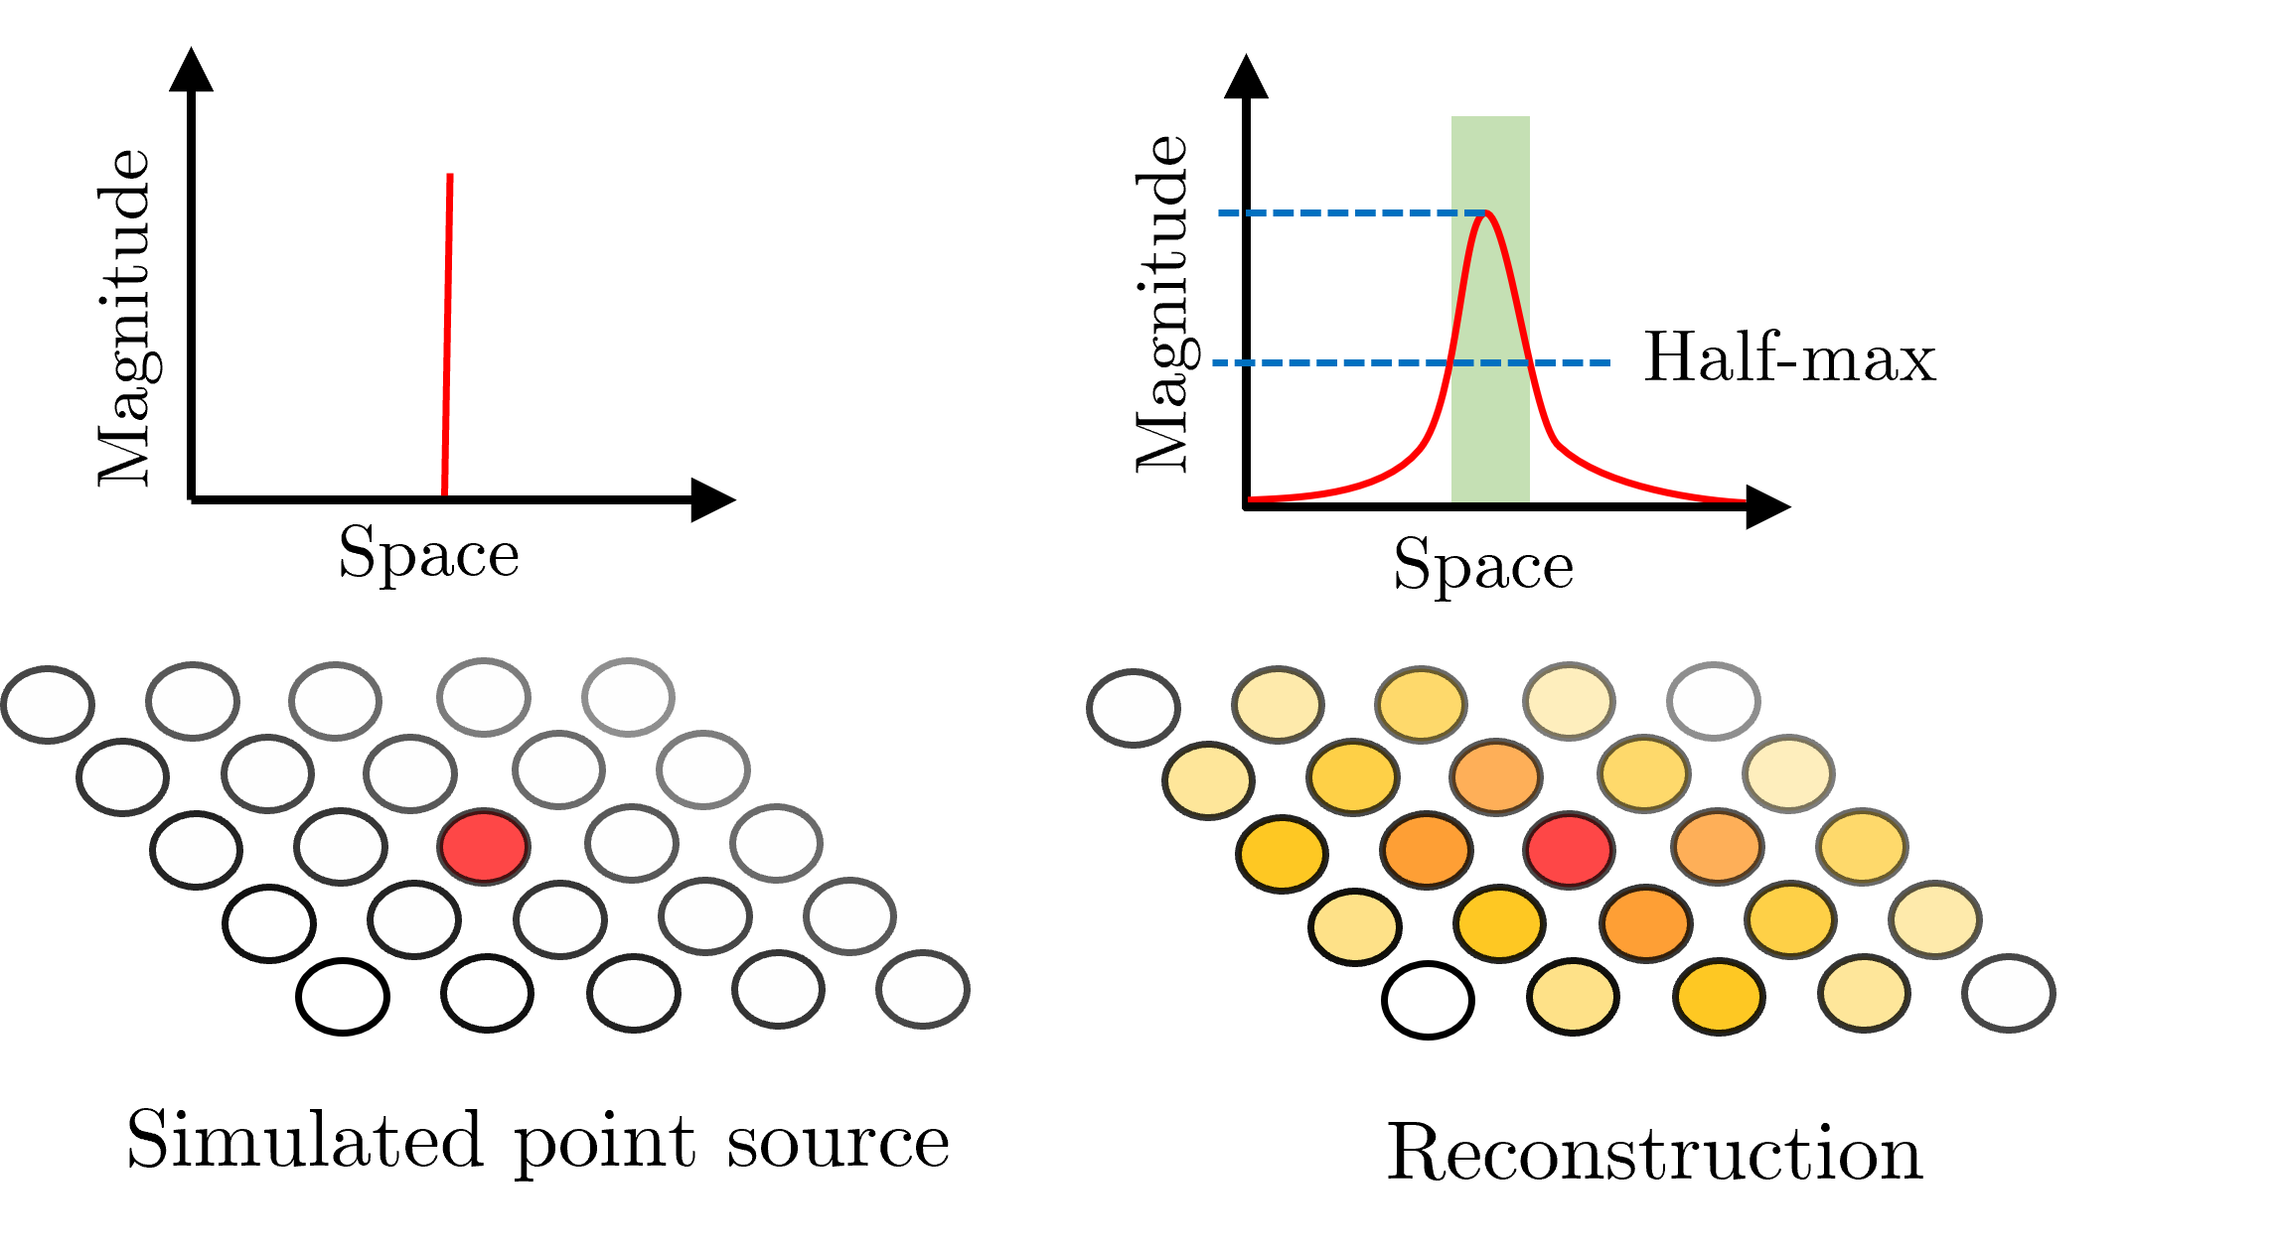
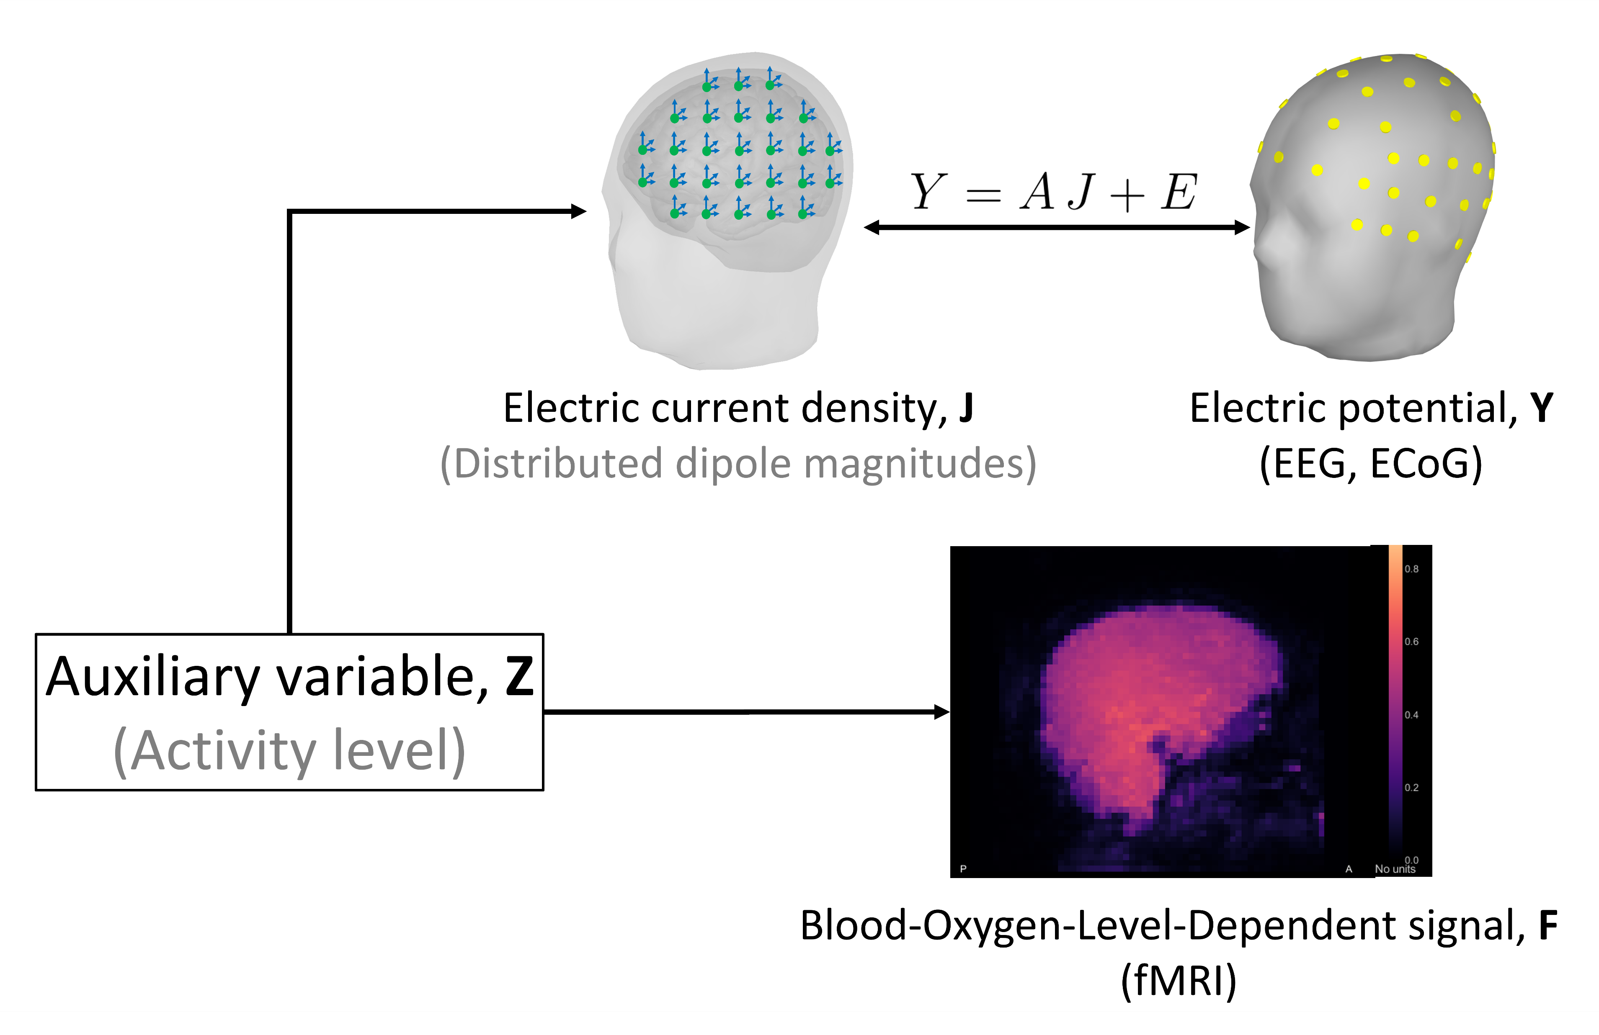
Evaluation of Methods for fMRI-Informed Electrical Source Reconstruction from EEG
Julio Cesar Enciso-Alva¹, Jianzhong Su¹ | (1) University of Texas at Arlington
Introduction
FIRE algorithm
Results
Electrical Source Reconstruction is a widely used technique for localization of electrical activity inside the brain related to neuron firing. Electrical activity is estimated from electrical field potential measured at the scalp (EEG), cerebral cortex (ECoG), implanted electrodes (iEEG), among others.
Electrical activity can be measured at high temporal resolution but low spatial resolution, making the reconstruction of its sources ill posed.
Recent technologies allows to record the field potentials and, simultaneously, functional Magnetic Resonance Imaging, fMRI. Roughly, fMRI is measures changes in blood oxygen due to energy consumption in the brain. This vascular activity can be measured at high spatial resolution but low temporal resolution.
In this work we review one technique for integration of fMRI data into the process of Electrical Source Reconstruction proposed by Ou et al [3].
Our goal is to establish the usability of this techniques for localization of epilepsy generators in future work.
fMRI-Informed Regional Estimation (FIRE) is an algorithm proposed by Ou et al [3] to enhance the Electrical Source Reconstruction with fMRI data.
On a side note, F can be directly read from fMRI data, but J is not directly found from EEG/ECoG data, Y. Instead, consider the following ‘traditional’ mixture model with normal additive noise
With A, referred as lead-field matrix, computed from the subject anatomy and the electrode positions. For more details, refer to Hämäläinen et al [2].
Then, J is estimated via maximum likelihood
This estimation is a measurement of J to be refined with information from the other variables. Those variables are estimated by iterating the EM algorithm over the hidden variable Z, as follows:
Initialize Z.
Update U, V as
Update the following quantities related to Z
Iterate until convergence is achieved.
Based on numerical experiments, the estimation of J can be refined using a MAP estimator based on Y and the estimations of U and Z.
The methods described above were implemented using the Brainstorm toolbox [5], which is open source and freely available from the webpage of the authors.
Simulations with point sources of both electrical and vascular signals suggest that the pointwise dispersion can be reduced from an average of 1.4 cm (only ECoG, sLORETA) to an average of 2.8 cm (ECoG+fMRI, FIRE). Pointwise dispersion using FIRE algorithm is larger near the cortex surface, possibly due to the contribution of fMRI data.
Further experiments used simulated ‘silent’ point sources, sources to electrical signals but not to vascular signals. The average pointwise dispersion for these experiments were not different from those of sLORETA.
Limitations to this simulations is the temporal factor, since fMRI and ECoG are generated simultaneously. A common setup is to record those modalities at different sessions of the same experiment.
Further experiments are needed to explore the behaviour of these algorithms in more complicated setups of clinical relevance, such as a network of sources.
Dataset description
A
B
The dataset used was published by Berezkaya et al [1] and is available to the public. It involves 51 patients from University Center Utrecht which were subject to different types of implanted electrodes and/or fMRI. The experiment consist on observing an audiovisual material involving speech.
Only 4 of those participants were considered since they had undergone both fMRI and iEEG recordings, although it were not simultaneous. The motivation is that evoked activity is expected to be similar, on average, among trials.
Figure 4. Average pointwise dispersion in cm for point sources with random magnitudes and locations over the brain volume; see text for details. Reconstruction algorithms used are sLORETA (A) and FIRE (B). Notice how FIRE has a greater resolution for locations at the deep brain, while sLORETA is less sensitive on the location of the sources.
A
B
Discussion
The implementation of FIRE model is a significant improvement for electrical source reconstruction when compared to the
One direction for future work is to modify the model to include non-normal priors. Using a normal posterior distribution for Y produces a smooth objective function to compute J trough minimization in l²; using an exponential distribution will lead instead to a minimization in l¹, which doesn’t have a closed form solution but is more robust to noise and artifacts.
Point-wise blurring was selected as comparison between methods because, on the context of epilepsy, the spatial accuracy is especially relevant. Traditional measures like absolute error were left out from this poster.
Evaluation paradigm
Figure 1. ECoG array for subject 45, consisting of 81 surface electrodes (2.3 mm) over 7 strips (10 mm between electrodes) at the dominant hemisphere. View from left (A) and bottom (B).
The paradigm of comparison is point-wise blurring, which represents the resolution of the reconstruction. Point-wise blurring is measured by simulating point sources (J) with unit magnitude at known locations; the sensors recordings are computed and used to reconstructed the source.
The blurring intrinsic to the method is measured by computing the radius of the region whose magnitude is more than half of the maximum; see Figure 3 for details. This process is repeated for each point in the grid, resulting on a map of which regions are more likely to be misrepresented.
Neurovascular coupling model
The model proposed by Ou et al [3] uses an auxiliary hidden variable Z to represent the level of activity from neurons; the vascular and electrical correlates of this activity (F and J, respectively) are dependent on Z but independent on each other. In other words, P(F,J|Z)=P(F|Z)*P(J|Z).
Furthermore J|Z and F|Z, as well as Z, are assumed to be normal. To facilitate estimation, the N discrete points in the brain are divided into K regions. Variables J|Z and F|Z are assumed to be independent on time and space but scaled similarly within the same region, while their mean is a scaled version of a regional averages, U and V. Variable Z covariance may be adjusted to produce smoothness in space, and it must be scaled to fit the data.
Acknowledgements
Special tanks to Dr Jianzhong Su and the Department of Mathematics at UTA for guidance and support during the realization of this project. Thanks to Dr Juan Pascual for the original idea of this project.
References
Berezutskaya, J., Vansteensel, M. J., Aarnoutse, E. J., Freudenburg, Z. V., Piantoni, G., Branco, M. P., & Ramsey, N. F. (2022). Open multimodal iEEG-fMRI dataset from naturalistic stimulation with a short audiovisual film. Scientific Data, 9(1), 91.
Hämäläinen, M. S., & Sarvas, J. (1989). Realistic conductivity geometry model of the human head for interpretation of neuromagnetic data. IEEE Transactions on Biomedical Engineering, 36(2), 165-171.
Ou, W., Nummenmaa, A., Ahveninen, J., Belliveau, J. W., Hämäläinen, M. S., & Golland, P. (2010). Multimodal functional imaging using fMRI-informed regional EEG/MEG source estimation. Neuroimage, 52(1), 97-108.
Pascual-Marqui, R. D. (2002). Standardized low-resolution brain electromagnetic tomography (sLORETA): technical details. Methods Find Exp Clin Pharmacol, 24(Suppl D), 5-12.
Tadel, F., Baillet, S., Mosher, J. C., Pantazis, D., & Leahy, R. M. (2011). Brainstorm: a user-friendly application for MEG/EEG analysis. Computational intelligence and neuroscience, 2011, 1-13.
Figure 3. Visual summary of the process to compute point-wise blurring. Recall that the distributed dipoles are located along the brain volume, and so the average radius of the half-max region is reported.
FIRE algorithm is compared to sLORETA [4], a common algorithm for Electric Source Reconstruction from EEG and MEG. sLORETA is stigmatized to be ‘good enough’ for many applications, and thus is regarded as a benchmark for new algorithms. sLORETA is not designed to use fMRI data, and thus that component is ignored.
The goal of this experiment is to measure the increase of quality by using fMRI data in addition to using only EEG/MEM/ECoG, etc.
Figure 2. Visual summary of the neurovascular model. Given the auxiliary variable Z, the electrical and vascular measurements behave independently. The electrical current density represents neuronal electrical activity; the estimation of it is the main objective.

