Slide 1
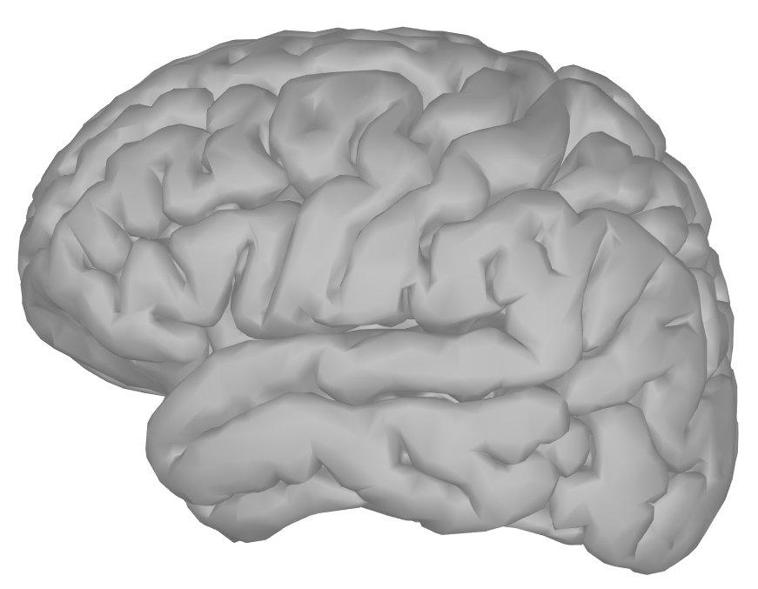
Functional Deficit Zone
Irritative Zone
Epileptogenic Zone
Seizure Onset Zone

Slide 2
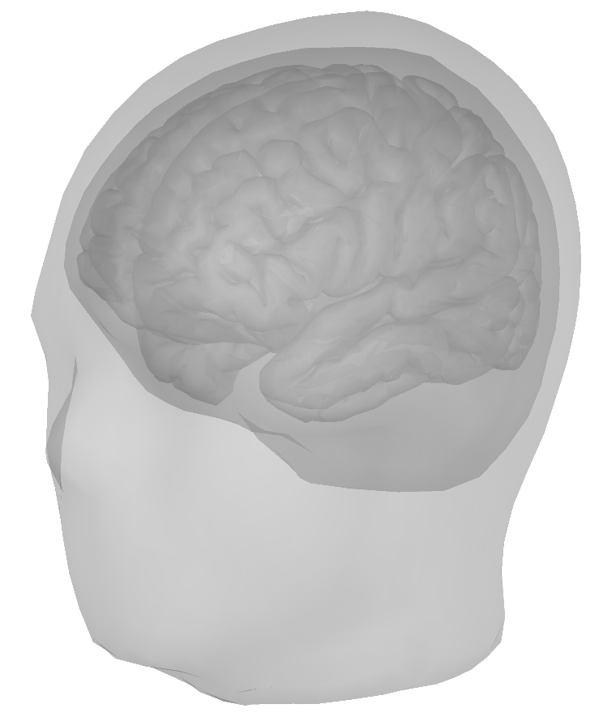

Slide 4
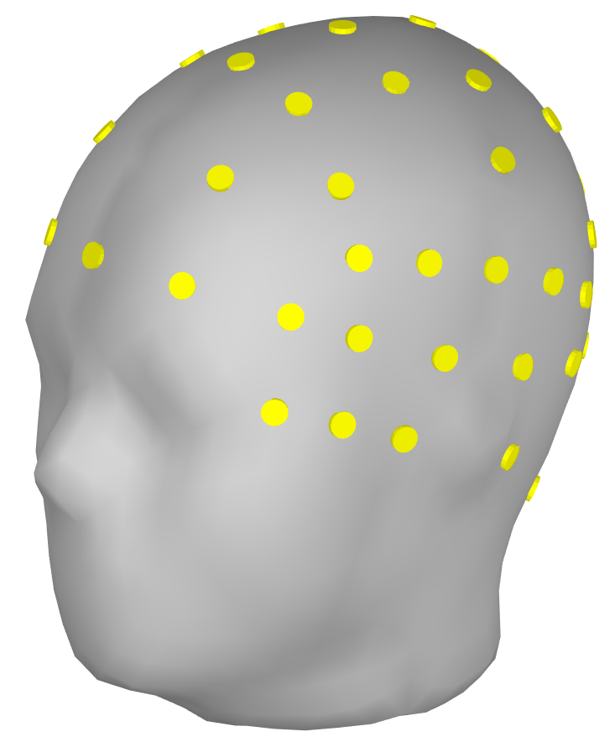

Slide 5

Electric current density, J
(Brain)
Electric potential, Y
(Scalp)

Slide 6
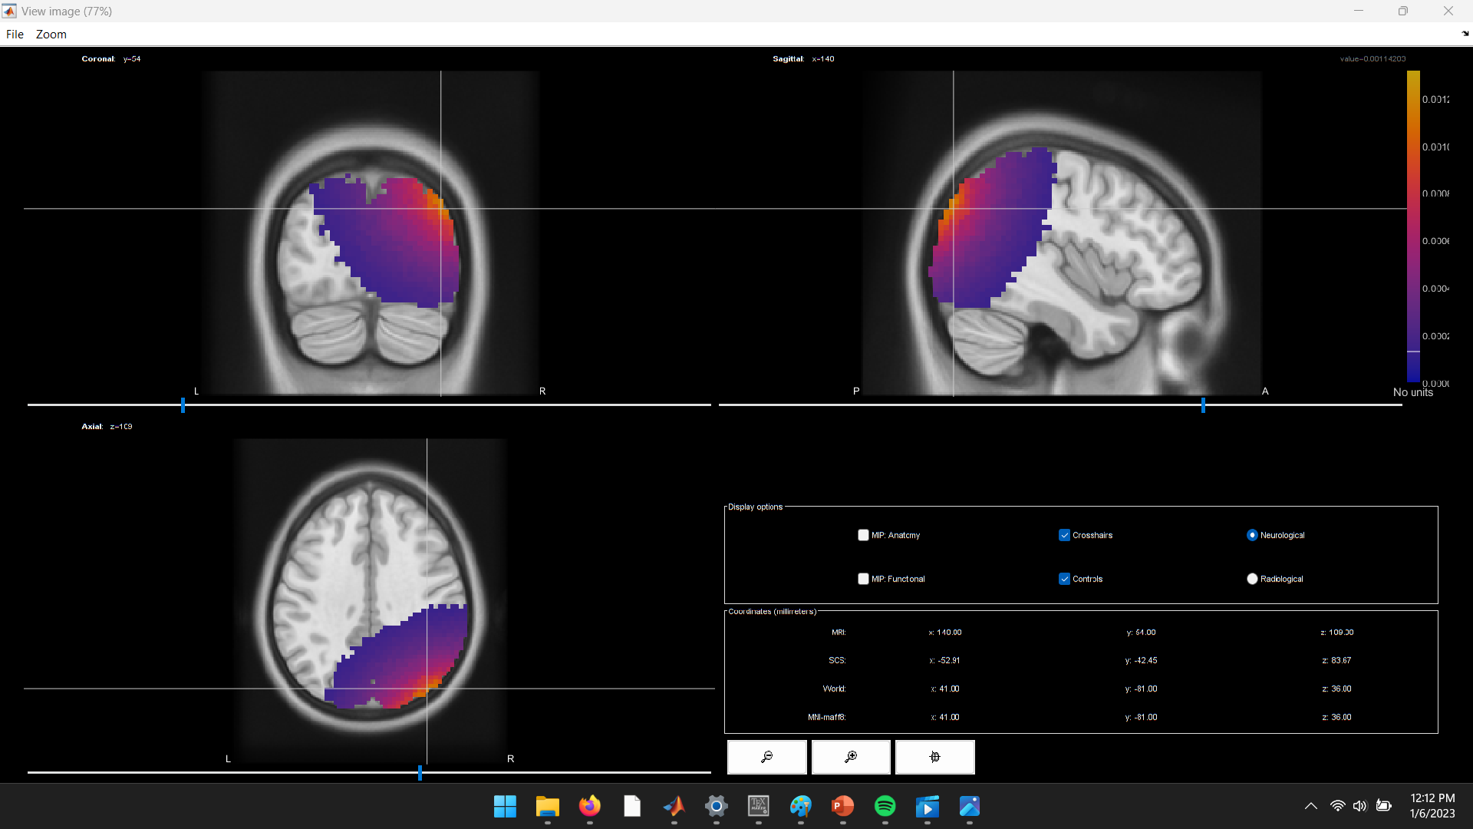
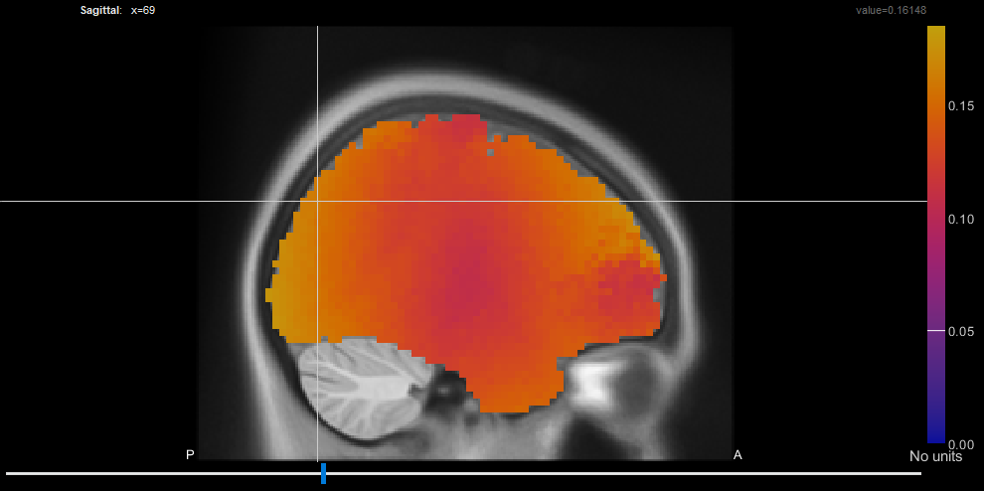

Slide 7
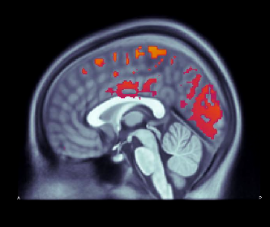

Slide 8
