Slide 1
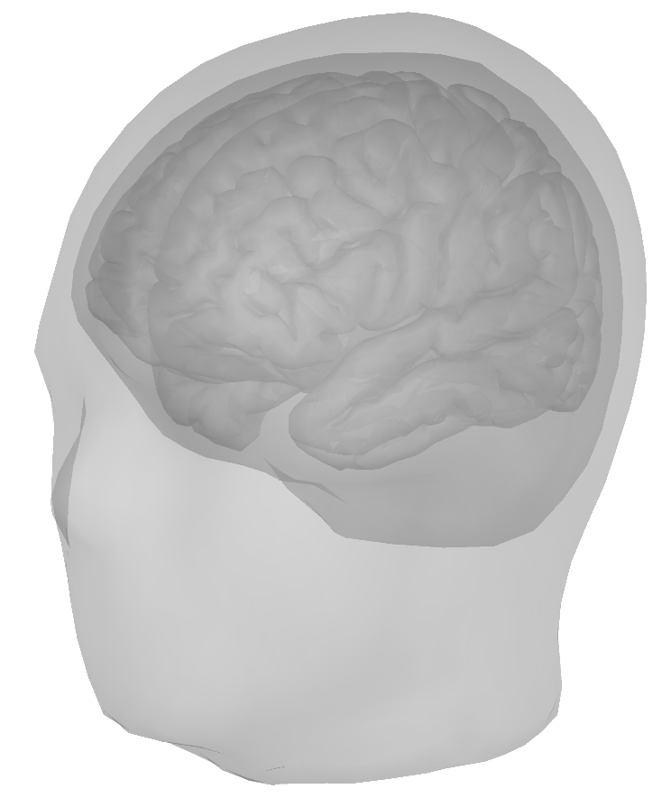
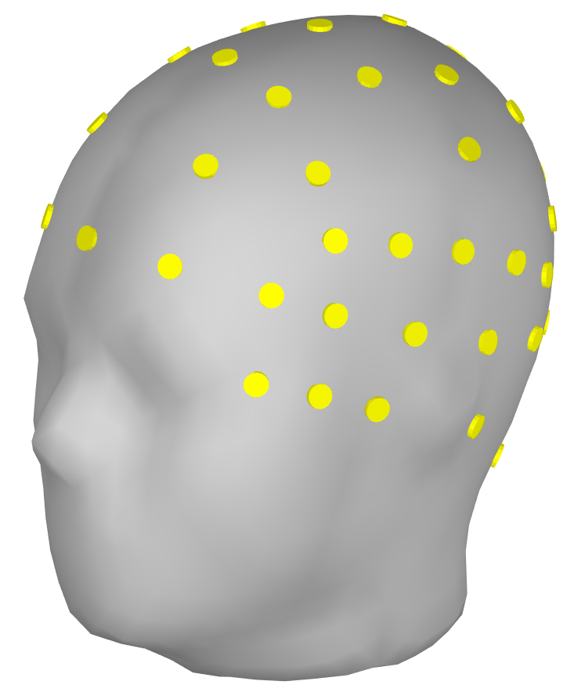

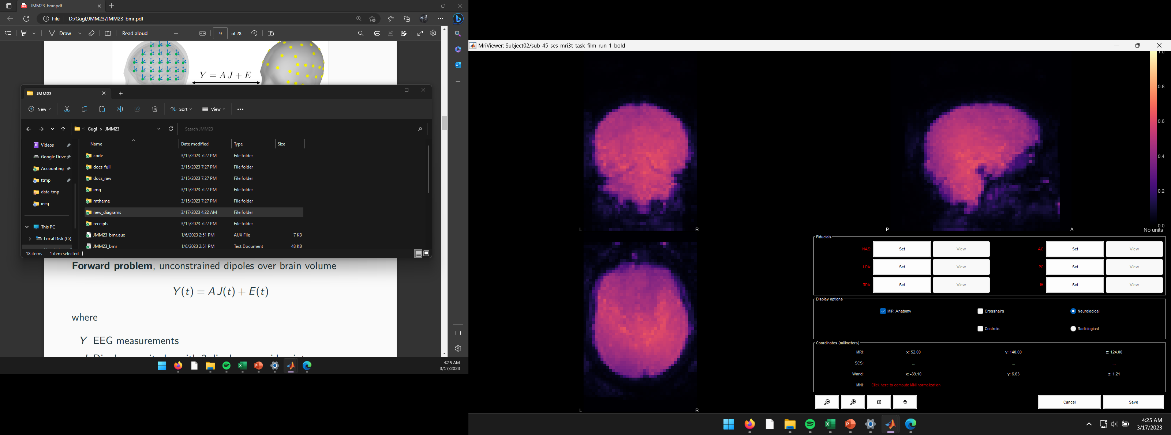
Electric current density, J
(Distributed dipole magnitudes)
Electric potential, Y
(EEG, ECoG)
Hidden variable, Z
(Activity level)
Blood-Oxygen-Level-Dependent signal, F
(fMRI)

Slide 2
Electric current density, J
(Distributed dipole magnitudes)
Electric potential, Y
(EEG, ECoG)
Auxiliary variable, Z
(Activity level)
Blood-Oxygen-Level-Dependent signal, F
(fMRI)

Slide 3
Electric current density, S
(Distributed dipole magnitudes)
Electric potential, Y
(EEG, ECoG, etc)

