Slide 1
.NET
Intermediate Level

Slide 2
Overview
Last Session Recap
API Testing
Introduction to API Testing
Importance of API Testing
Types of API Testing
Tools for API Testing
Best Practices for API Testing
TDD

Slide 3
Introduction to API Testing
Testing APIs directly to ensure they meet expectations for functionality, reliability, performance, and security
Importance in modern software development

Slide 4
Importance of API Testing
Ensures core functionality of the application
Identifies issues early in the development cycle
Reduces overall cost of development and maintenance
Facilitates smooth integration with other systems

Slide 5
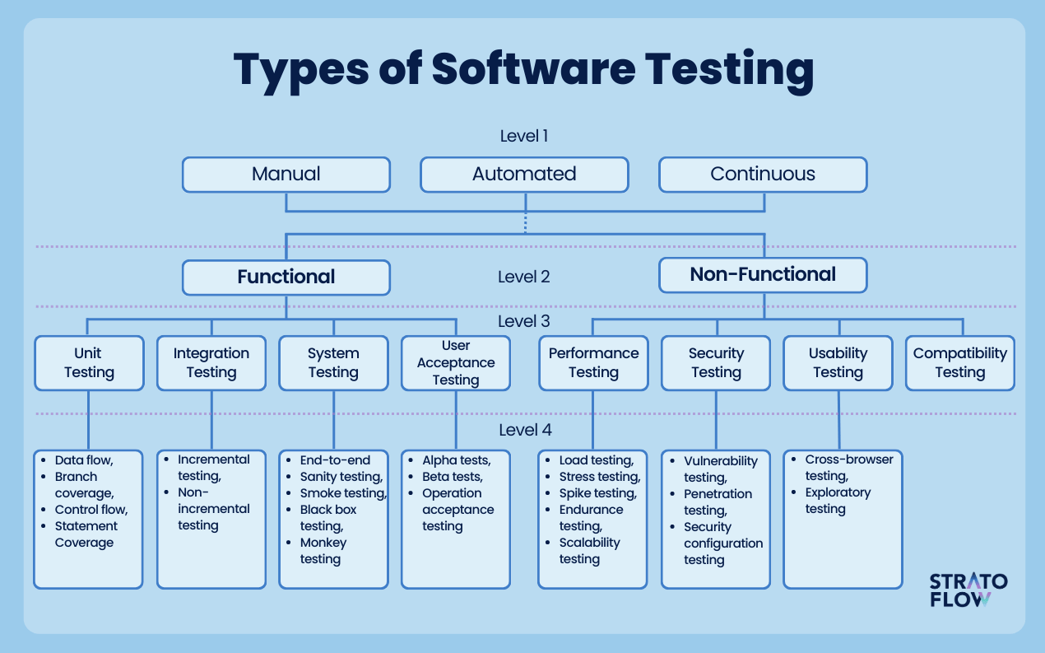

Slide 6
What is Functional Testing
Functional testing is a type of software testing that validates the software system against the functional requirements/specifications
To ensure that the software behaves as expected and all functionalities work correctly

Slide 7
Importance of Functional Testing
Ensures Correctness
Enhances User Satisfaction
Reduces Risks

Slide 8
Types of Functional Testing
Unit Testing
Testing individual components or modules
Integration Testing
Testing the interaction between integrated units/modules
System Testing
Testing the complete and integrated software system
Acceptance Testing
Testing the software in a real-world scenario to verify compliance with business requirements

Slide 9
Functional Testing Techniques
Black Box Testing
Testing without knowledge of the internal code structure
White Box Testing
Testing with knowledge of the internal code structure
Smoke Testing
Preliminary testing to check the basic functionality
Sanity Testing
Testing to ensure that a particular function works as expected after a minor change

Slide 10
Unit Testing
Testing individual components or units of the software
To ensure that each unit functions correctly in isolation
Tools
xUnit
Nunit
MSTest
JUnit

Slide 11
Integration Testing
Testing the interaction between integrated units/modules
To ensure that combined units work together as expected
Tools
Junit
Nunit
TestNG

Slide 12
System Testing (E2E)
Testing the complete and integrated software system
To validate the end-to-end system specifications
Tools
Selenium

Slide 13
Acceptance Testing
Testing the software in a real-world scenario to verify compliance with business requirements
To ensure the software meets user needs and requirements

Slide 14
Best Practices in Functional Testing
Early Involvement
Clear Requirements
Prioritize Testing
Automate
Continuous Integration

Slide 15
Challenges in Functional Testing
Incomplete Requirements
Time Constraints
Complex Systems
Changing Requirements

Slide 16
Non-Functional
Non-functional testing refers to aspects not related to specific behaviors or functions of the system. It focuses on performance, usability, reliability, and other quality attributes
Ensure that the system meets specified criteria beyond functionality
Helps in delivering a robust and user-friendly application

Slide 17
Types of Non-Functional Testing
Performance Testing
Load Testing
Stress Testing
Security Testing
Compatibility Testing
Scalability Testing

Slide 18
Performance Testing
Evaluates the speed, responsiveness, and stability of the system under a given workload
Ensures that the system meets performance criteria
Identifying performance bottlenecks
Tools
JMeter
LoadRunner
Gatling

Slide 19
Load Testing
Checks the system's behavior under expected user load
Maximum operating capacity
Identifying the load limit
Tools
JMeter
BlazeMeter
NeoLoad

Slide 20
Stress Testing
Evaluates how the system behaves under extreme conditions
Identify the breaking point
Ensure system recovers gracefully
Tools
LoadRunner
NeoLoad
JMeter

Slide 21
Scalability Testing
Ensures the system can scale up or down to meet varying load demands
Evaluate the system's ability to handle increased load
Identify scalability issues
Tools
Gatling
WebLOAD

Slide 22
Security Testing
Identifies vulnerabilities and ensures data protection
Protect against attacks
Ensure data confidentiality and integrity
Tools
OWASP ZAP
Burp Suite
Nessus

Slide 23
Compatibility Testing
Ensures the application works across different environments
Validate application behavior on various devices, OS, browsers
Tools
BrowserStack
Sauce Labs

Slide 24
Importance of Non-Functional Testing
Ensures a high-quality product
Improves user experience and trust
Identifies issues early, reducing cost

Slide 25
Best Practices
Define clear objectives and criteria
Integrate non-functional testing into the development cycle
Use automated tools to streamline testing processes

Slide 26
Introduction to TDD
Test-Driven Development (TDD) is a software development approach where tests are written before writing the actual code
It promotes simple designs and inspires confidence
Cycle: Red-Green-Refactor

Slide 27
TDD Cycle
Red
Write a failing test
Green
Write just enough code to make the test pass
Refactor
Improve the code without changing its behavior

Slide 28
Benefits of TDD
Ensures code quality and correctness
Simplifies debugging
Provides a clear documentation of code behavior
Reduces the number of bugs in the production environment
Encourages modular and maintainable code

Slide 29
TDD in Practice
Write a test for a new feature or function
Run the test and see it fail (Red)
Write the minimum code required to pass the test (Green)
Run the test and see it pass
Refactor the code while keeping it functional
Repeat for each new feature or function

Slide 30
Example Workflow
Add a function to check if a number is prime
Red - Write a test case for the prime checking function
Green - Implement a basic prime checking function
Refactor - Optimize the prime checking logic

Slide 31
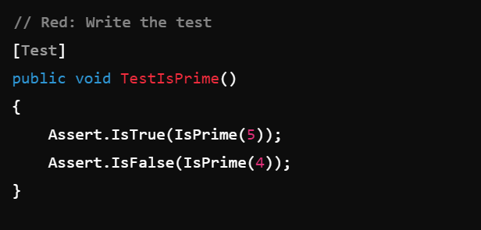
Test

Slide 32
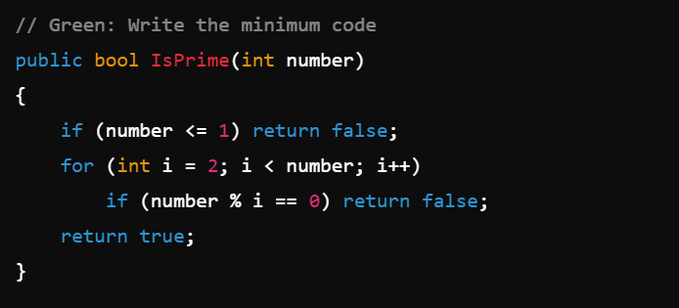
Implementation

Slide 33
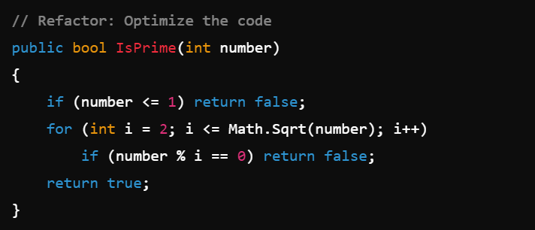
Improve

Slide 34
TDD Best Practices
Write tests for both positive and negative cases
Keep tests small and focused
Refactor tests to remove duplication
Use meaningful names for test cases
Ensure tests run fast

Slide 35
Challenges of TDD
Initial learning curve
Can slow down development initially
Requires discipline to write tests first
Tests can become maintenance overhead

Slide 36
TDD Tools and Frameworks
.NET (NUnit, xUnit, MSTest)
Java (JUnit, TestNG)
JavaScript (Jest, Mocha, Jasmine)

Slide 37
TDD and Agile
TDD fits well within Agile methodologies
Supports continuous integration and continuous delivery (CI/CD)
Enhances collaboration between developers and testers
Helps in delivering working software iteratively

Slide 38
TDD Summary
TDD is a powerful development practice that helps ensure code quality and reliability
The Red-Green-Refactor cycle promotes incremental development
While TDD has a learning curve, the long-term benefits outweigh the initial challenges

Slide 39
QA

Slide 40
Thank you !

