Slide 1
.NET
Intermediate Level

Slide 2
Overview
Last Session Recap
JSON
Problem JSON
Validation

Slide 3
JSON
JSON stands for JavaScript Object Notation
It is a lightweight data-interchange format
Easy for humans to read and write
Easy for machines to parse and generate

Slide 4
History of JSON
Created by Douglas Crockford
Became popular with the rise of JavaScript and web development
Officially standardized as ECMA-404 and ISO/IEC 21778:2017

Slide 5
JSON Structure
Basic Structure
Objects
Arrays
Data Types
Strings
Numbers
Objects
Arrays
Booleans
Null

Slide 6
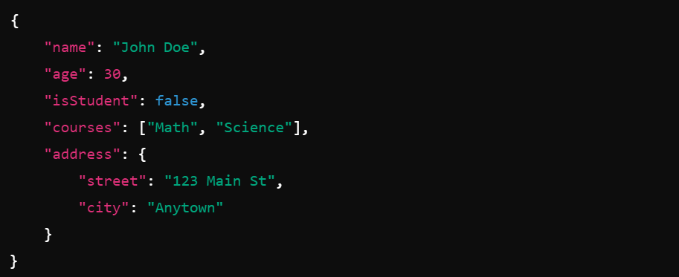
Example of JSON

Slide 7
JSON vs XML
Simplicity
JSON is more readable and less verbose than XML
Data Types
JSON supports different data types directly, XML relies on schemas
Usage
JSON is often used in web APIs and configuration files, XML is used in older systems and documents

Slide 8
Using JSON in .NET
System.Text.Json
Newtonsoft.Json

Slide 9
Problem+JSON
A standardized format for error responses in HTTP APIs
Defined by RFC 7807 (Problem Details for HTTP APIs)
Provide a consistent structure for conveying error information in APIs

Slide 10
Why Use Problem+JSON
Standardization
Ensures a uniform format for error responses
Clarity
Improves the readability and understanding of error messages
Interoperability
Facilitates easier integration and debugging across different systems

Slide 11
Problem+JSON Structure
Attributes
Type: A URI reference that identifies the problem type
Title: A short, human-readable summary of the problem
Status: The HTTP status code (e.g., 404, 500)
Detail: A human-readable explanation specific to this occurrence of the problem
Instance: A URI reference that identifies the specific occurrence of the problem

Slide 12
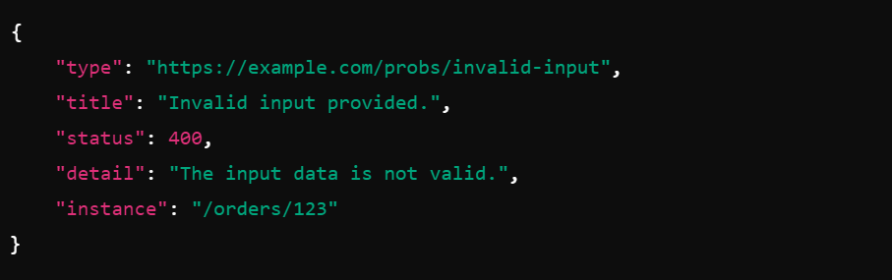
Error Response Examples

Slide 13
Best Practices
Use Meaningful “type “ URIs
Ensure “type” URIs point to documentation about the specific error
Provide Clear “title“ and ”detail”
Make sure error messages are concise yet informative
Include “instance” for Specific Errors
Use instance to link to more details about the specific occurrence of the problem

Slide 14
Validation

Slide 15
QnA

Slide 16
Thank you

