Slide 1
.NET
Intermediate Level

Slide 2
Overview
Last Session Recap
Introduction
Overview of API Authentication
Authentication Methods in .NET Core API
Implementing JWT Authentication
Token Refresh
Best Practices

Slide 3
Introduction
API authentication ensures that only authorized users can access your API
It's crucial for maintaining the security and integrity of your application

Slide 4
Overview of API Authentication
API authentication verifies the identity of the user or application making the request
Common authentication mechanisms
Basic Authentication: Simple but less secure
Token-based Authentication: More secure and scalable
OAuth: Open standard for access delegation

Slide 5
Authentication vs. Authorization
Authentication
Verifies the identity of the user (e.g., login)
Authorization
Determines what resources the authenticated user can access (e.g., permissions)

Slide 6
Authentication Methods in .NET Core API
Basic Authentication
API Key Authentication
JWT Authentication

Slide 7
Basic Authentication
Basic Authentication is a simple authentication scheme built into the HTTP protocol
It uses a username and password to authenticate requests
Suitable for simple scenarios but has significant security limitations
Dev purposes

Slide 8
Basic Authentication
The client sends the username and password encoded in the Authorization header
The server decodes and validates the credentials

Slide 9
API Key Authentication
API keys are a simple and effective way to authenticate requests between 2 APIs
Each client application is issued a unique API key to include in their requests

Slide 10
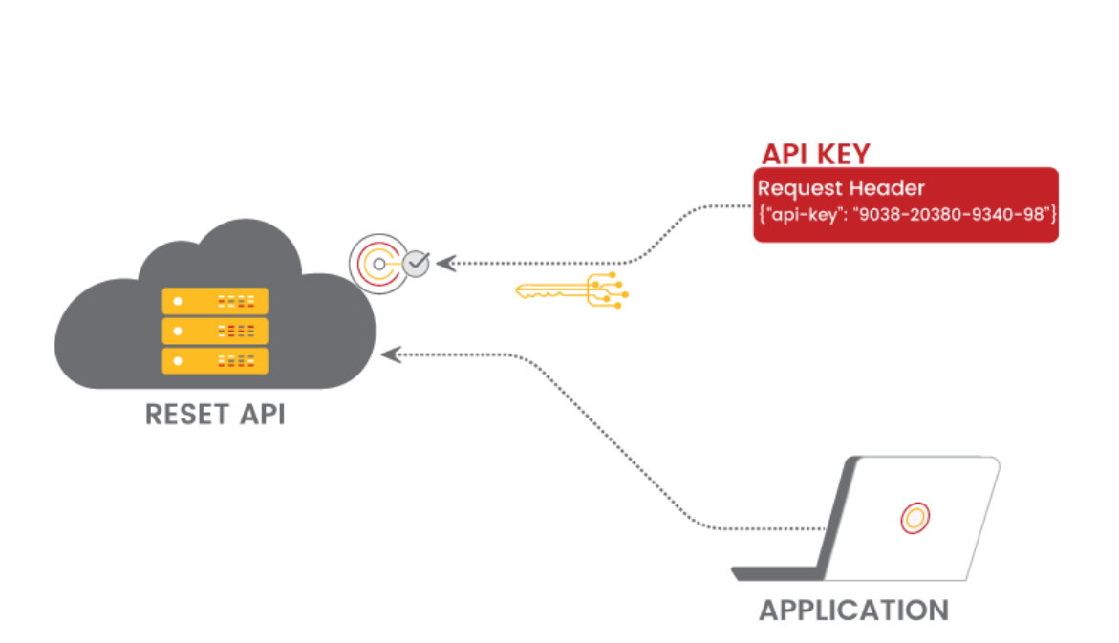
API Key Authentication
The client includes the API key in the request header or URL
The server validates the API key against a stored list of keys

Slide 11
JSON Web Token (JWT) Authentication
JWT is a compact, URL-safe means of representing claims between two parties
Structure of a JWT
Header: Algorithm and token type
Payload: Claims (user data)
Signature: Verifies the token's integrity

Slide 12
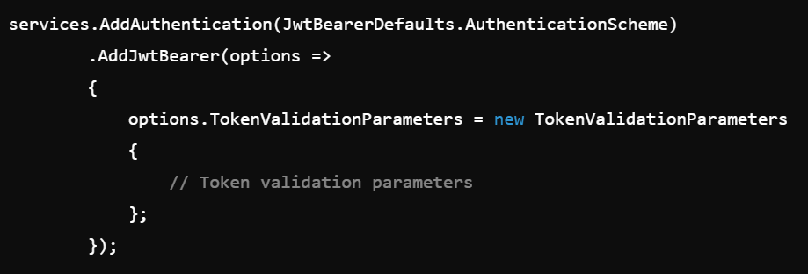
Implementing JWT Authentication
Microsoft.AspNetCore.Authentication.JwtBearer

Slide 13

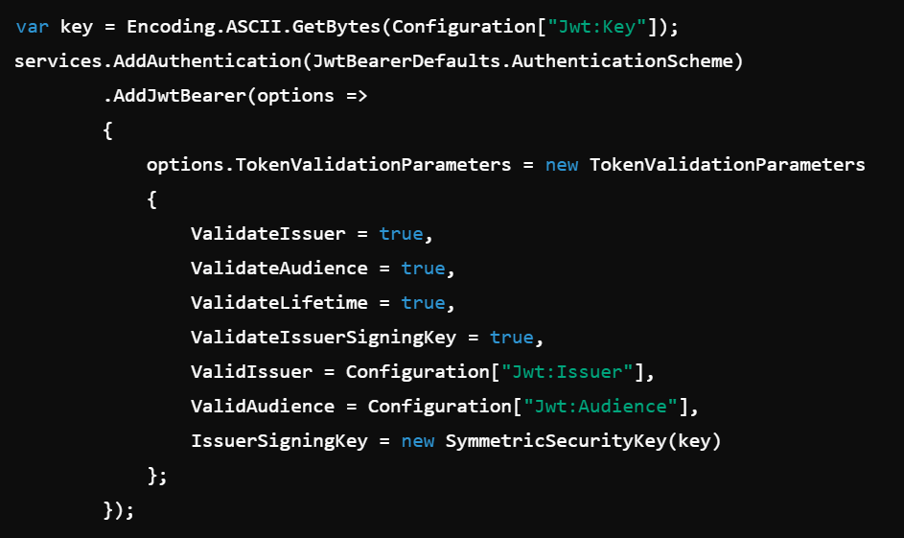
Implementing JWT Authentication - Configuring JWT
Add JWT settings in appsettings.json
Register JWT in Startup.cs

Slide 14
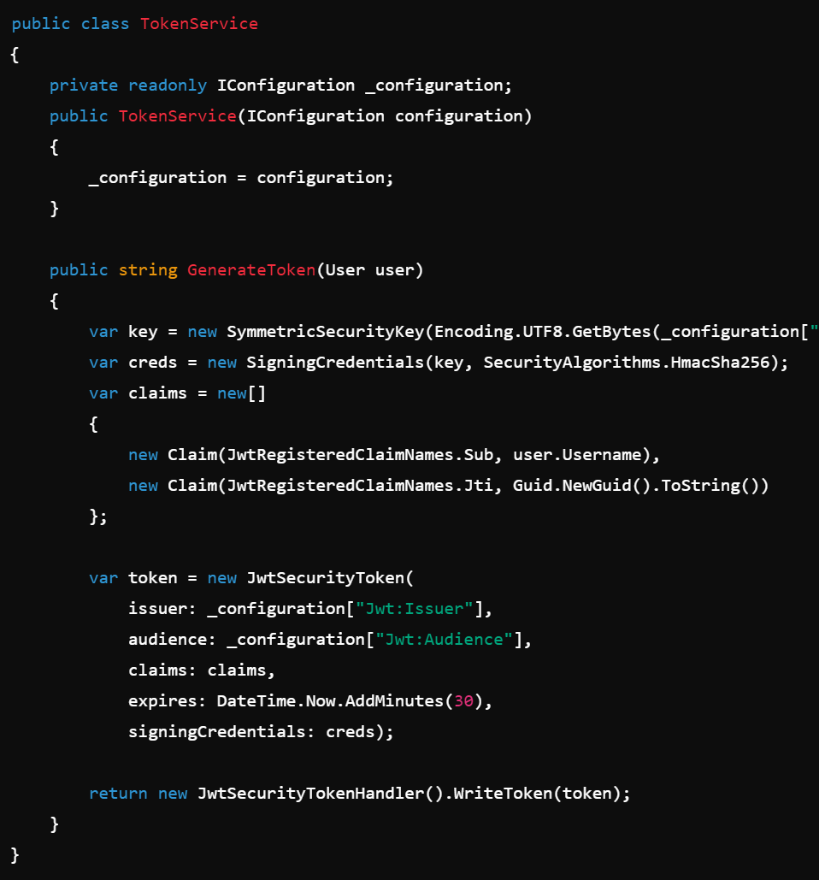
Implementing JWT Authentication - Generating Tokens

Slide 15
Token Refresh
Provides a way to issue new access tokens without requiring the user to re-authenticate
Enhances security by allowing shorter-lived access tokens
Store refresh tokens securely and protect them from unauthorized access
Implement mechanisms to detect and prevent token misuse or replay attacks
Set appropriate lifetimes for refresh tokens

Slide 16
Authorization
Authorization determines what actions an authenticated user can perform
Essential for securing sensitive data and operations

Slide 17
Authorization
Policy-based Authorization
Define policies and apply them to endpoints
Role-based Authorization
Restrict access based on user roles
Claims-based Authorization
Authorize based on user claims

Slide 18
Best Practices
Set appropriate token lifetimes (e.g., short-lived access tokens)
Implement token renewal to maintain security and user convenience
Enforce HTTPS for all API communications
Secure communication prevents token interception and man-in-the-middle attacks
Implement logging for authentication events
Handle authentication errors gracefully
Provide meaningful error messages to help users and developers understand issues

Slide 19
Resources
Resources:Official .NET Documentation
JWT.io
OAuth 2.0
Further reading and tutorials:
ASP.NET Core Authentication
Securing APIs with JWT in .NET Core

Slide 20
QA

Slide 21
Thank you

