Slide 1
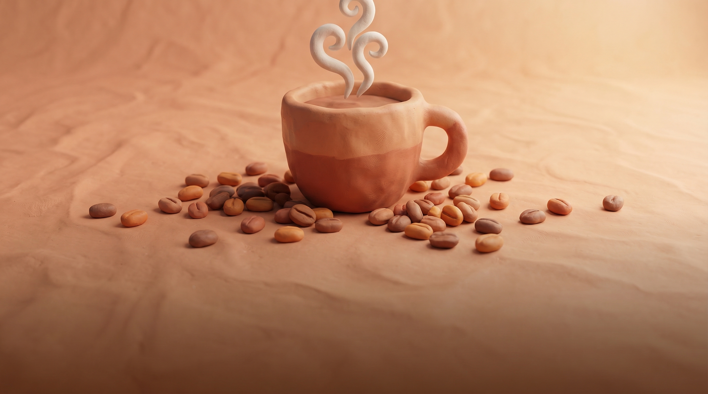
THE WORLD OF COFFEE
From Bean to Cup — A Journey Through Flavor
01

Slide 2
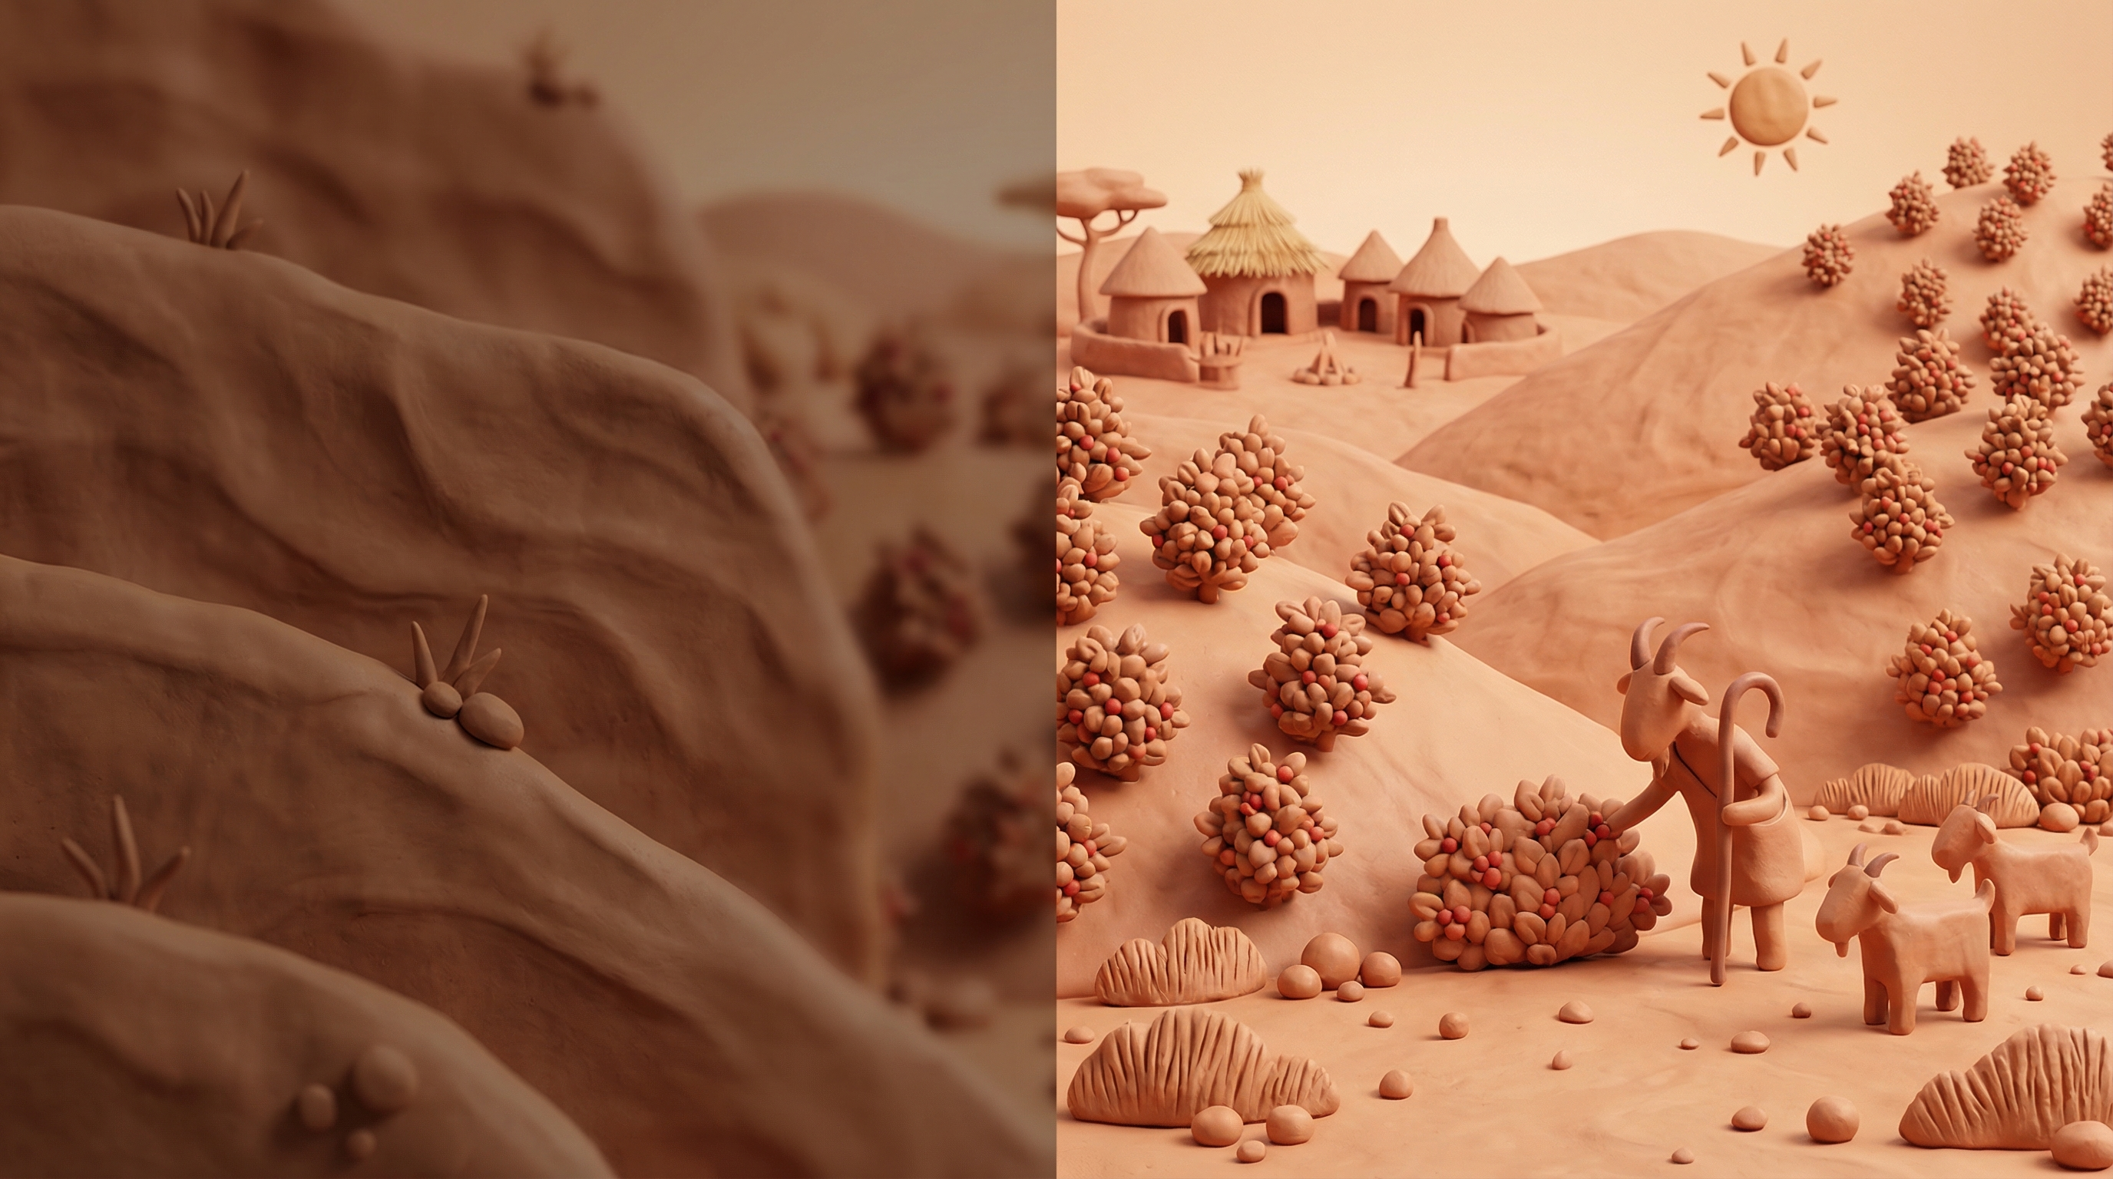
THE ORIGIN STORY
Legend tells of an Ethiopian goat herder named Kaldi who noticed his goats dancing after eating bright red berries from a wild bush. That discovery in the 9th century sparked a revolution — from the ancient coffee forests of Ethiopia to the bustling cafes of Istanbul, Venice, and Vienna. Today, coffee is the world's second most traded commodity, connecting over 125 million people across 70+ countries in a global chain from seed to cup.
125M+ PEOPLE
Connected through the global coffee chain
02

Slide 3
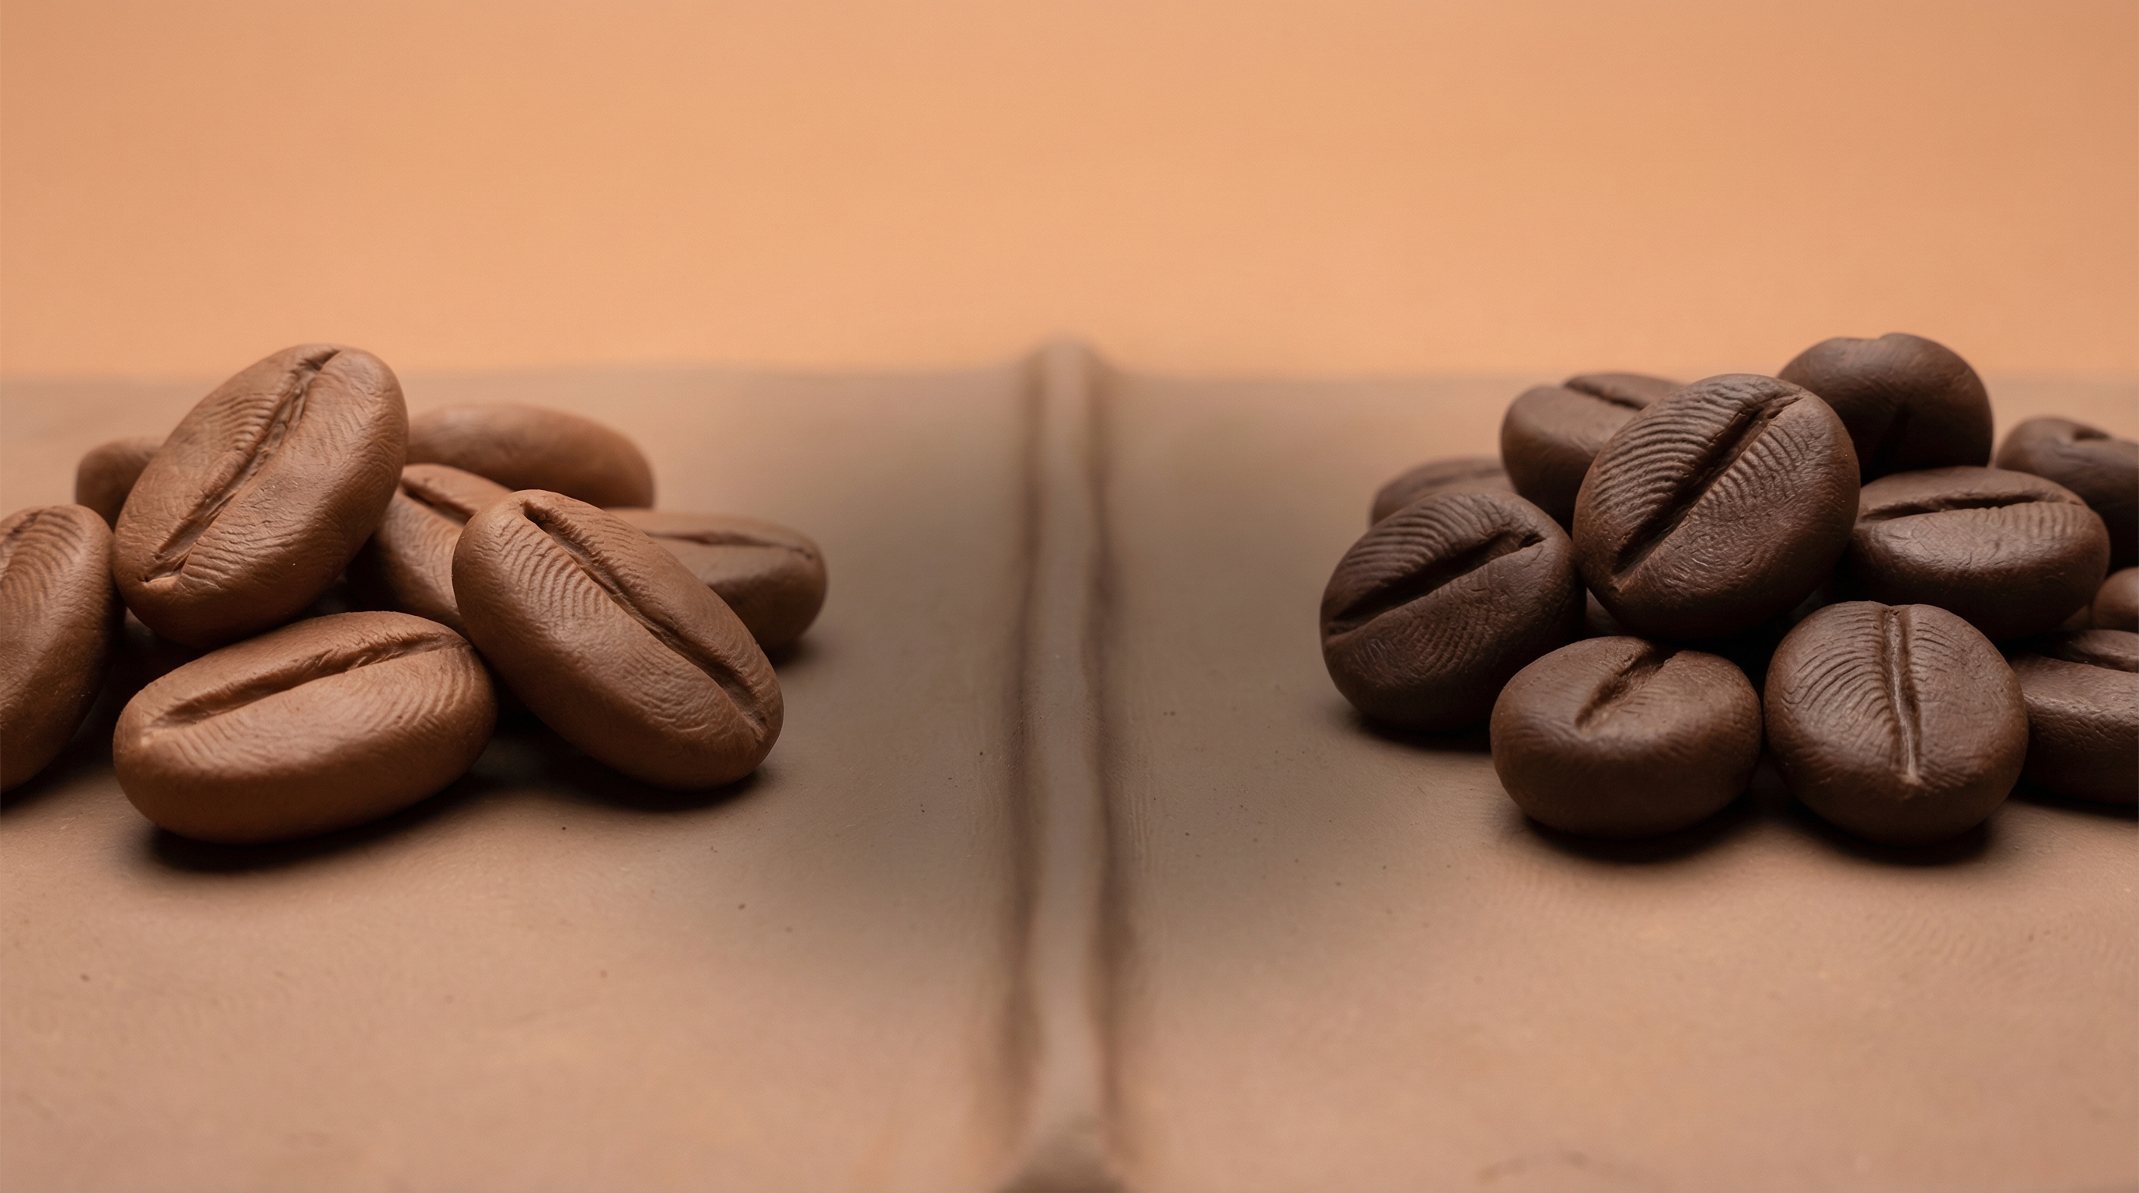
ARABICA vs ROBUSTA
Two beans, two personalities
ARABICA
ROBUSTA
Flavor
Flavor
Sweet, fruity, complex
Bold, earthy, bitter
Caffeine
Caffeine
1.2% — smooth, gentle
2.7% — strong, punchy
Growing
VS
Growing
900-2000m altitude
0-800m altitude
Share
Share
60-70% of world production
30-40% of world production
Price
Price
Premium — specialty grade
Affordable — instant/espresso
Body
Body
Light to medium, bright acidity
Full, heavy, low acidity
03

Slide 4

BREWING METHODS
Four ways to unlock your perfect cup
Pour Over
Espresso
French Press
Cold Brew
3-4 min
25-30 sec
4-5 min
12-24 hr
Clean, bright, nuanced. Highlights single-origin character.
Concentrated, bold, crema-topped. The soul of Italian coffee.
Full-bodied, rich, oily. Retains natural coffee oils.
Smooth, sweet, low-acid. Steeped cold for mellow flavor.
04

Slide 5

“
Every cup tells a story — of the soil it grew in, the hands that picked it, and the moment you savor it.
— The World of Coffee
From bean to cup, every sip is a journey.
05

