Slide 1

The K-Beauty Revolution
How Korean skincare conquered the world
01

Slide 2
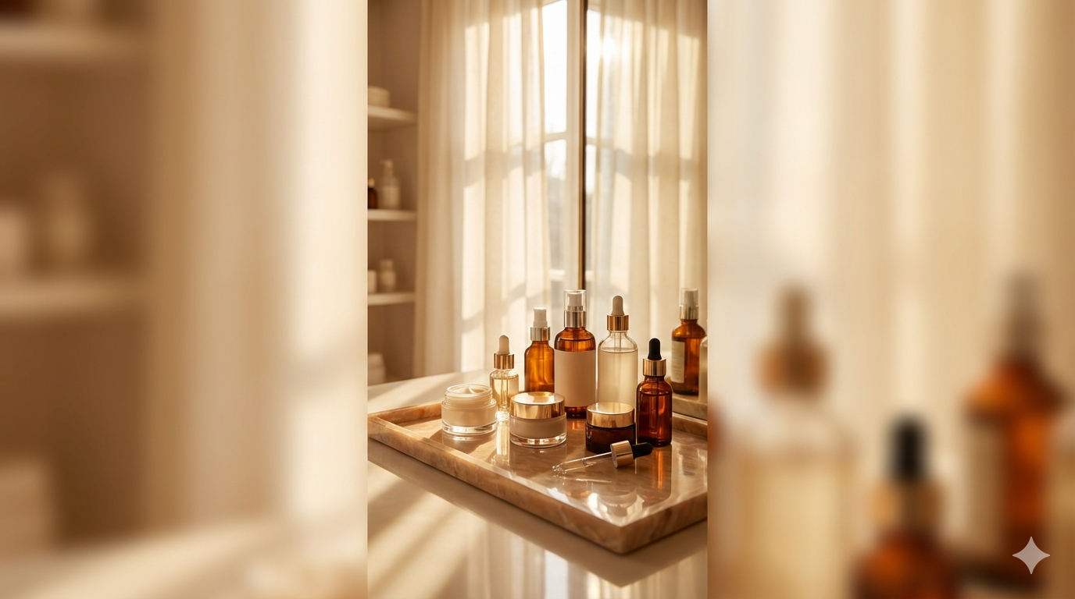
THE 10-STEP ROUTINE
92% Korea | 35% Global
follow multi-step routines
Morning protection meets evening restoration
MORNING — Protection
NIGHT — Repair
1. Oil Cleanser
Dissolve sunscreen
1. Oil Cleanser
Double cleanse
2. Water Cleanser
Deep clean pores
2. Water Cleanser
Remove impurities
3. Exfoliant
Weekly cell turnover
3. Exfoliant
Chemical turnover
4. Toner
Balance skin pH
4. Toner
Rebalance pH
5. Essence
Core hydration
5. Essence
Fermented nutrients
6. Serum
Targeted treatment
6. Serum/Ampoule
Concentrated repair
7. Moisturizer
Seal in layers
7. Sheet Mask
15-min infusion
8. Sunscreen
SPF50+ daily
8. Night Cream
Overnight recovery
02

Slide 3
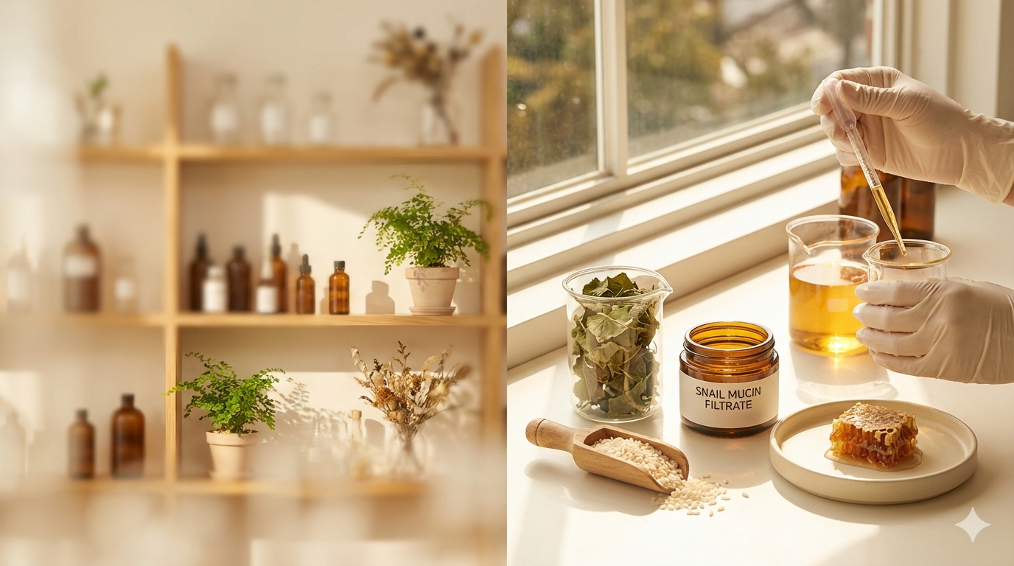
Hero Ingredients
Nature meets science in every formula
Snail Mucin
Glycoproteins for deep repair and hydration
Centella Asiatica
Anti-inflammatory healing from tiger grass
Rice Extract
Brightening enzyme complex for radiance
Propolis
Bee-derived antioxidant barrier shield
03

Slide 4
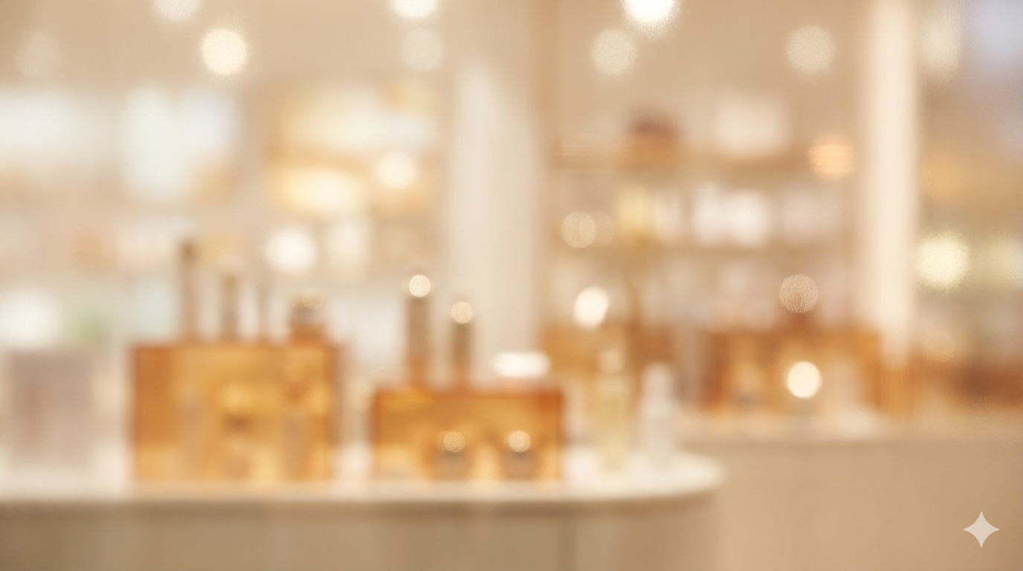
Global Impact
K-Beauty's worldwide footprint in numbers
MARKET SIZE
TIKTOK VIEWS
ANNUAL SPEND
$13.2B
48B
$230
Global value at 9.3% CAGR
#KBeauty Gen Z adoption
Korean woman avg yearly
IMPORT GROWTH
TOP DESTINATIONS
BRANDS GLOBAL
400%
4
50+
US skincare imports surged
US, China, Japan, SE Asia
Korean brands in 100+ countries
04

Slide 5

Your Skin, Your Story
The future of beauty is Korean — science-driven, nature-inspired, and endlessly innovative.
#KBeautyRevolution
05

