Slide 1

MARKET VALUE
$13.2B
Growing at 9.3% CAGR
THE K-BEAUTY
REVOLUTION
How Korea Redefined Skincare for the World

Slide 2
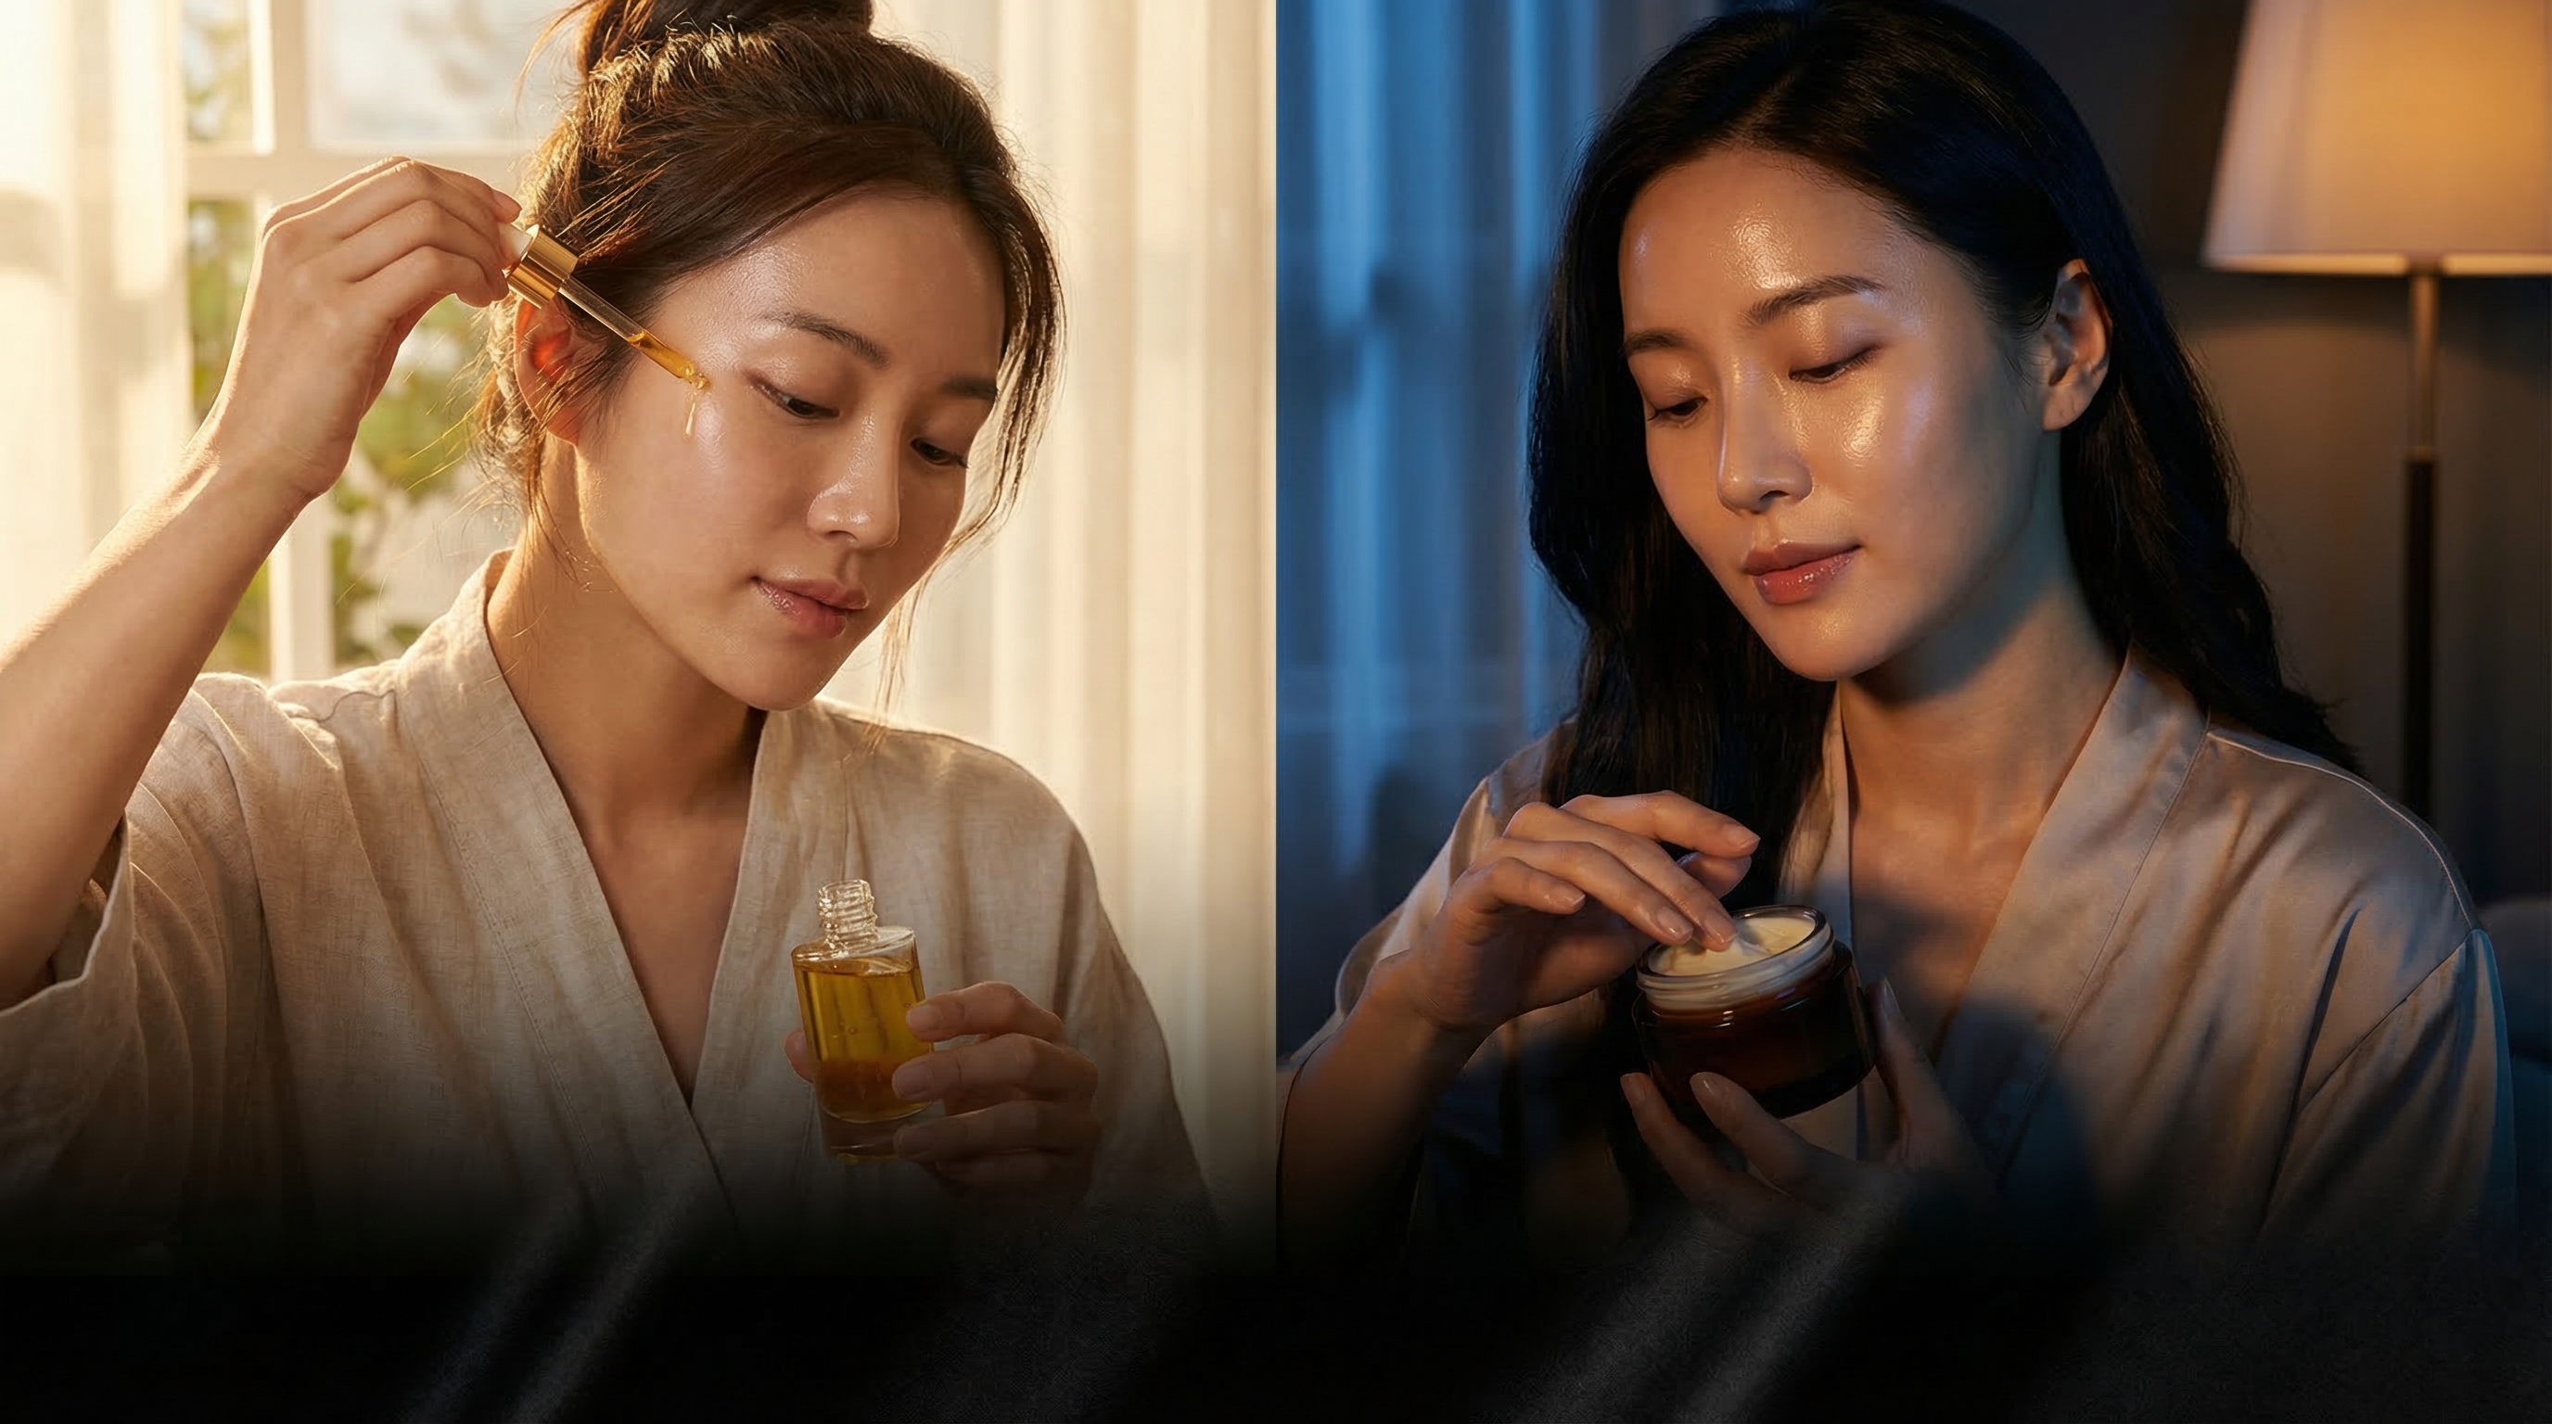
THE 10-STEP ROUTINE
92%
Korean women | 35% Global
Morning protection meets evening restoration
MORNING — Protection & Prep
NIGHT — Repair & Restore
1. Oil Cleanser
Dissolve sunscreen & makeup
1. Oil Cleanser
Double cleanse start
2. Water Cleanser
Deep clean pores
2. Water Cleanser
Remove residual impurities
3. Exfoliant
2-3x weekly cell turnover
3. Exfoliant
Chemical/physical turnover
4. Toner
Balance & prep skin pH
4. Toner
Rebalance after cleansing
5. Essence
Core hydration layer
5. Essence
Fermented nutrient boost
6. Serum
Targeted treatment
6. Serum/Ampoule
Concentrated repair
7. Moisturizer
Seal in all layers
7. Sheet Mask
15-min deep infusion
8. Sunscreen
SPF 50+ daily protection
8. Night Cream
Rich overnight recovery

Slide 3

HERO INGREDIENTS
Science-backed actives powering the revolution
Snail Mucin
Glycoproteins & hyaluronic acid. Repair micro-tears, deep hydration, fade scars.
Niacinamide
Vitamin B3. Brightens dark spots, minimizes pores, strengthens barrier.
Centella Asiatica
Tiger grass. Anti-inflammatory, accelerates healing, calms redness.
Rice Extract
Fermented rice water. Kojic acid for brightening, centuries of use.
Propolis
Bee resin. Antibacterial, antioxidant, seals moisture.
MARKET GROWTH
$13.2B → $21.8B
65% growth driven by global adoption of Korean skincare science

Slide 4
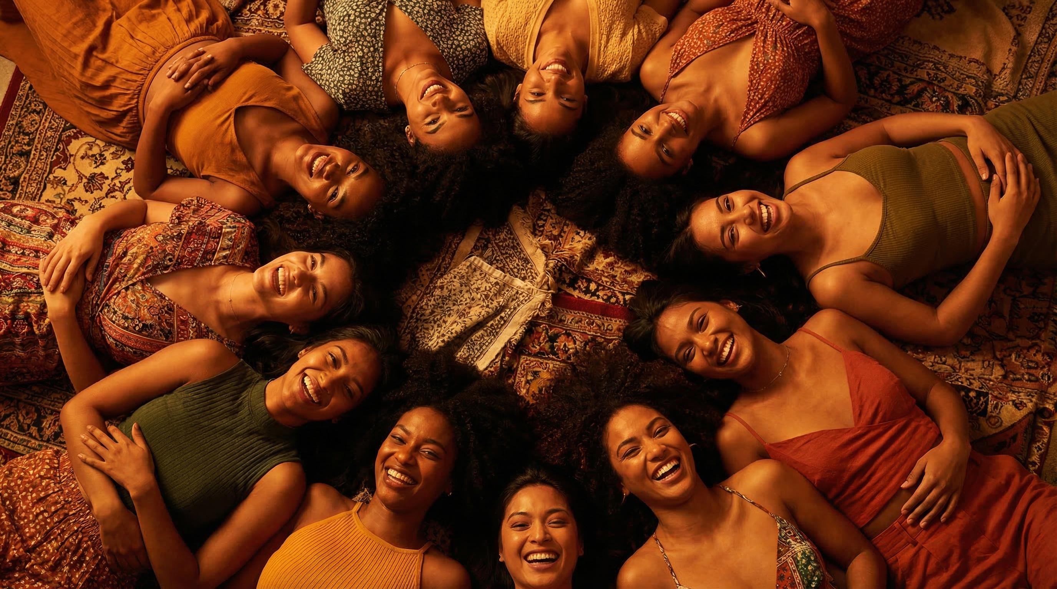
GLOBAL IMPACT
K-Beauty's worldwide footprint in numbers
MARKET SIZE
IMPORT GROWTH
TIKTOK VIEWS
$13.2B
400%
48B
Global value, 9.3% CAGR annually
US Korean skincare imports surged
#KBeauty driving Gen Z adoption
ANNUAL SPEND
Korean woman avg. yearly investment
TOP DESTINATIONS
US, China, Japan, SE Asia
$230
4 MARKETS

Slide 5

INNOVATION
Korean labs lead global skincare R&D and fermentation biotech.
COMMUNITY
48 billion TikTok views. A worldwide movement of shared routines.
Your Skin, Your Story
ACCESSIBILITY
From luxury to drugstore — quality skincare for every budget.
The future of beauty is personal, science-driven, and inclusive.

