Slide 1
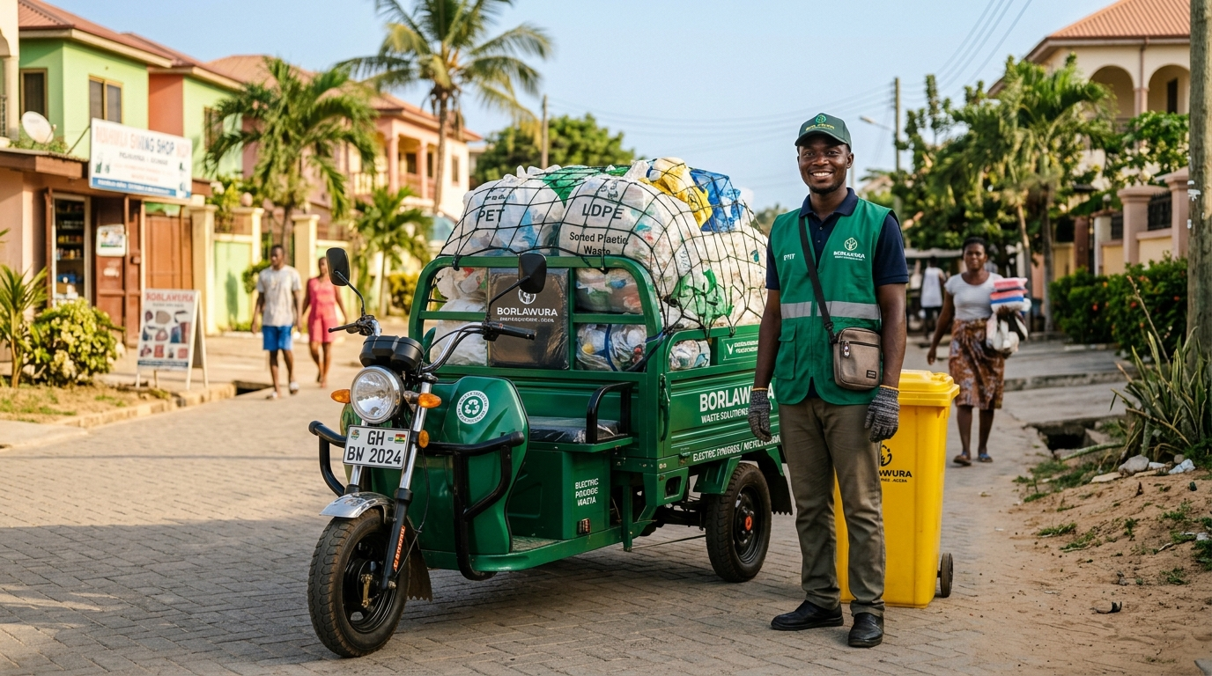
GHANA'S ON-DEMAND WASTE LOGISTICS PLATFORM
Borlawura Waste Connect
“Snap it. Request it. It’s gone.”
The ride-hailing revolution for municipal and commercial waste management in Ghana. Connecting households and businesses with verified haulers through transparent pricing, live GPS tracking, and Mobile Money payments.
Verified Borlawura Hauler — Accra, Ghana
Equipped with electric tricycle haulers & sorted recyclables
Explore Interactive Hub ➔
Open Live Web App ↗

Slide 2
☖ Hub
Problem
Customer App
Collector App
Admin CMS
Economics
ESG Impact
Tech Stack
Roadmap
PLATFORM DIRECTORY
Interactive Presentation Hub
Click on any module tile below to jump directly to that section
⚠ THE CHALLENGE
The Problem & Context
Municipal waste bottlenecks, burning, & informal hauler hurdles
Click to View Section ➔
📱 CUSTOMER VIEW
Customer Mobile App
3-step request flow, waste photo AI, & live GPS tracking
Click to View Section ➔
🚚 COLLECTOR VIEW
Collector Driver App
Online job alerts, navigation, photo proof, & MoMo wallet
Click to View Section ➔
🖥 OPERATIONS CMS
Admin & Operations CMS
City fleet command center, KYC verification, & pricing engine
Click to View Section ➔
₵ ECONOMICS
Tariff & Business Model
Transparent formula in ₵ & 4 scalable marketplace revenue streams
Click to View Section ➔
🌱 ESG & CLIMATE
Environmental ESG Impact
Cleaner communities, flood mitigation, & dignified green jobs
Click to View Section ➔
⚡ Key Highlights: Average Match Time: 3 mins | 1,240+ Verified Haulers | 98% On-Time Pickups | Zero Bank Account Needed (100% MoMo)

Slide 3
☖ Hub
Problem
Customer App
Collector App
Admin CMS
Economics
ESG Impact
Tech Stack
Roadmap
THE OPPORTUNITY
Transforming Urban Waste Management in Ghana
Bridging the critical gap between uncollected urban waste and informal collector livelihoods
THE PROBLEM WE SOLVE
Urban Bottlenecks & Inefficiencies
• Irregular municipal rounds: Households wait weeks for scheduled waste trucks, causing unpleasant overflow, odor, and roadside dumping.
• Opaque, arbitrary cash pricing: Informal 'aboboyaa' haulers charge inconsistent prices with zero transparency or receipts.
• Open air burning & hazards: Desperate communities burn mixed plastics, emitting carcinogens and hazardous fumes.
• Collector fuel & time loss: Informal haulers waste up to 40% of their day roving streets searching blindly for customers.
THE BORLAWURA DIGITAL SOLUTION
Tech-Enabled Waste Logistics
✔ On-Demand Uber-style dispatch: Nearby collectors are matched instantly via GPS proximity and capacity.
✔ Transparent Ghana Cedi pricing: Algorithmic pricing based on base fee, volume, waste type, and distance.
✔ Mandatory photo proof of work: Pre-pickup waste photos and post-collection disposal verification guarantee accountability.
✔ Mobile Money financial inclusion: 100% cashless flow with MTN MoMo, Telecel Cash, and AirtelTigo for seamless instant payouts.

Slide 4

☖ Hub
Problem
Customer App
Collector App
Admin CMS
Economics
ESG Impact
Tech Stack
Roadmap
CUSTOMER MOBILE EXPERIENCE
“Snap it. Request it. It’s gone.” in Under 3 Minutes
Frictionless mobile-first experience designed for households and commercial businesses
1. Snap it (Photo & Waste Classification)
• Upload or snap up to 3 photos of waste
• Select stream: Plastic, Organic, Mixed, or E-Waste
• Choose volume: Small Bag (1.0x), Sack (1.6x), or Bin (2.4x)
2. Request it (Pin Location & Upfront Price)
• Pin exact GPS location (Osu, East Legon, Tema, Kumasi)
• Instant dynamic tariff calculation breakdown in ₵
• Select Mobile Money (MTN MoMo, Telecel Cash, AirtelTigo)
• Optional: SOS Urgent pickup or Community neighborhood code
3. It's gone (Live Tracking & Photo Proof)
• Watch collector move toward pickup on live map
• ETA, collector photo, vehicle type, and verified badge
• Collector submits mandatory after-photo proof of collection
• Instant receipt, tip collector, and rate the experience
Try Customer Request Flow Live ↗

Slide 5
☖ Hub
Problem
Customer App
Collector App
Admin CMS
Economics
ESG Impact
Tech Stack
Roadmap
COLLECTOR DRIVER EXPERIENCE
Dignifying & Empowering Urban Waste Haulers
A dedicated driver interface turning informal waste pickers into tech-enabled logistics entrepreneurs
Smart Proximity Job Alerts
Drivers toggle Online/Offline. Incoming requests display waste photos, pickup distance, urgency badge, and guaranteed net earnings in ₵ before acceptance.
Turn-by-Turn Route Guidance
Integrated navigation route to customer pickup pinpoint. Status transitions: 'Start Route' → 'Arrived' → 'Start Collection' with 1-tap customer call.
Mandatory Photo Proof Verification
Before closing the job, the driver must snap and submit an 'After Photo' showing cleared premises, protecting drivers against disputes.
Instant Mobile Money Cashout
Zero banking barriers. Earnings reflect immediately into the Collector Wallet. 1-click withdrawals direct to MTN MoMo, Telecel Cash, or AirtelTigo.
Explore Collector Portal Live ↗

Slide 6
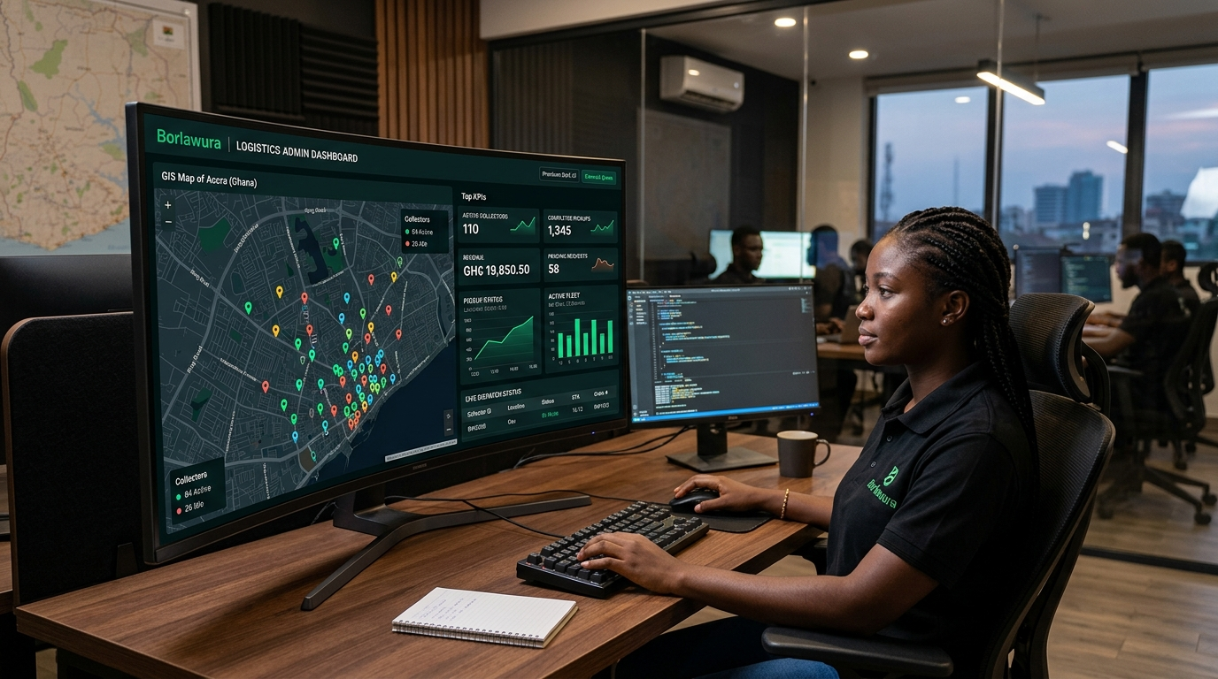
☖ Hub
Problem
Customer App
Collector App
Admin CMS
Economics
ESG Impact
Tech Stack
Roadmap
OPERATIONS & GOVERNANCE
Operations Command Center & Fleet CMS
Desktop-grade platform for municipal authorities, fleet managers, and finance teams
Live Operations Command
Full real-time map displaying active city pickups, collector locations, SOS priority alerts, and manual dispatcher reassignments.
Collector KYC & Compliance
Structured onboarding pipeline reviewing Ghana Card IDs, driving licences, and vehicle roadworthiness inspection before certification.
Financial Clearinghouse
Inbound customer MoMo ledger, automated driver commission deductions, and withdrawal approval queue.
Dynamic Tariff & Content CMS
Configure base tariffs, per-km fees, waste multipliers, community codes, and announcements without code changes.
Role-Based Security & Audit Logs
5 segregated roles: Super Admin, Operations, Finance, Support, and Content Admin with tamper-evident audit trails.
Access Admin Operations Portal ↗

Slide 7
☖ Hub
Problem
Customer App
Collector App
Admin CMS
Economics
ESG Impact
Tech Stack
Roadmap
BUSINESS MODEL & MONETIZATION
Transparent Pricing Formula & Revenue Streams
Predictable pricing for users and sustainable marketplace unit economics
DYNAMIC TARIFF FORMULA
How Every Pickup Is Priced in GHS (₵)
• Base Mobilization Fee: ₵15.00 flat entry fee covering hauler dispatch
• Waste Type Multiplier: Plastic (1.1x), Organic (1.0x), Mixed (1.2x), E-Waste (1.5x)
• Volume Tier Factor: Small Bag (1.0x), Sack (1.6x), Standard Bin (2.4x)
• Distance Surcharge: ₵2.50 per kilometer from collector to customer
• SOS Urgency Add-on: +₵10.00 priority fee for rapid guaranteed matching
• Community Discount: -12% discount for pooled neighborhood pickups
MARKETPLACE REVENUE STREAMS
Multi-Pronged Revenue Model
✔ Platform Take Rate (15% - 20%)
Transaction commission deducted automatically on every completed on-demand pickup.
✔ Recurring Subscriptions
Predictable weekly and monthly scheduled pickup subscriptions for residential estates and businesses.
✔ Commercial & B2B Contracts
Enterprise waste management contracts for restaurants, hotels, hospitals, and shopping centers.
✔ Recyclables Aggregation
Secondary revenue through sorting, bailing, and selling aggregated plastics and e-waste to recycling processors.

Slide 8

☖ Hub
Problem
Customer App
Collector App
Admin CMS
Economics
ESG Impact
Tech Stack
Roadmap
IMPACT & SUSTAINABILITY
ESG Alignment & Cleaner Communities for Ghana
Combining climate resilience, flood prevention, and dignified livelihoods
Environmental: Landfill Diversion & Zero Burning
Pre-sorting plastics and e-waste at the household level diverts thousands of tons from landfills and eliminates neighborhood smoke pollution.
Disaster Resilience: Accra Flood Prevention
Uncollected plastic debris blocks open storm gutters during tropical downpours. Fast on-demand pickup prevents catastrophic neighborhood flooding.
Social: Dignified Incomes & Financial Inclusion
Formalizes informal haulers with digital MoMo payments, safety credentials, and verifiable earnings records for micro-loans.
Governance: Data-Driven Municipal Oversight
Generates city-wide waste heatmaps, empowering municipal assemblies (AMA, TMA) with actionable data for urban planning.
Community Recycling Initiative — Accra
Color-coded sorting for plastics, organics, and e-waste

Slide 9
☖ Hub
Problem
Customer App
Collector App
Admin CMS
Economics
ESG Impact
Tech Stack
Roadmap
TECHNICAL ARCHITECTURE
Built for Speed, Reliability, & Mobile Operability
High-performance modern web and mobile architecture engineered for real-world conditions
Frontend & UI Architecture
• React 19 & TypeScript for robust end-to-end type safety
• TanStack Router for client-side stateful routing
• Tailwind CSS with custom Emerald / Ghana Gold design tokens
• Radix UI primitives for accessible mobile bottom sheets
Interactive Map & Geolocation
• Custom canvas-based map rendering with smooth zoom
• Real-time collector GPS positioning and simulated routing
• Instant dynamic distance calculation and ETA range
• Geofenced support for Osu, East Legon, Tema, Kumasi, etc.
Fintech & Payment Engine
• MTN Mobile Money, Telecel Cash, & AirtelTigo integration
• Automated payment status cycle (Pending, Paid, Failed)
• Collector digital balance ledger and payout security checks
• Instant withdrawal approval pipeline
Operations, Audit & Reliability
• Granular Role-Based Access Control (5 Admin security roles)
• Tamper-evident audit log tracking all status & price changes
• Reactive state management with offline recovery
• Comprehensive error capturing and diagnostic monitoring

Slide 10
FUTURE HORIZONS
Scaling Borlawura Across Ghana & West Africa
PHASE 1: CURRENT ROLLOUT
Accra & Tema Operations
• Customer map-first web app live with MoMo
• Collector driver workflow & photo proof
• Operations & Finance CMS portal
• Active in Osu, East Legon, Adenta, Tema
PHASE 2: H2 EXPANSION
Regional Hubs & Buy-Backs
• Native iOS & Android mobile applications
• Partnerships with certified plastic recyclers
• Commercial B2B waste contracts
• Expansion to Kumasi, Takoradi & Cape Coast
PHASE 3: LONG-TERM VISION
Circular Economy Ecosystem
• AI waste material sorting & volume appraisal
• Tokenized green credits for recycling households
• Corporate ESG sustainability reporting APIs
• Expansion into West African urban centers
☖ Return to Interactive Hub
Open Live Web Application ↗
Open Operations CMS ↗

