Slide 1
Towards Seamless Mobility Solutions using Software Defined Networks
Mayank Pandey
CSED, MNNIT Allahabad, Prayagraj

Slide 2








Context
Video Streaming/ Mobile end devices:
  According to the recent Cisco Survey:
    IP video traffic - 82% of all consumer Internet traffic by 2021,
    up from 73% in 2016.

Slide 3

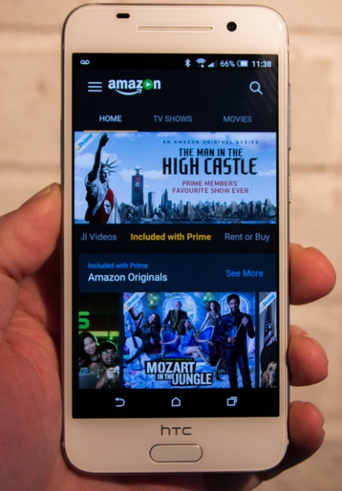
Context
Majority of the destination end hosts are
  mobile devices using
    WLAN techniques
  Connectivity during Mobility??
    Layer-2 mobility/Layer-3 mobility

Slide 4
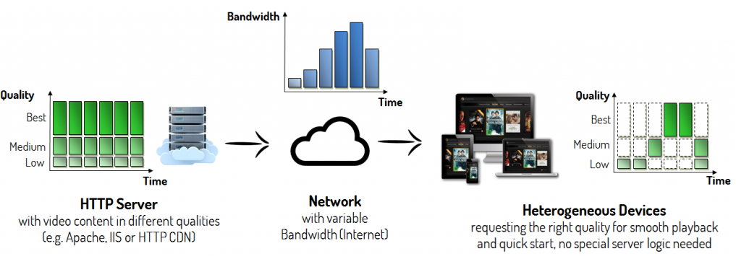
Context
Video streaming over HTTP - The DASH protocol :
  HTTP uses TCP as underlying Protocol
Mobility of clients: TCP with all its problems
  Takes packet loss as a signal of congestion: throttles the sender
  Many proposals: no current standard.

Slide 5
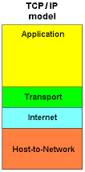
Revisiting Network Protocol Stack
TCP/IP Reference Model
  Protocol stack
  Lower layers provide services to upper layers. For e.g.
    HTTP gets support of TCP which takes services from
      IP and IEEE 802.x

Slide 6
The Network layer
Forwards datagrams to next hop (Forwarding)
  On the path towards destination
  Uses routing table
Finds out the best path (Routing)
  Routing process
  Distributed algorithm

Slide 7

The Perpetual Confusion
Which layer device the router is?
  Network Layer (a normal response)
Router searches for best path
  Talk to other router
    RIP (Routing Information Protocol)
    BGP (Border Gateway Protocol)
Here lies the confusion:
  RIP uses UDP
  BGP uses TCP

Slide 8

The Perpetual Confusion
Actually:
  Routers run a daemon (a process, an application)
    routed (implementation of RIP or BGP)
    And use underlying transport layer to talk to each other
So... Which layer device router is?
  Application?
  Transport?
  Network?

Slide 9
More Confusion
Network management fellows can:
  Ping a router
    means echo server is running
      May run over TCP or UDP
  telnet a router
    means telnet application is running
      Runs over TCP

Slide 10
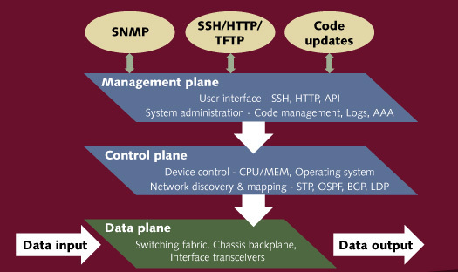
Planes...Planes...Planes...
Three different planes:
  Data plane
  Control Plane
  Management Plane

Slide 11
Traditional Network Devices
All three planes are tightly coupled
  Standard protocol implementations
  Lots of vendor proprietary protocols
Devices configured by network administrators
  routing and forwarding rules are configured once
    utilized for their lifetime
  behaviour remains almost same all the time.
    reconfiguration is difficult and time consuming
      Even a minor modification requires substantial intervention

Slide 12


Analogy
Vs
Programmability Vs Configurability

Slide 13
Programmable Networks
Can Networks be programmed
  According to Context
  According to application
Vision
  Behavior, Flavor and policies of Network can be adjusted dynamically
    Based on the needs of application
    Based on the Contextual changes
      Mobility of nodes
      Migration of VMs

Slide 14
Early efforts
Active Networks
  Where switches can perform custom computations on packets
    Packets themselves carry procedure and data
Network Virtualization
  Virtual Switches (1990s, Switchlets)
  VINI (Virtual Network Infrastructure) (2006)
  Virtual Services (Cabo) (2007)

Slide 15
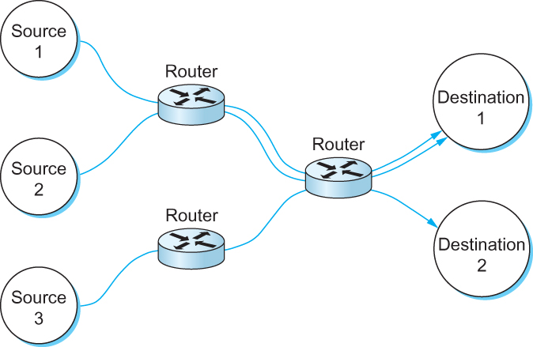
Adaptive Networks: Flow aware routing
Traditionally Network layer is
  Stateless
  Treat every incoming packet similar
Modern Sophisticated routers can
  Learn the flows going through them
    Maintain per flow soft state
  Helpful in providing
    Line-rate processing speed
    Differentiated QoS based on the requirement
  Dynamic creation of flow rules and classifiers

Slide 16
Software Defined Networks
Concept of Centralized Control
  Traditional Networks have Distributed Control
Analogous to old times of computing
  Single Mainframe
    With lots of dumb terminals
Similarly
  Logically centralized Control/Management plane
  With network of dumb switches running data-plane

Slide 17
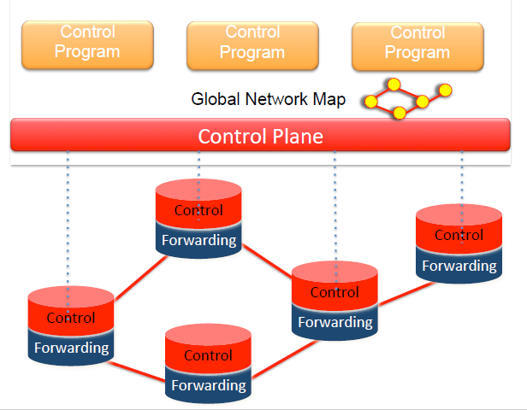
SDN (Abstract View)

Slide 18
SDN : Important Components
How Applications can talk to Controller
  Northbound APIs (e.g. REST API)
How Controller can talk to Switches (Data Plane)
  Southbound API (Openflow, ForCES etc.)
How Global Network Map can be formulated
  Using popular LLDP (Link layer Discovery Protocol)
How Controller can talk to other controllers
  West bound API (Not standardized, usually TCP)

Slide 19
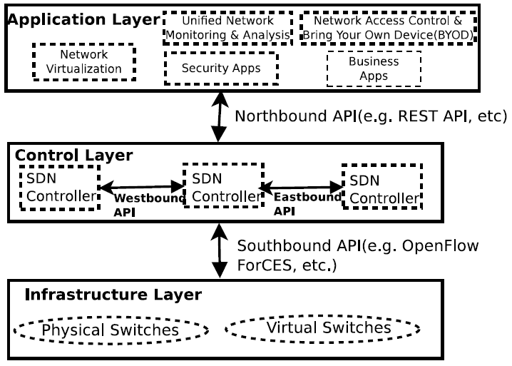
SDN: Basic Architecture

Slide 20
Example usage: SDN and Mobility
Can these two concepts be correlated
  Yes Obviously
  How???
    Lets see whether Audience can tell after some time!!!

Slide 21
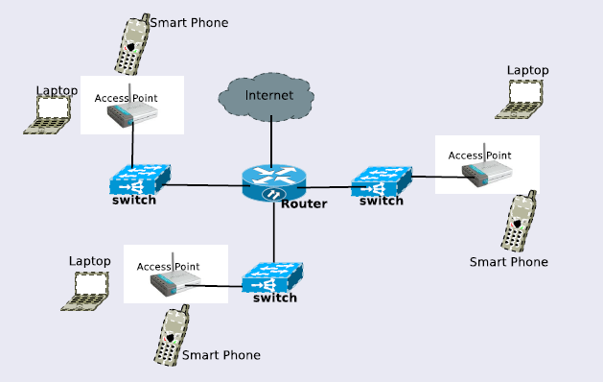
Typical layout of WiFi Network

Slide 22
Mobility in IP Networks: Issues
Layer-2 Mobility
  when a node moves within a subnet
    From range of one WAP to another
  Challenges:
    Possibility of packet loss (IEEE 802.11 is “break before make”)
    MAC tables of self-learning Infrastructure layer-2 switches are required to be modified

Slide 23
Mobility in IP Networks: Issues
Layer-3 Mobility
  When a node moves across different subnets
  Challenges:
    Network prefix changes
    Mobile node needs to change its IP address
      Results in termination of on-going sessions
  Use Mobile IP concepts
    Though promising but very few deployable products
      Issues of triangular and sub-optimal routing

Slide 24
Mobility in IP Networks: Issues
Effect on TCP
  TCP takes loss of packet as implicit signal of Congestion
    Enters into congestion control
      Slows down transmission rate
    Sender may remain idle even if receiver is re-associated
      Due to doubling of RTO at each missed ACK.
  True assumption for wired networks
    Very unreal for wireless networks
      Most of packet losses are mobility induced
      During handover from one POA to another

Slide 25
Layer-2 Switch: self-learning
Source: A
Dest: A’
A
A A’
switch learns which hosts can be reached through which interfaces
  when frame received, switch “learns” location of sender: incoming LAN segment
  records sender/location pair in switch table
C’
B
1
2
6
3
5
4
C
B’
A’
MAC addr interface TTL
A
1
60
Switch table
(initially empty)

Slide 26
Switch: frame filtering/forwarding
When frame received:
1. record link associated with sending host
2. index switch table using MAC dest address
3. if entry found for destination
then {
if dest on segment from which frame arrived
then drop the frame
else forward the frame on interface indicated
}
else flood
forward on all but the interface
on which the frame arrived

Slide 27
Self-learning, forwarding: example
Source: A
Dest: A’
A
A A’
C’
B
frame destination unknown:
1
2
flood
6
3
A A’
A A’
A A’
A A’
A A’
5
4
destination A location known:
C
selective send
A’ A
B’
A’
MAC addr interface TTL
A
1
60
Switch table
(initially empty)
A’
4
60

Slide 28
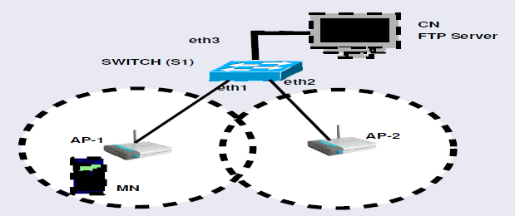
Case of Layer-2 Mobility
Suppose a mobile node is in role of FTP receiver:

Slide 29
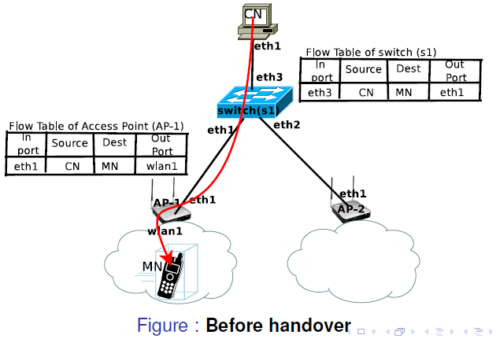
How SDN can Help??

Slide 30
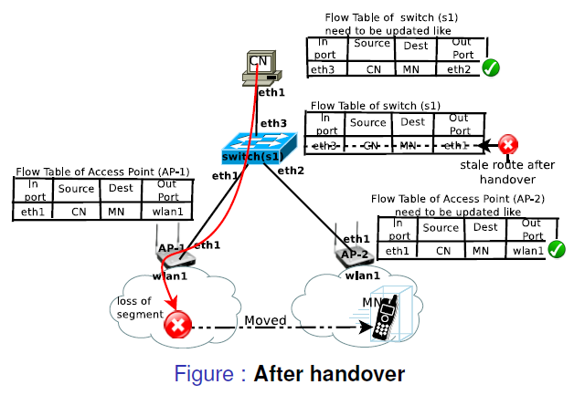
How SDN can Help??

Slide 31
How SDN can help: TCP case
Can we hide mobility induced packet losses
  To avoid drastic reduction of congestion window at sender.
Can we redirect and recover the packets in transit when:
  Mobile node is disassociated
Can we do above stuffs without
  Modifying the TCP implementation
  Compromising end-to-end semantics

Slide 32
How SDN can help: TCP case
Intelligent usage of ZWA (Zero Window Advertisement) of TCP
Intelligent usage of Protection against spurious timeouts of TCP
Making SDN controller to take the role of receiver during disconnection and
  Relinquishing that role gracefully as soon as receiver gets connected.

Slide 33
To Conclude:
SDN has lots of promise
  Slowly and steadily getting pace
  Already popular in Data-Centers
  Can be helpful in many domains:
    Content based routing
    Event based routing
    Named data Networking
    Information Centric Networks
    And obviously (IoT)

Slide 34
Talk was based on:
“Software-Defined Mobility in IP based Wi-Fi Networks: Design Proposal and Future Directions”. 10th IEEE International Conference on Advanced Networks and Telecommunications Systems (ANTS) 2016.
  Authors: Krishna Vijay Singh and Mayank Pandey
“Improving performance of TCP for wireless network using SDN”. 20th ACM International Conference on Distributed Computing and Networking (ICDCN) 2019.
  Authors: Krishna Vijay Singh and Mayank Pandey

Slide 35
For Further Details and References:
Feel free to contact me on
  mayankpandey@mnnit.ac.in
  Thanks….

