Slide 1


CommitPass
Notes:
TARGET: 7 seconds
NARRATION
At a workshop I joined, many registered guests never showed up. Their reserved seats stayed empty.
SUPPORTING NOTES AND SOURCES
The workshop experience is supplied by Albary. The opening hook is narration only. Original CommitPass logo. Dark terracotta and cream ring artwork generated with the built-in image tool; source asset commitpass-dark-accent-v9.png .

Slide 2

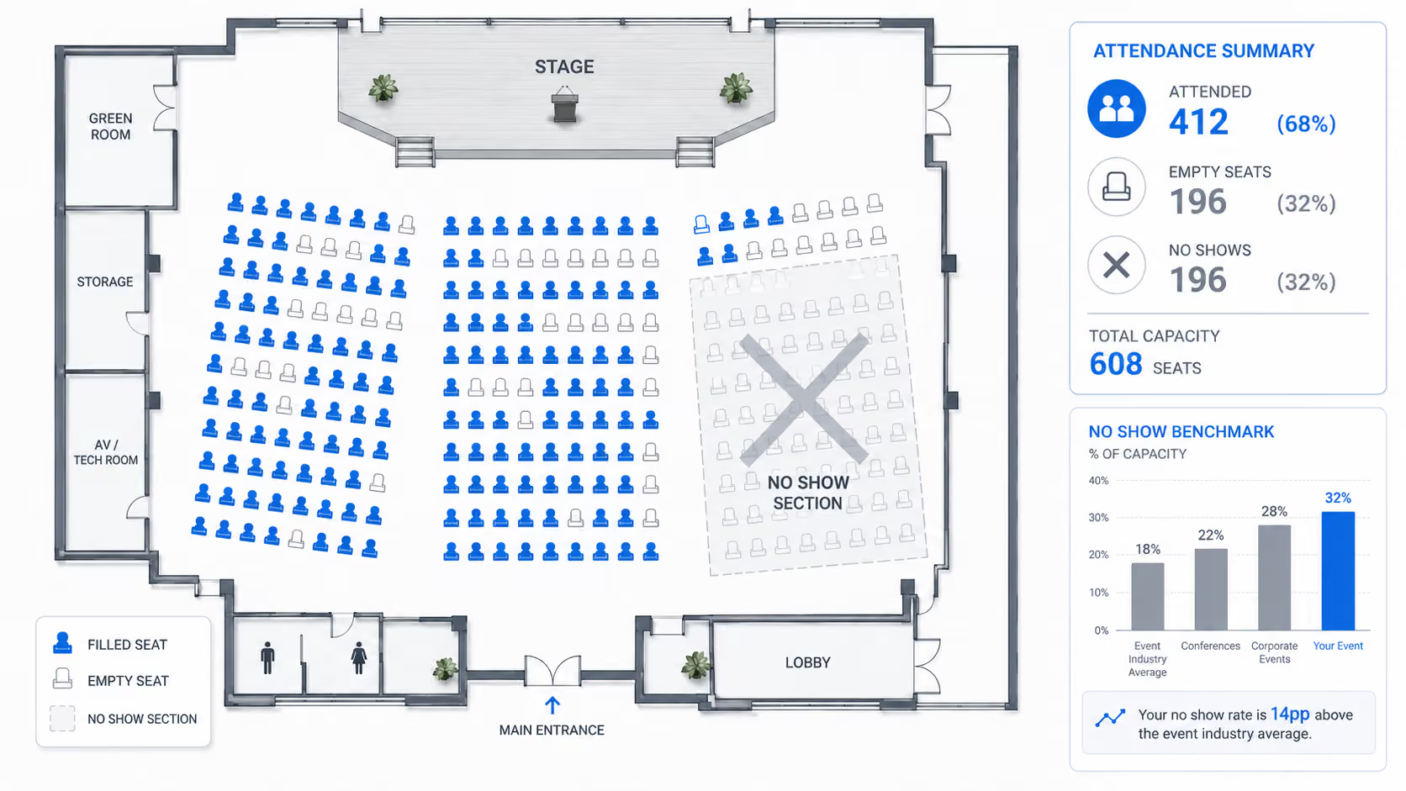
An RSVP leaves attendance uncertain
Registration records interest
Guests can reserve a limited seat
without a clear commitment to attend.
Empty seats waste preparation
Hosts prepare space and materials.
Other interested guests lose a place.
Venue illustration: KNVI Labs
Notes:
TARGET: 12 seconds
NARRATION
On platforms like Luma, reserving a seat is easy. But an RSVP doesn’t mean someone will show up. Hosts prepare, while others lose their chance to join.
SUPPORTING NOTES AND SOURCES
Problem statement concerns limited-capacity workshops and community events. Image is an illustration from KNVI Labs, not measured CommitPass attendance or a photograph of Albary's workshop. Source: https://www.knvilabs.com/stories/no-show-rate-definition-and-benchmarks-2026 .

Slide 3
The no-show problem is bigger
Free in-person events
40–60%
reported no-show range
How can we turn a reservation
into a real commitment?
Source: KNVI Labs
Notes:
TARGET: 14 seconds
NARRATION
KNVI Labs reports forty to sixty percent no-shows at free events. That matches the problem I saw. That made me ask: how can we turn a reservation into a real commitment?
SUPPORTING NOTES AND SOURCES
Source: https://www.knvilabs.com/stories/no-show-rate-definition-and-benchmarks-2026 , published 23 June 2026. Provider estimates for North America, with no linked dataset or detailed sampling method. External context, not measured CommitPass effectiveness. The spoken question ends this slide and introduces the refundable-deposit rationale on the next slide.

Slide 4
CommitPass
Onchain commitments
for events
A refundable reason to show up
$3–$25
14–25%
refundable
deposit
reported
no-show range
Reserve with USDC.
Show up. Claim after settlement.
A small deposit gives people
a reason to follow through.
For workshops and community meetups
with limited capacity.
Source: KNVI Labs. Normal settlement: attendees claim; no-shows forfeit.
Notes:
TARGET: 18 seconds
NARRATION
The same guide reports fourteen to twenty-five percent no-shows with small refundable deposits. They give people a reason to follow through. That’s the idea behind CommitPass: reserve with USDC, show up, and claim your deposit back after settlement.
SUPPORTING NOTES AND SOURCES
Source: https://www.knvilabs.com/stories/no-show-rate-definition-and-benchmarks-2026 , published 23 June 2026. North American provider estimates for $3–$25 deposits, not controlled causal proof or measured CommitPass results. Product flow and policy: https://sama-3.gitbook.io/commitpass-docs/documentation/ ; https://github.com/EndPx/commitpass/blob/main/contracts/SETTLEMENT.md . Host cancellation and zero-attendance outcomes have separate principal-refund rules.

Slide 5
Why Monad
Deposits and payouts guests can trace
Commit USDC
Every commitment and completed claim
has an onchain record.
Contracts apply the return rules
Monad event vault
Published return rules
Recorded attendance determines
each guest’s allocation.
Claim the return
A practical chain for small deposits
Fast, low-cost transactions with familiar EVM tools.
Notes:
TARGET: 14 seconds
NARRATION
With money involved, guests need to see where it goes. Blockchain records the deposits and payouts, while contracts apply the rules. Monad adds fast, low-cost transactions with familiar Ethereum tools.
SUPPORTING NOTES AND SOURCES
Monad platform facts: https://docs.monad.xyz/introduction/monad-for-users and https://docs.monad.xyz/introduction/monad-for-developers , checked 6 October 2026. Performance and low costs are platform characteristics described by Monad, not measured CommitPass transaction benchmarks or a guaranteed fee. CommitPass rationale and financial behavior: contracts/src/CommitPassVault.sol and https://github.com/EndPx/commitpass/blob/main/contracts/SETTLEMENT.md . Deposits, allocation state, and completed claims are distinct onchain records. Organizer-authorized attendance originates offchain; blockchain does not independently prove physical attendance. The current public demo is on Monad testnet.

Slide 6
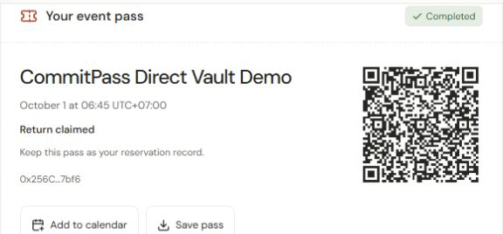
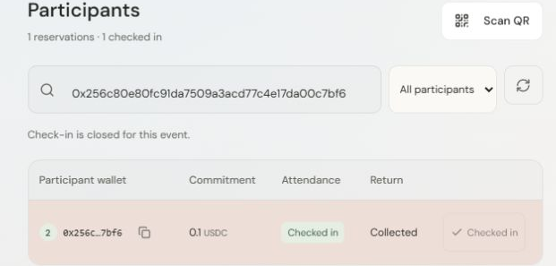
How CommitPass works
Create
Commit USDC
Start
QR check-in
Settle
Claim
Guest reservation pass
Host participant management
The organizer records attendance. Settlement fixes allocations. Each guest signs a claim.
Notes:
TARGET: 9 seconds
NARRATION
Hosts create the event. Guests commit USDC and get a QR pass. At the door, the host scans it to record attendance.
SUPPORTING NOTES AND SOURCES
Screenshots are recorded CommitPass testnet product screens from the workspace. Financial actions use the vault contract; organizer-authorized API records check-ins. Source: https://github.com/EndPx/commitpass . Allocation and payout are distinct. Guest pass and host participant screenshots are embedded original images with native cropping; editable six-step process and attached connectors remain native.

Slide 7
Commitments at work
While you’re at the event,
your money can earn yield.
Event vault
USDC deposits
Yield vault
Morpho path
Deposit + yield
at settlement
Morpho: Hyperithm USDC Apex
Integration path tested through Tenderly simulation by the builder.
Public demo: MockYieldVault on Monad testnet. Yield depends on recovered funds.
Notes:
TARGET: 12 seconds
NARRATION
While we’re at the event, our money doesn’t just sit there. It can earn extra money through a Morpho vault. I’ve tested that path in Tenderly.
SUPPORTING NOTES AND SOURCES
The builder reports testing the Morpho integration path using Tenderly. This deck does not independently verify that simulation or assert a deployed Morpho integration in the public demo. Target vault: https://app.morpho.org/monad/vault/0x78999cc96d2Ba0341588C60CcB0E91c6C33CF371/hyperithm-usdc-apex . Current configuration: https://github.com/EndPx/commitpass/blob/main/packages/shared/src/deployments/monad-testnet.json . Settlement redeems shares and checks principal before allocations. Shortfall or redemption failure reverts settlement; there is no guaranteed APY or payout.

Slide 8
Rewards for attendance
Two guests commit 5 USDC each. One attends.
Party | Attendance | Allocation
Guest A | Attends | 7.5 USDC + Y
Guest B | No-show | 0 USDC
CommitPass | Protocol share | 2.5 USDC
5 USDC principal + 2.5 USDC no-show share + recovered yield
Y = any recovered yield. Example assumes normal settlement with one attendee and successful redemption.
Host cancellation and zero-attendance events follow separate refund rules.
Notes:
TARGET: 12 seconds
NARRATION
Showing up also earns a share of forfeited deposits. Two guests deposit five dollars; one attends. That guest gets seven-fifty plus recovered yield. CommitPass gets two-fifty.
SUPPORTING NOTES AND SOURCES
Illustrative example, not a measured event return. Two 5 USDC deposits = 10 USDC principal. Guest A receives 5 principal + 2.5 no-show share. CommitPass receives 2.5. Guest B receives zero. All recovered surplus goes to attendees. With multiple attendees, the attendee pool is shared under the fixed-deposit contract allocation policy. Contract source: https://github.com/EndPx/commitpass/blob/main/contracts/src/CommitPassVault.sol ; policy: https://github.com/EndPx/commitpass/blob/main/contracts/SETTLEMENT.md . If yield redemption fails or assets recovered are below principal, settlement reverts and claims cannot open from that failed settlement.

Slide 9
Business model
Current protocol mechanism
50%
of forfeited no-show principal
goes to CommitPass
Planned recurring revenue
Organizer tools for repeat events
Attendance analytics across events. Pricing and willingness to pay will be tested in pilots.
Notes:
TARGET: 8 seconds
NARRATION
That protocol share is our current revenue mechanism. Next, I’ll test paid organizer tools for repeat events and attendance analytics.
SUPPORTING NOTES AND SOURCES
Current protocol mechanism applies only to normal settlement with eligible attendees. If there is no no-show principal, this source of revenue is zero. Planned organizer tools are a future commercial direction, not active subscriptions or demonstrated paid demand. Current policy: https://github.com/EndPx/commitpass/blob/main/contracts/SETTLEMENT.md .

Slide 10
Roadmap
Now
Next
Later
Working testnet demo
Community pilots
Production readiness
Reservation, QR check-in,
settlement and claim
3–5 organizers
5–10 pilot events
Security review, real yield
integration and paid tools
First hosts: direct outreach to community workshop organizers, with help running their first event.
Pilot counts are planning targets. Measure attendance, repeat hosting and willingness to pay.
Notes:
TARGET: 8 seconds
NARRATION
I’ll start with community workshop hosts, help them run pilots, and measure attendance and repeat use before expanding to production and paid tools.
SUPPORTING NOTES AND SOURCES
Roadmap directions are proposed, without a dated delivery promise. Initial targets are 3–5 organizers and 5–10 pilot events, not existing traction. Testnet demo and mainnet readiness are separate. Public plan: https://sama-3.gitbook.io/commitpass-docs/documentation/mission/roadmap .

Slide 11

Team
Albary
Muhammad Meidy Noor Al Barry
Fullstack Developer
Solo Builder
X @endpx_
Notes:
TARGET: 4 seconds
NARRATION
I’m Albary, the fullstack developer and solo builder behind CommitPass.
SUPPORTING NOTES AND SOURCES
Name, preferred name, role, solo status and X handle were supplied by the user. Profile: https://x.com/endpx_ . Original avatar reference: https://pbs.twimg.com/profile_images/2079847479584108544/_s7gCZDw_normal.jpg . Higher-resolution variant retrieved from the same asset: https://pbs.twimg.com/profile_images/2079847479584108544/_s7gCZDw_400x400.jpg .

Slide 12
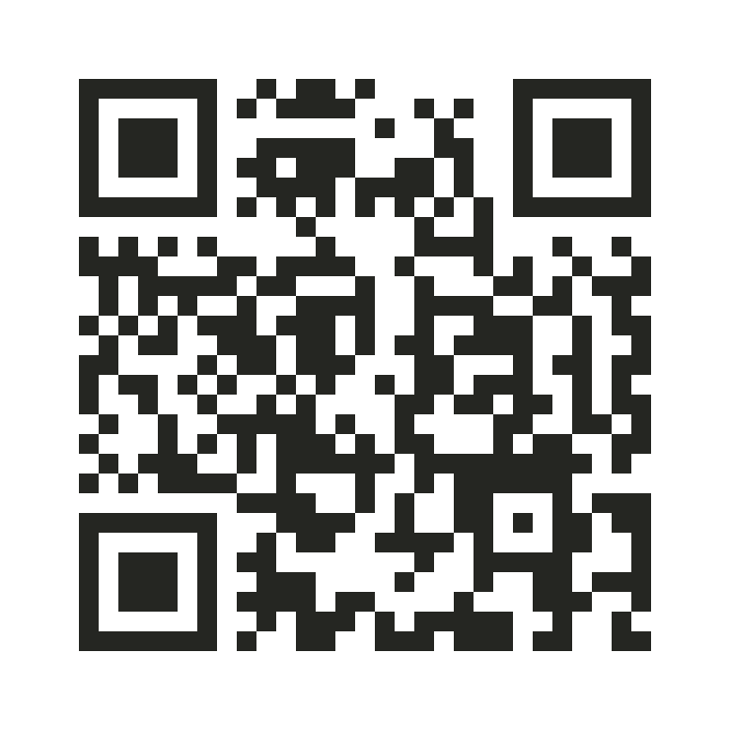
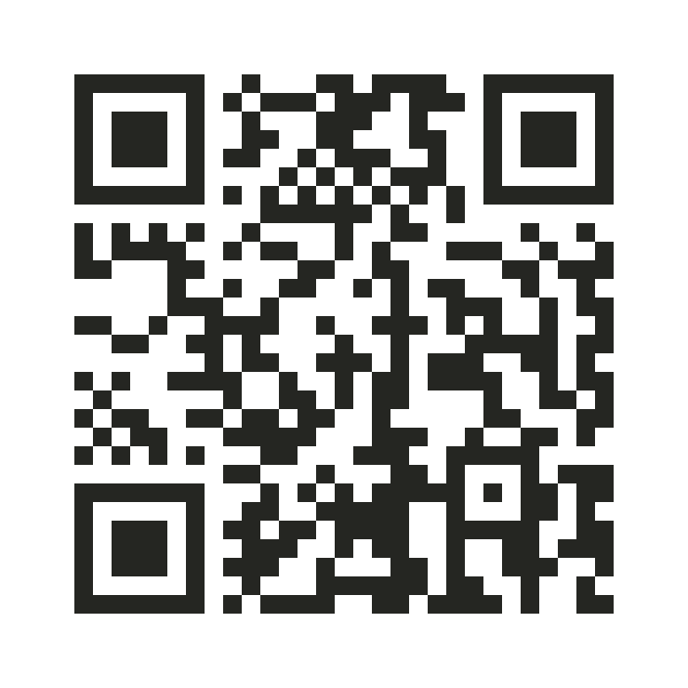
GitHub
Try the app
Thank you
CommitPass
Onchain commitments
for events.
github.com/EndPx/commitpass
commitpass-event.vercel.app
Notes:
TARGET: 2 seconds
NARRATION
Thank you.
SUPPORTING NOTES AND SOURCES
Application: https://commitpass-event.vercel.app/ . Repository: https://github.com/EndPx/commitpass . GitBook: https://sama-3.gitbook.io/commitpass-docs/ . Both QR codes encode their respective HTTPS URLs with four-module quiet zones and medium error correction. Dark terracotta and cream ring artwork: commitpass-dark-accent-v9.png .

