Slide 1


Symbolon
Private fixed-rate financing on Canton.
Notes:
Narration
Imagine borrowing against assets without knowing your final interest bill. That is the problem behind Symbolon.
Target timing: 7 seconds. Timing is an estimate, not a recorded rehearsal.
Sources and claim scope
Hypothetical opening situation. No personal borrowing episode is claimed for the presenter.
Product: https://github.com/EndPx/symbolon
Original logo: repository brand/logo-mark.png.
Cover positioning: Private fixed-rate financing on Canton. This is the founder-selected fixed-rate tagline retained in the project README.

Slide 2

Repayment uncertainty
A treasury team needs cash
for a known period
The rate can change while
the position stays open.
The interest budget remains uncertain.
Illustrative treasury situation. Rates can rise or fall.
Notes:
Narration
Floating rates can change before repayment. A treasury team financing a known period still cannot lock its interest budget.
Target timing: 10 seconds. Timing is an estimate, not a recorded rehearsal.
Sources and claim scope
Initial customer hypothesis: treasury manager at a small or mid-sized digital-asset fund with Canton exposure or a concrete adoption plan. This profile remains unvalidated.
Aave rate mechanism: https://aave.com/help/borrowing/borrow-tokens
GTM hypothesis: https://github.com/EndPx/symbolon/blob/main/docs/submission/form/04-gtm.md

Slide 3
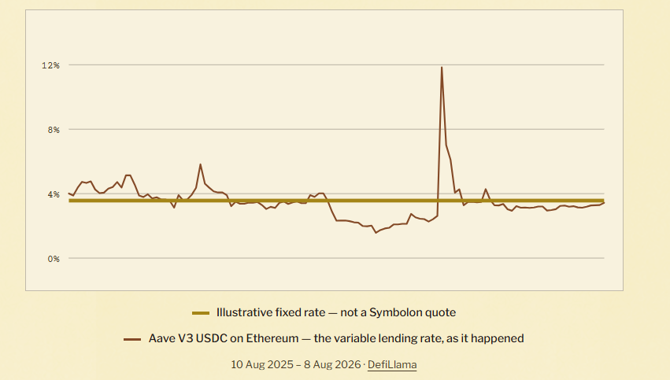
Rates can move
Notes:
Narration
Rate uncertainty affects lenders too. This Aave USDC lending series moves against an illustrative fixed line. Symbolon lets counterparties agree their rate before settlement.
Target timing: 10 seconds. Timing is an estimate, not a recorded rehearsal.
Sources and claim scope
The user supplied this existing landing chart. It shows the Aave V3 USDC Ethereum variable LENDING/supply rate from 10 August 2025 to 8 August 2026, not borrowing rates. The gold line is an illustrative fixed rate at the historical average, not a Symbolon quote, measured Symbolon return or promise. Its labels, date range and source credit are preserved unchanged.
Landing source: web/src/App.tsx, Why a fixed rate section. Series source: web/src/rates.ts, DefiLlama apyBase percentages, sampled every third day for display. Generation source: scripts/fetch-rates.ps1. No historical data is refreshed, extrapolated or reconstructed from pixels for this revision. The supply/lending APY series is distinct from Symbolon's simple annualized APR / ACT/360 contract convention. The unrelated Galaxy >15% historical BORROW-rate callout has been removed from this slide.
DeFiLlama pool: https://defillama.com/yields/pool/aa70268e-4b52-42bf-a116-608b370f9501
Data API: https://yields.llama.fi/chart/aa70268e-4b52-42bf-a116-608b370f9501
Original supplied image: codex-clipboard-595073bd-d1d2-4468-ba3e-b6b18f63be08.png.

Slide 4
A fixed bill before settlement
1,000 USDCx-demo for 30 days
Lender offer | Annualized APR | Contractual repayment
Lender A | 5.20% | 1,004.33 USDCx-demo
Lender B | 5.80% | 1,004.83 USDCx-demo
The borrower chooses the funded quote.
Illustrative quotes. Simple ACT/360 interest, rounded to two decimals. Fees are separate.
Notes:
Narration
Symbolon lets lenders offer fixed APRs. One thousand for thirty days at five point two percent means a contractual repayment of one thousand four point three three.
Target timing: 13 seconds. Timing is an estimate, not a recorded rehearsal.
Sources and claim scope
Illustrative two-lender comparison, not a new observed customer quote. Interest = principal × APR × 30/360. Lender A: 1,000 × 0.052 × 30/360 = 4.3333333333 interest and 1,004.3333333333 repayment. Lender B: 4.8333333333 interest and 1,004.8333333333 repayment. Exact on-ledger values have 10 decimal places. All examples use simulated USDCx-demo holdings, without native-asset integration. Fixed financing can be more or less expensive than floating borrowing.
Daml implementation: https://github.com/EndPx/symbolon/blob/main/daml/Symbolon/Repo.daml
Reference agreement: https://github.com/EndPx/symbolon/blob/main/docs/submission/evidence/shared-devnet.md

Slide 5
Why Canton
One agreement governs
cash against collateral
Record | Who can see it
Open financing request | Authenticated Symbolon users
A lender’s quote | That lender and the borrower
Accepted position | Borrower and winning lender
Issuers see their holdings and movements. Application and participant operators remain trust dependencies.
Notes:
Narration
Canton applies the agreed rules and exchanges cash against collateral atomically. Requests reach Symbolon users. Quotes and positions stay bilateral. Issuers and operators remain trust dependencies.
Target timing: 12 seconds. Timing is an estimate, not a recorded rehearsal.
Sources and claim scope
Why a ledger: counterparties need shared, enforced authorization and simultaneous cash/collateral exchange. Why Canton: Daml authorization, contract-specific and subtransaction privacy, and atomic settlement fit that need. Symbolon's open request board deliberately discloses borrower identity, principal, collateral quantity and tenor to all authenticated supported Symbolon parties after publication consent. It does not preserve request confidentiality. Separate lender quotes and accepted positions remain bilateral. The offchain application/database operator sees stored discovery records. Participant administrators and hosting operators remain trust dependencies. An issuer can observe its holdings and asset movements and may infer financing activity. Accounts controlling the same party see the same party view. Prior disclosures cannot be revoked.
Canton privacy: https://docs.digitalasset.com/overview/3.5/explanations/ledger-model/ledger-privacy.html
Canton protocol: https://www.canton.network/protocol
Core contracts: https://github.com/EndPx/symbolon/blob/main/daml/Symbolon/Repo.daml
Demo holdings: https://github.com/EndPx/symbolon/blob/main/daml/Symbolon/DemoAsset.daml
Current direct-flow status: A founder-operated internal direct Open RFQ cycle completed on canonical https://symbolon.endpx.cloud/app using synthetic authorized borrower/dealer parties and simulated cBTC-demo/USDCx-demo. Request b510ba2f was published, the original 7% funded quote reserved 1,000 cash and synced without a duplicate reservation, acceptance settled atomically and withdrew the request, and full repurchase of 1,005.8333333333 USDCx-demo returned 0.025 cBTC-demo with ClosedRepo: Repurchased. This is engineering evidence, not external-customer adoption, native-asset settlement or wallet signing. Historical governance/margin evidence remains separate..

Slide 6
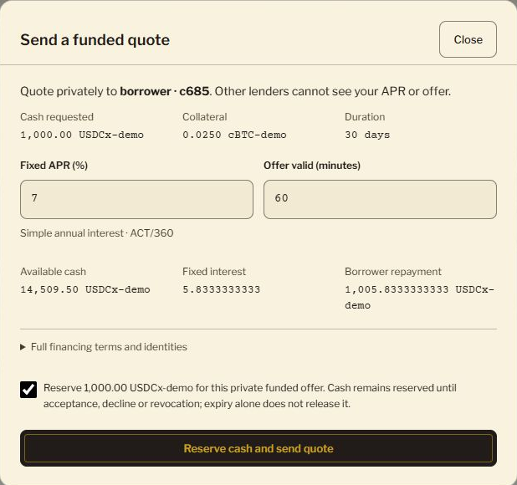
The financing flow
Publish
Borrower shares a request
Quote
Lender reserves quote cash
Accept
Cash and collateral settle
Repay
Collateral returns
Actual DevNet quote review. Quotes require a distinct lender party.
Notes:
Narration
Publish once. Lenders quote directly with reserved cash. The borrower compares offers, accepts one, and later repays to recover collateral.
Target timing: 12 seconds. Timing is an estimate, not a recorded rehearsal.
Sources and claim scope
Latest intended interaction: borrower consents once to share an open request, all authenticated supported Symbolon parties can discover it, any distinct authorized lender can submit a funded APR quote without registration or separate detail-access permission. Borrower reviews full quote terms and accepts one. A funded quote reserves cash, and acceptance exchanges cash against pledged collateral atomically. The fixed agreement requires full repayment even on early closure. No automatic quote, rollover, matching time or guaranteed lender liquidity is claimed.
Live app: https://symbolon.endpx.cloud/app
Product documentation: https://symbolon.gitbook.io/symbolon-docs/
Core contracts: https://github.com/EndPx/symbolon/blob/main/daml/Symbolon/Repo.daml
Image scope: actual application screenshot.
Current direct-flow execution status: A founder-operated internal direct Open RFQ cycle completed on canonical https://symbolon.endpx.cloud/app using synthetic authorized borrower/dealer parties and simulated cBTC-demo/USDCx-demo. Request b510ba2f was published, the original 7% funded quote reserved 1,000 cash and synced without a duplicate reservation, acceptance settled atomically and withdrew the request, and full repurchase of 1,005.8333333333 USDCx-demo returned 0.025 cBTC-demo with ClosedRepo: Repurchased. This is engineering evidence, not external-customer adoption, native-asset settlement or wallet signing. Historical governance/margin evidence remains separate..

Slide 7
Collateral still needs attention
Illustrative position | Collateral | Health factor
At a 60,000 mark | 0.0250 cBTC-demo | 1.43
At a 36,000 mark | 0.0250 cBTC-demo | 0.86
After a 0.0050 top-up | 0.0300 cBTC-demo | 1.03
Repayment stays at 1,004.33 USDCx-demo
1,000 principal and 105% maintenance cover. Simulated marks and assets. Early closure pays the full agreed amount.
Notes:
Narration
Collateral risk remains. Falling prices can trigger a margin call, requiring a top-up. Even early repayment still costs the full agreed amount.
Target timing: 10 seconds. Timing is an estimate, not a recorded rehearsal.
Sources and claim scope
Illustrative health factor uses the actual Symbolon convention: collateralAmount × price / (cashAmount × maintenanceMargin). This prototype uses principal, not accrued total debt, as the margin denominator. 0.025 × 60,000 / (1,000 × 1.05) = 1.42857, displayed 1.43. At 36,000: 0.85714, displayed 0.86. After top-up to 0.030: 1.02857, displayed 1.03. A fresh mark below agreed maintenance can support a margin call; cure periods and deadline/freshness conditions apply. The 30-day, 5.2% repayment remains 1,004.3333333333 simulated cash units. All amounts refer to cBTC-demo and USDCx-demo holdings, with no native token integration. Fixed repayment does not eliminate margin calls, maturity default, counterparty risk or network fees. Closeout in this prototype releases collateral but does not demonstrate a collateral sale or full surplus/deficiency accounting.
Implementation: https://github.com/EndPx/symbolon/blob/main/daml/Symbolon/Repo.daml
Retained run: https://github.com/EndPx/symbolon/blob/main/docs/submission/evidence/shared-devnet.md

Slide 8
What we have demonstrated
Shared DevNet
Open request, funded quote, settlement
and repurchase with committed receipts
Early human feedback
1 borrower episode and approximately 3–5 informal app explorers
Simulated assets. Tester count and completed steps remain unrecorded. ICP fit, willingness to pay and pilot commitments remain open.
Notes:
Narration
The direct financing flow has completed on DevNet with simulated assets. One borrower episode and roughly three to five informal explorers provide early feedback. Institutional adoption remains unvalidated.
Target timing: 12 seconds. Timing is an estimate, not a recorded rehearsal.
Sources and claim scope
Engineering evidence: existing retained core reference run has 20 committed transactions on shared HackCanton DevNet, one expected below-threshold rejection, and governed mark/margin/top-up/Repurchased closure. Separate public-app internal cycles have their own evidence. These do not establish real cBTC/USDCx settlement, external wallet signing or independent operators.
Shared reference: https://github.com/EndPx/symbolon/blob/main/docs/submission/evidence/shared-devnet.md
Public frontend: https://github.com/EndPx/symbolon/blob/main/docs/submission/evidence/public-devnet.md
BitSafe Contribution Pool separately has reproducible 2-of-3 governed mark execution using three LocalNet participants and DecMan services on one operator host. It is not the Gold entry or an independent-hosting/outage claim.
BitSafe proof: https://github.com/EndPx/symbolon/blob/main/docs/submission/bitsafe-contribution.md
Human evidence: one founder-reported Aave USDC loan against ETH at roughly 60% LTV, closed after about two months. No actual rate spike or quantified budgeting consequence was established. Approximately 3–5 informal community/friend app explorers are founder-reported; exact count, roles, dates and completed steps remain undocumented, and overlap with the borrower is unknown. Fictional personas never count as testers.
Discovery record: https://github.com/EndPx/symbolon/blob/main/docs/submission/borrower-discovery.md
Current new direct-board status: A founder-operated internal direct Open RFQ cycle completed on canonical https://symbolon.endpx.cloud/app using synthetic authorized borrower/dealer parties and simulated cBTC-demo/USDCx-demo. Request b510ba2f was published, the original 7% funded quote reserved 1,000 cash and synced without a duplicate reservation, acceptance settled atomically and withdrew the request, and full repurchase of 1,005.8333333333 USDCx-demo returned 0.025 cBTC-demo with ClosedRepo: Repurchased. This is engineering evidence, not external-customer adoption, native-asset settlement or wallet signing. Historical governance/margin evidence remains separate..

Slide 9
Business model
0.1% of interest
From the borrower and from the lender
Illustrative interest | Fee from each side | Total protocol fee
5,000 USDCx-demo | 5 USDCx-demo | 10 USDCx-demo
Intended model. Fee collection is not implemented in the demo. Current protocol fees and revenue are zero.
Notes:
Narration
The proposed fee is zero point one percent of interest from each side. For five thousand in interest, Symbolon would receive ten. The demo currently collects nothing.
Target timing: 10 seconds. Timing is an estimate, not a recorded rehearsal.
Sources and claim scope
The intended fee base is contractual term interest I, not principal P. Borrower fee = I × 0.001. Lender fee = I × 0.001. Intended total protocol revenue = I × 0.002. A generic illustrative I = 5,000 USDCx yields 5 from each party, 10 total. It does not describe achieved volume. For the 1,000 principal / 5.2% APR / 30-day ACT/360 quote on slide 4, I = 4.3333333333, each fee is approximately 0.0043333333 and total approximately 0.0086666667 depending the future rounding policy. Conceptually a future borrower pays P + I + borrower fee, and lender receives P + I minus lender fee. No fee collection is implemented or demonstrated in current Daml settlement. Current protocol fees and revenue are zero. Willingness to pay remains unvalidated.
Current implementation: https://github.com/EndPx/symbolon/blob/main/daml/Symbolon/Repo.daml
Source: founder-selected intended model, 0.1% of interest from both borrower and lender, 10 October 2026 WIB.

Slide 10
The next 90 days
Weeks 1–4
Weeks 5–8
Weeks 9–12
Operator discovery
External rehearsal
Pilot decision
8 relevant interviews
3 observed walkthroughs
1 borrower and lender pair
Asset and oracle feasibility
3 external simulated cycles
Operational release gates
Planning targets. First channel: Canton ecosystem introductions and direct treasury outreach. Native assets require adapters and approvals.
Notes:
Narration
Over ninety days, we plan operator interviews and an external borrower and lender rehearsal. Native assets and operational approval come before a real asset pilot.
Target timing: 12 seconds. Timing is an estimate, not a recorded rehearsal.
Sources and claim scope
Proposed milestones rather than traction: first 90 days after the hackathon. Weeks 1–4: eight relevant operator interviews and three observed walkthroughs. Weeks 5–8: one external borrower/dealer simulated rehearsal, two additional walkthrough participants, and asset/oracle feasibility. Weeks 9–12: three external simulated cycles and an explicit go/no-go pilot decision. Acquisition channels are Canton ecosystem introductions and direct treasury outreach. No named institution is a customer or partner. Real-value pilot requires supported native token adapters, permissions, price lineage, closeout accounting, named operating responsibilities and review. MainNet timing is not promised.
GTM: https://github.com/EndPx/symbolon/blob/main/docs/submission/form/04-gtm.md
Discovery: https://github.com/EndPx/symbolon/blob/main/docs/submission/borrower-discovery.md

Slide 11
Team
albary
EndPx
Product and implementation
github.com/EndPx/symbolon
Notes:
Narration
I'm albary, building Symbolon through EndPx.
Target timing: 5 seconds. Timing is an estimate, not a recorded rehearsal.
Sources and claim scope
Presenter handle: albary. Project namespace: EndPx.
Public project: https://github.com/EndPx/symbolon

Slide 12



Try the app
GitHub
Docs
Thank you
Symbolon
Know your repayment
before settlement.
symbolon.endpx.cloud/
app
github.com/EndPx/
symbolon
symbolon.gitbook.io/
symbolon-docs
Notes:
Narration
Try the app, read the docs, and inspect the source. Help shape the first treasury rehearsal. Thank you.
Target timing: 7 seconds. Timing is an estimate, not a recorded rehearsal.
Sources and claim scope
Canonical destinations. All three QR codes use genuine QR encoding with four-module quiet zones and M error correction.
Live DevNet app: https://symbolon.endpx.cloud/app
GitHub: https://github.com/EndPx/symbolon
Documentation: https://symbolon.gitbook.io/symbolon-docs/
The app requires a provider-authorized HackCanton/NODERS account. It is a simulated-asset DevNet prototype. TestNet work is deferred and MainNet financing is not enabled.

