Slide 1

Hate speech detection engine
DA SILVA Kevin
DIETRICH Louise
INGAUD-JAUBERT Ivan
MECKER Maéva
MONARI Alberto
SERRANO DIEGO Marina

Slide 2
Table of Contents
01
02
03
04
05
06
Business case
Context
Project goals
Context and motivation
Education and social media
Mission and objectives
Model
App
Conclusion
Model planning, model building and results analysis
Design and example of usage
Benefits and future improvements

Slide 3


01
Business case
Context and motivation

Slide 4

About us
OUR POINT OF VIEW : We are a company that offers social network services
MISSION : We have been contacted by TWITTER in order to develop a new application capable to detect hate speech and offensive messages.

Slide 5

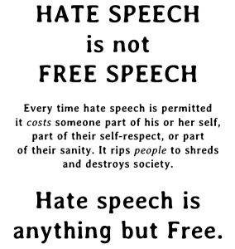
The subjectivity of hate data
Notes:
The first question to understand the context is understanding what is hate speech.
The first thing that comes to our minds when we think about hate speech are insults or hurtful messages that we want to avoid.
Nevertheless, if we take the definition of social media we find something like websites and applications that enable users to create and share content or to participate in social networking. Share content means allowing people to express freely. If something bad happens in the world, some injustice or crime, people can express and criticize behaviours through social media. Anger here is a reaction to injustice, so we could consider that as freedom of expression. But knowing that right and wrong sometimes are quite controversial how we can distinguish free speech and hate speech. In order to answer this question we have to define hate speech. Hate speech is speech that attacks a person or group on the basis of attributes such as race, religion, ethnic origin, national origin, sex, disability, sexual orientation, or gender identity: Which means that it is not a reaction but a promotion of violence that attacks specific targets with no reason.

Slide 6

Hate speech a real danger
Hate speech is something that society must take seriously, not dismiss as something that might at worst hurt the feelings.
Hate speech represent a danger for the society , the protection of human rights and the rule of law.
There is evidence that hate speech predicts violence, that groups more exposed to hate speech are more likely to commit suicide, and that it causes what scientists call a ‘dehumanization effect’ which makes it easier for us to justify suffering and harm caused to another human being.
Notes:
Hate speech is something that society must take seriously, not dismiss as something that might at worst hurt the feelings.
As I said previously, hate speech represent a danger for the society , the protection of human rights and the rule of law.
We are now aware of the dangerous link between hate speech and violence.
There is evidence that hate speech predicts violence, that groups more exposed to hate speech are more likely to commit suicide, and that it causes what scientists call a ‘dehumanization effect’ which makes it easier for us to justify suffering and harm caused to another human being.

Slide 7

Offensive Speech
Offensive speech-> Language capable of upset or embarrass people because is rude or insulting
Notes:
What about verbal violence besides attributes such as race, religion, ethnic origin, national origin, sex, disability, sexual orientation, or gender identity. What about insults that upset, embarrass because is rude or insulting. For example physical insults that are very common on schools or between teenagers. This all hurtful language is what is called offensive speech.

Slide 8
02
Context
Education and social media

Slide 9

Engines to correct
SOCIAL MEDIA PLATFORMS : Catalizator of hate crimes
Cluster people - > make money
Image degradation
GOVERNMENTS : Force social media platforms to take responsibility
Notes:
In this case the use of algorithms can help.

Slide 10

Movements to prevent
EDUCATION : Social media platforms are the support but the real problem is in the society
Notes:
Help to promote human rights online

Slide 11
03
Project goals
Mission and objectives
Notes:
Out of our scope

Slide 12
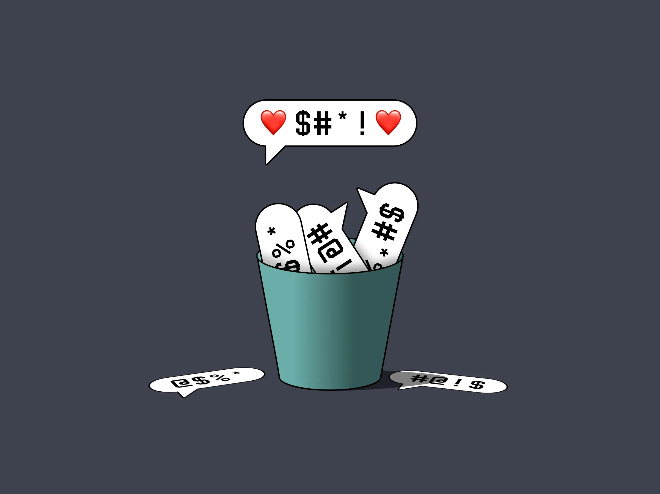
What we have to achieve
ALGORITHM : For a given tweet/retweet, our application should be able to classify the comment as a hate message, an offensive message or neither hate speech nor offensive
APPLICATION : Our code should be convert into an Application
Notes:
To easily classify in real time new messages

Slide 13
04
Model
Model planning, model building and results analysis

Slide 14
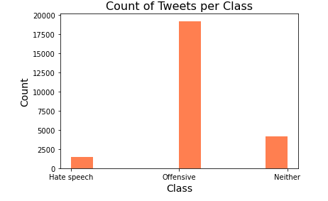
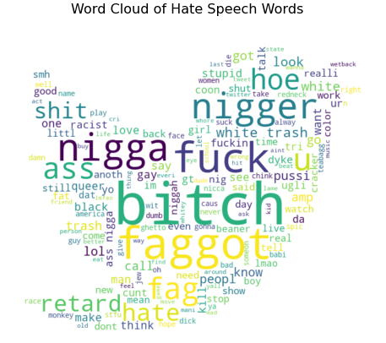
Data preparation
Dataset : 24783 rows × 6 columns(count,hate_speech, offensive_language, neither, class, tweet) - > Each tweet is classified by at least 3 experts
Preprocessing : remove extra space, mentions, urls, punctuations and numbers, capitalization, tokenizing, removal of stopwords, stemming
Data exploration : Wordcloud visualization: most common words globally in all tweets, in tweets classified as hate speech and in tweets classified as offensive language.
Feature engineering :
Original features : TF-IDF Matrix
Additional features : Sentiment analysis, Doc2vec, #, URL tags, new features
Final featuring selection : TF-IDF scores, the polarity scores, and the textual features
Notes:
Dataset : 24783 rows × 6 columns:
count = number of experts who coded each tweet (minimum is 3, sometimes more users coded a tweet when judgments were determined to be unreliable).
hate_speech = number of experts who judged the tweet to be hate speech.
offensive_language = number of experts who judged the tweet to be offensive.
neither = number of experts who judged the tweet to be neither offensive nor non-offensive.
class = class label for majority of experts: 0 - hate speech, 1 - offensive language, 2 - neither
The dataset is unbalanced in favour of tweets containing offensive language compared to hate speech or tweets without any insult.We will try in a later step to resolve that issue so that or predictive model will not be biased towards the most populated class.
Preprocessing : remove extra space, mentions, urls, punctuations and numbers, capitalization, tokenizing, removal of stopwords, stemming
Data exploration : Wordcloud visualization (Most common tweets, hate and offensive speech)
Featuring engineer :
Original features : TF-IDF Matrix
We used the TF-IDF (term frequency–inverse document frequency) measures as features for our model. They are intended as weighting factors reflecting the importance of a word in a tweet among a collection of tweets.
The term frequency represents the number of appearance of a word in a document, and the adjustment is made by the inverse document frequency. The inverse document frequency role is to give more weight to meaningful words, and reduce the weight of word not giving relevant information.
Additional features : Sentiment analysis, #, URL tags, Doc2vec, new features)
Sentiment analysis
We then computed a sentiment analysis on our collection of tweets, in order to use the polarity scores as features.
We also took into account the number of mentions in the tweet, of hashtags used, or of URLs shared.
Doc2vec
We set up a doc2vec vector columns to generate a numerical representation of our data, able to capture relationships between words.
To initiate the doc2vec we used the Distributed Bag of Words model. It ignores the context words in the tweet, but force the model to predict the probability distribution of words in a tweet given a randomly sampled word from the document.
New features
We created 8 new features in regards to the textual composition of the tweets (in matter of characters/syllables or readability).
1 the Flesch-Kincaid Readability Age grade (FKRA): shows the required education to be able to understand a text (the higher the score the more difficult it is for a reader to understand the text)
2 the Flesch Reading Ease score (FRE): takes into account the number of words in a sentence and the average number of syllables per word to assess the readability score (the higher the FRE is, the easier it is to read. Thus a tweet with a high FKRA will have a lower FRE score)
3 syllables: total number of syllables per tweet
4 avg_syl: the total of syllables in a tweets divided by the total number of words
5 num_chars: sum of the number of characters in a tweet
6 num_chars_total: lenght of a tweet
7 num_words: number of words in the tweet
8 num_unique_terms: number of words that only occur once in a tweet
Final selection
We tried different combinations among our features: TF-IDF scores matrix, polarity scores, doc2vec vector, and additional textual features.
The better performing feature for the classification of hate speech tweets was the TF-IDF matrix, while the doc2vec vector was not very significant to improve the results of our model.
Thus, we decided to remove the doc2vec from our set of final features, and kept the TF-IDF scores, the polarity scores, and the textual features.

Slide 15
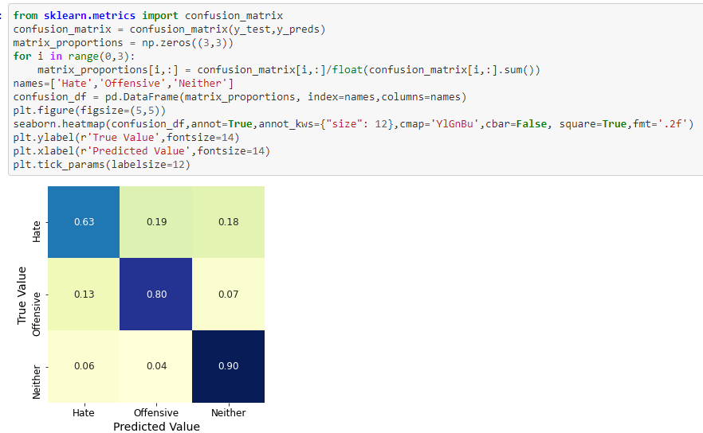
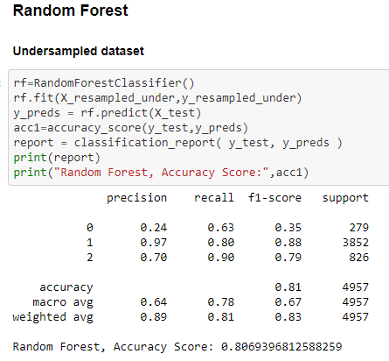
Model planning
Balance of our dataset :
Oversampling -> Synthetic Minority Over-Sampling Technique
Undersampling
Try of different models : Logistic regression, random forest, linear SVC, K Neighbors classifier, gradient descent
Notes:
Balance our dataset with undersampling or oversampling
The imbalanced classes in our dataset are a problem in our predicting model, as it can lead to a bias towards the class of Offensive Language which is overpopulated compared to the two other classes.
To resolve this issue, we tried to manage our dataset by undersampling the most populated classes, or to oversample the minority class with the Synthetic Minority Over-Sampling Technique (SMOTE).
We will then compare the 2 new datasets results on our different models and choose the best performing ones.
To select our best performing model, we compared different classifiers:
the logistic regression
the random forest
the linear SVC
the K Neighbors classifier
the gradient descent
Each of these models were trained and tested on the undersampled dataset, the oversampled, and the original dataset.

Slide 16
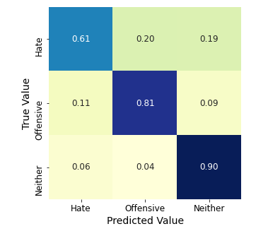
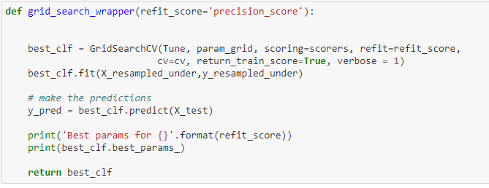
Model building
Gridsearch:
Best model -> Random Forest with undersampled database and SVC with the original dataset
Tuning hyperparameters -> Our model : The Random Forest Classifier
Final confusion matrix -> good recall scores and an accuracy of 81%.
Notes:
According to our previous testing, two models appear interesting to be used for our tweet classification task:
the Random Forest Classifier with the undersampled dataset
The SVC with the original dataset
They will be tuned with the Grid Search to find their best hyperparameters and improve their accuracy. Before trying to find those best parameters we put in place a K-fold cross validation with 2 splits to avoid over-fitting.
The Random Forest Classifier performs well on sorting the tweets from the dataset in the three different classes, with good recall scores and an accuracy of 81%.
We will use this as our final model that will be integrated in the Dash application to detect if a sentence a user will input is hate speech, offensive language, or neither of them.

Slide 17
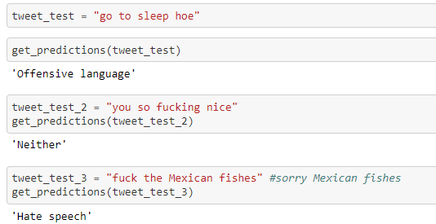
Communicate resuts
Preparing the integration of our model in the Dash application :
Preprocessing of the tweets
Creation of final features
Pilot testing
Notes:
To make our model operational for the application we first need to create functions for all the preparative steps the user's input text will go through to give a prediction..
These preparative functions involve:
the preprocessing of the tweets (removal of punctuation & special characters, stemming, tokenization,...)
the creation of the final features used for classification: the TF-IDF array, the sentiment analysis, and the additional textual features
Finally we define a get_predictions function that will get the input text to funnel through the previous preparative functions and lead to the prediction.

Slide 18
05
App
Design and example of usage

Slide 19


App components
The app was made using Dash, which is an Open Source Python library for creating reactive, web-based applications.
The application is composed by the following files:
app.py: is the main file in which the app is launched and calls all the other files and produces output from them
user.py: design of the first page where the user can classify the sentence
algorithm.py: design of the second page with infographics explaining the algorithm development process
nav.py: design of the navigation menu where the user can choose the desired tab
navbar.py: top bar design, with GitHub link to the full project
model.py: complete model that takes the string, does all the necessary transformations and returns the output
final_model.sav: the best model (random forest) saved, so that the training does not have to be done every time and the application can output quickly
Then it was fully deployed on Heroku and its currently available at this link:
https://hate-speech-automatic-detector.herokuapp.com/

Slide 20
06
Conclusion
Global evaluation and future improvements

Slide 21

Achievements
ALGORITHM :
Operational python code -> Github
Classification : hate speech, offensive speech, neutral
Accuracy 81%
APPLICATION :
Operational dash application
User friendly
Classify new messages in seconds
Recognise languages

Slide 22
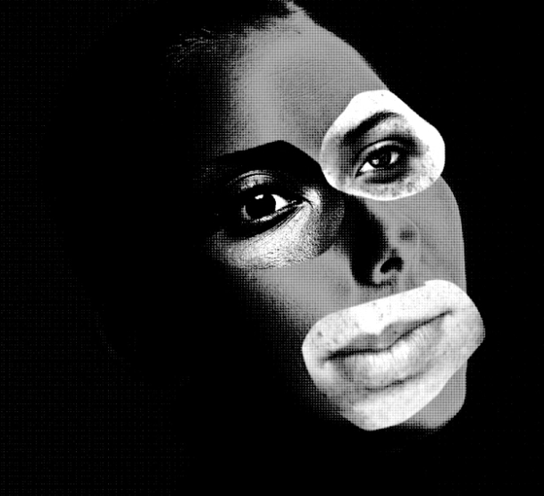
Challenges
VISION AI: Advancements in AI have dramatically improved the company’s ability to identify written hate speech thanks to the use of natural language algorithms. But when it comes to rooting out hateful images, videos, and memes, it becomes more challenging.
As more and more ways of information transmission are created, social media have to adapt their AI algorithms which is not simple.
Notes:
Advancements in AI have dramatically improved the company’s ability to identify written hate speech thanks to the use of natural language algorithms. But when it comes to rooting out hateful images, videos, and memes, it becomes more challenging.
As more and more ways of information transmission are created, social media have to adapt their AI algorithms which is not simple.
Artificial Intelligence vision algorithm are now being developing through social media platform, as one step further to hate speech detection.

Slide 23
Thank you
Questions?
DA SILVA Kevin
DIETRICH Louise
INGAUD-JAUBERT Ivan
MECKER Maéva
MONARI Alberto
SERRANO DIEGO Marina

