Slide 1

Final Home Take Exam
Mobile Health Application Programming (HIT 6124)
Prepared by
Endashaw Amsalu 2018/MHIT/007/PS
Ndibarekera Maureen 2018/MHIT/020/PS

Slide 2
Outline
Introduction
Problem Statement
Proposed Solution
Android features used in this project
Demo

Slide 3
Introduction
The use of mobile applications for healthcare is a young and dynamic field that could improve the well-being of people around the world.
Mobile applications can lower costs and improve the quality of healthcare as well as shift behavior to strengthen prevention, all of which can improve health outcomes over the long term (World Bank, 2011).

Slide 4
Problem Statement
Most developing countries address many drawbacks and barriers in healthcare sectors. Few of them are
Implementing EMR(Electronic medical record),
In providing a real time help for physician and in providing just in time learning.

Slide 5
Proposed Solution
In this project we are implementing a mobile application that can be used for multipurpose.
Medical Health record system
That allow physician to refer either an online help or reference from documents
Note taking app for just in time of learning
Alarm adjuster

Slide 6
Android features used in this project
Data Persistence: Firebase, SQLite, Room Persistence Library
Files and Permissions
Service
Broadcast

Slide 7
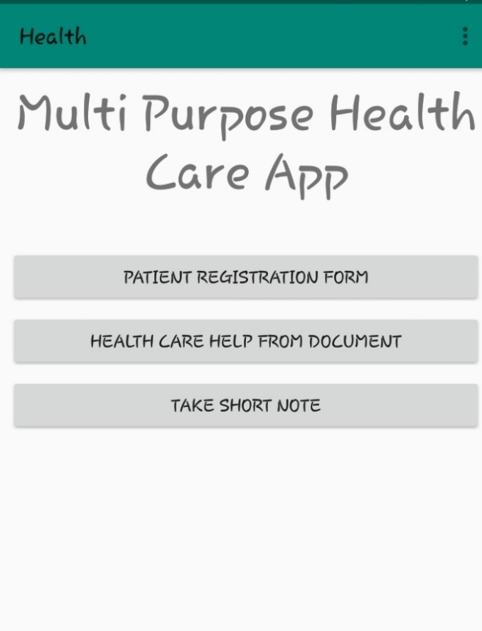
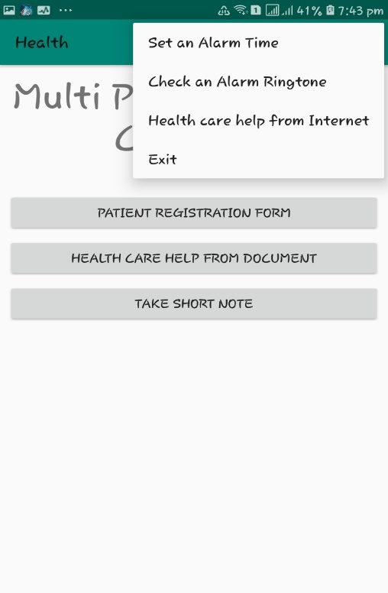
Demo
Fig 1: a) Home Screen
b) Home Screen with menu bar

Slide 8
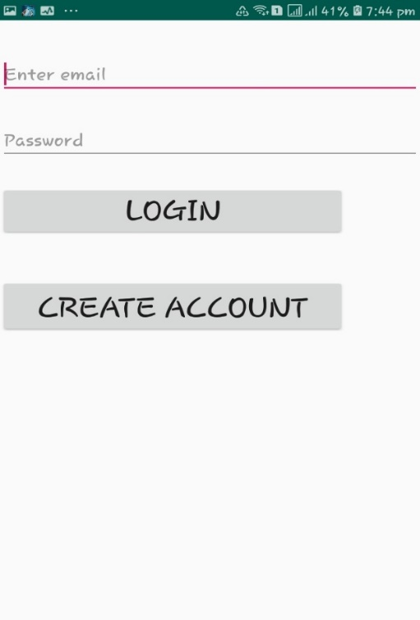
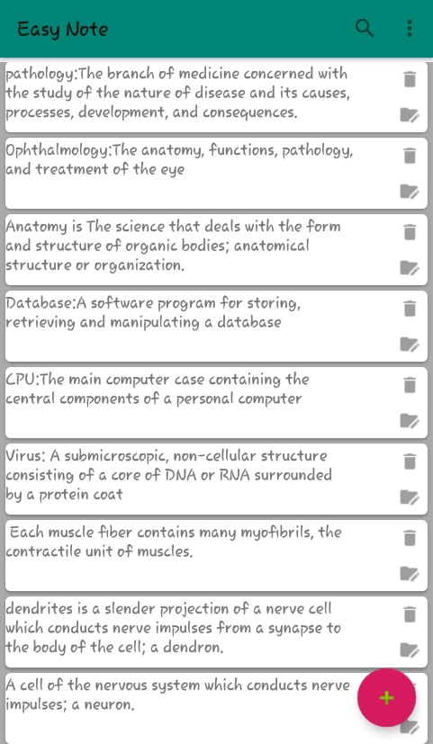
Demo cont.…
Fig 2: Clicking the home screen button for patient registration
Fig 3: Clicking the take note button

Slide 9
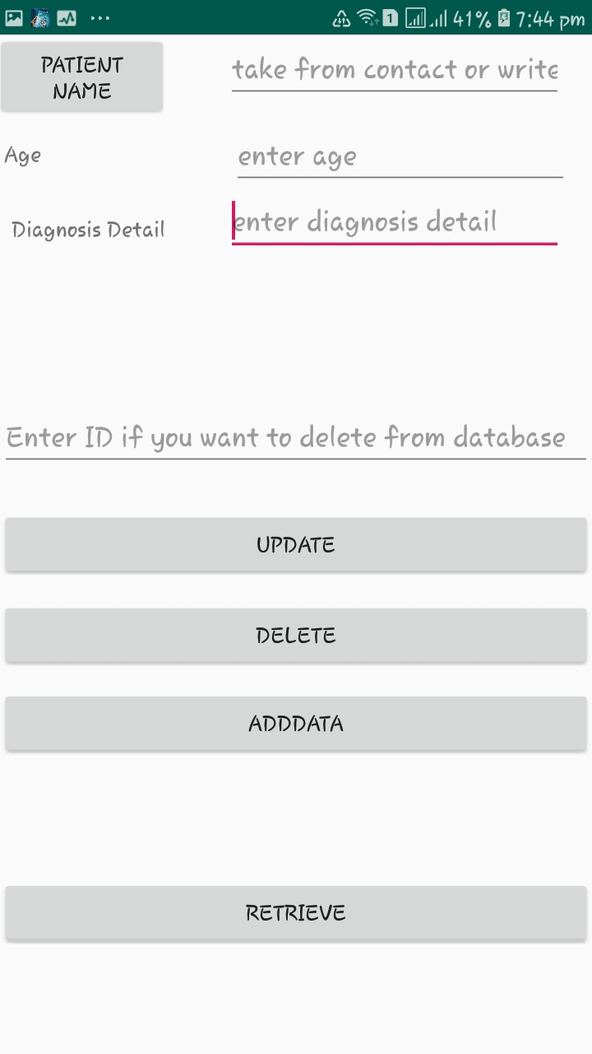
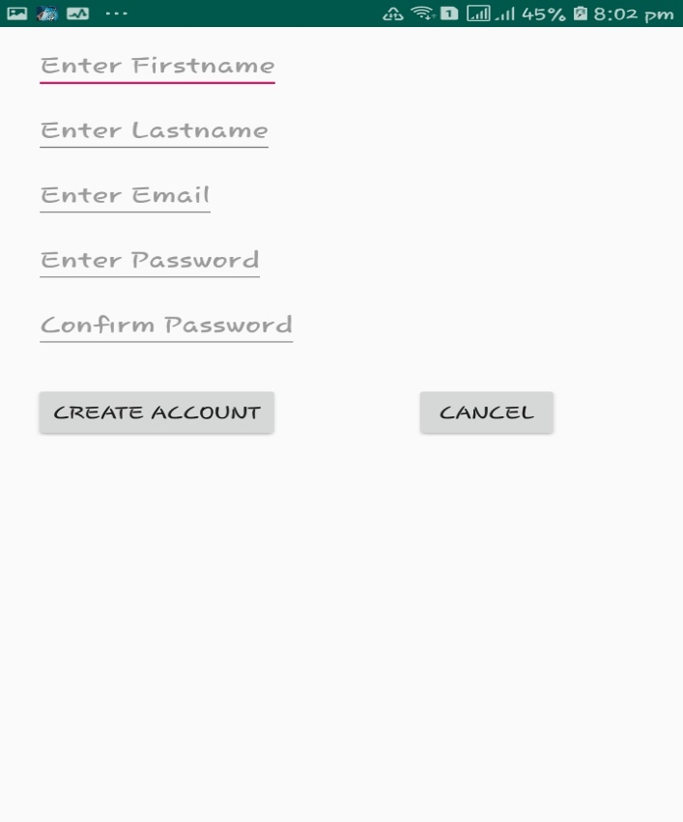
Demo cont.…
Fig 4: Clicking the login button of fig 2
Fig 5: clicking the create account button of fig 2

Slide 10
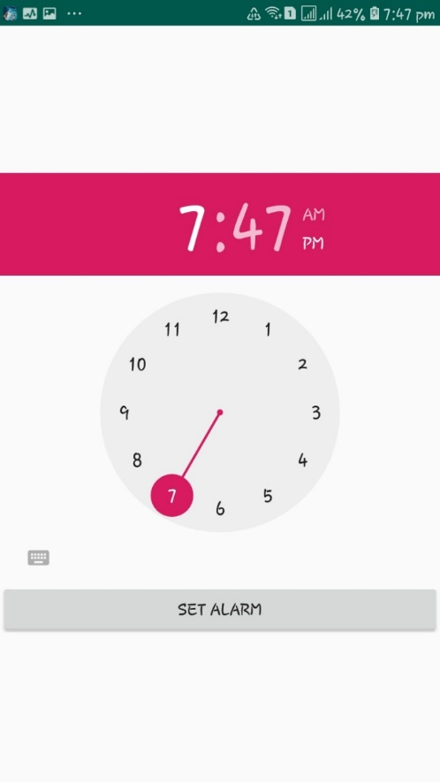
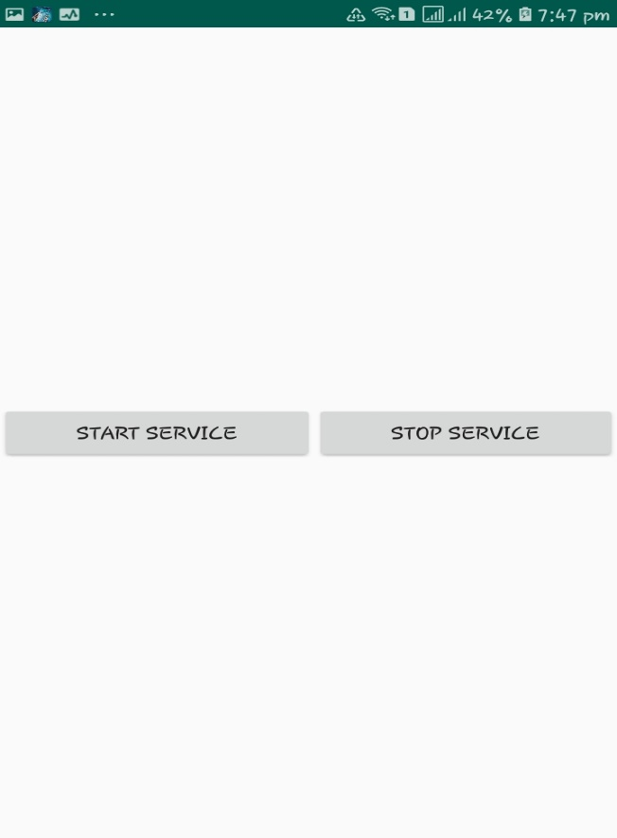
Demo cont.…
Fig 6: clicking the set an alarm time menu button of fig 1B
Fig 7: clicking the check an alarm ringtone menu button of fig 1B

Slide 11
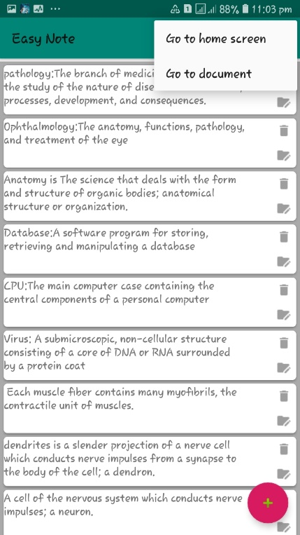
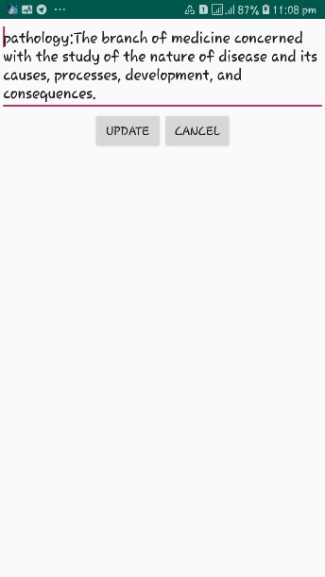
Demo cont.…
Fig 8: clicking the menu button of fig 3
Delete the Note from Room Database

Slide 12
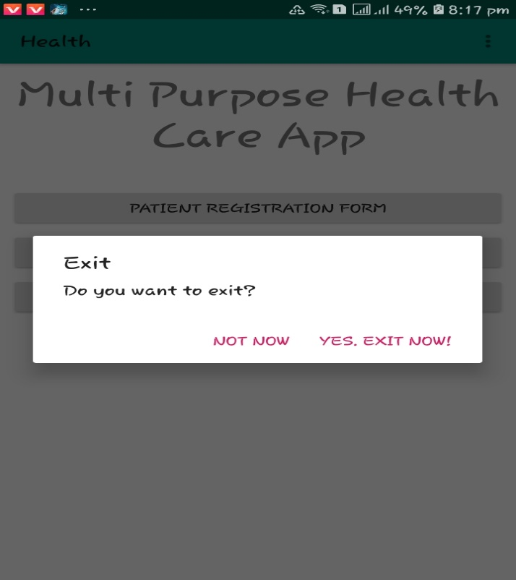
Demo cont.…
Fig 8: clicking the exit button of fig 1B

Slide 13
References
Nik Azliza bt Nik Ariffin, et al., 2018. Implementation of Electronic Medical Records in Developing Countries: Challenges & Barriers. Acadamic research, 7(3).
WorldBank, 2011. Mobile Applications for the Health Sector.
Developer, A., n.d. Room Persistence Library. [Online]
Available at: https://android.jlelse.eu/android-architecture-components-room-introduction-4774dd72a1ae[Accessed 6 February 2019].
Developer, A., 2019. Permission. [Online] Available at: https://developer.android.com/guide/topics/permissions/overview [Accessed 16 02 2019].
Kumar, G., 2016. Permission Model In Android Marshmallow Using READ_CONTACTS Permission. [Online] Available at: https://www.c-sharpcorner.com/article/permission-model-in-android-marshmallow-using-readcontacts/[Accessed 16 2 2019].

