Slide 1
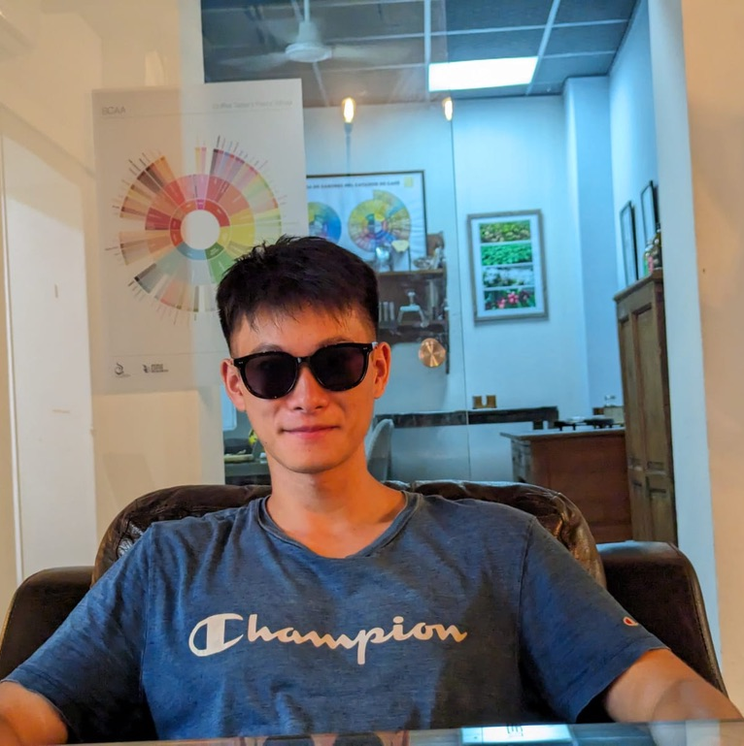


Ende Sun
Biomedical engineer – Software developer
I am a professional with a background in biomedical engineering, which has equipped me to tackle complex problems related to biomedicine. Additionally, I have experience in developing software for mobile devices on both Android and iOS platforms.
About
Work experience
CONTACT
GENETICS ANALYST
Spain, Alicante / Madrid / Zaragoza
ELCHE, SPAIN – BIOARRAY SL | 2023/SEP - 2024/JAN
681 671 050 ✆
Analysis of genetic variants.
Preparation of different genetic reports.
1195562121ende@gmail.com ✉️
Freelance – web developer/ designer
EDUCATION
FREELANCE | 2023 - NOW
Design and development of websites for different companies such as hospitality, clothing stores, restaurants...
Use of differents tecnology like html, css, js, react, bootstrap, node, vite.
Preparation of different designs for marketing.
University of Alicante - degree
Biomedical engineering
University of Alicante - master
Highlights
Software development for mobile app
LANGUAGES
TFG “Analysis and monitoring of anatomical areas of the laryngeal área”
Using computer vision techniques to automatically detect the different parts of the larynx and track them in the video.
TFM “Ecommerce”
Development of a hybrid application with different front-end and back-end technologies of an online store.
Chinese
Spanish
Valencian
Other works experience
English
Teacher 2017 - now
Photographer 2021 - now
Chinese – spanish translator 2020 - now
Waiter – hakata ramen – 2022/jun - 2022/aug
Waiter – buga ramen zaragoza – 2023/aug - 2023/oct
Sushi chef – zake – 2021/jun - 2021/aug
OFFICE WORKER – MEILIHUA (J&E) – 2020/JUN - 2020/AUG
Interesting links
https://github.com/EndeSun
https://www.linkedin.com/in/endeSun/

