Slide 1
Fundamentals of Circuits

Slide 2
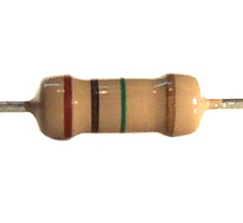


Question 1: Series
10Ω
10Ω
9V
What is the total power delivered by the source?
Through math prediction
Using simulation
Show work

Slide 3
Show your work here

Slide 4
Question 2: Parallel
10Ω
10Ω
9V
What is the total power delivered by the source?
Through math prediction
Using simulation
Show work

Slide 5
Show your work here

Slide 6
Question 3: Analysis with one source
13Ω
6Ω
5Ω
10Ω
9V
7Ω
What is the power dissipated across the 13Ω?
Through math prediction (Ohm’s Law)
Using simulation
Show work

Slide 7
Show your work here

Slide 8
Question 4: Analysis with more than one source
20Ω
25V
15V
7Ω
5Ω
9V
12V
10Ω
16V
3Ω
What is the current going through the 20Ω?
What is voltage across the 5Ω?
Through math prediction (Kirchhoff)
Using simulation
Show work

Slide 9
Show your work here

Slide 10
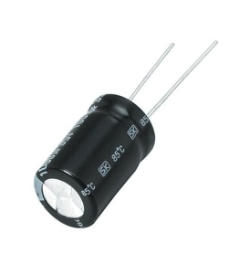

Charging capacitor
Question 5
0.10F
16Ω
16V
switch
a) What maximum charge stored in the capacitor?
b) What is the charge at t=0.9s
c) What is the energy at that this time?
Solve using math then simulation.
For simulation you can measure : time, voltage and therefore RC time
For charge and energy use equations only
Show work

Slide 11
Show your work here

