Slide 1
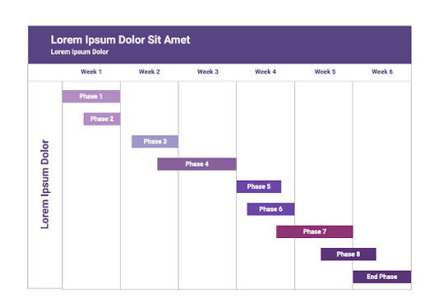
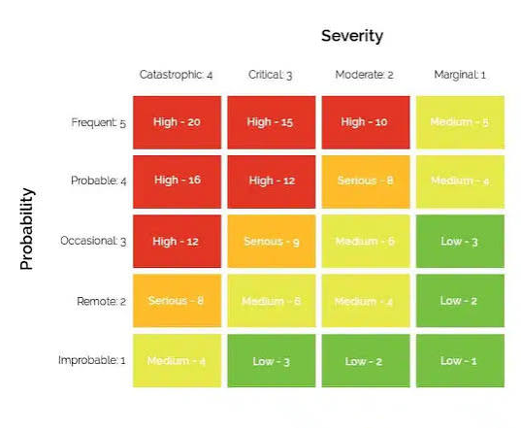


GA 11 – Project Management
Task Allocation
(demonstrates task breakdown and responsibility allocation)
Individual tasks were allocated to each member.
A Quality Assurance Manager was assigned for each submission.
Project Planning
(demonstrates complex project planning)
Internal project schedule and milestones were established via Gantt Chart.
Member
QA
Member
Member
Control Concept Plan
SCADA Concept Plan
Coordination
(demonstrates integration and inter-task relationships)
Weekly meetings were held on Teams with rotating chairs.
The WBS was created and regularly updated to ensure all sections were on track.
The team leader communicated project feedback to the group via WhatsApp.
Members discussed common tasks, both in meetings and online.
Monitoring
(demonstrates project control and documentation)
The project/team risks were assessed and updated weekly.
The Quality Assurance Manager signed off on all work within a milestone prior to its submission.
WBS

