Slide 1
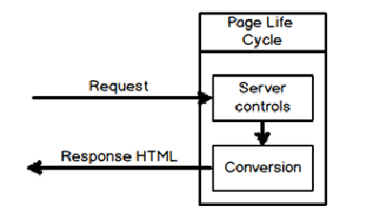
Problems with Asp.Net Web Forms
when ASP.NET Webform was so successful, why Microsoft thought of creating ASP.NET MVC. The main problem with ASP.NET Webform is performance.
In web application there are two aspects which define performance:-
Response time: - How fast the server responds to request?.
Bandwidth consumption: - How much data is sent ?.
Response time: When We did a small load testing experiment of Webform vs. Asp. Net MVC and we found Asp.Net MVC to be twice faster.
In Asp.net Every request there is a conversion logic which runs and converts the server controls to HTML output. This conversion get’s worse and heavy when we have grids, tree view controls Due to this unnecessary conversion the response time get affected.

Slide 2
Problems with Asp.Net Web Forms
Bandwidth consumption
Viewstate has been a very dear and near friend of ASP.NET developers for past many years because it automatically saves states between post backs and reduces our development time. But this reduction in development time comes at a huge cost ,viewstate increases the page size considerably. In this load test we found viewstate increases the page size twice as compared to Asp.Net MVC.
Less Control over HTML: In Web Forms many times we are not sure about what html we will get at the end making integration with JavaScript frameworks like jQuery a difficult task
Less support for parallel development: ASPX page are tightly coupled with code behind files. So it’s not possible that 2 different developers are working on one section (one on aspx and one on code behind) at same time.
Unit Testing
very difficult to do unit testing, because you cannot instantiate behind code straight forward in Asp.net

Slide 3
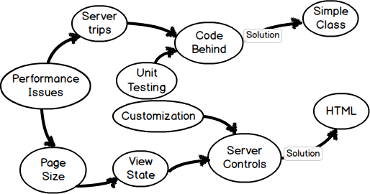
What’s the solution ?
The solution is we need to move the code behind to a separate simple class library and get rid of ASP.NET Server controls and write simple HTML.

Slide 4
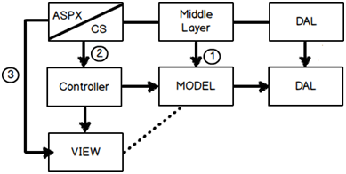
How Microsoft Asp.Net MVC tackles problems in Web Forms?
The current WebForm architecture which developers are using it’s mostly 3 layer architecture. This three layer architecture comprises of UI which has ASPX and the CS code behind.
So Asp.Net MVC comprises of three sections Model , View and Controller. The code behind logic goes in to the controller. View is your ASPX i.e. pure HTML and your Model is your middle layer. You can see in the above diagram how those layers fit in.
So if you see there are two major changes VIEW becoming simple HTML and code behind moving to simple .NET classes termed as controller.

Slide 5
Asp.Net Web Forms problems resolved with ASP.NET MVC
Response time: ASP.net MVC implements Model-View-Controller UI pattern for web application development that lets you allows to develop applications in a loosely couples manner. developer write HTML straight forward.
Performance: ASP.NET MVC don’t have support for view state, so there will not be any automatic state management which reduces the page size and so gain the performance.
Full control over HTML: ASP.NET MVC doesn’t support server controls, only option available is using html input controls, so we will be sure about final html rendered at the end. We will also be aware about 'id' of every element.
Support for parallel development: In ASP.NET MVC layers are loosely coupled with each other, so one developer can work on Controller ,at the same time other on View and third developer on Model. This is called parallel development.
Existing ASP.NET Features: ASP.NET MVC framework is built on top of matured ASP.NET framework and thus provides developer to use many good features such as forms authentication, windows authentication, caching, session and profile state management etc.

Slide 6
Difference between Asp.Net WebForm and Asp.Net MVC
Asp.Net Web Forms
Asp.Net MVC
Asp.Net Web Form follow a traditional event driven development model.
ASP.NET WebForms model follows a Page Life cycle.
Asp.Net Web Form has server controls.
In ASP.NET Web Forms, minimal knowledge of HTML, JavaScript and CSS is required.
In order to achieve stateful behavior, viewstate is used. Purpose was to give developers the same experience of a typical WinForms application.
Asp.Net MVC is a lightweight and follow MVC (Model, View, Controller) pattern based development model.
No Page Life cycle like WebForms. Request cycle is simple in ASP.NET MVC model.
Asp.Net MVC has html helpers.
In MVC, detailed knowledge of HTML, JavaScript and CSS is required.
ASP.NET MVC approach is stateless as that of the web. So there is no concept of viewstate.

Slide 7
Difference between Asp.Net WebForm and Asp.Net MVC
Asp.Net Web Forms
Asp.Net MVC
Statefulness has a lots of problem for web environment in case of excessively large viewstate. Large viewstate means increase in page size.
ASP.NET Web Forms use Page controller pattern approach for rendering layout. In this approach, every page has its own controller, i.e., code-behind file that processes the request.
No separation of concerns. As we discussed that every page (.aspx) has its own controller (code behind i.e. aspx.cs/.vb file), so both are tightly coupled.
Because of this coupled behavior, automated testing is really difficult.
As controller and view are not dependent and also no viewstate concept in ASP.NET MVC, so output is very clean.
ASP.NET MVC uses Front Controller approach. That approach means a common controller for all pages processes the requests.
Very clean separation of concerns. View and Controller are neatly separate.
Testability is a key feature in ASP.NET MVC. Test driven development is quite simple using this approach.

Slide 8
Difference between Asp.Net WebForm and Asp.Net MVC
Asp.Net Web Forms
Asp.Net MVC
Asp.Net Web Form has Master Pages for consistent look and feels.
Asp.Net Web Form has User Controls for code re-usability.
Asp.Net Web Form has built-in data controls and best for rapid development with powerful data access.
With a lots of control libraries availability and limited knowledge of other related technologies, ASP.NET WebForms is RAD(Rapid Application Development) approach.
good for small scale applications with limited team size.
Asp.Net Web Form is not Open Source.
Asp.Net MVC has Layouts for consistent look and feels.
Asp.Net MVC has Partial Views for code re-usability.
Asp.Net MVC is lightweight, provide full control over markup and support many features that allow fast & agile development.
It's a step back. For developers decrease in productivity.
It’s better as well as recommended approach for large-scale applications where different teams are working together.
Asp.Net MVC is an Open Source.

Slide 9
MVC Overview
ASP.NET MVC is a new web application framework from Microsoft.
MVC stands for Model-View-Controller, a pattern that’s becoming increasingly popular with web development frameworks.
MVC is a framework for building web applications.
MVC divides an application's implementation into three components models, views and controller.
Model: Model represents shape of the data and business logic. It maintains the data of the application. Model objects retrieve and store model state in a database.
View: View is a user interface. View display data using model to the user and also enables them to modify the data.
Controller: Controller handles the user request. It is the bridge between the Model and the View.Typically, user interact with View, which in-tern raises appropriate URL request, this request will be handled by a controller. The controller renders the appropriate view with the model data as a response.

Slide 10
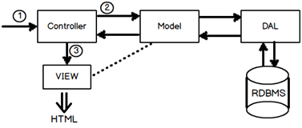
MVC Overview
Asp.Net MVC request flow
Step 1:- The first hit comes to the controller.
Step 2:- Depending on the action controller creates the object of the model. Model in turn calls the data access layer which fetches data in the model.
Step 3:- This data filled model is then passed to the view for display purpose.
when the user enters a URL in the browser, it goes to the server and calls appropriate controller. Then, the Controller uses the appropriate View and Model and creates the response and sends it back to the user.

Slide 11
MVC Flow
Request
Controller
Step 1
Incoming request directed to Controller

Slide 12

MVC Flow
Controller
Model
Step 2
Controller processes request and forms a data Model

Slide 13
MVC Flow
Controller
View
Step 3
Model is passed to View

Slide 14

MVC Flow
Controller
View
Step 4
View transforms Model into appropriate output format

Slide 15
MVC Flow
Controller
View
Response
Step 5
Response is rendered

Slide 16
ASP.NET MVC Version History
MVC Version | Visual Studio | .Net Version | Release date
MVC 1.0 | VS2008 | .Net 3.5 | 13-Mar-2009
MVC 2.0 | VS 2008, | .Net 3.5/4.0 | 10-Mar-2010
MVC 3.0 | VS 2010 | .Net 4.0 | 13-Jan-2011
MVC 4.0 | VS 2010 SP1, VS 2012 | .NET 4.0/4.5 | 15-Aug-2012
MVC 5.0 | VS 2013 | .NET 4.5 | 17-oct-2013
MVC 6.0 rc1 | VS 2015 | .NET 4.5 | 18-nov-2015
Notes:
Release Condidate

Slide 17
ASP.NET MVC Version Features
MVC 1.0
MVC architecture with webform engine
Routing
HTML Helpers
Ajax Helpers
MVC 2.0
Html helper methods with lambda expression
DataAnnotations attributes
Client side validation
Custom template
Scaffolding

Slide 18
ASP.NET MVC Version Features
MVC 3.0
New Project Templates having support for HTML 5 and CSS 3.
Improved Model validation.
Razor View Engine introduced with a bundle of new features.
Razor view engine
Global filters
Partial page output caching.
Controller improvements like ViewBag dynamic property and ActionResults Types etc.
MVC 4.0
ASP.NET Web API, a framework that simplifies the creation of HTTP services and serving a wide range of clients
Based on jQuery Mobile, new Mobile Project Template introduced.
Bundling and minification
Support for Windows Azure SDK

Slide 19
ASP.NET MVC Version Features
MVC 5.0
Authentication filters
Bootstrap support
New scaffolding items
Attribute based routing
MVC 6.0
Single Programming Model for ASP.NET MVC and ASP.NET Web API.
Optimized for Cloud Computing.

Slide 20
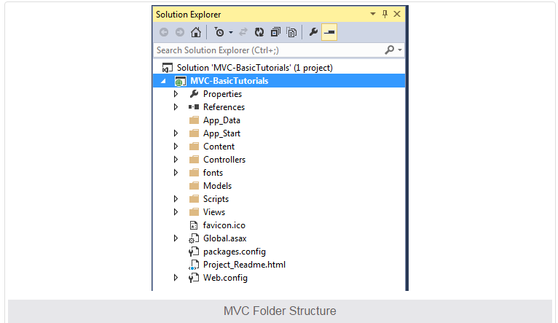
ASP.NET MVC Folder Structure

Slide 21
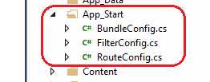
ASP.NET MVC Folder Structure
App_Data:
App_Data folder can contain application data files like LocalDB, .mdf files, xml files and other data related files. IIS will never serve files from App_Data folder.
App_Start:
App_Start folder can contain class files which will be executed when the application starts. Typically, these would be config files like AuthConfig.cs, BundleConfig.cs, FilterConfig.cs, RouteConfig.cs etc. MVC 5 includes BundleConfig.cs, FilterConfig.cs and RouteConfig.cs by default. We will see significance of these files later.

Slide 22
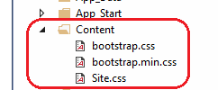

ASP.NET MVC Folder Structure
Content:
Content folder contains static files like css files, images and icons files. MVC 5 application includes bootstrap.css, bootstrap.min.css and Site.css by default.
Controllers:
Controllers folder contains class files for the controllers. Controllers handles users' request and returns a response. MVC requires the name of all controller files to end with "Controller".

Slide 23
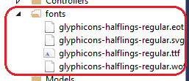
ASP.NET MVC Folder Structure
fonts:
Fonts folder contains custom font files for your application.
Models:
Models folder contains model class files. Typically model class includes public properties, which will be used by application to hold and manipulate application data.

Slide 24
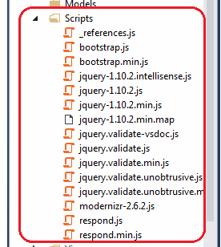
ASP.NET MVC Folder Structure
Scripts:
Scripts folder contains JavaScript or VBScript files for the application. MVC 5 includes javascript files for bootstrap, jquery 1.10 by default.

Slide 25
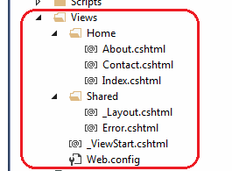
ASP.NET MVC Folder Structure
Views:
Views folder contains html files for the application. Typically view file is a .cshtml file where you write html and C# or VB.NET code.
Views folder includes separate folder for each controllers. For example, all the .cshtml files, which will be rendered by HomeController will be in View > Home folder.
Shared folder under View folder contains all the views which will be shared among different controllers e.g. layout files.

Slide 26
ASP.NET MVC Folder Structure
MVC project also includes following configuration files:
Global.asax:
Global.asax allows you to write code that runs in response to application level events, such as Application_BeginRequest, application_start, application_error, session_start, session_end etc.
Packages.config:
Packages.config file is managed by NuGet to keep track of what packages and versions you have installed in the application.
Web.config:
Web.config file contains application level configurations.

Slide 27
Controller
The Controller in MVC architecture handles any incoming URL request. Controller is a class, derived from the base class System.Web.Mvc.Controller. Controller class contains public methods called Action methods. Controller and its action method handles incoming browser requests, retrieves necessary model data and returns appropriate responses.
In ASP.NET MVC, every controller class name must end with a word "Controller". For example, controller for home page must be HomeController and controller for student must be StudentController. Also, every controller class must be located in Controller folder of MVC folder structure.
In the Visual Studio, right click on the Controller folder -> select Add -> click on Controller
Note: MVC will throw "The resource cannot be found" error when you do not append "Controller" to the controller class name.
New controller can be created using different scaffolding templates. You can create custom scaffolding template also.
Note:Scaffolding is an automatic code generation framework for ASP.NET web applications. Scaffolding reduces the time taken to develop a controller, view etc. in MVC framework.
Note:This base Controller class contains helper methods that can be used for various purposes.

Slide 28
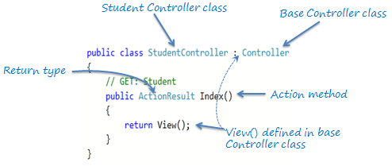
Action method
All the public methods of a Controller class are called Action methods. They are like any other normal methods with the following restrictions:
Action method must be public. It cannot be private or protected
Action method cannot be a static method.

Slide 29
Passing Data from Controller to View
In ASP.NET MVC offers us three options - ViewData, ViewBag and TempData to pass data from controller actions to view and in next request.
ViewData
ViewData is used to pass data from controller to corresponding view.
ViewData is Key-Value Dictionary collection.
ViewData is a dictionary object and it is property of ControllerBase class.
ViewData requires typecasting for complex data type and check for null values to avoid error.
Viewdata[“key”]=value
ViewBag
ViewBag is also used to pass data from controller to corresponding view.
ViewBag is a dynamic property that takes advantage of the new dynamic features in C# 4.0.
ViewBag is Dynamic property of ControllerBase class.
It doesn’t required typecasting for getting complex data type.
Note: Can we pass ViewData and get it as ViewBag?
Yes, We can. Vice versa is also possible.
Viewbag.PropName=value

Slide 30
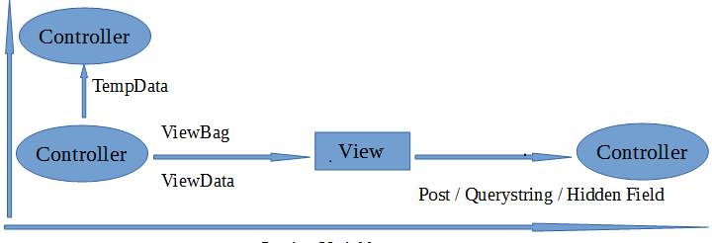
Controllers
TempData
TempData is also Key-Value Dictionary collection.
TempData is used to pass data from current request to subsequent request (pass data from controller to controller).
TempData requires typecasting for complex data type and check for null values to avoid error.

Slide 31
Problems with ViewData and ViewBag
ViewData and ViewBag is a good option for passing values between Controller and View. But in real time projects couple of disadvantages of using ViewData and ViewBag.
Performance issues
Values inside the ViewData are of type Object. We have to cast the value to correct type before using it. It adds additional overhead on performance.
No Type safety and no compile time errors
If we try to cast values to wrong type or if we use wrong keys while retrieving the values, we will get runtime error. As a good programming practice, error should be tackled in compiled time.
No Proper connection between Data sent and Data Received
In MVC, controller and View are loosely connected to each other. Controller is completely unaware about what’s happening in View and View is unaware about what’s happening in Controller.
From Controller we can pass one or more ViewData/ViewBag values. Now when Developer writes a View, he/she have to remember what is coming from the controller. If Controller developer is different from View developer then it becomes even more difficult. Complete unawareness. It leads to many run time issues and inefficiency in development.

Slide 32
Model
Model represents domain specific data and business logic in MVC architecture. It maintains the data of the application. Model objects retrieve and store model state in the persistance store like a database.
Model class holds data in public properties. All the Model classes reside in the Model folder in MVC folder structure.
namespace MVC_BasicTutorials.Models
{
public class Student
{
public int StudentId { get; set; }
public string StudentName { get; set; }
public int Age { get; set; }
}
}

