Slide 1
Classification of BRAIN MRI IMAGES
Beibarys Nyussupov

Slide 2
Problem Statement
01
02
03
TARGET
In 2023, 6.7 millions Americans were reported living with Alzheimer’s disease.
Number is expected to increase to 13.8 millions in 2060 (NIH).
Alzheimer’s dementia became 7th leading cause of death after Covid in 2020-2021 (NIH)
To Develop a support tool that will help doctors in indicating and treating Alzheimer’s

Slide 3
Project Significance
Area - Health & Medicine
Goal - Identify and distinguish between brain with Alzheimer’s disease and healthy brain in MRI Scans
3. Model Role - supportive tool for doctors in diagnosing the Alzheimer’s dementia. Doctors should not finalize the decision on the model, SUPPORTIVE TOOL, NOT A DIAGNOSIS MODEL

Slide 4
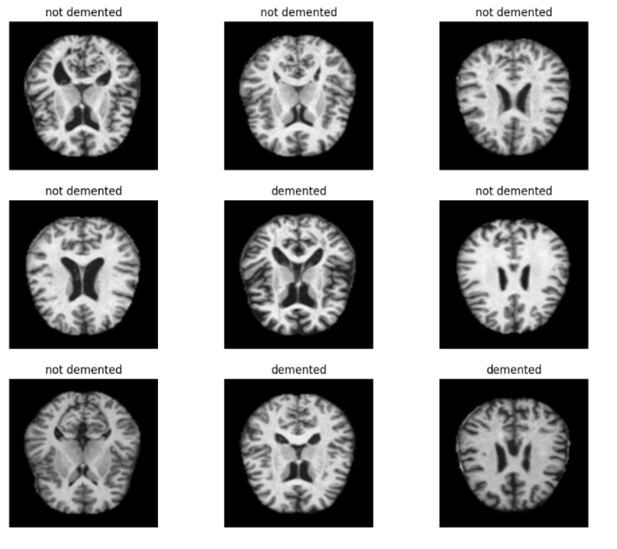
Source: Kaggle - Alzheimer MRI Preprocessed Dataset
Structure:
Unstructured - Individual MRI Images of patients
Number of initial classes (images):
Mild Demented (896)
Moderate Demented (64)
Non Demented (3000)
Very Demented (2240)
Sample images in greyscale

Slide 5
How is project different from other works?
Model fine-tuning:
Pre-trained weights were not used to predict the image as used by others in Kaggle (using ImageNet pre-trained weights - illogical and explainable)
All 4 classes were distributed into 2 categories: Non Demented and Demented (goal - identifying Alzheimer’s, not classifying the degree)
EfficientNet (Neural Networks) model focus:
Application of high intensity V2 Efficient Net models for classification (most of the kaggle projects use V1 models).

Slide 6
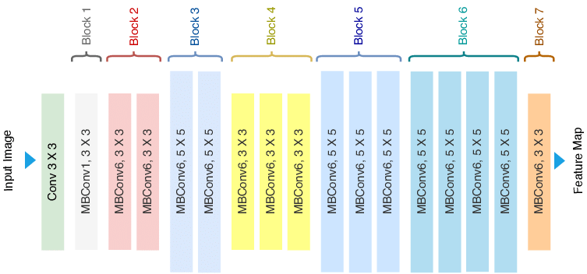
UNDERSTANDING EfficientNet
EfficientNet:Compound Scaling

Slide 7
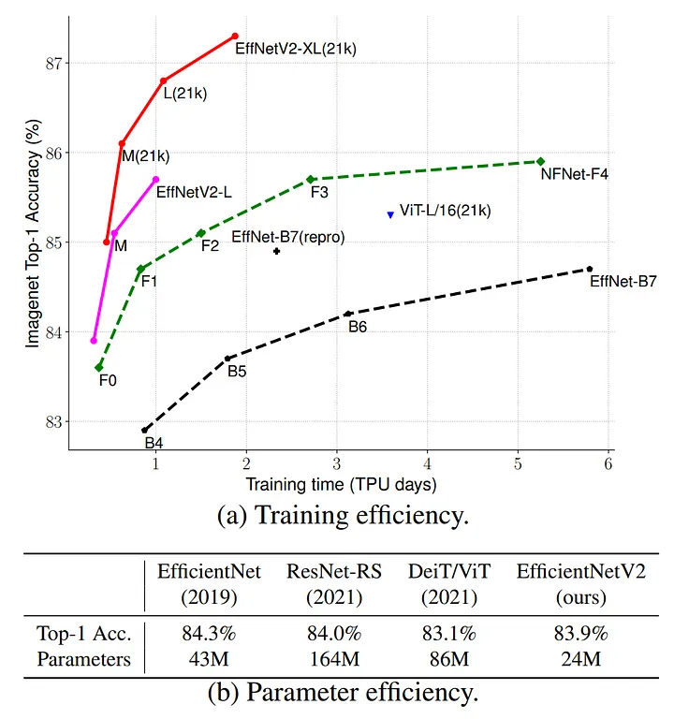
More about Model: EfficientNetV2
EfficientNetV2B0:
Baseline model
Was used to compare with high-intensity S model.
5 million parameters
EfficientNetV2S (Small):
High-intensity model
Higher accuracy in a cost of time
~24 million parameters
Models Comparisons

Slide 8
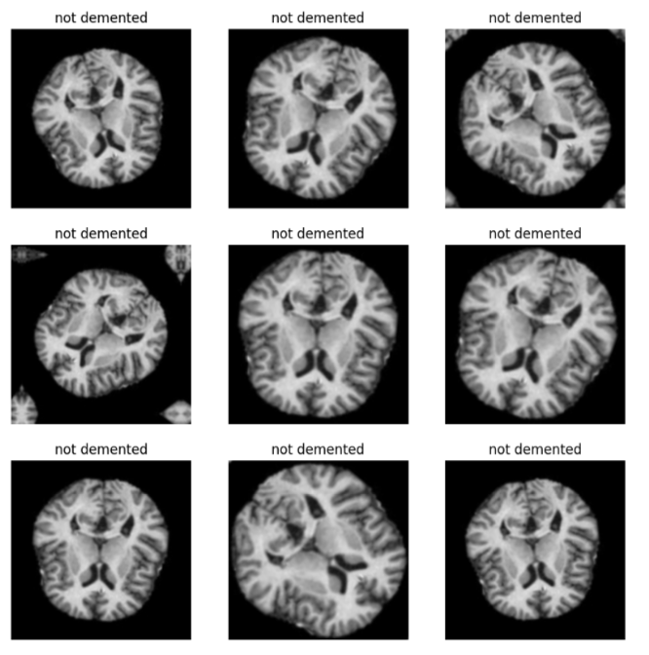
Pre-processing
Image scale - original image size - 128x128 pixels
Images were scaled to 224x224 pixels to meet EfficientNet requirements
Data augmentation - random image zoom, angle turn, etc.
Resulted in a low performance and predictive ability - augmentation was removed
Train and validation data was prefetched and cached:
While model learns a patterns of picture, the next picture is already uploaded into memory ready to be explored - higher efficiency
Batch size - 64, number of samples that go through neural network during each training epoch (round).
64 maximum batch size for google collab
Image augmentation

Slide 9
Tuning steps taken:
Dense layers - “decision-makers”
Convolutional Layers in EfficientNet - extract features
Dense Layer - makes predictions
Mean input-output neurons size method was chosen to determine number of neurons and layers, read here: link
Optimal threshold was chosen to maximize TP (True Positive) predictions.
Mean input-output:
(input neuron size + number of classes in the data) / 2
Example: input - 1280
Output - 1 (binary classification)
Next dense layer - 641 neurons (1280 +1) / 2

Slide 10
Results
 | EfficientV2B0 (Baseline model) | EfficientNetV2S (Small intensity model)
Validation Accuracy (before threshold) | 98.20 % | 97%
Cross-Validation Accuracy | 98% | 99%
Precision | 99% | 98%
Recall | 98% | 97%
F1-Score | 98% | 97%

Slide 11
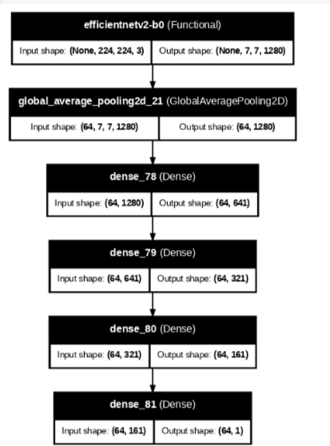
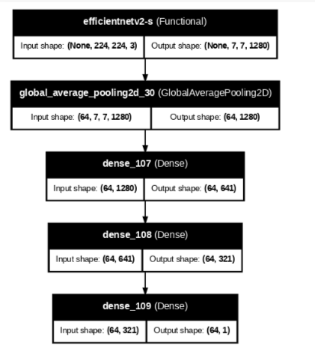
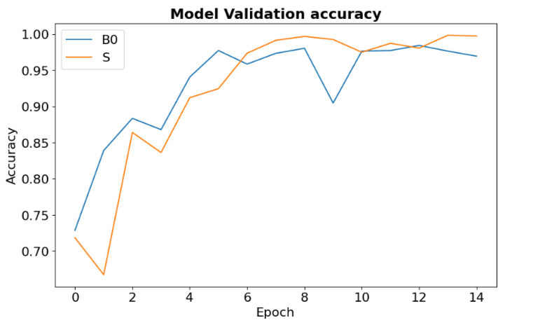
Result - Model Stability
15 epochs
B0 model
S model

Slide 12
Maximization of True Positives
Method: application of probability threshold where TP number is maximized.
Cost: increased number of False positives (FP). Not important as it is more critical to find Alzheimer’s in scans.
Threshold chosen: 0.03 (slightest probability - Alzheimer’s warning).
Practical recommendation:
Using the model only as a support tool.
If a doctor is doubtful about prediction - additional screening of a patient is needed.

Slide 13
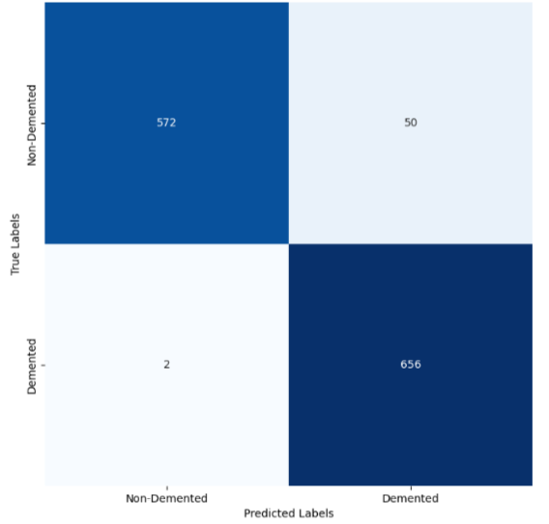
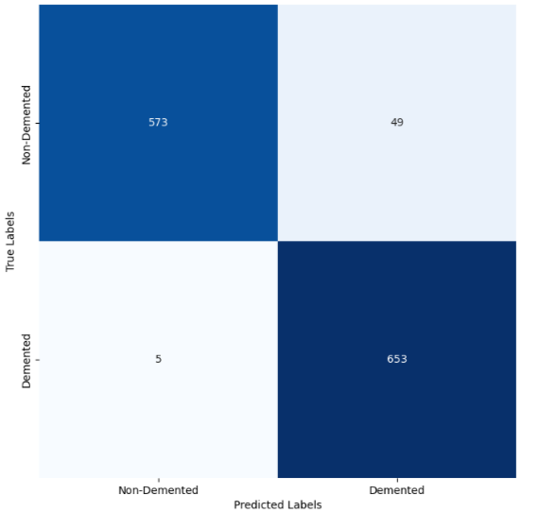


Maximization of True Positives 2
Model B0
Model S

Slide 14
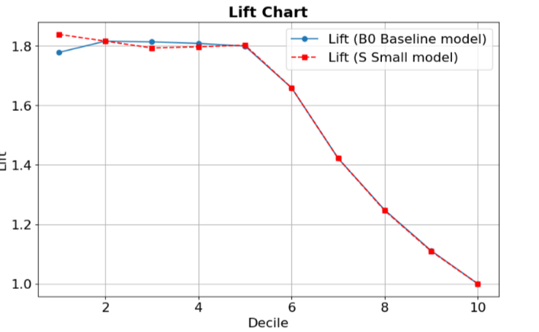
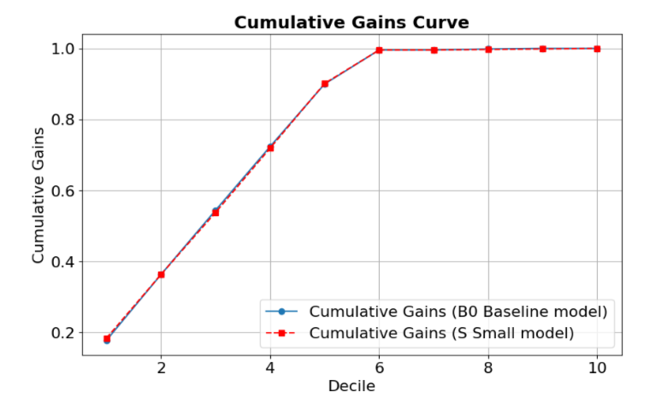
Additional Metrics

Slide 15
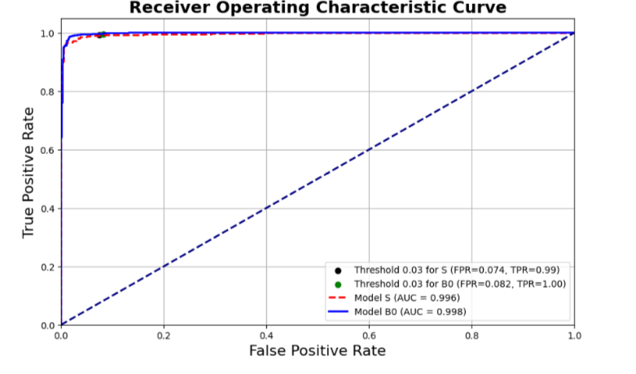
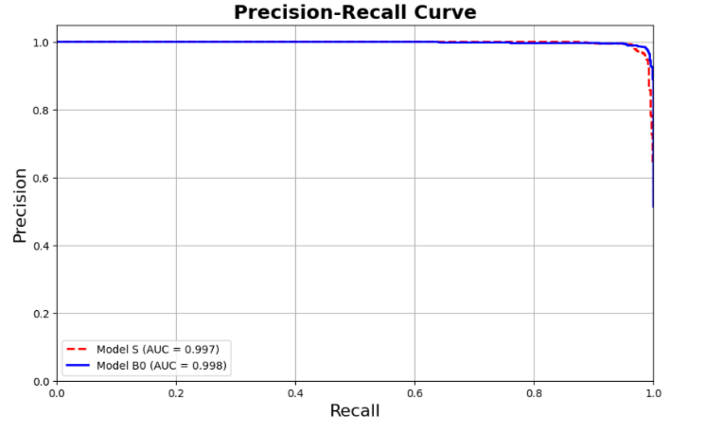
Additional Metrics 2

Slide 16
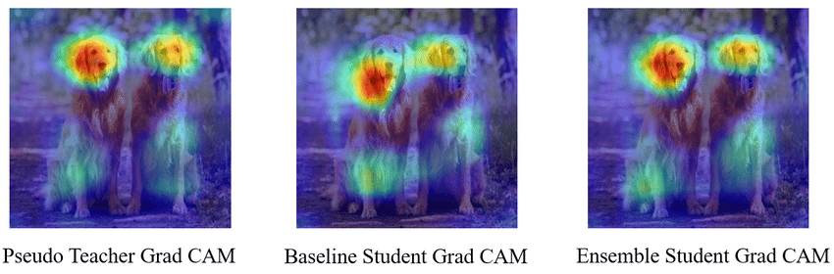
Limitations and Future Considerations:
Limited Explainability & Interpretability - it is possible to explain the results and predictions of the Neural Network Models. But it is nearly impossible to visualize and explain on what’s happening in Hidden Layers (Dense, Convolutional Layers)
Application of Gradient Maps are needed (unachievable at current level of machine learning knowledge)
Higher batch size & Higher Epochs -
Higher results Possible
Google Collab is limited to
64 batch size
Exploration of even higher intensity
models (Medium, Large, XL, XXL):
a. Might bring even more stability
b. Might bring even more accuracy
c. Google Collab can’t sustain such models
Gradient Classification Maps

Slide 17
THANK YOU FOR YOUR ATTENTION!
For additional information, contact:
nyussupovb@gwu.edu
Beibarys Nyussupov

