Slide 1
INTERNSHIP REPORT
Internet of Things (IoT)
Technology Innovation Hub | IIT Guwahati
Team Members
Moharnab Gogoi · Aryyaman Bora · Mayuree Khanikar · Indrani Gogoi
ESP32 • DHT11 • OLED • Wi-Fi • Firebase • ThingSpeak
TIH IIT Guwahati Internship Report
1

Slide 2
Table of Contents
01
About TIH IIT Guwahati
02
Team Members
03
Experiment 1 — Push Button & IR Sensor with ESP32
04
Experiment 2 — Interfacing DHT11 Temperature Sensor
05
Experiment 3 — DHT11 with OLED Display (I2C)
06
Experiment 4 — ESP32 Wi-Fi Network Scanner
07
Experiment 5 — Cloud Data Logging with Firebase
08
Experiment 6 — Cloud Data Logging with ThingSpeak
09
Key Learnings & Skills Developed
10
Conclusion & Thank You
TIH IIT Guwahati Internship Report
2

Slide 3
About TIH — IIT Guwahati
▸ Introduction: Technology Innovation Hub (TIH) at IIT Guwahati is a premier initiative under the National Mission on Interdisciplinary Cyber-Physical Systems (NM-ICPS), DST, Government of India, fostering cutting-edge innovation and entrepreneurship.
▸ Vision: To emerge as a global centre of excellence in research, technology development and innovation in IoT and Cyber-Physical Systems.
▸ Mission: Bridge academia, industry and society by nurturing deep-tech startups, enabling translational research, and developing skilled human resources in emerging technologies.
Internet of Things
Artificial Intelligence
Robotics & Automation
Industry Collaboration
Start-up Incubation
Smart Manufacturing
Research Focus Areas: Intelligent Sensors · Edge Computing · Cloud Platforms · Embedded Systems · Smart Agriculture · Healthcare IoT · Connected Mobility
TIH IIT Guwahati Internship Report
3

Slide 4
Team Members
MG
AB
MK
IG
Moharnab Gogoi
Aryyaman Bora
Mayuree Khanikar
Indrani Gogoi
IoT / Backend
Frontend
Documentation / Research
Documentation / Research
All team members contributed collaboratively across hardware assembly, coding, testing, and documentation.
TIH IIT Guwahati Internship Report
4

Slide 5
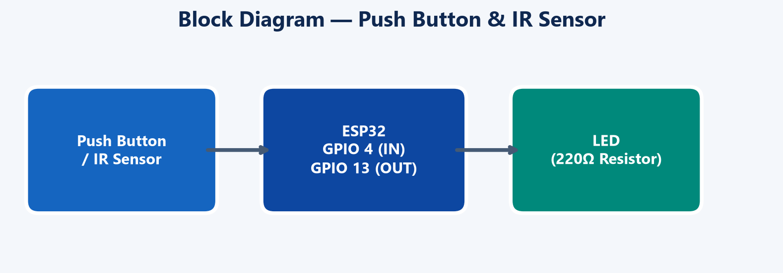
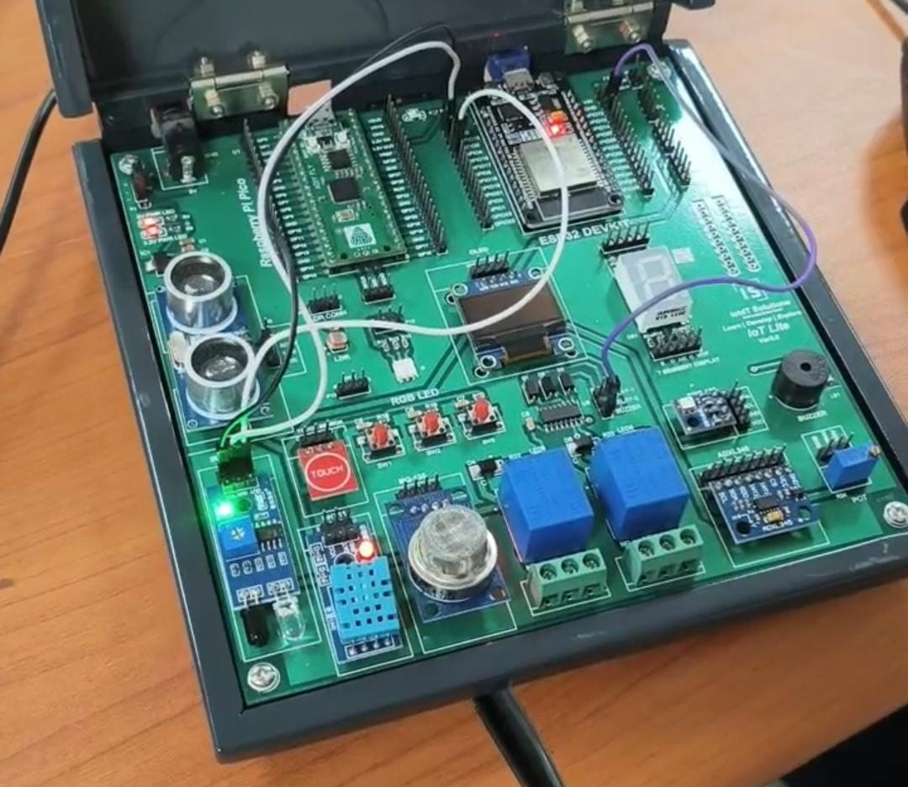
Experiment 1 — Push Button & IR Sensor with ESP32
Objective: Interface a push button or IR sensor with ESP32 to control an LED based on digital input signals.
Working Principle: The digitalRead() function reads the sensor state on GPIO 4. If HIGH, the LED on GPIO 13 is turned ON via digitalWrite(). The loop() function runs continuously to monitor the sensor in real-time.
Components: ESP32 DevKit, LED, 220 Ω Resistor, Push Button, IR Obstacle Sensor, Breadboard, Jumper Wires.
Fig 1.1 — Block Diagram: Push Button / IR → ESP32 → LED
ESP32 Pin | Connection
Pin 13 | LED Anode (via 220Ω resistor)
GND | LED Cathode
Pin 4 | Push Button / IR Sensor OUT
5V | IR Sensor VCC
GND | IR Sensor GND
Fig 1.2 — IoT Development Board with ESP32
TIH IIT Guwahati Internship Report
5

Slide 6
Experiment 1 — Code, Output & Applications
const int sensorPin = 4; // Push Button or IR
const int ledPin = 13; // LED
int sensorState = 0;
void setup() {
pinMode(ledPin, OUTPUT);
pinMode(sensorPin, INPUT);
}
void loop() {
sensorState = digitalRead(sensorPin);
if (sensorState == HIGH)
digitalWrite(ledPin, HIGH); // LED ON
else
digitalWrite(ledPin, LOW); // LED OFF
}
Observations: When the push button is pressed or the IR sensor detects an object (HIGH signal), the LED on Pin 13 turns ON instantly. When released or no object detected, it turns OFF.
Result: Successfully demonstrated digital input/output interfacing with ESP32. Both push button and IR sensor behave identically since both produce digital HIGH/LOW signals.
Applications
✦ Automatic lighting systems
✦ Obstacle detection robots
✦ Security & alarm systems
✦ Automatic doors & gates
✦ Smart home automation projects
Source Code — Push Button & IR Sensor Control
TIH IIT Guwahati Internship Report
6

Slide 7
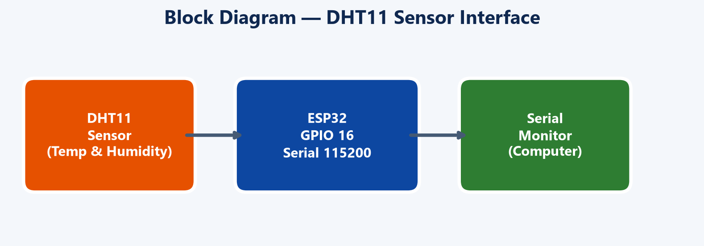
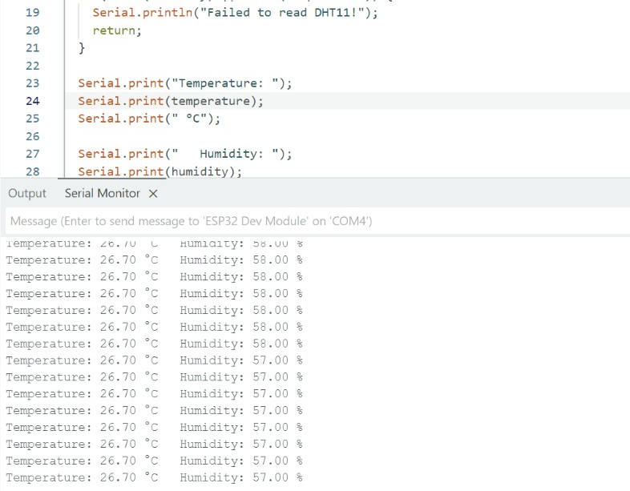
Experiment 2 - Interfacing DHT11 Temperature & Humidity Sensor
Objective: Interface a DHT11 sensor with ESP32 to read real-time temperature (°C) and humidity (%) values and display them on the Serial Monitor.
Working Principle: The DHT library simplifies communication. The ESP32 reads data via GPIO 16 using readTemperature() and readHumidity(). Invalid readings are caught with isnan(). Serial communication at 115200 baud transmits data to the computer via USB.
Components: ESP32 DevKit, DHT11 Temperature & Humidity Sensor, 10 kΩ Pull-up Resistor (bare sensor only), Jumper Wires.
Connections: DHT11 VCC → 3.3V, GND → GND, DATA → GPIO 16.
Fig 2.1 — Block Diagram: DHT11 → ESP32 → Serial Monitor
Fig 2.2 — Arduino IDE: Code & Serial Monitor Output
TIH IIT Guwahati Internship Report
7

Slide 8
Experiment 2 — Code, Output & Applications
#include <DHT.h>
#define DHTPIN 16
#define DHTTYPE DHT11
DHT dht(DHTPIN, DHTTYPE);
void setup() {
Serial.begin(115200);
dht.begin();
}
void loop() {
float humidity = dht.readHumidity();
float temperature = dht.readTemperature();
if (isnan(humidity) || isnan(temperature)) {
Serial.println("Failed to read DHT11!");
return;
}
Serial.print("Temperature: ");
Serial.print(temperature);
Serial.println(" C");
Serial.print("Humidity: ");
Serial.print(humidity);
Serial.println(" %");
delay(1000);
}
Observations: The ESP32 reads temperature (26.70 °C) and humidity (57–58%) accurately every second. Values update continuously on the Serial Monitor.
Result: Successfully interfaced the DHT11 sensor and displayed live environmental readings. Validated error handling for sensor read failures.
Key Learnings: Serial.begin(), dht.begin(), isnan() error checking, and delay()-based periodic sampling.
Applications
✦ Room temperature & humidity monitoring
✦ Weather monitoring stations
✦ Smart home (fan, cooler, humidifier control)
✦ Greenhouse & agriculture monitoring
✦ IoT cloud integration projects
TIH IIT Guwahati Internship Report
8

Slide 9
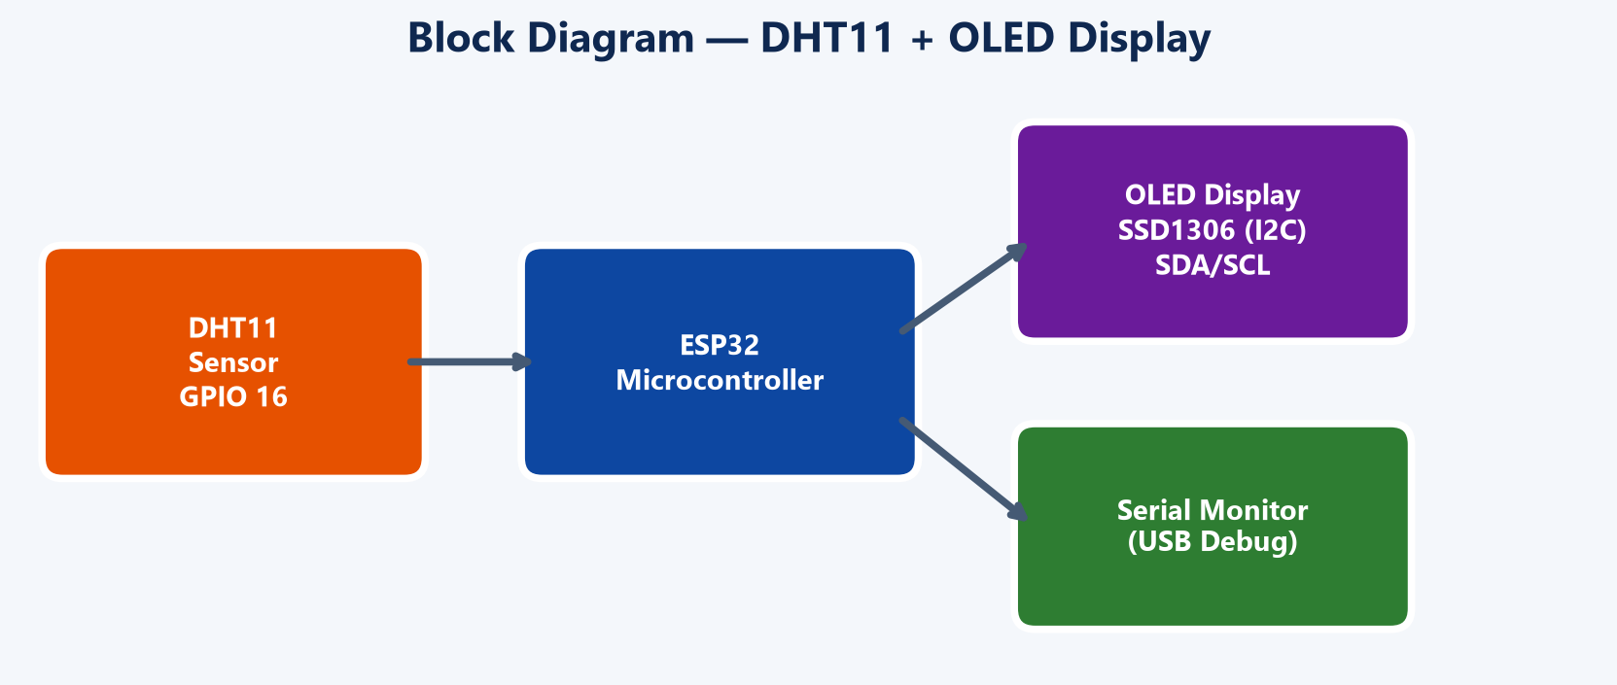
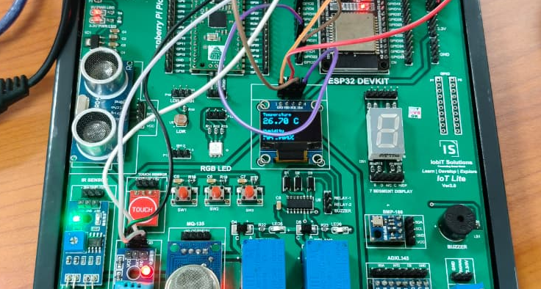
Experiment 3 — DHT11 Sensor with OLED Display (I2C)
Objective: Read temperature and humidity from DHT11 and display the values on a 128×64 SSD1306 OLED using the I2C protocol.
Working Principle: The ESP32 communicates with the OLED via I2C (SDA → GPIO 21, SCL → GPIO 22). Adafruit_SSD1306 renders text and numbers. The display is cleared before each update to prevent ghosting.
Components: ESP32 DevKit, DHT11 Sensor (GPIO 16), SSD1306 OLED Display (128×64, I2C), Jumper Wires.
Connections: OLED VCC → 3.3V, GND → GND, SDA → GPIO 21, SCL → GPIO 22.
Libraries: Wire.h, Adafruit_GFX.h, Adafruit_SSD1306.h, DHT.h.
Fig 3.1 — Block Diagram: DHT11 → ESP32 → OLED + Serial
Fig 3.2 — OLED screen showing temperate and humidity
TIH IIT Guwahati Internship Report
9

Slide 10
Experiment 3 — Code, Output & Applications
#include <Wire.h>
#include <Adafruit_GFX.h>
#include <Adafruit_SSD1306.h>
#include <DHT.h>
Adafruit_SSD1306 display(128, 64, &Wire, -1);
DHT dht(16, DHT11);
void loop() {
float t = dht.readTemperature();
float h = dht.readHumidity();
display.clearDisplay();
display.setTextSize(2);
display.setCursor(0, 12);
display.print(t); display.print(" C");
display.setCursor(0, 52);
display.print(h); display.print("%");
display.display();
}
Observations: Temperature and humidity values render on the OLED in two text sizes. The display refreshes every 2 seconds without flickering thanks to clearDisplay().
Result: Successfully integrated three hardware modules (ESP32, DHT11, OLED) into a standalone embedded display system without requiring a computer.
Key Learnings: I2C protocol, OLED address 0x3C, cursor positioning, text sizing, multi-module embedded integration.
Applications
✦ Weather monitoring stations with display
✦ Smart home temperature panels
✦ Greenhouse & indoor environment monitors
✦ Server room / laboratory condition displays
✦ Educational embedded systems projects
Source Code — DHT11 + OLED Display
TIH IIT Guwahati Internship Report
10

Slide 11
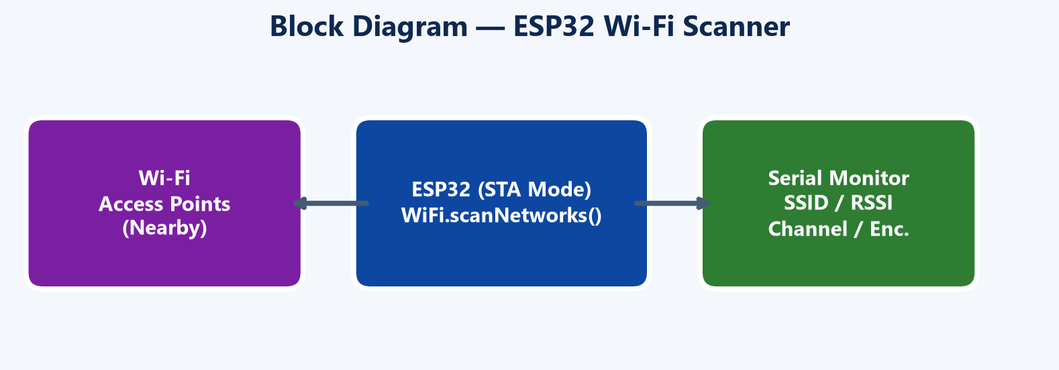
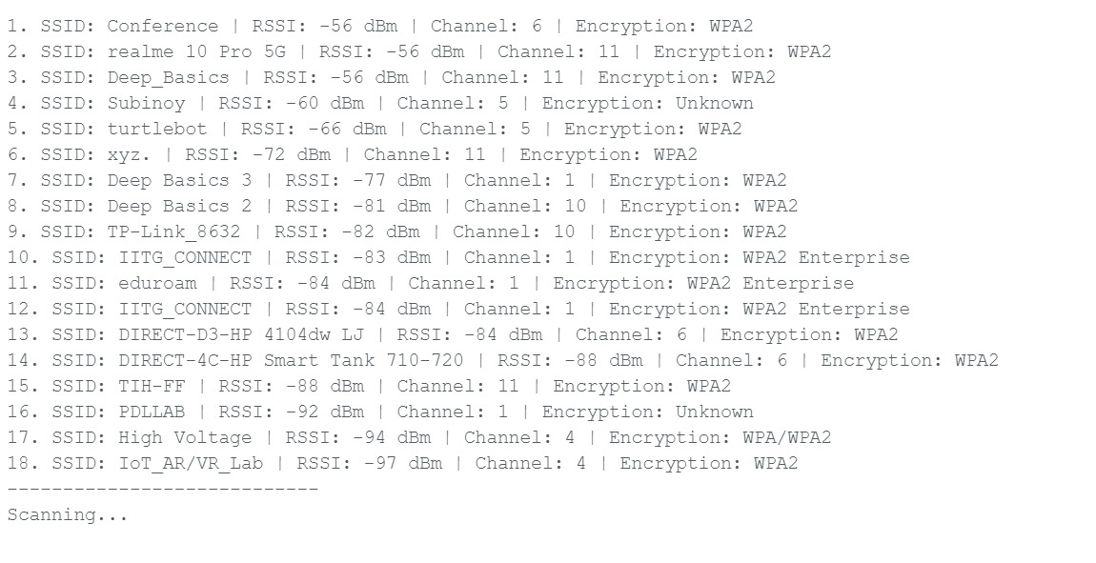
Experiment 4 — ESP32 Wi-Fi Network Scanner
Objective: Utilise the ESP32's built-in Wi-Fi capability to scan and list all nearby wireless networks along with their details.
Working Principle: The ESP32 is set to Station (STA) mode and disconnected from any previous network. WiFi.scanNetworks() initiates a scan and returns the count. For each network, SSID, RSSI (signal strength in dBm), channel number, and encryption type are extracted and displayed.
Components: ESP32 DevKit, USB Cable, Computer with Arduino IDE. No external sensors or components required.
Encryption Detection: Open, WEP, WPA, WPA2, WPA/WPA2, WPA2 Enterprise, WPA3.
Fig 4.1 — Block Diagram: Wi-Fi APs → ESP32 (STA) → Serial
Fig 4.2 — Serial Monitor: 18 networks detected at IIT Guwahati
TIH IIT Guwahati Internship Report
11

Slide 12
Experiment 4 — Code, Output & Applications
#include <WiFi.h>
void setup() {
Serial.begin(115200);
WiFi.mode(WIFI_STA);
WiFi.disconnect();
}
void loop() {
int n = WiFi.scanNetworks();
for (int i = 0; i < n; i++) {
Serial.print(WiFi.SSID(i));
Serial.print(" | RSSI: ");
Serial.print(WiFi.RSSI(i));
Serial.print(" dBm | Ch: ");
Serial.print(WiFi.channel(i));
Serial.print(" | Enc: ");
// switch-case for encryption type
}
delay(5000); // scan every 5 seconds
}
Observations: Detected 18 networks at IIT Guwahati including IITG_CONNECT, eduroam, Conference, TIH-FF, and IoT_AR/VR_Lab. Signal strengths ranged from −56 dBm (strong) to −97 dBm (weak). Multiple encryption types identified.
Result: Successfully demonstrated passive Wi-Fi reconnaissance using ESP32's built-in radio without any external hardware. Scan repeats every 5 seconds.
Key Learnings: Wi-Fi STA mode, RSSI measurement, channel analysis, encryption type identification, continuous scanning patterns.
Applications
✦ Wi-Fi site survey & coverage analysis
✦ Network security auditing
✦ Smart home device setup assistance
✦ Signal strength mapping for IoT deployment
Source Code — ESP32 Wi-Fi Scanner
TIH IIT Guwahati Internship Report
12

Slide 13
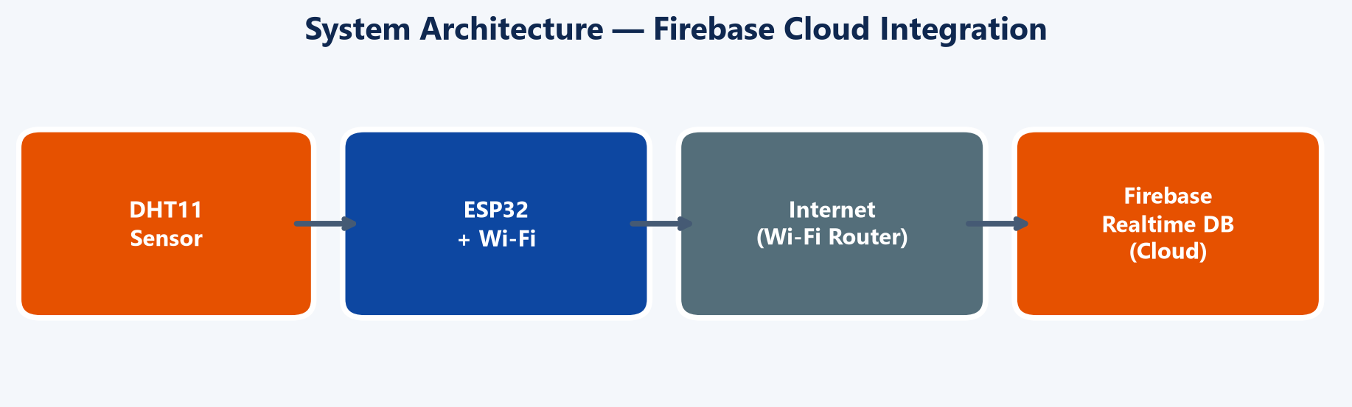
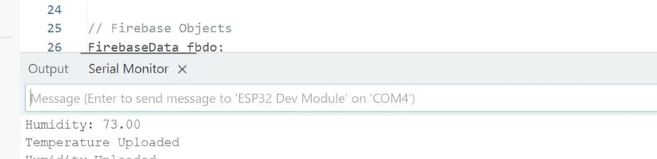
Experiment 5 — Cloud Data Logging with Firebase RTDB
▸ Objective: Read DHT11 sensor data on ESP32, connect to Wi-Fi, authenticate with Firebase, and upload temperature and humidity values to Firebase Realtime Database in real-time.
▸ Working Principle: The ESP32 connects to Wi-Fi, then authenticates with Firebase using an API key and user credentials. Every 10 seconds, it reads the DHT11 sensor and uses Firebase.RTDB.setFloat() to push values to the /DHT11/ path in the cloud database.
▸ Components: ESP32 DevKit, DHT11 Sensor (GPIO 16), Wi-Fi Network, Firebase Project (Realtime Database).
▸ Libraries: WiFi.h, Firebase_ESP_Client.h, DHT.h, TokenHelper.h, RTDBHelper.h.
Fig 5.1 — Architecture: DHT11 → ESP32 → Wi-Fi → Firebase Cloud
Fig 5.2 — Serial Monitor: Firebase upload confirmation
TIH IIT Guwahati Internship Report
13

Slide 14
Experiment 5 — Code, Output & Applications
#include <WiFi.h>
#include <Firebase_ESP_Client.h>
#include <DHT.h>
// WiFi & Firebase credentials configured
FirebaseData fbdo;
void loop() {
if (Firebase.ready() && signupOK &&
(millis() - prevMillis > 10000)) {
prevMillis = millis();
float temp = dht.readTemperature();
float hum = dht.readHumidity();
Firebase.RTDB.setFloat(&fbdo,
"/DHT11/Temperature", temp);
Firebase.RTDB.setFloat(&fbdo,
"/DHT11/Humidity", hum);
}
}
Observations: The ESP32 successfully connects to Wi-Fi, authenticates with Firebase, and uploads data every 10 seconds. Serial Monitor confirms 'Temperature Uploaded' and 'Humidity Uploaded'. Humidity reading: 73.00%.
Result: Real-time sensor data available in Firebase Realtime Database console, accessible from any device worldwide via the internet.
Key Learnings: Firebase authentication flow, RTDB write operations, non-blocking timer using millis(), error handling for cloud uploads.
Applications
✦ IoT remote environmental monitoring
✦ Smart home climate control dashboards
✦ Industrial data logging & analytics
✦ Agricultural field condition tracking
Source Code — Firebase RTDB Upload (Key Sections)
TIH IIT Guwahati Internship Report
14

Slide 15
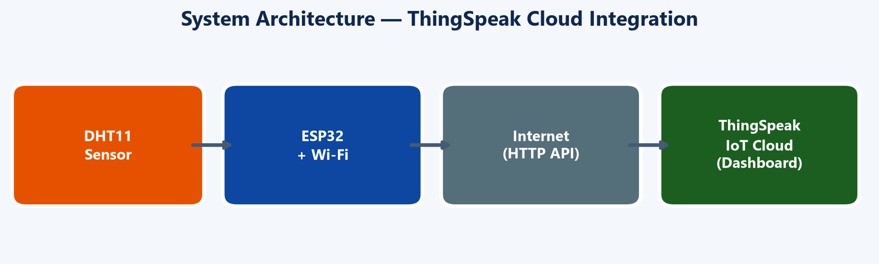
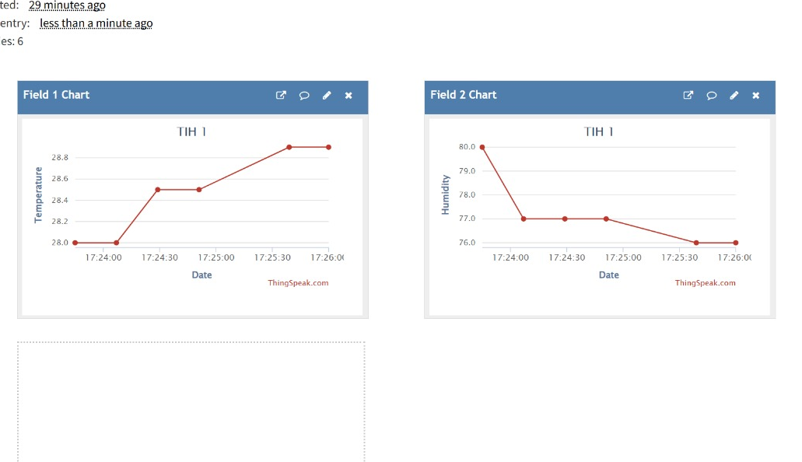
Experiment 6 — Cloud Data Logging with ThingSpeak
Objective: Connect ESP32 with DHT11 sensor to the ThingSpeak IoT cloud platform, upload temperature and humidity data using API keys, and visualise the data on the ThingSpeak web dashboard.
Working Principle: The ESP32 connects to Wi-Fi, initialises the ThingSpeak client, and reads DHT11 data. ThingSpeak.setField() maps sensor values to channel fields. ThingSpeak.writeFields() uploads data using the channel ID and write API key. Free tier requires minimum 15-second interval.
Components: ESP32 DevKit, DHT11 Sensor (GPIO 16), Wi-Fi Network, ThingSpeak Account (Channel ID: 3422621).
Libraries: WiFi.h, ThingSpeak.h, DHT.h.
Fig 6.1 — Architecture: DHT11 → ESP32 → Wi-Fi → ThingSpeak Cloud
Fig 6.2 — ThingSpeak Dashboard: Temperature & Humidity Charts
TIH IIT Guwahati Internship Report
15

Slide 16
Experiment 6 — Code, Dashboard & Applications
#include <WiFi.h>
#include <ThingSpeak.h>
#include <DHT.h>
unsigned long channelID = 3422621;
const char* writeAPIKey = "20RHNVSS5T...";
void loop() {
float temperature = dht.readTemperature();
float humidity = dht.readHumidity();
ThingSpeak.setField(1, temperature);
ThingSpeak.setField(2, humidity);
int response = ThingSpeak.writeFields(
channelID, writeAPIKey);
if (response == 200)
Serial.println("Data uploaded");
delay(20000); // 15s min for free tier
}
Observations: Data uploads every 20 seconds. Dashboard shows real-time temperature (~28°C) and humidity (~77-80%) with timestamps. Response code 200 confirms success.
Result: Complete IoT pipeline from physical sensor to cloud visualisation. Data accessible from any browser worldwide.
Applications
✦ IoT cloud dashboards & analytics
✦ Remote environmental monitoring
✦ MATLAB integration for data science
Source Code — ThingSpeak Upload (Key Sections)
TIH IIT Guwahati Internship Report
16

Slide 17
Key Learnings & Skills Developed
ESP32 Programming: Mastered GPIO configuration, digital I/O, and Arduino IDE workflow for the ESP32 microcontroller.
Sensor Interfacing: Hands-on experience with DHT11 (temperature/humidity), IR obstacle sensors, and push buttons.
Wi-Fi Networking: Learned STA mode configuration, network scanning, RSSI analysis, and encryption type detection.
Cloud Integration: Implemented real-time data pipelines to Firebase RTDB and ThingSpeak IoT platforms.
I2C Communication: Interfaced SSD1306 OLED display using Wire library and I2C protocol (SDA/SCL).
Hardware Debugging: Practical troubleshooting for circuit connections, sensor failures, and serial communication.
Embedded Systems: Understood the full cycle from circuit design to firmware development to cloud deployment.
Team Collaboration: Worked effectively across backend, frontend, documentation, and research roles.
TIH IIT Guwahati Internship Report
17

Slide 18
THANK YOU
Internet of Things Internship | TIH IIT Guwahati
Moharnab Gogoi · Aryyaman Bora · Mayuree Khanikar · Indrani Gogoi
ESP32 · DHT11 · OLED · Wi-Fi · Firebase · ThingSpeak
TIH IIT Guwahati Internship Report
19

