Slide 1

The Machine Learning and Pianos Project

Slide 2
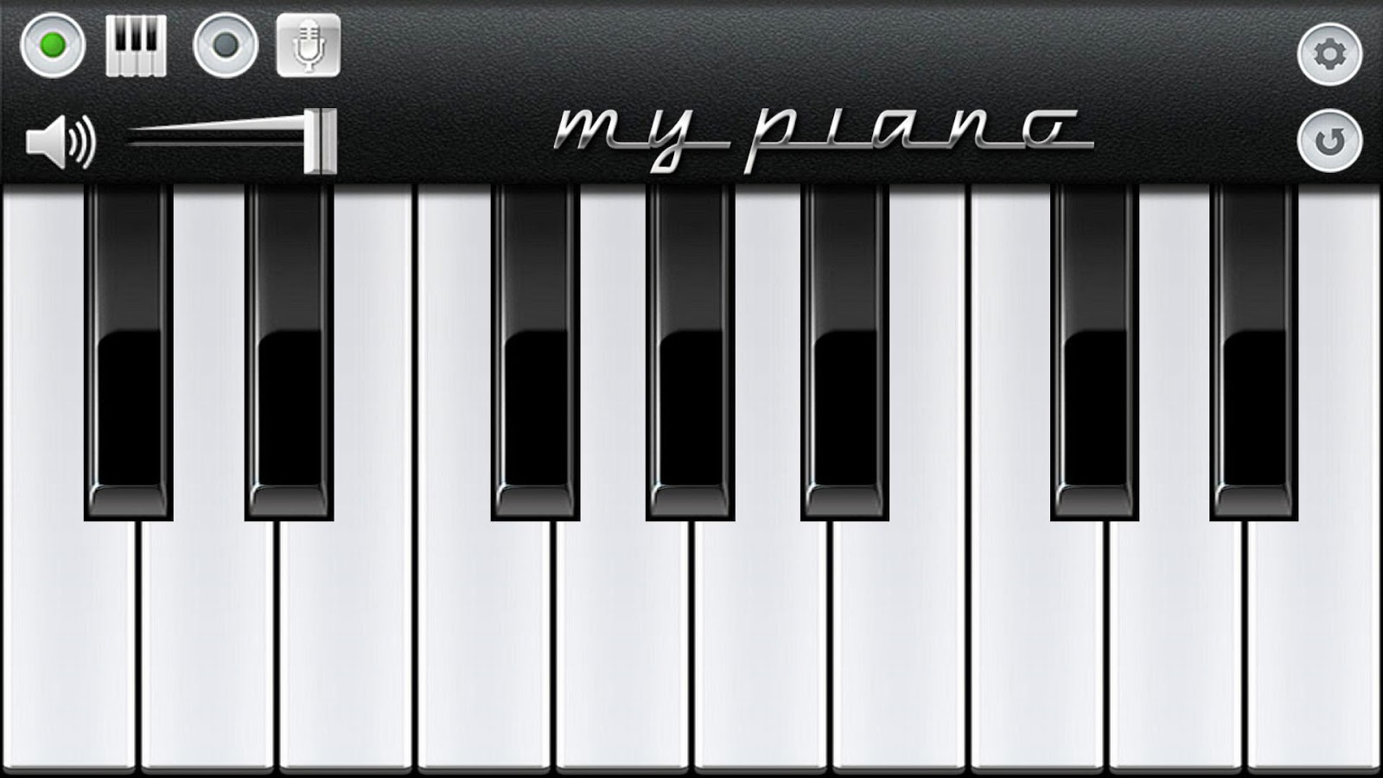



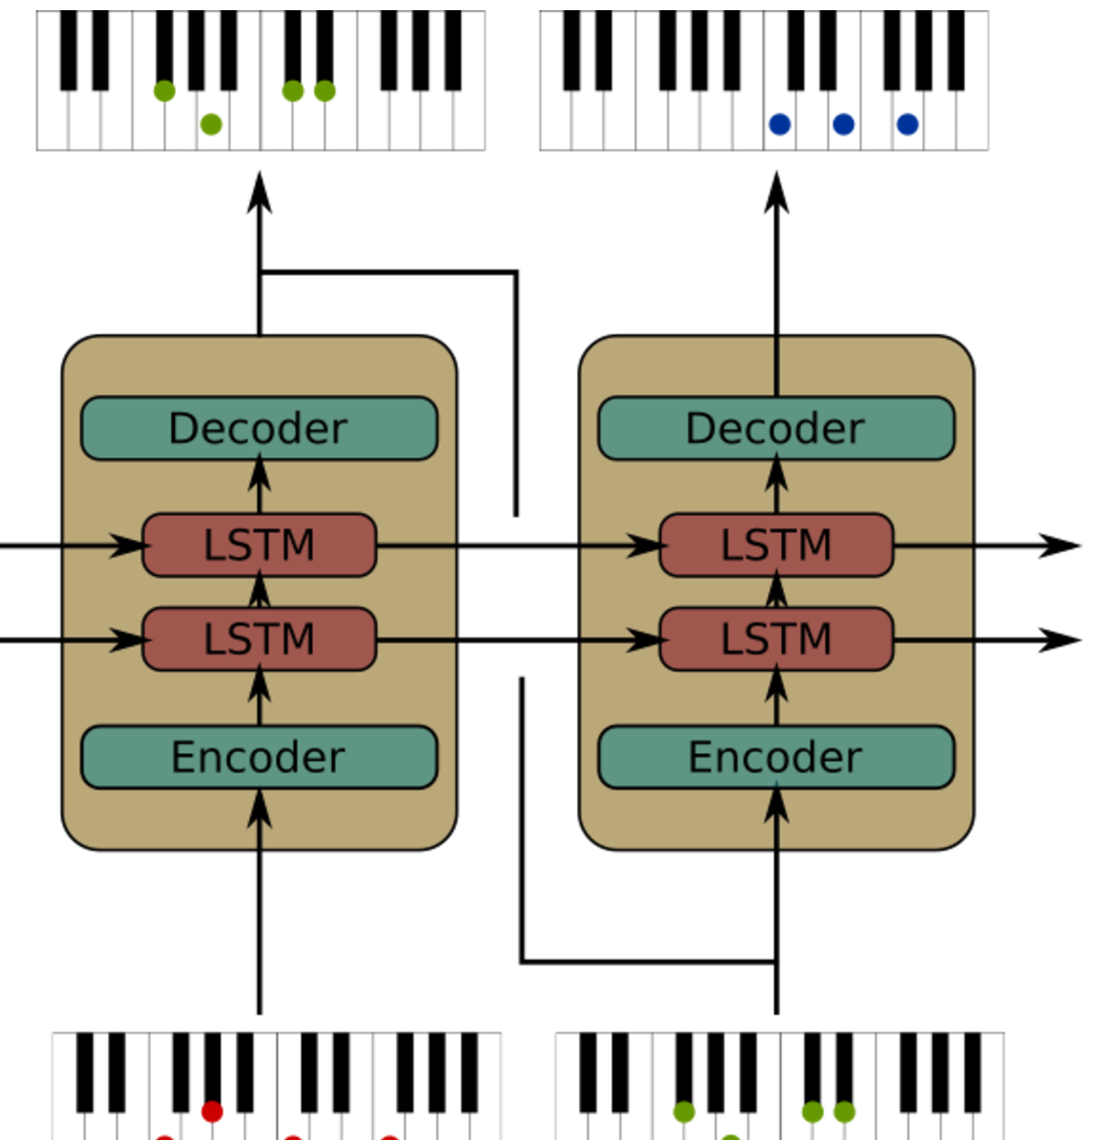

The Machine Learning and Pianos Project

